Slide 1
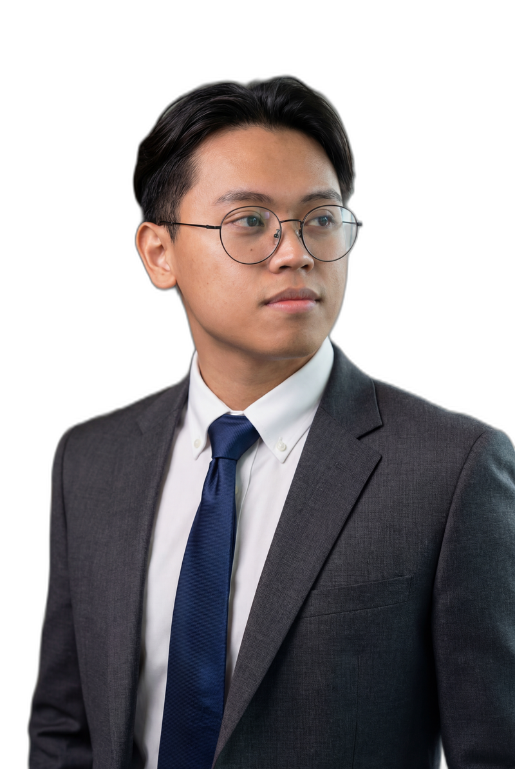
K3
Kim Edrian Binasoy [ relearn.ing ]
hello@binasoy.kim • Toronto, Canada • github.com/kedbin
I build systems
that automate, scale, and learn.
CORE STACK
Azure
AWS
Python
TypeScript
React
Node.js
Power Automate
Cloud Operations
QA Automation
Runbooks
Incident Triage
GenAI Tooling
SELECTED EXPERIENCE
NOV 2025 — PRESENT
Founder Relearn.ing
• Leading product direction for a digital learning platform centered on AI-era work and continuous improvement.
• Architecting cloud-native workflows for content delivery, automation, and user engagement.
CERTIFICATIONS
Google Professional Cloud DevOps Engineer
Google Professional Security Operations Engineer
Google Professional Cloud Architect
Google Generative AI Leader
Azure Developer / AI Fundamentals / Azure Fundamentals
AWS Certified Cloud Practitioner
JUN 2023 — Present
Quality Automation Engineer Transportation
• Executed 800+ test cases and shipped an automation tool that reduced documentation time by 70%.
• Improved testing efficiency by 40% through cross-functional automation and process improvements.
• Built MS Teams bots and GenAI-powered knowledge transfer tooling for onboarding and operations.
• Automated Playwright Tests with Agentic Frameworks
• Created and managed CI systems for regression testing
• Managed Azure Dev Ops pipeline for seamless merge to release
Cloud Engineer
Automation • AI Systems • Developer
HIGHLIGHTS
• 4+ years across transportation, banking, and IT.
• 70% documentation time reduction via automation.
• 40% testing efficiency improvement.
• Portfolio: binasoy.kim
• Publication: relearn.ing
Builds cloud-native systems, automation workflows, and AI-assisted tools that reduce friction, and scale delivery.

