Slide 1

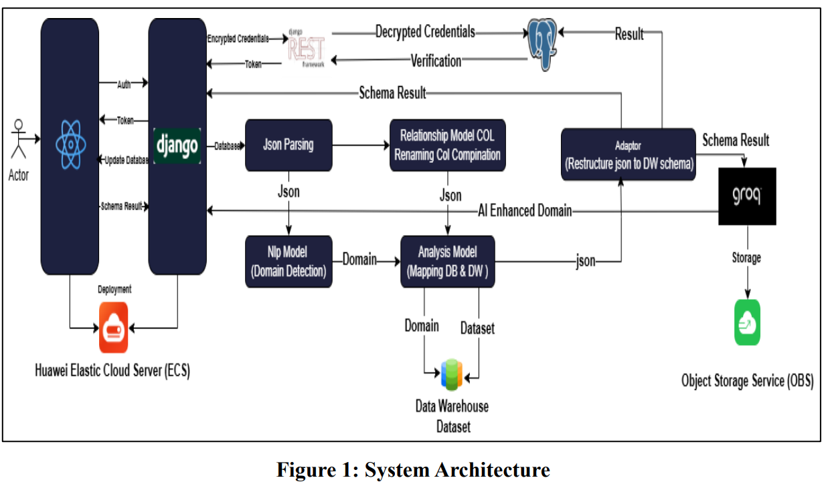
Smart Emergency Response Manager
By: Students Names…
Supervised by: Dr. … , TA. ……
Department Name
Faculty of Computer and Information Sciences - Ain Shams University
Introduction
Results/Findings
Emergency response is a time-critical public-safety task where every second directly affects survival and damage. Traditional systems (Public Safety Answering Points) still rely on phone calls and manual coordination between callers, dispatchers, and response units. Under heavy load or large-scale events this leads to delayed responses, fragmented and duplicated information, miscommunication, and inconsistent decisions driven by human fatigue and stress.
The rise of Smart City and Next-Generation 911 initiatives has pushed emergency management toward digital, AI-assisted platforms that combine mobile applications, cloud services, geospatial analysis, and Artificial Intelligence to speed up decisions and improve situational awareness.
The Smart Emergency Response Manager (ERM) follows this direction as an AI-driven platform connecting Citizens, Response Units, and Administrators in a single ecosystem. Citizens report emergencies by text or voice, and the system automatically attaches their GPS location and timestamp. The AI then transcribes voice reports, filters out fake reports, classifies the incident type and severity, and detects duplicate reports of the same event. Valid incidents are prioritized and the nearest suitable unit is dispatched automatically, with real-time notifications and live tracking for the citizen.
The goal is to reduce response time, automate triage, optimize the use of emergency resources, and minimize reliance on manual judgment — transforming a largely manual and reactive process into a proactive, data-driven response framework.
Key findings from testing the integrated system:
1- The AI triage pipeline performed accurately:
Severity classification (Low / Urgent / Critical) achieved high accuracy on the test set.
Unit-type prediction correctly identified the required services (Police / Ambulance / Fire).
OpenAI Whisper reliably transcribed voice SOS reports, even under noisy conditions.
2- Fake and duplicate filtering improved resource efficiency:
The fake-report detector prevented unnecessary dispatches to false alarms.
Duplicate detection merged repeated reports of the same event into one case.
3- Smart dispatching reduced response time:
The nearest available unit was selected automatically using Haversine distance.
Severity-based prioritization ensured critical incidents were served first.
Freed units were automatically reassigned to the highest-priority waiting incident.
4- The system demonstrated scalability and reliability:
One global queue and a centralized database coordinated all stations.
Race-free dispatching prevented double-assignment of units under load.
5- Real-time communication enhanced the user experience:
Citizens received push notifications and live tracking of the responding unit.
Citizens could rate the service and leave feedback after resolution.
Table 1: Model Performance (test set)
Model / Task | Accuracy | Precision | Recall | F1-score
Severity (4-class) | 90.6% | 0.906 | 0.906 | 0.906
Fire needed | 98.6% | 0.980 | 0.973 | 0.976
Ambulance needed | 96.4% | 0.972 | 0.944 | 0.958
Police needed | 95.6% | 0.962 | 0.968 | 0.965
Response-time metrics (time-to-dispatch and time-to-resolve) are computed from incident timestamps to evaluate operational performance.
Methodology
The project follows a modular, layered design that separates the user interface, the processing/decision logic, and the data storage, allowing each part to be developed, tested, and scaled independently.
Each emergency report is handled through a sequential AI processing pipeline: the report is received with the citizen's location and timestamp; voice reports are converted to text; the text is screened for authenticity (fake-report filtering); the incident is classified by type and severity; it is checked against recent reports for duplicates; valid incidents are placed in a priority queue; the most suitable available unit is selected and dispatched; and all parties are notified, with feedback collected after resolution.
Dispatching follows a two-step decision method: incidents are first ordered by urgency (severity, then waiting time), and a unit is then matched to each incident by geographic proximity. When a unit becomes free, it is automatically reassigned to the highest-priority waiting incident.
The AI models were trained on a labeled dataset of emergency descriptions and integrated into the system as an always-on processing service.
Conclusion
The Smart Emergency Response Manager provides a complete end-to-end intelligent workflow that existing systems lack — unifying multi-modal reporting, AI triage (fake detection, severity, unit type), duplicate handling, severity-based prioritization, geospatial smart dispatching, and real-time notifications in one platform.
By automating these stages, it reduces emergency response times and improves resource utilization, turning a manual, reactive process into a proactive, data-driven framework.
Future work: live road-routing for exact ETAs, a four-level severity scale, coverage-aware dispatching, and cloud deployment of the AI worker.
Key Algorithms
• Severity: TF-IDF features + multiclass Logistic Regression (Low / Urgent / Critical).
• Unit type: three binary Logistic Regression classifiers over 768-dim Sentence-Transformer (all-mpnet-base-v2) embeddings (Police / Ambulance / Fire).
• Fake detection: binary classifier over the same embeddings; flagged reports are rejected before dispatch.
• Duplicate detection: geographic (≤ 500 m), temporal (≤ 30 min), and semantic similarity (cosine ≥ 0.5).
• Smart dispatch: nearest available unit via the Haversine great-circle distance; ETA from road-adjusted distance and average city speed.
• Priority queue: severity order (Critical > Urgent > Low) with FIFO tie-break; a database trigger auto-reassigns freed units.
References
1. Radford, A., et al. (2023). Robust Speech Recognition via Large-Scale Weak Supervision (Whisper). OpenAI.
2. Reimers, N., & Gurevych, I. (2019). Sentence-BERT: Sentence Embeddings using Siamese BERT-Networks. EMNLP.
3. Pedregosa, F., et al. (2011). Scikit-learn: Machine Learning in Python. JMLR, 12, 2825–2830.
4. Supabase Documentation. https://supabase.com/docs
Order online at https://www.postersession.com/order/

