Slide 1
Improving Linux updates in Mauritius
A humble attempt to bring Linux 🐧 content closer to you

Slide 2



About us

Slide 3
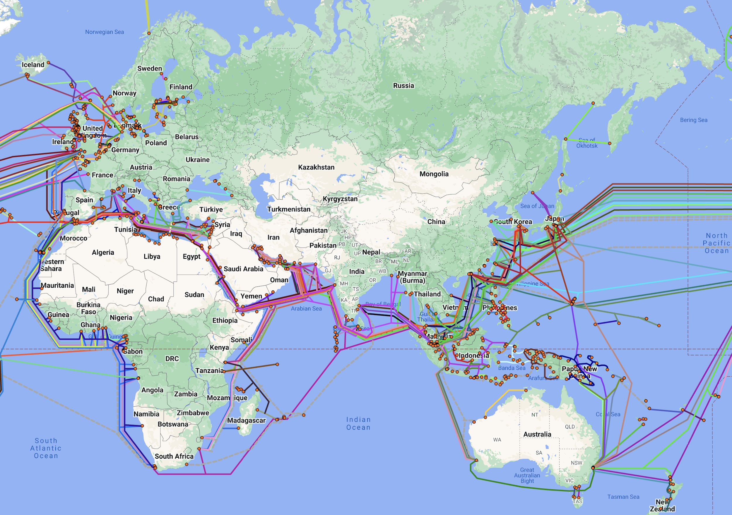
Mauritius

Slide 4
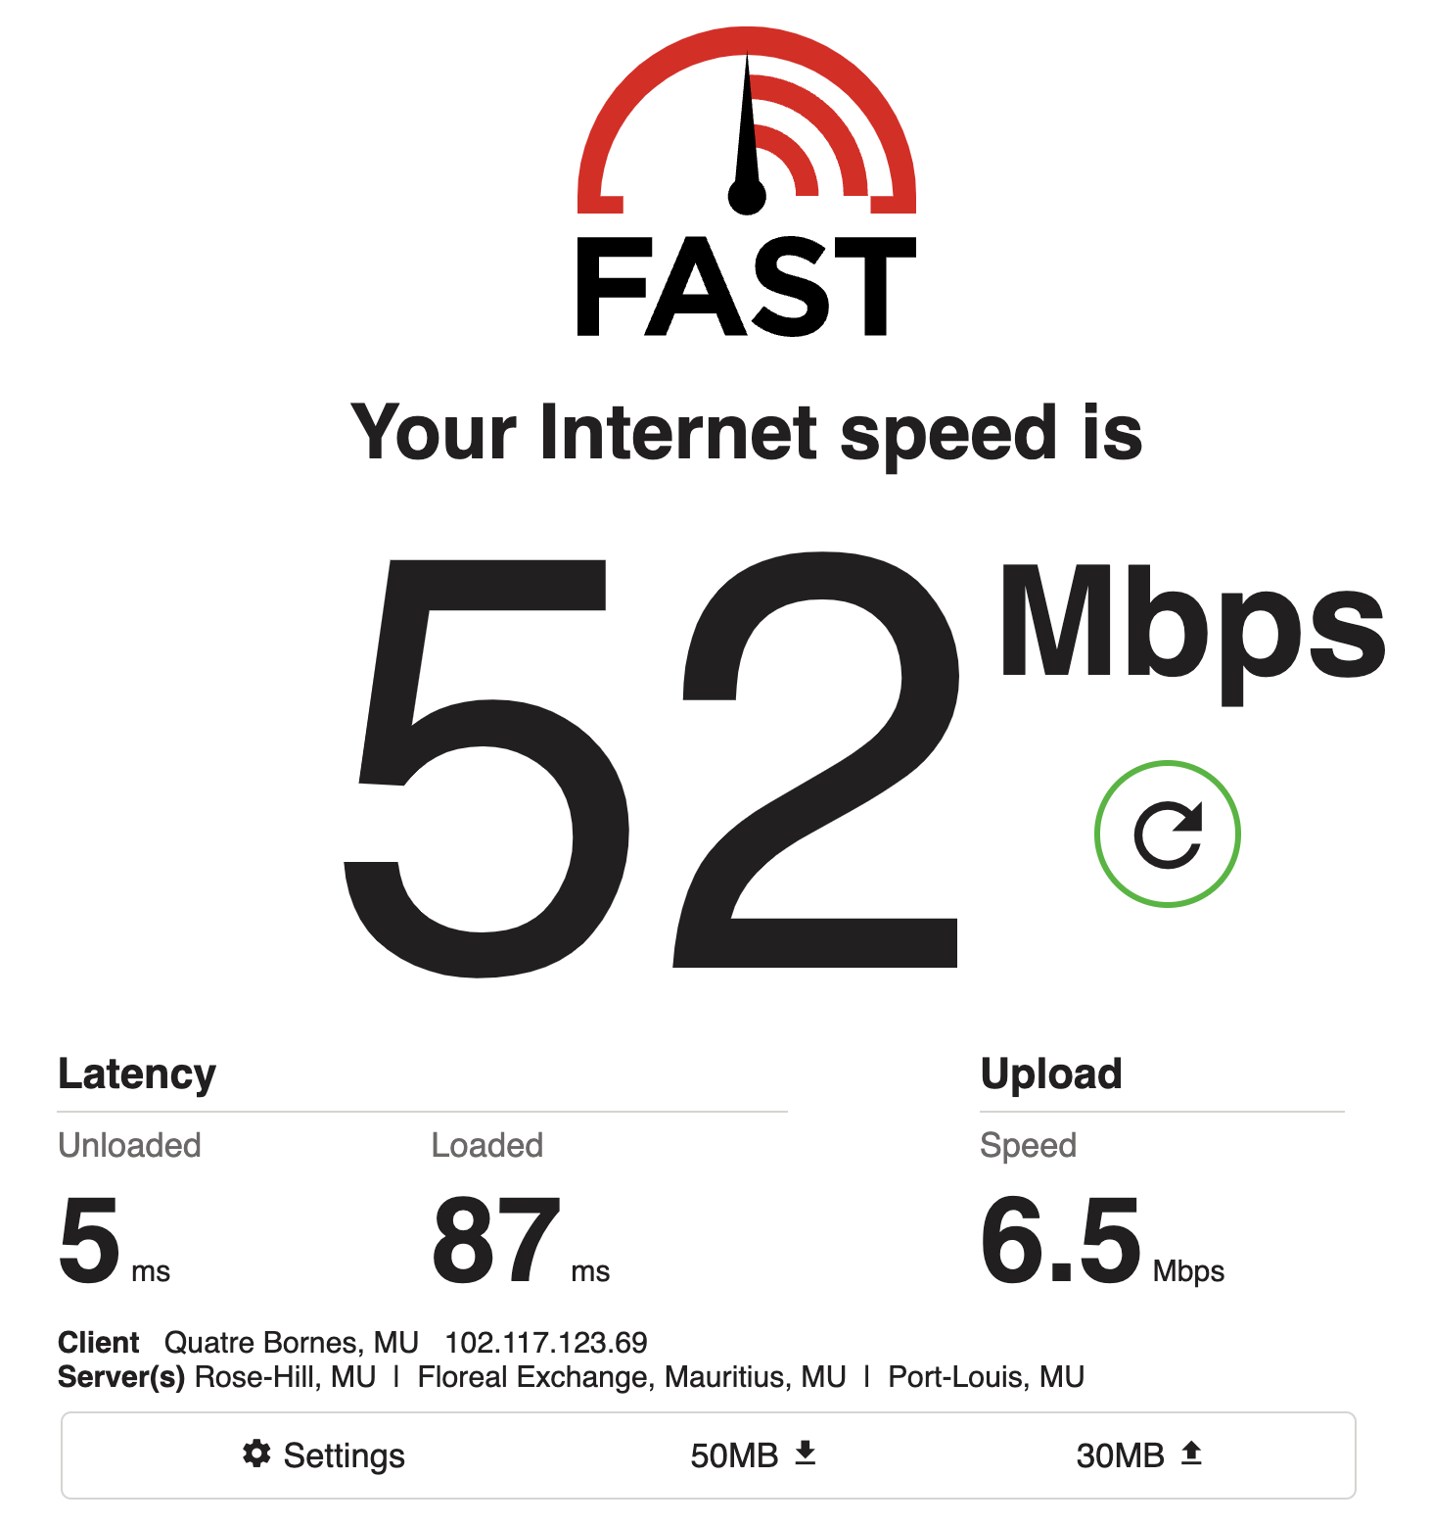

Slide 5
Demystifying latency
Latency refers to the time delay it takes for data to travel from its source to its destination over a network.

Slide 6
How far is Mauritius from other Linux mirrors?
Latency in ms
-------------
US (West Coast) — 18,000 km 400+
US (East Coast) — 16,000 km 300+
United Kingdom — 9,850 km 200+
France — 9,800 km 200+
Germany — 9,650 km 200+
Singapore — 6,660 km 120+
India — 3,500 km 150+
South Africa — 3,200 km 60+
Kenya — 4,216 km 100+
Approximate distance in kilometres.

Slide 7
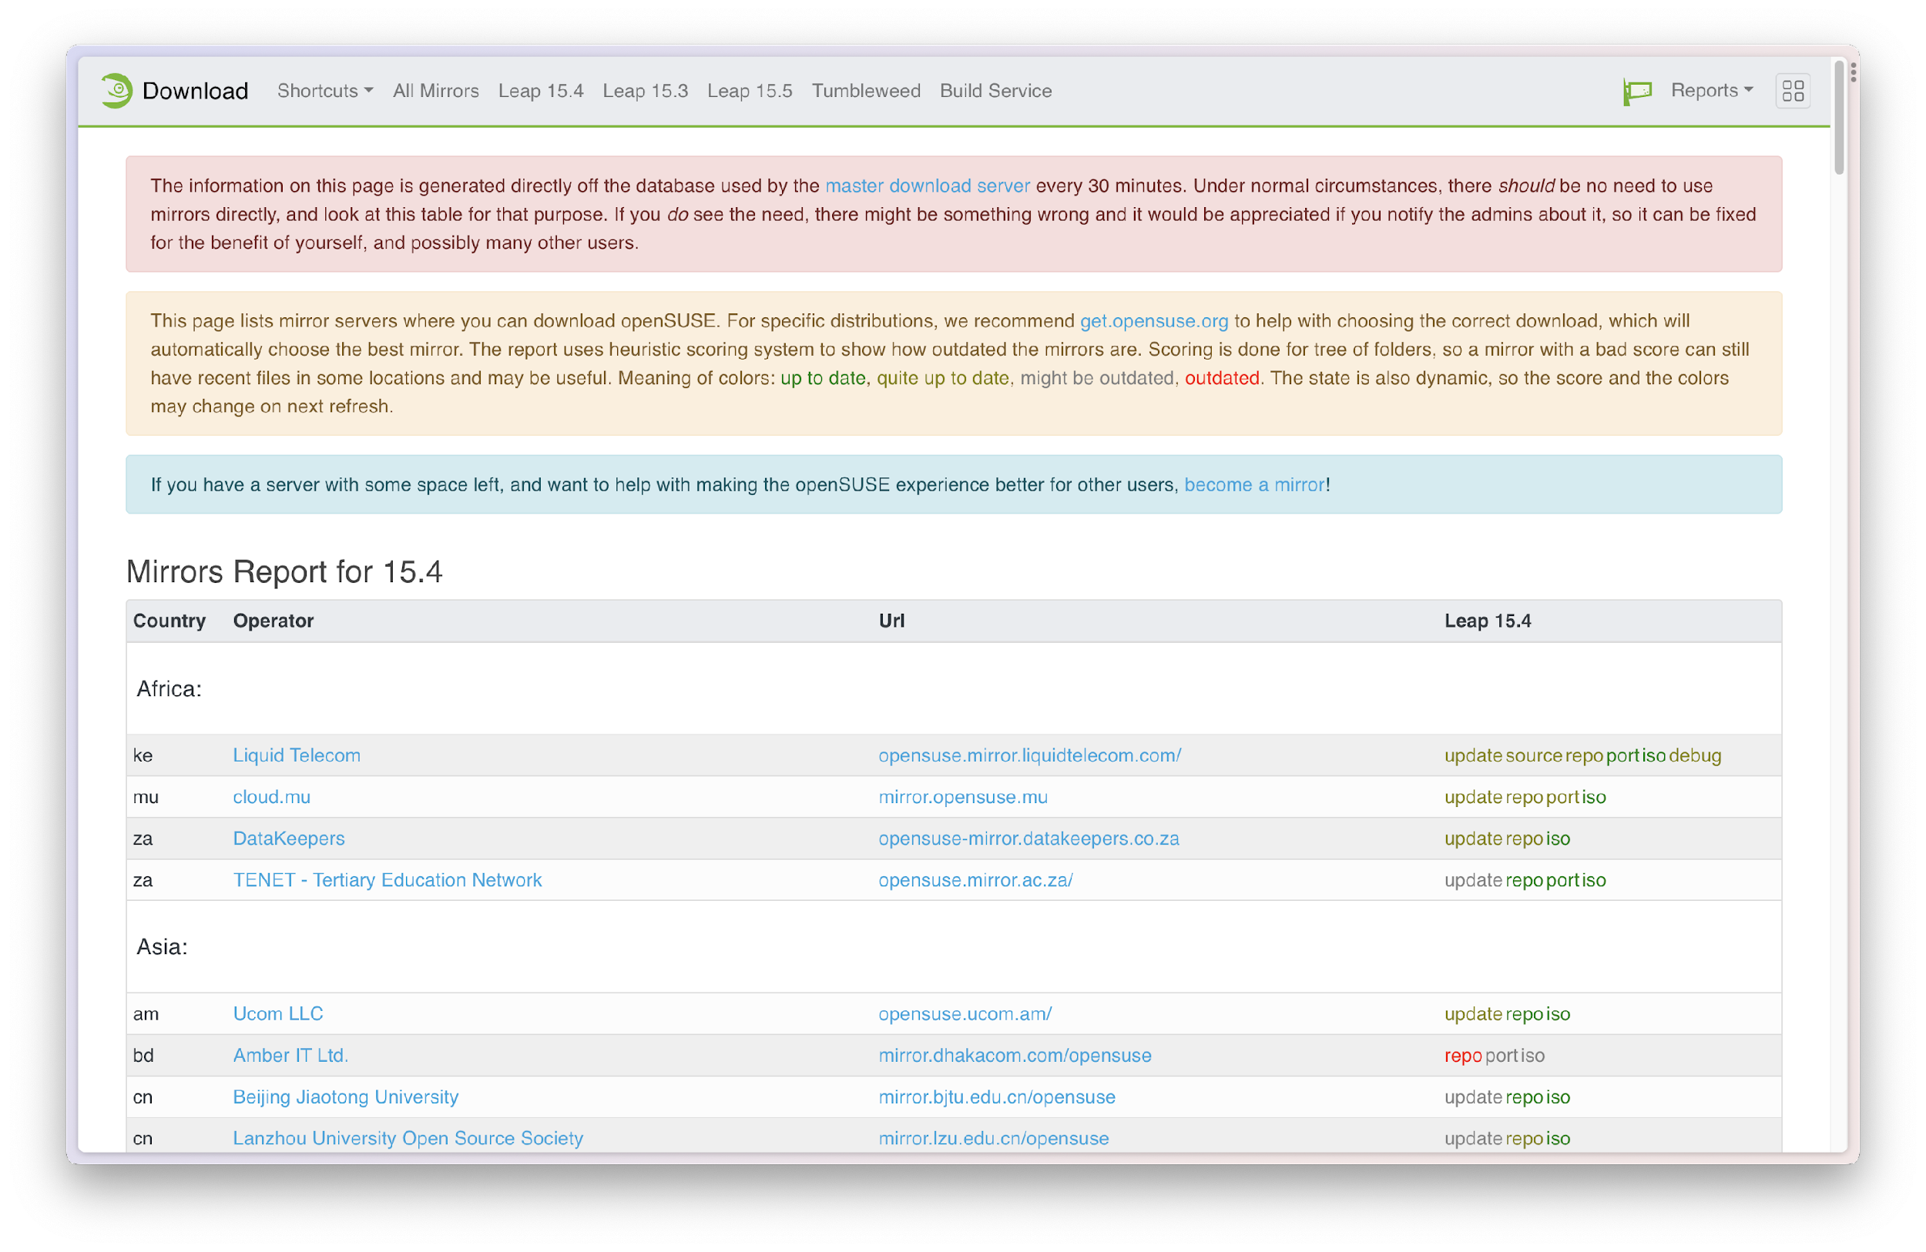

Slide 8

openSUSE mirrors infrastructure uses MirrorCache, a download redirector and metalink generator.
You do not have to select a mirror yourself.
If you use software.opensuse.org or download.opensuse.org the server will take care of finding the fastest mirror for you. It will automatically select of the known and active mirrors from a database and redirect the download.

Slide 9
How to setup an openSUSE mirror?
Read the wiki (https://en.opensuse.org/openSUSE:Mirror_infrastructure)
Especially the section on Rsync modules
An Rsync module is a designated directory, set of files or group of files and directories that can be synchronised using Rsync.
To properly estimate the disk space requirements for your mirror, check the two links provided for the Rsync servers.

Slide 10
What does a server need to become a public mirror?
It needs at least 40GB to 60GB of disk space, depending on what is being mirrored.
It needs a lot of bandwidth bandwidth; The actual amount is hard to predict but e.g. in Germany 1 TB per month should be considered the minimum and would be quite easily reached. The mirror should ideally be able to afford 2 TB per month to avoid bandwidth caps. 10mbit is minimum, 100mbit is better. The situations and requirements will vary from location to location and may different than expected. In general, the more content is being mirrored, the more traffic is attracted, on the other hand we can control the number of redirects quite well. The presence of ISO images is the largest determinant for caused traffic.
The hardware or OS doesn't really matter.
According to the wiki 😉

Slide 11
How to setup an openSUSE mirror?
opensuse-ports 4.45T
opensuse-full 4.90T
opensuse-full-with-factory 4.23T
opensuse-full-with-factory-dvd5 3.89T
opensuse-full-really-everything 9.71T
opensuse-full-really-everything-including-repositories 32.23T
opensuse-updates 864.09G
buildservice-repos 7.90T
buildservice-repos-main 4.40T
opensuse-source 656.58G
opensuse-debug 2.71T
opensuse-history 1.63T
opensuse-hotstuff-640gb 2.45T
opensuse-hotstuff-320gb 2.45T
opensuse-hotstuff-160gb 1.52T
opensuse-hotstuff-80gb 129.29G
opensuse-hotstuff-30gb 15.36G
opensuse-hotstuff-hackweek 813.24G

Slide 12
How to setup an openSUSE mirror?
There are three servers from which you can rsync content, depending on the type of mirror you are managing.
rsync.opensuse.org is publicly accessible (but slower)
stage.opensuse.org is accessible only to registered mirrors (it's faster)
stage-main-repos.opensuse.org is publicly accessible (it has same configuration as stage.opensuse.org but with a 5 min delay and holds only a small collection of the ports repo)

Slide 13
How to setup an openSUSE mirror?
Read the Mirror Howto wiki (https://en.opensuse.org/openSUSE:Mirror_howto)
It walks you through the steps to configure your mirror, setting up Rsync, ports to allow on the firewall, setting up a web server, etc.
Finally, to register your mirror, follow the instructions at
https://en.opensuse.org/openSUSE:Mirror_infrastructure#Registering_your_mirror

Slide 14
1 */6 * * * mirror sleep $(($RANDOM/16));
/usr/bin/withlock /home/mirror/LOCK-opensuse-hotstuff \
rsync -rlpt rsync.opensuse.org::opensuse-hotstuff-160gb
/srv/pub/opensuse/ --delete-after --delete-excluded \
--max-delete=4000 --timeout=1800 -hi

Slide 15
1 */6 * * * mirror sleep $(($RANDOM/16));
/usr/bin/withlock /home/mirror/LOCK-opensuse-hotstuff \
rsync -rlpt rsync.opensuse.org::opensuse-hotstuff-160gb
/srv/pub/opensuse/ --delete-after --delete-excluded \
--max-delete=4000 --timeout=1800 -hi

Slide 16
# Tumbleweed only
0 */4 * * * mirror /opt/mirrorscripts/tw.sh
# Tumbleweed aarch64
0 */3 * * * mirror /opt/mirrorscripts/tw-aarch64-repo.sh
0 3 * * * mirror /opt/mirrorscripts/tw-aarch64-iso.sh
# Leap 15.5
0 */12 * * * mirror /opt/mirrorscripts/leap-15.5.sh
0 */12 * * * mirror /opt/mirrorscripts/leap-15.5-update.sh
# Leap 15.4
0 */8 * * * mirror /opt/mirrorscripts/leap-15.4.sh
0 */8 * * * mirror /opt/mirrorscripts/leap-15.4-update.sh
# Leap 15.3
0 23 * * * mirror /opt/mirrorscripts/leap-15.3.sh
0 23 * * * mirror /opt/mirrorscripts/leap-15.3-update.sh
# Leap Micro
0 21 * * * mirror /opt/mirrorscripts/leap-micro.sh

Slide 17
rsync -rlptyH stage.opensuse.org::opensuse-full/opensuse/distribution/leap/15.4 \
/vol-mirror/mirror/opensuse/distribution/leap --delete --delete-before -hi --stats \
| mail -s 'openSUSE Mirror - Leap 15.4 synced' mirror-admin@lists.mixp.org

Slide 18
rsync -rlptyH stage.opensuse.org::opensuse-full/opensuse/distribution/leap/15.4 \
/vol-mirror/mirror/opensuse/distribution/leap --delete --delete-before -hi --stats \
| mail -s 'openSUSE Mirror - Leap 15.4 synced' mirror-admin@lists.mixp.org

Slide 19
rsync -rlptyH stage.opensuse.org::opensuse-full/opensuse/distribution/leap/15.4 \
/vol-mirror/mirror/opensuse/distribution/leap --delete --delete-before -hi --stats \
| mail -s 'openSUSE Mirror - Leap 15.4 synced' mirror-admin@lists.mixp.org

Slide 20
rsync -rlptyH stage.opensuse.org::opensuse-full/opensuse/distribution/leap/15.4 \
/vol-mirror/mirror/opensuse/distribution/leap --delete --delete-before -hi --stats \
| mail -s 'openSUSE Mirror - Leap 15.4 synced' mirror-admin@lists.mixp.org

Slide 21
rsync -rlptyH stage.opensuse.org::opensuse-full/opensuse/distribution/leap/15.4 \
/vol-mirror/mirror/opensuse/distribution/leap --delete --delete-before -hi --stats \
| mail -s 'openSUSE Mirror - Leap 15.4 synced' mirror-admin@lists.mixp.org

Slide 22
rsync -rlptyH stage.opensuse.org::opensuse-full/opensuse/distribution/leap/15.4 \
/vol-mirror/mirror/opensuse/distribution/leap --delete --delete-before -hi --stats \
| mail -s 'openSUSE Mirror - Leap 15.4 synced' mirror-admin@lists.mixp.org

Slide 23
.
├── distribution 624G
│ ├── leap
│ │ ├── 15.3 166G
│ │ ├── 15.4 191G
│ │ └── 15.5 205G
│ ├── leap-micro
│ │ ├── 5.2 12G
│ │ ├── 5.3 26G
│ │ └── 5.4 26G
│ ├── openSUSE-current -> leap/15.4
│ └── openSUSE-stable -> openSUSE-current
├── factory -> tumbleweed
├── ports 98G
├── tumbleweed 125G
└── update 789G
Total 1.6T

Slide 24
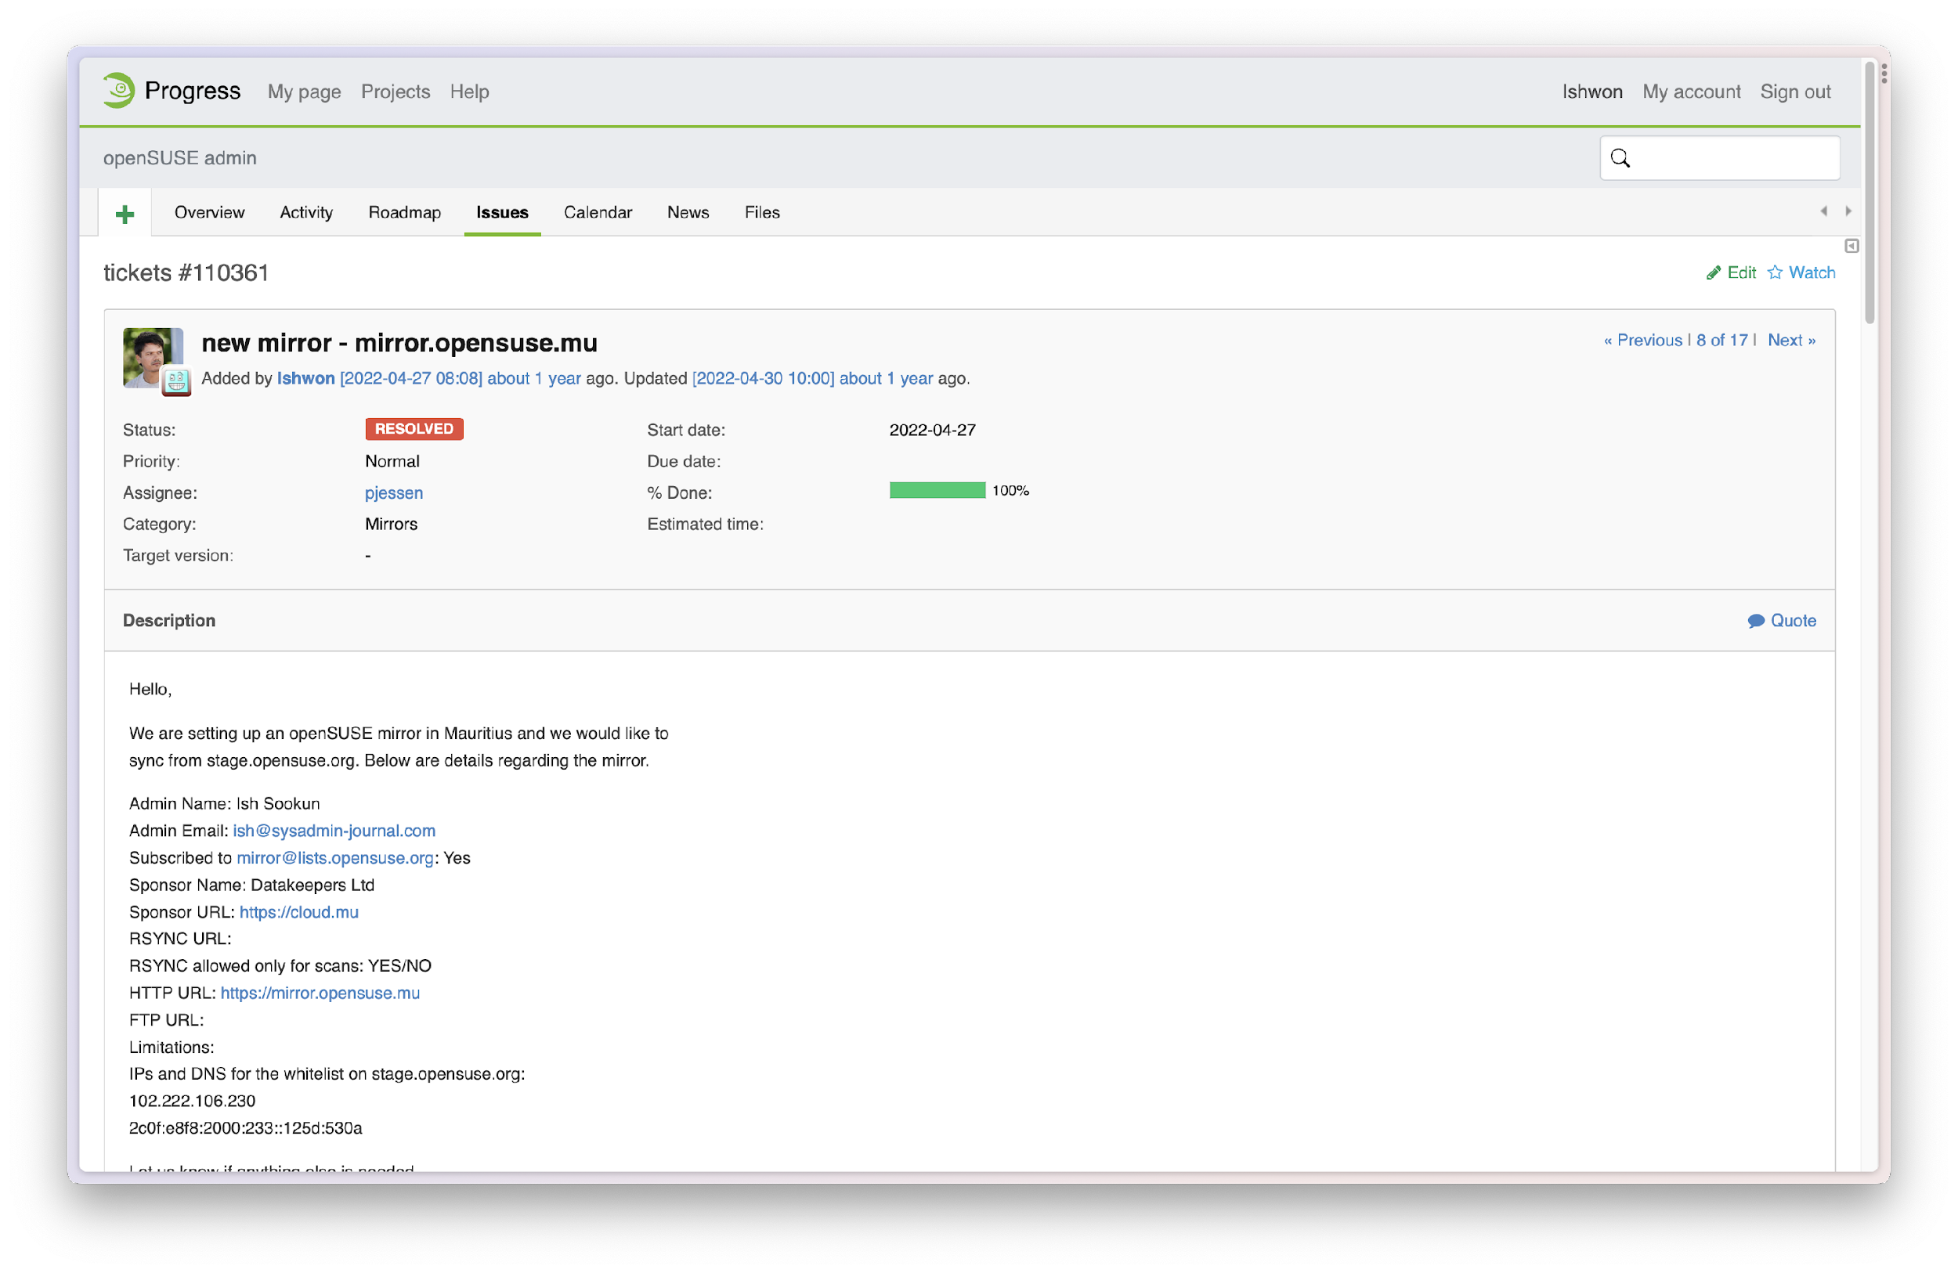

Slide 25
* Ish made announcement during OSCA Open-source Event at Flying dodo
* Asked for volunteers help
* till now ubuntu,fedora & alma linux mirrors setup
* J & G made debian, Arch, Manjaro, EoS
* github repo
* Mint linux
* bottlenecks
* missions

Slide 26
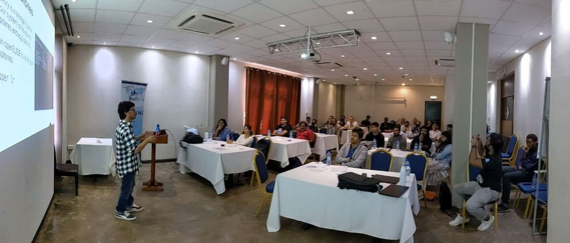
Ish made a public announcement about the openSUSE mirrors in mauritus and explained the process behind it at OSCA Mauritius Open-Source event.

Slide 27
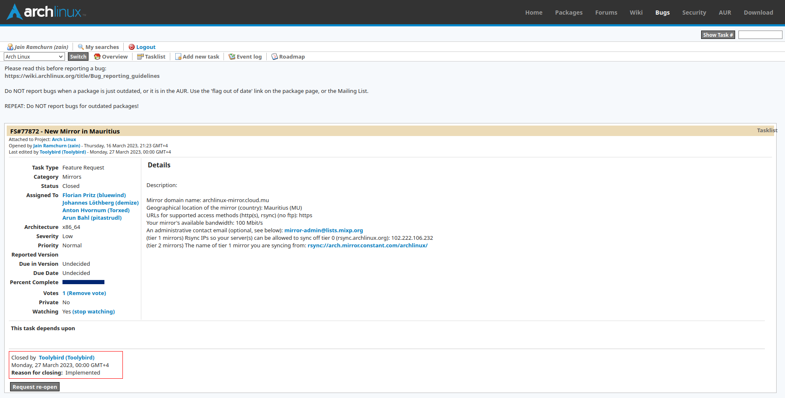

Slide 28
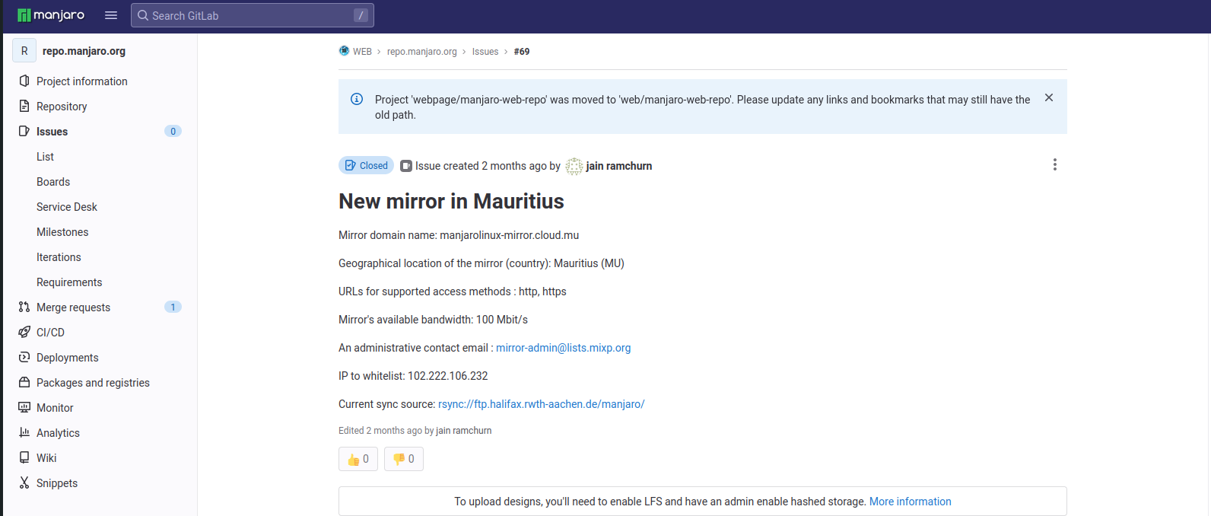

Slide 29
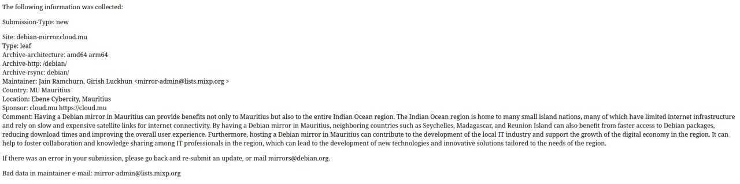

Slide 30
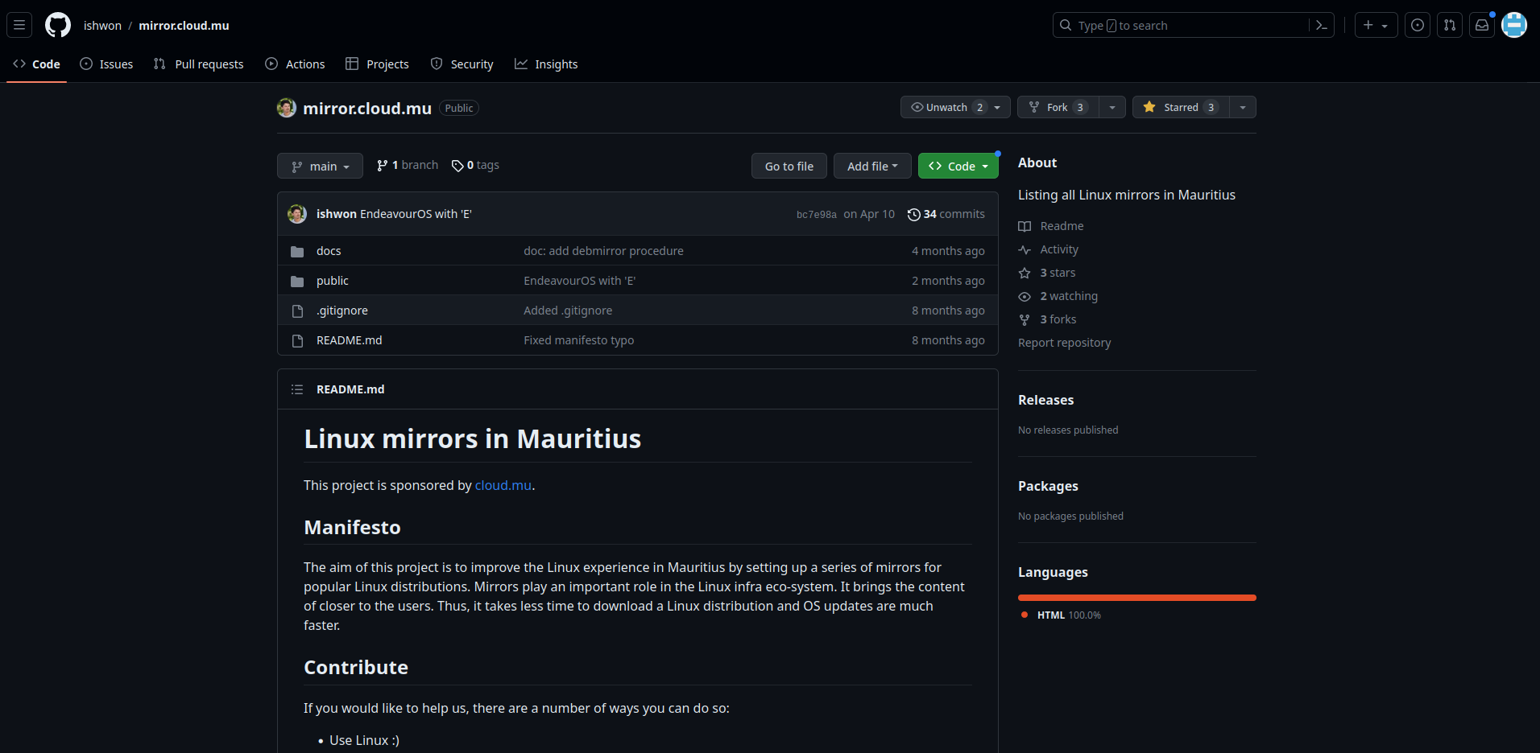

Slide 31
Bottlenecks (cry emoji)
* disk space (specially with Fedora)
* proper documentation (outdated wiki)
* No response till Debian yet (Ignored)
* need to find mirrors with rsync protocol enabled

Slide 32
Improve experience of Linux
- demo opensuse/ubuntu

Slide 33



Future Projects

Slide 34
Need volunteers
- shared responsibilities
Need more sponsors
- anything will do

Slide 35









Slide 36



Project Sponsors

Slide 37
T hank you☺️

