Slide 1
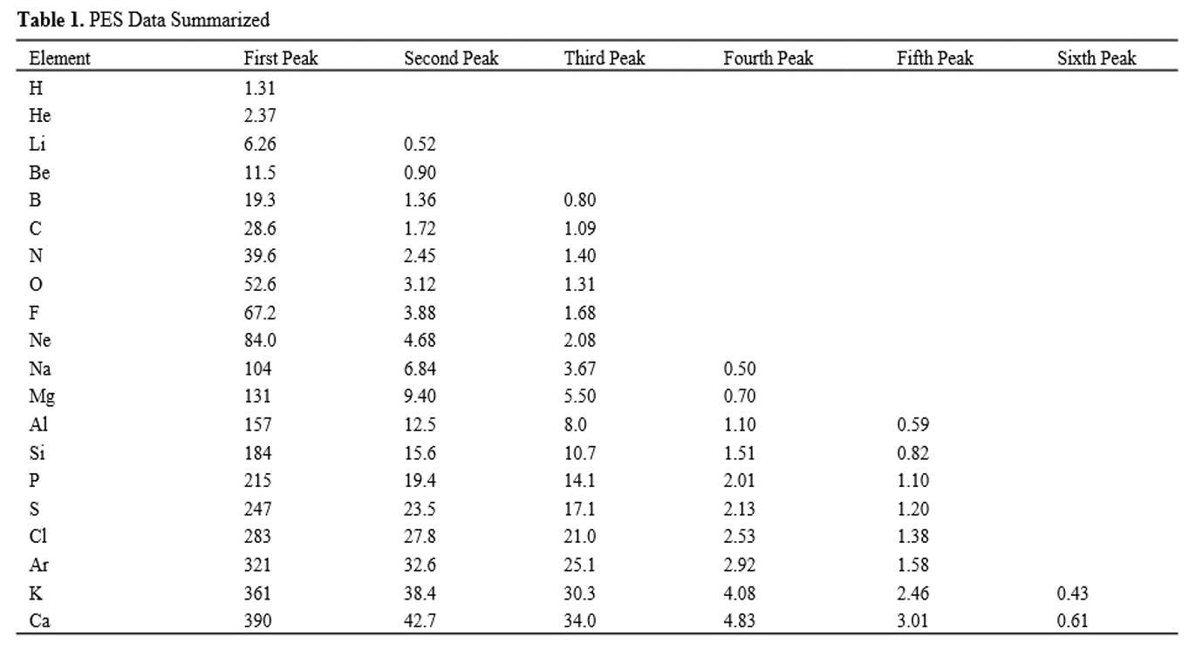

Slide 2
Hydrogen (H)
Relative Number
of Electrons
20
15
10
5
0
Binding Energy (MJ/mol)

Slide 3
Helium (He)
Relative Number
of Electrons
20
15
10
5
0
Binding Energy (MJ/mol)

Slide 4
Lithium (Li)
Relative Number
of Electrons
20
15
10
5
0
Binding Energy (MJ/mol)

Slide 5
Beryllium (Be)
Relative Number
of Electrons
20
15
10
5
0
Binding Energy (MJ/mol)

Slide 6
Boron (B)
Relative Number
of Electrons
45
40
35
30
25
20
15
10
5
0
Binding Energy (MJ/mol)

Slide 7
Carbon (C)
Relative Number
of Electrons
45
40
35
30
25
20
15
10
5
0
Binding Energy (MJ/mol)

Slide 8
Nitrogen (N)
Relative Number
of Electrons
45
40
35
30
25
20
15
10
5
0
Binding Energy (MJ/mol)

Slide 9
Oxygen (O)
Relative Number
of Electrons
90
85
80
75
70
65
60
55
50
45
40
35
30
25
20
15
10
5
0
Binding Energy (MJ/mol)

Slide 10
Fluorine (F)
Relative Number
of Electrons
90
85
80
75
70
65
60
55
50
45
40
35
30
25
20
15
10
5
0
Binding Energy (MJ/mol)

Slide 11
Neon (Ne)
Relative Number
of Electrons
90
85
80
75
70
65
60
55
50
45
40
35
30
25
20
15
10
5
0
Binding Energy (MJ/mol)

Slide 12
Sodium (Na)
Relative Number
of Electrons
1000
100
10
1
0.1
Binding Energy (MJ/mol)

Slide 13
Magnesium (Mg)
Relative Number
of Electrons
1000
100
10
1
0.1
Binding Energy (MJ/mol)

Slide 14
Aluminum (Al)
Relative Number
of Electrons
1000
100
10
1
0.1
Binding Energy (MJ/mol)

Slide 15
Silicon (Si)
Relative Number
of Electrons
1000
100
10
1
0.1
Binding Energy (MJ/mol)

Slide 16
Phosphorus (P)
Relative Number
of Electrons
1000
100
10
1
0.1
Binding Energy (MJ/mol)

Slide 17
Sulfur (S)
Relative Number
of Electrons
1000
100
10
1
0.1
Binding Energy (MJ/mol)

Slide 18
Chlorine (Cl)
Relative Number
of Electrons
1000
100
10
1
0.1
Binding Energy (MJ/mol)

Slide 19
Argon (Ar)
Relative Number
of Electrons
1000
100
10
1
0.1
Binding Energy (MJ/mol)

Slide 20
Potassium (K)
Relative Number
of Electrons
1000
100
10
1
0.1
Binding Energy (MJ/mol)

Slide 21
Calcium (Ca)
Relative Number
of Electrons
1000
100
10
1
0.1
Binding Energy (MJ/mol)

