Slide 1
Introduction to Spectrophotometry & Beer’s Law
AP Chemistry

Slide 2
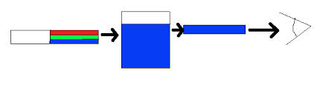
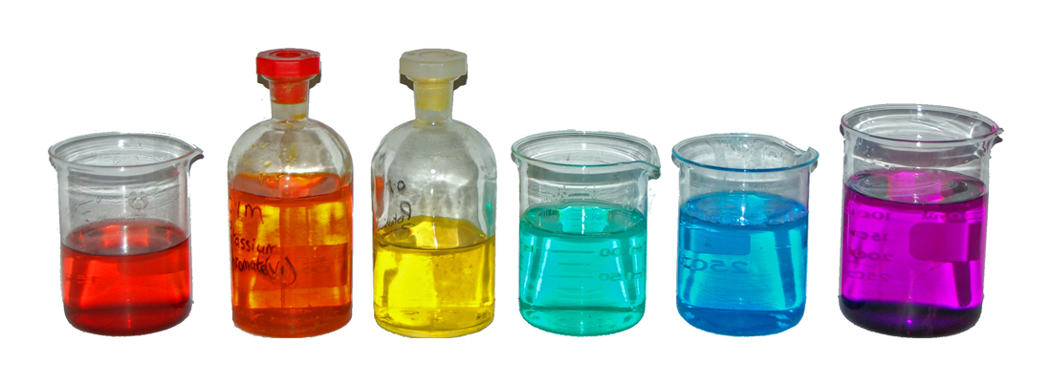
Introduction
absorbs: R, G
transmits: B
many solutions have distinctive colors
  absorb/transmit different wavelengths of visible light
intensity of color is an indication of the solution’s concentration
  more concentrated = darker color

Slide 3
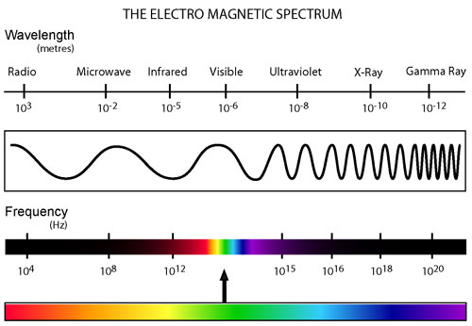
Spectrophotometry
a quantitative method of studying matter
studies amount of light transmitted/absorbed by matter

Slide 4
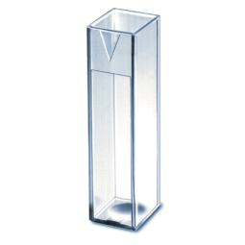
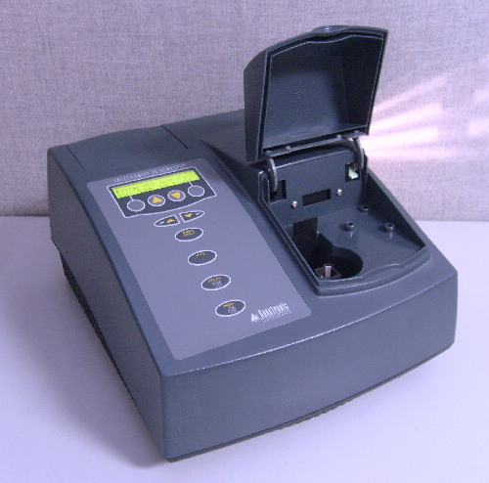
Spectrophotometer
measures absorbance or transmittance of light, as a function of wavelength
General procedure:
  sample is placed into cuvette
  light of selected wavelength (λ_{max)}
  is passed through sample
  instrument measures the amount of light absorbed by the sample
a cuvette
spectrophotometer

Slide 5
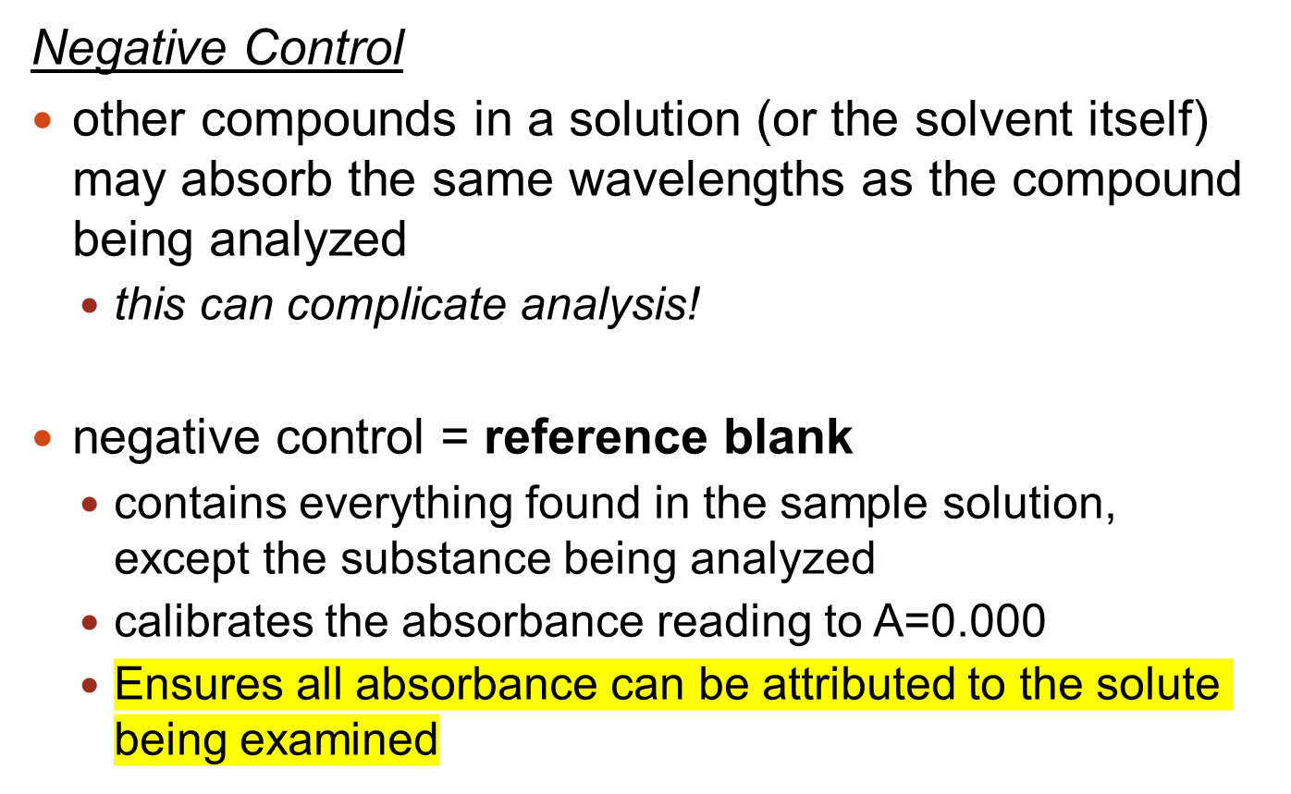
Notes:
provides point of reference… all absorbance can be attributed to the solute alone

Slide 6
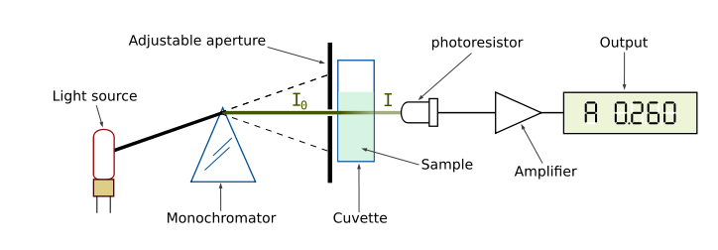
I_{o} = Original intensity of light
I = Intensity of transmitted light
Monochromator separates and transmits a particular wavelength (color) of light
Two ways of Reporting:
Transmission, T = I/I_{o}
or %T = I/I_{o} × 100%
Absorbance, A = 2-log(%T)

Slide 7
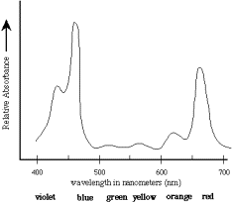
Choosing a Wavelength
use wavelength at which most light is absorbed (λ_{max})
λ_{max}
What is λ_{max} for this compound?
What color light would you use to analyze this compound?
What color does this solution appear to the observer?
Figure 1. Absorption spectrum for a sample
Notes:
450 nm
violet-blue light
greenish-yellow (these colours are transmitted right through)

Slide 8
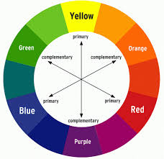
Color Wheel

Slide 9
Beer’s Law
Describes the relationship between the absorbance of a solution, and its concentration:
  “The amount of light absorbed is proportional to the concentration of the solution.”
A = ε b c
solution concentration
(mol/L)
Absorbance (unitless)
molar absorptivity constant
(depends on combination of solute/solvent/λ)
length of path traveled by light (usually cm)
Notes:
Path length, L, is usually expressed in cm (as this is the most convenient, given the scale of the instrument)
…can you deduce the units of the molar absorptivity constant, ε? Absorption is a unitless quantity.

Slide 10
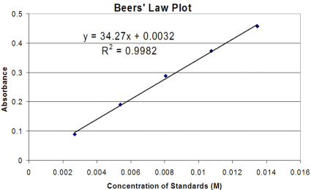
What does this tell us?
there is a direct relationship between absorbance and concentration
empirical evidence: prepare solutions of known concentration and analyze them at λ_{max}: plot of absorbance vs. concentration is linear.

Slide 11
Since A is a linear function of c,
equation of line: y = mx + b
A = εbc
…slope of best-fit line = εb

Slide 12

Using Spectrophotometry and Beer’s Law…
…to find the concentration of an unknown
Method 1: Graphing
Part A: Prepare a Standardized Plot
prepare a plot of A vs. c for standard solutions
determine equation of line
Part B: ID that Unknown concentration!
measure absorbance of unknown solution
use measurement and equation to solve for concentration of unknown

Slide 13
Example 1: Use the plot to determine the concentration of a solution that has an absorbance of A = 0.25.
Recall:
y = A
x = c
Solution:
equation of best-fit line: y = 34.27x + 0.0032
substitute y = 0.25 and solve for x
x = 0.0072 mol/L = c

Slide 14
Method 2: Proportionality
Beer’s law tells us that absorption is proportional to concentration, therefore…
=
A₁
A₂
c₁
c₂

Slide 15
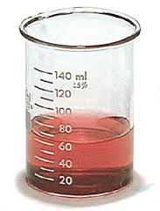
A₁
A₂
c₁
c₂
=
Example 2: Calculate the concentration of a solution CoCl₂ that has an absorbance value of 0.400 at λ_{max}, if a 5.00 × 10⁻³ mol/L solution of CoCl₂ has an absorption of 0.175 under the same conditions.
c₂ = 0.0114 mol/L
Notes:
It can sometimes be difficult to keep the values straight! If it’s hard for you, make a table :
c A
Solution 1
Solution 2 (unk)

Slide 16
A = ε b c
Method 3: Just use the Beer’s Law equation!!
seems simple, but ε is usually not readily available
Example 3: The molar absorptivity of ethanal in hexane at its λ_{max} is 15 L•cm⁻¹•mol⁻¹. Calculate the concentration of ethanal in a solution that has an absorbance of 0.652 with a path length of 1.2 cm.
c = 0.036 mol/L

Slide 17
Summary
Matter interacts with light by absorbing and transmitting different wavelengths.
  The specific nature of the interaction depends on a compound’s molecular structure.
Spectrophotometry quantitatively describes either the transmittance or absorbance of light by a substance.
  the optimal light wavelength to use for analysis is denoted λ_{max}, and is the wavelength at which maximal light absorbance occurs

Slide 18
Beer’s Law states that a substance’s absorbance value is directly proportional to its concentration.
  if absorbance can be measured, it can be used to determine the concentration of an unknown solution
Be aware of the three methods by which Beer’s Law can be used to determine the concentration of an unknown solution

