Slide 1
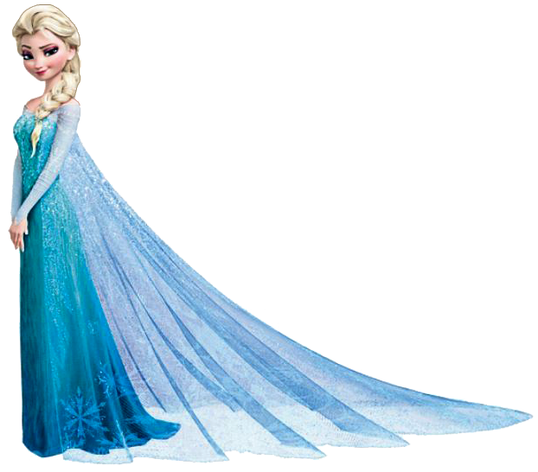

Extra Credit
Clifford Kim
MATH 115
Model the skirt section of the dress. Determine how much fabric is needed and what the cuts look like.
Waist: 23”
Length: 17”
Dress Design Explanation:
In order to make a skirt, you will need two identical trapezoids of fabric: one trapezoid for the front and back each. With the waist required at 23 inches, the top of the trapezoid is 11.5 inches (or half of the length).
The trapezoid bottom is 1.5 times longer than the top (11.5 inches vs. 17.25 inches) due to the fact that a Disney dress always has ripples at the bottom (e.g. Belle, Cinderella, and Sleeping Beauty). I’ve included an image of Elsa below as an illustration.
Total Fabric Amount:
The amount of fabric needed is the summation of the areas of the two trapezoid shapes.
$Total Area=2(\frac{a+b}{2}×$ h) (2 $×$Area of Trapezoid)
$=2(\frac{11.5+17.25}{2}×17)$
$=2\left(244.375\right)$
$=488.75 in2$
11.5”
11.5”
Skirt Front
17”
Skirt
Back
2.875”
11.5”
17.25”
17.25”

Slide 2



Extra Credit
Clifford Kim
MATH 115
Other Considerations:
In order to create an authentic representation of Elsa’s dress, the fabric used must be a gradient fabric
For your convenience, I have provided the RGB codes below:
In order to truly receive your daughters adoration and admiration, you should include snowflakes on the bottom of the skirt as well
Snowflakes can be added via heat presses and iron on transfer paper
I have added sample snowflakes on the skirt back as a visual representation
Snowflakes can be seen at the bottom of Elsa’s skirt in the image below
Please see the sample vendor at the following location for more information: https://www.proworldinc.com/
Skirt Location | Color | Red | Green | Blue
Top | Teal | 102 | 255 | 255
Middle | Light Blue | 0 | 176 | 240
Bottom | Dark Blue | 0 | 112 | 192
11.5”
11.5”
Skirt Front
17”
Skirt
Back
2.875”
11.5”
17.25”
17.25”

