Slide 1
Estimating the Net Social Benefits of the National Flood Insurance Program
James P. Howard, II
University of Maryland Baltimore County
Fifth Annual Conference and Meeting of the Society for Benefit-Cost Analysis
February 21, 2013
Notes:
Missouri floods in the 1920s caused significant damage.
Private insurers pulled out of the market for decades.
Gilbert White proposed national flood insurance in 1942.
After initial trials in 1956, NFIP comes in 1968
Changes include introduction of flood mitigation standards
--and requirements for actuarial soundness

Slide 2
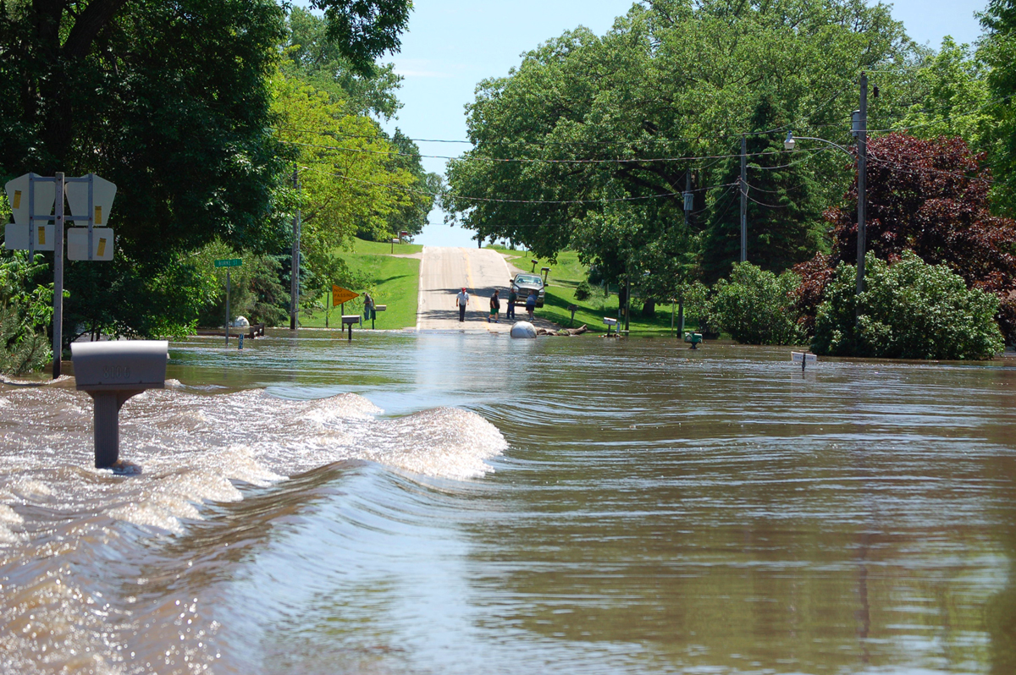
Flood Disaster Management
Flood recovery
Insurance program/payout
Federally administered
Privately financed
Flood mitigation
Dams, flood control
Building codes
Planning laws
United States Geological Survey
Notes:
Flood Insurance implemented to piggy back on homeowners policies
FEMA manages the National Flood Insurance Fund
Traditional insurers provide administrative duties
Severe losses from major storms.
--Katrina hit ~16B losses
--Rita ~2B losses
Flood mitigation comes from three programs
FMA
SRL
RLF

Slide 3
Data
Benefit-Cost Analysis
Provided by FEMA:
NFIP financial statements
FMA grant summaries
County-level data
Study period is 1996-2010
Willingness-to-Pay for Flood Insurance
Heinz Center for Science, Economics, and the Environment
Survey data and financial data, collected 1998
Notes:
This is fundamentally an economic analysis
Will cover from 1996-2010
Will address both flood mitigation and flood recovery
Have recoded info for local governments
Statewide-allocation issues
- by population makes distribution more equitable
- by income biases toward inequitable

Slide 4
NFIP Theoretical Model
Benefits
Costs
Insurance claims paid to victims
Administrative fees paid to insurance companies
Marginal Excess Tax Burden
Willingness-to-pay for Flood insurance
Insurance premiums paid to the program
Environmental impacts of the program
Notes:
BCA may be considered as a balance sheet, looking like an accounting question
BCA can also be considered as the sum of economic surpluses contributing to the NSB
Delta-S is the change in S due to the program
This takes advantage of that thought to simplify the development of the flood insurance NSB model

Slide 5
Valuing Flood Insurance
∆S = ∆C + ∆P + ∆G + ∆E
⇓ ∆S = λγ + φωπ − κ + mκ
λ = covered amount
γ = WTP for flood insurance
φ = administrative fees
ω = premiums paid to NFIP
π = profitability ratio
κ = claims against NFIP
m = METB
Notes:
This is the key equation in valuing the flood insurance component
represents 1 year's net social benefits

Slide 6
Estimating the WTP
Calculated using Tobit censored-data model
Data from Heinz survey on flood insurance
Dependent variable is amount of flood insurance purchased
Control variable for price is unknown, but estimated at lower and upper bounds
Notes:
The exact premium paid is unknown so the lower figure represents the WTP at the lower-bound estimate and the upper figure represents the WTP at the upper-bound estimate.
Model 1 is a model including all respondents, including participants and non-participants
Model 2 is a model only including those who do not believe they are required to carry NFIP insurance
Model 3 is a model only including those who are not required to carry NFIP insurance

Slide 7
WTP for Flood Insurance
Controls for several factors, e.g., location and presumed risk
Price coefficient may be biased due to endogeneity in deciding to purchase flood insurance
Cost / $100 of coverage
Model | Lower | Upper
Model 1 | 0.4971 | 0.9378
Model 2 | 0.6276 | 1.1999
Model 3 | 0.0831 | 0.1276
Notes:
The exact premium paid is unknown so the lower figure represents the WTP at the lower-bound estimate and the upper figure represents the WTP at the upper-bound estimate.
Model 1 is a model including all respondents, including participants and non-participants
Model 2 is a model only including those who do not believe they are required to carry NFIP insurance
Model 3 is a model only including those who are not required to carry NFIP insurance

Slide 8
FMA Theoretical Model
Benefits transfer
Uses estimates of other mitigation projects
Scales-up estimates to national level
Assumes estimate is broadly applicable across time
Uses 2050 FMA grants during the study period
Estimates returns to the year 2010
Artificially discounts more recent grants due unrealized returns
Notes:
BCA may be considered as a balance sheet, looking like an accounting question
BCA can also be considered as the sum of economic surpluses contributing to the NSB
Delta-S is the change in S due to the program
This takes advantage of that thought to simplify the development of the flood insurance NSB model

Slide 9
Valuing Flood Mitigation
2005 MMC report
Based on sample of 28 FEMA grants
Used Hazus-US report to estimate benefit-cost ratio
BCR = 5.0 at 2% SDR
⇓
≅17.4% annualized
Multihazard Mitigation Council. (2005). Natural hazard mitigation saves: an independent study to asses the future savings from mitigation activities. National Institute of Building Sciences. Washington.
Notes:
This is what the Multi-Hazard Mitigation Council found
forms a major baseline in establishing the NSB of flood mitigation today
BCR is lifetime returns (at 50 years). MMC report premised on funds spent in year 0 and a useful lifetime of 50 years
The 2% SDR is removed and we are free to apply our own SDR

Slide 10
Net Social Benefits—2010
 |  | Atkinson Distributional Weight
WTP Est. | Premium | ε = 0.0 | ε = 0.25 | ε = 0.5 | ε = 0.75 | ε = 1.0
Model 1 | Lower | 60,832 | 48,492 | 36,899 | 26,435 | 14,597
 | Upper | 144,186 | 119,943 | 100,776 | 86,487 | 71,216
Model 2 | Lower | 85,510 | 69,646 | 55,811 | 44,214 | 31,359
 | Upper | 193,764 | 162,441 | 138,770 | 122,206 | 104,893
Model 3 | Lower | -17,485 | -18,642 | -23,118 | -29,890 | -38,601
 | Upper | -9,068 | -11,426 | -16,667 | -23,925 | -32,884
Millions of 2010 dollars

Slide 11
Conclusions
Estimate of WTP for flood insurance causes wide swings in NSB estimate
Aversion to income inequality causes smaller, but pronounced swings in NSB estimate
If NSB is positive, the benefit is coming indirectly from government funds
Large NFIP debt to Treasury
Notes:
Congress will have to address the large debt at some point

Slide 12
Acknowledgements
Advising and Review
Grant Support
Scott Farrow, UMBC
Craig Landry, ECU
UMBC Graduate Student Association

