Slide 1
Modeling Demand for Medical Resources
OSG All Hands Meeting 2021—March 1, 2021
James P. Howard, II—Johns Hopkins Applied Physics Laboratory
Anna C. Svirsko—United States Naval Academy

Slide 2
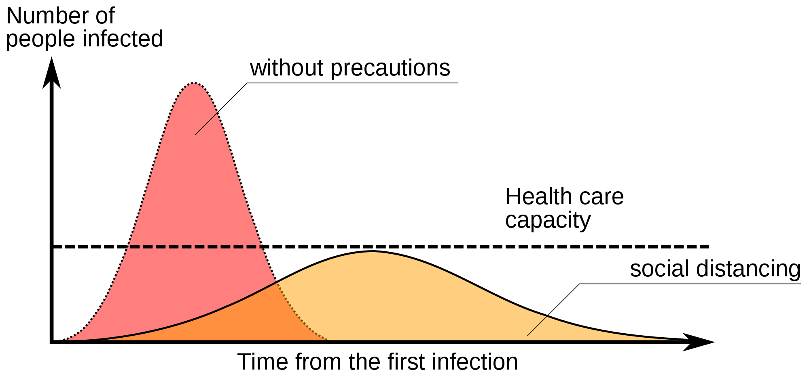
Flattening the Curve
Protect the Resources to Protect Us All
China and Italy were the two hardest hit countries at the beginning of COVID-19
  Both implemented early lockdowns
Italy was running out of hospital beds and ventilators
  Hospitals reported new arrivals every 5 minutes
By Johannes Kalliauer via Wikimedia Commons
Flattening the curve protects resources, but the allocation still has to work

Slide 3
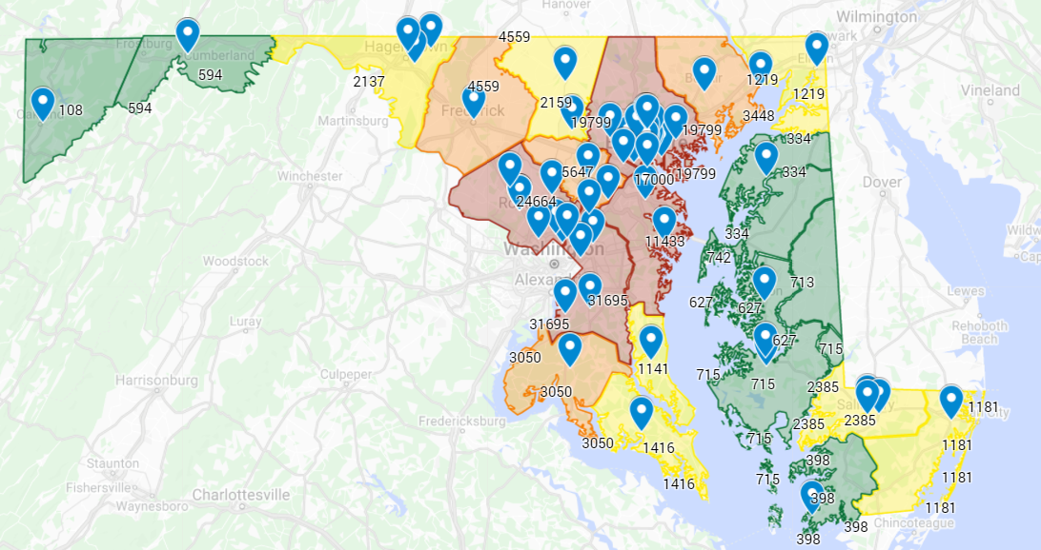
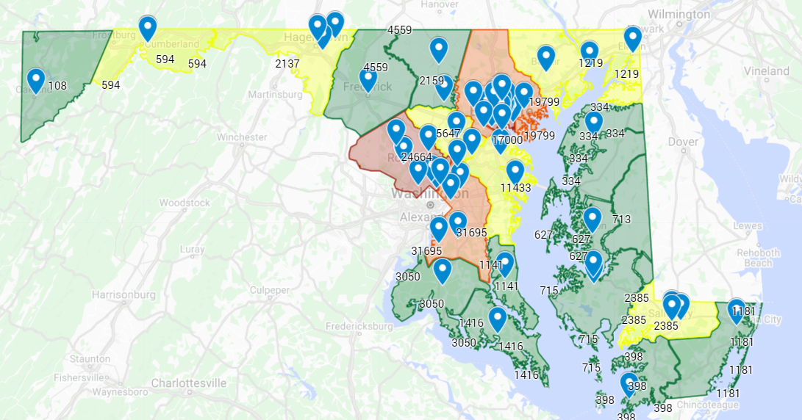
COVID-19 in Maryland
Counties in Maryland by Incidence of COVID-19
Counties in Maryland
by Number of Hospitals

Slide 4
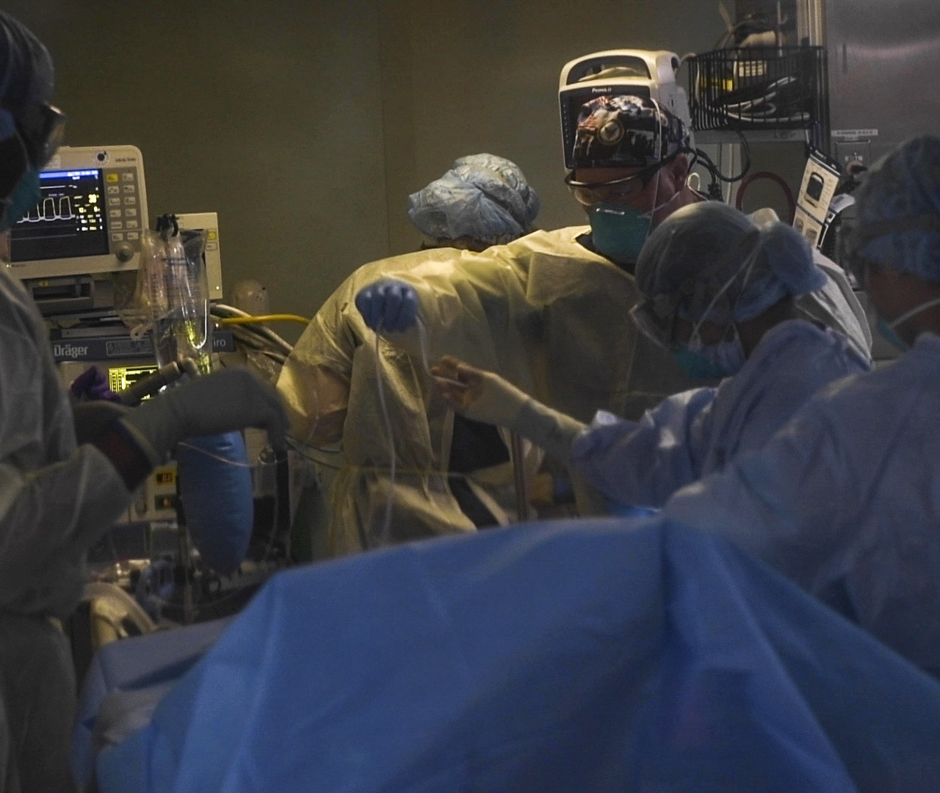
Prior Public Health Optimization Work
Resource Allocation
  American Hospital Capacity and Projected Need for COVID-19 Care
  Allocation of Intensive Care Unit Beds in Periods of High Demand
  COVID-19 Capacity Analysis Tool for Hospitals and EDs
Simulation
  How Simulation Modelling Can Help Reduce the Impact of COVID-19
  A Nonhomogeneous Agent-Based Simulation Approach to Modeling the Spread of Disease in a Pandemic Outbreak
  Locally Informed Simulation to Predict Hospital Capacity Needs During the COVID-19 Pandemic

Slide 5

The Question
Can we prevent resource shortages from affecting our ability to treat patients?

Slide 6
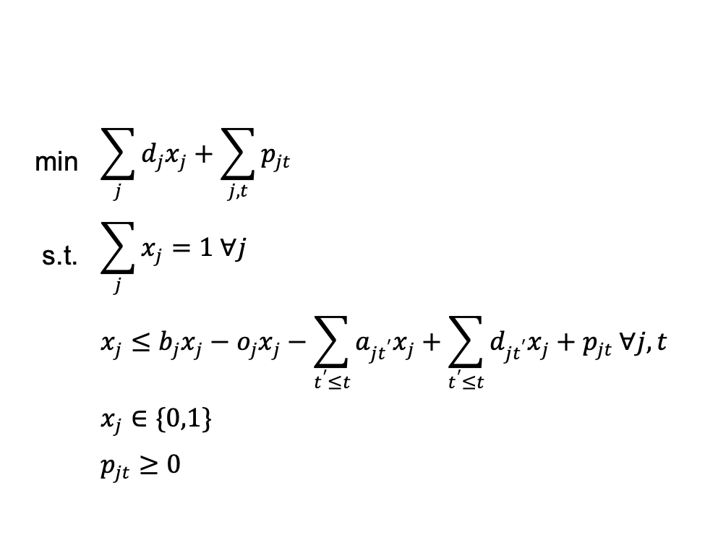
Patient Allocation Model
Goals
  Maximize utilization of hospital beds
  Minimize patient travel
  Minimize displacement of future patients
Decisions
  What hospital do we send a patient to?
  What penalty do we incur for potentially displacing patients?
Implementation
  Python and Pyomo
  Solvable with CBC, CPLEX, GLPK
min | $$\sum_{j}{d_{j}x_{j}}+\sum_{j,t}{p_{jt}}$$
s.t. | $$\sum_{j}{x_{j}}=1 ∀j$$
 | $$x_{j}≤b_{j}x_{j}−o_{j}x_{j}−\sum_{t^{′}≤t}{a_{jt^{′}}x_{j}}+\sum_{t^{′}≤t}{d_{jt^{′}}x_{j}}+p_{jt} ∀j, t$$
 | $$x_{j}∈\{0,1\}$$
 | $$p_{jt}≥0$$

Slide 7
Simulating the Epidemic
Hospital
  Each hospital in Maryland with ICU beds
  Count of ICU beds associated
Population
  Population taken at level of census tract
Two hospital assignment policies:
  Go to closest hospital
  Allow LP to solve for “best” hospital
Implementation
  Discrete event simulation (DES)
  Used Python and SimPy
Hospitals are key resource in simulation
  Time in ICU Weibull scaled by user parameter
Patients generated at random intervals
  Time interval exponential with user parameter
  Tract selection weighted by population
Metrics:
  Distance Travelled
  Number of Patients Displaced
  Wait Time
Goal is to evaluate policies against each other

Slide 8
How OSG Helped
Monte Carlo simulation
  Requires many runs
  All runs are independent of each other
  Perfect HTC problem
  OSG made for HTC
1600 runs for each policy made
  Run may take multiple hours
  Just need to capture metrics
Python worked well
  Used virtualenv per OSG documentation
  All required packages added to the venv
  Added compiled copy of glpk to venv
    Felt shady but necessary for Pyomo
  CSV files with patient stats written
  Logfiles via spdlog generated
  Results turned to OSG submit node
    Processed stats in R
    Logs provided info to answer questions

Slide 9
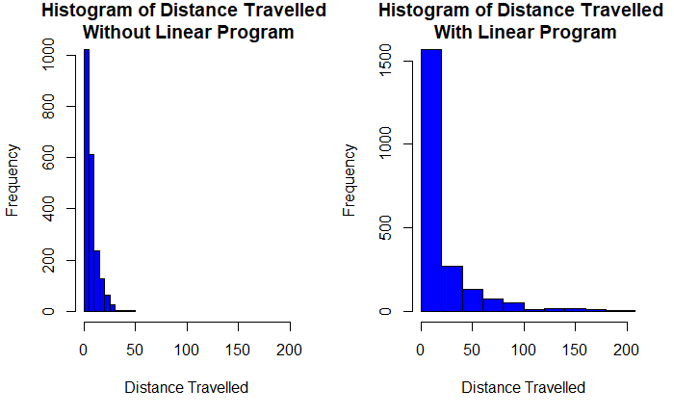
Distance Travelled

Slide 10
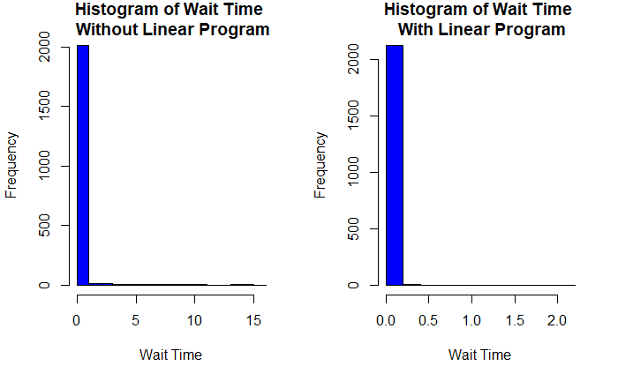
Waiting Time

Slide 11
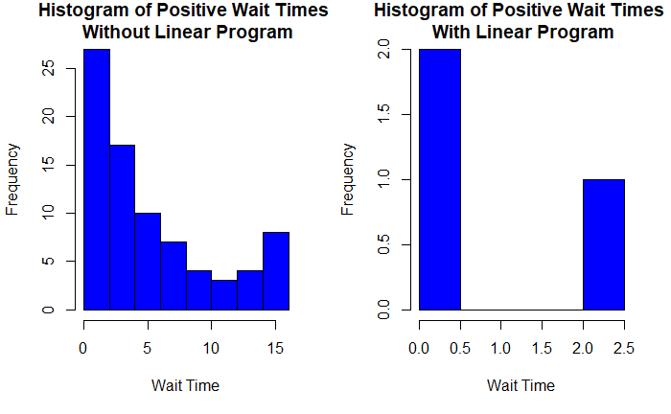
Positive Wait Times

Slide 12
Limitations and Future Directions
Simulation Model
  Fine tune parameters to generate patients more accurately
  Working to acquire patient data to generate patients in simulation as actual COVID-19 epidemic
Determine coefficients for the objective function
  Distance to the nearest hospital is weighted the same as the penalty
  We assume that the penalty is the same for each day
  Adjust the coefficient function to more accurately represent the tradeoff between waiting and travelling
Policies
  Send patients to the closest hospital with an open bed
Metrics
  Bed Utilization

