Slide 1
Planning for Martian Polity
James P. Howard, II
University of Maryland University College
18th Mars Society Convention
14 August 2015—Washington, DC

Slide 2
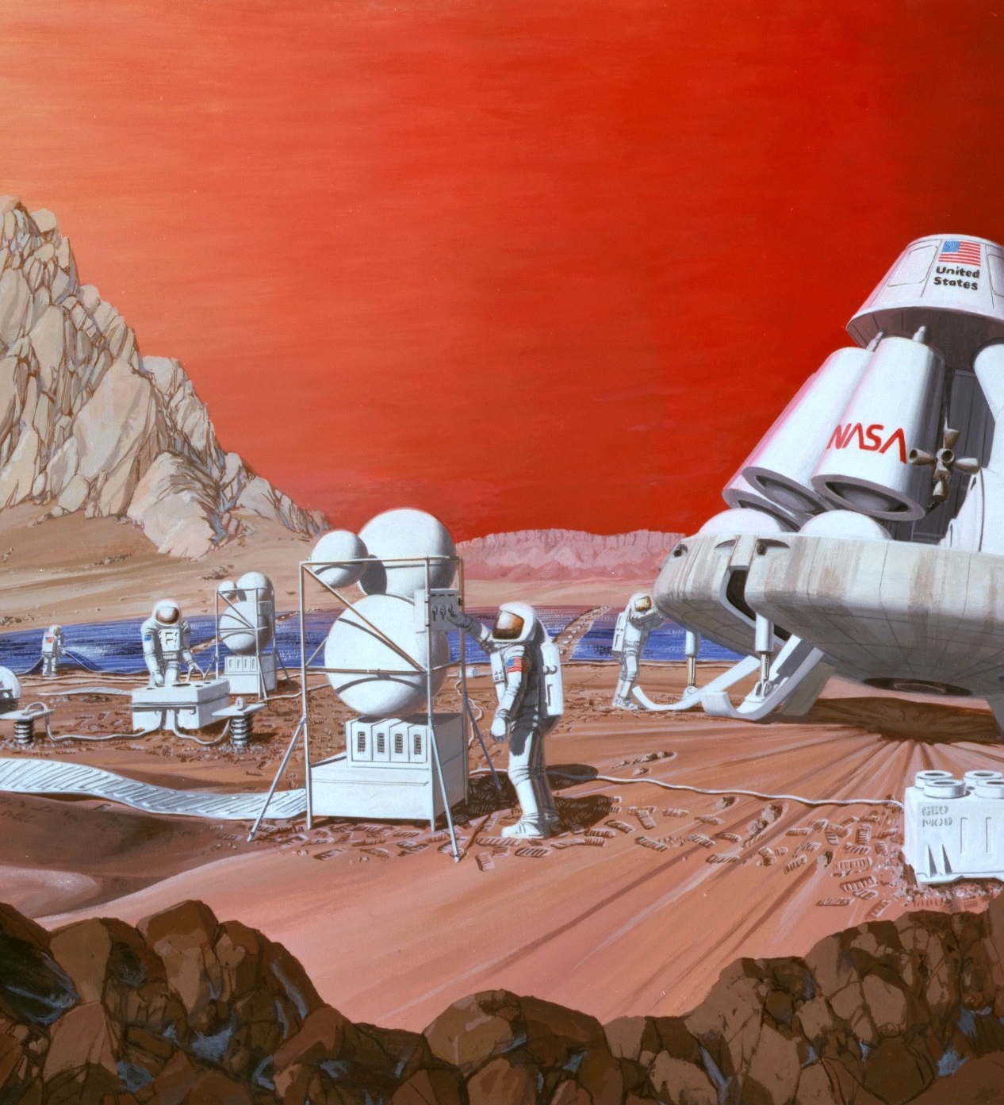
Introduction
Why talk about this
"Mars mission" by Les Bossinas of NASA Lewis Research Center

Slide 3
Motivation
MarsOne
Recommendations for global government
Need for private ownership
  Supports economic stability and growth
Recommendations for intergovernmental ethics
You can’t realistically claim what you can’t realistically defend

Slide 4
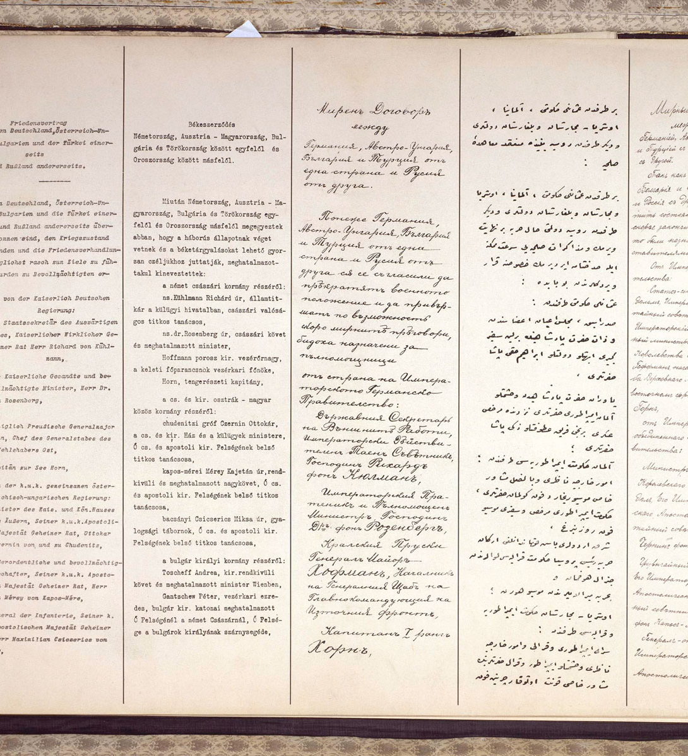
Existing Frameworks
Who’s already done something
"Traktat brzeski 1918". Licensed under Public Domain via Wikimedia Commons.

Slide 5
Overview
Outer Space Treaty
Rescue Agreement
Registration Convention
Moon Treaty
Space Liability Convention
Several treaties address the specifics of space exploration
Others include coincident material

Slide 6
Outer Space Treaty
Key Details
Highlights
Treaty on principles governing the activities of states in the exploration and use of outer space, including the moon and other celestial bodies.
Adopted in 1967
Defining framework for space use
Nongovernmental actors subject to governmental supervision
No nuclear weapons in space
Nobody can claim anything in space

Slide 7
Space Liability Convention
Key Details
Highlights
Nations have liability when their spacecraft crash
Only states can sue each other for damages
  No private action
Used once, when Kosmos 954 crashed in Canada
Convention on International Liability for Damage Caused by Space Objects
Adopted in 1972
Ensures safe exploration

Slide 8
Registration Agreement
Key Details
Highlights
Convention on Registration of Objects Launched into Outer Space
Adopted in 1975
Ensures we know what’s where
Every country needs to maintain a registry of what they are sending in to space
They need to periodically let the UN know what they are sending in to space

Slide 9
Rescue Agreement
Key Details
Highlights
Agreement on the Rescue of Astronauts, the Return of Astronauts and the Return of Objects Launched into Outer Space
Adopted in 1979
Ensures safe return of astronauts
Everyone has a duty to rescue astronauts
This includes landed astronauts
Covers safe return to home country

Slide 10
Moon Treaty
Key Details
Highlights
Agreement Governing the Activities of States on the Moon and Other Celestial Bodies
Adopted in 1979
Defining framework for international governance of all celestial bodies
Almost Nobody Signed It
Actually governs everything outside of Earth
Includes orbits around those bodies
Peaceful purposes
Everyone can go and play
Must only use what is necessary
Duty of rescue
  Must also notify in event of crash
Notes:
Don’t be a jerk

Slide 11
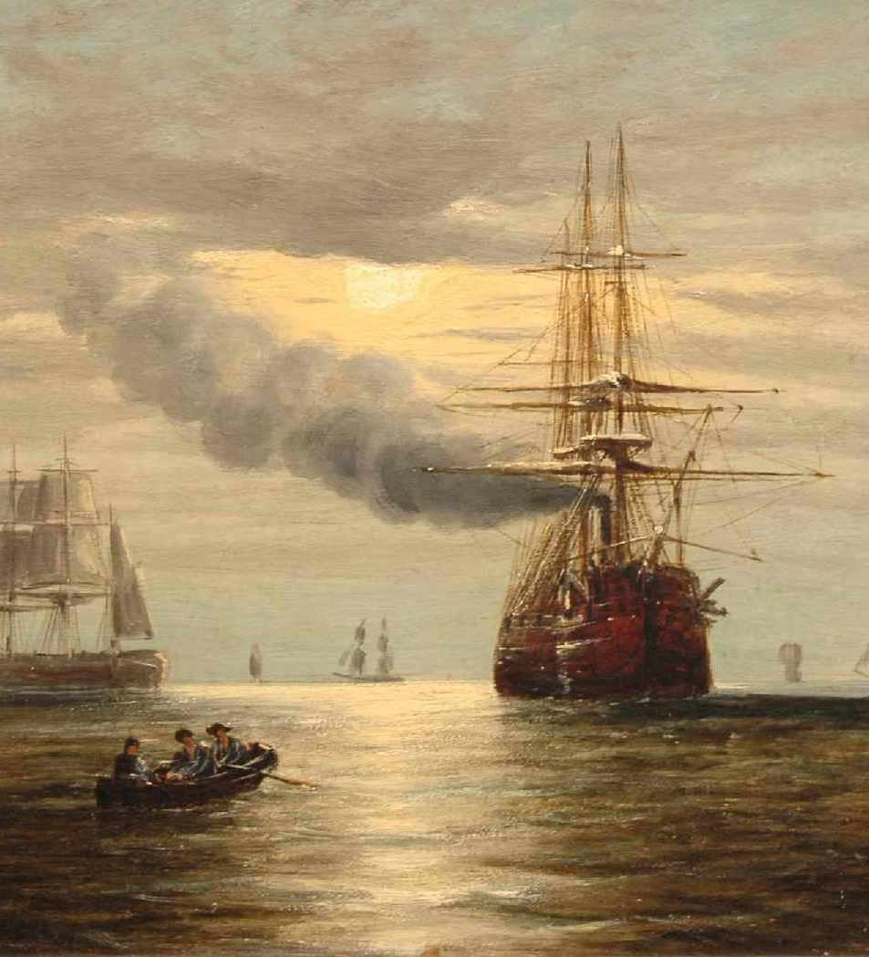
Historical Analogues
What can we learn from who came before us
By Claude Thomas Stanfield Moore [Public domain], via Wikimedia Commons

Slide 12
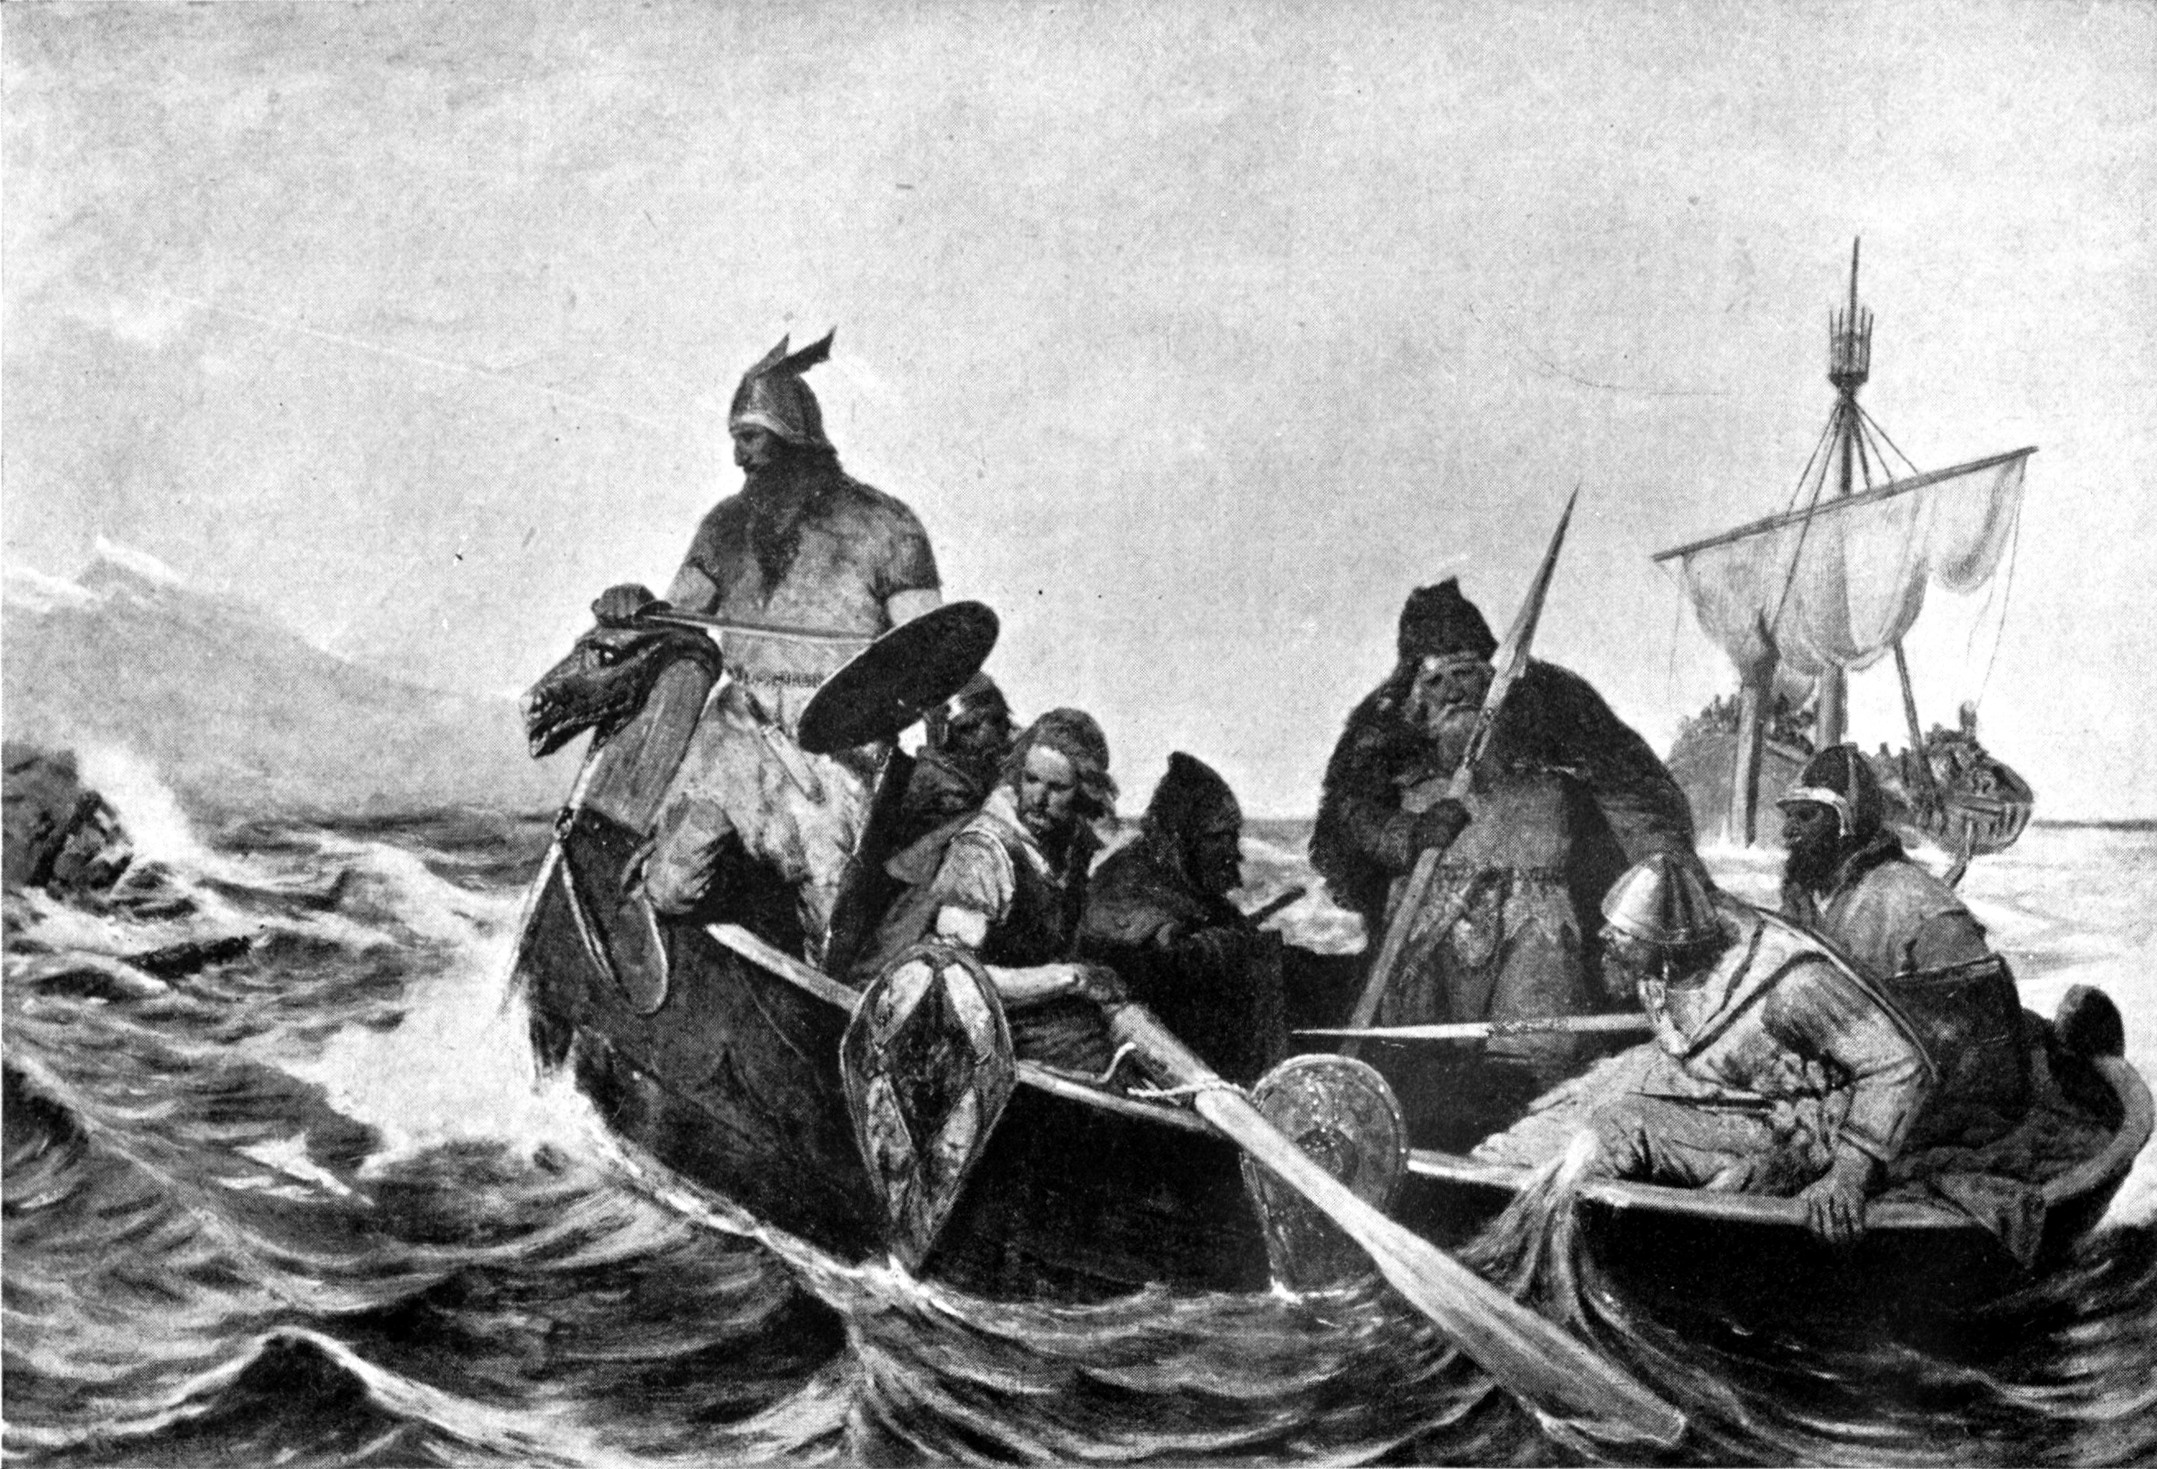
Iceland
Oscar Wergeland [Public domain], via Wikimedia Commons

Slide 13
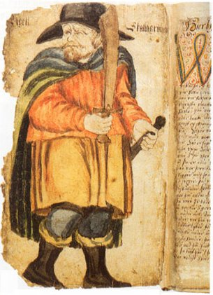
The Age of Settlement
Well-documented, due to Sagas
Small family farms, not cities
1500 place names in 60 years
  About 3500 people listed
  Source: Landnámabók
Age of Settlement ends with all usable land consumed
"Egil Skallagrimsson 17c manuscript" by Unknown

Slide 14
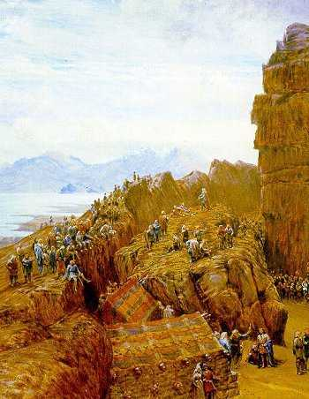
Self-Governance: Alþingi
General assembly
All free men could attend
Assembly met in legislative and judicial roles
Modeled on tradition Norse local governance
Power rested with local chieftains
  Largely run by nationwide aristocracy
W. G. Collingwood [Public domain], via Wikimedia Commons

Slide 15
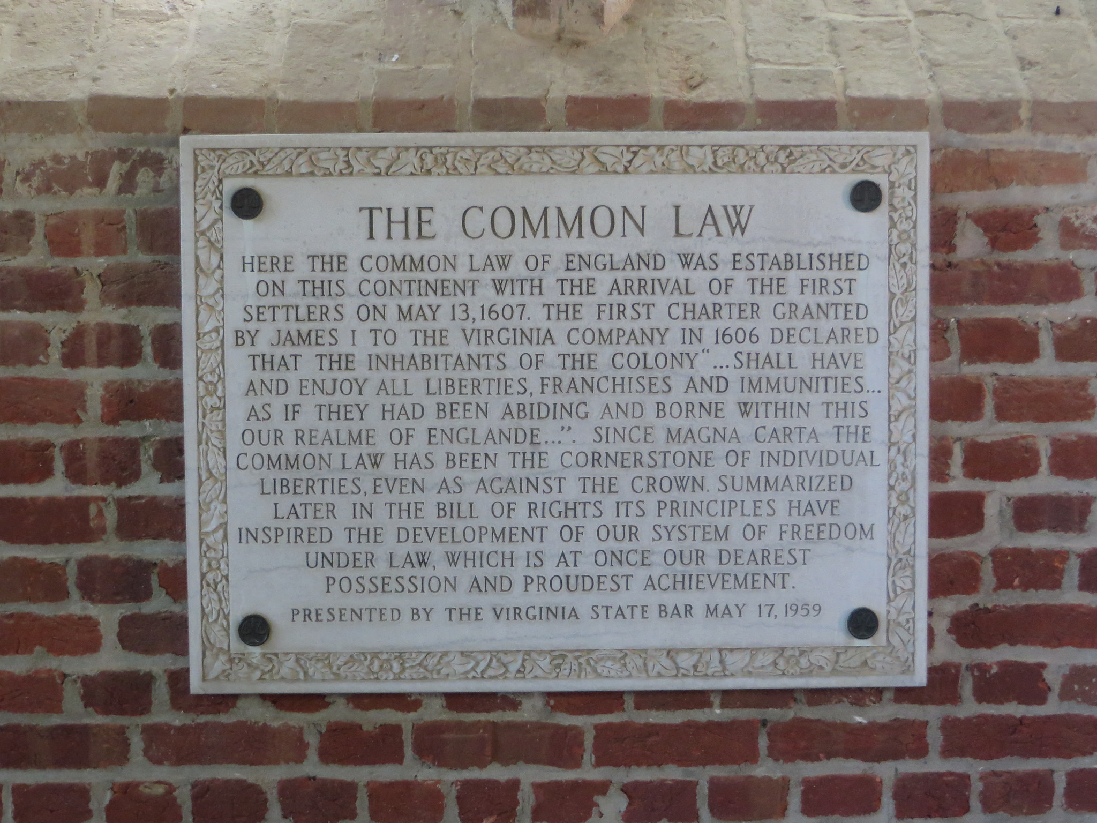
Jamestown
Ken Lund

Slide 16
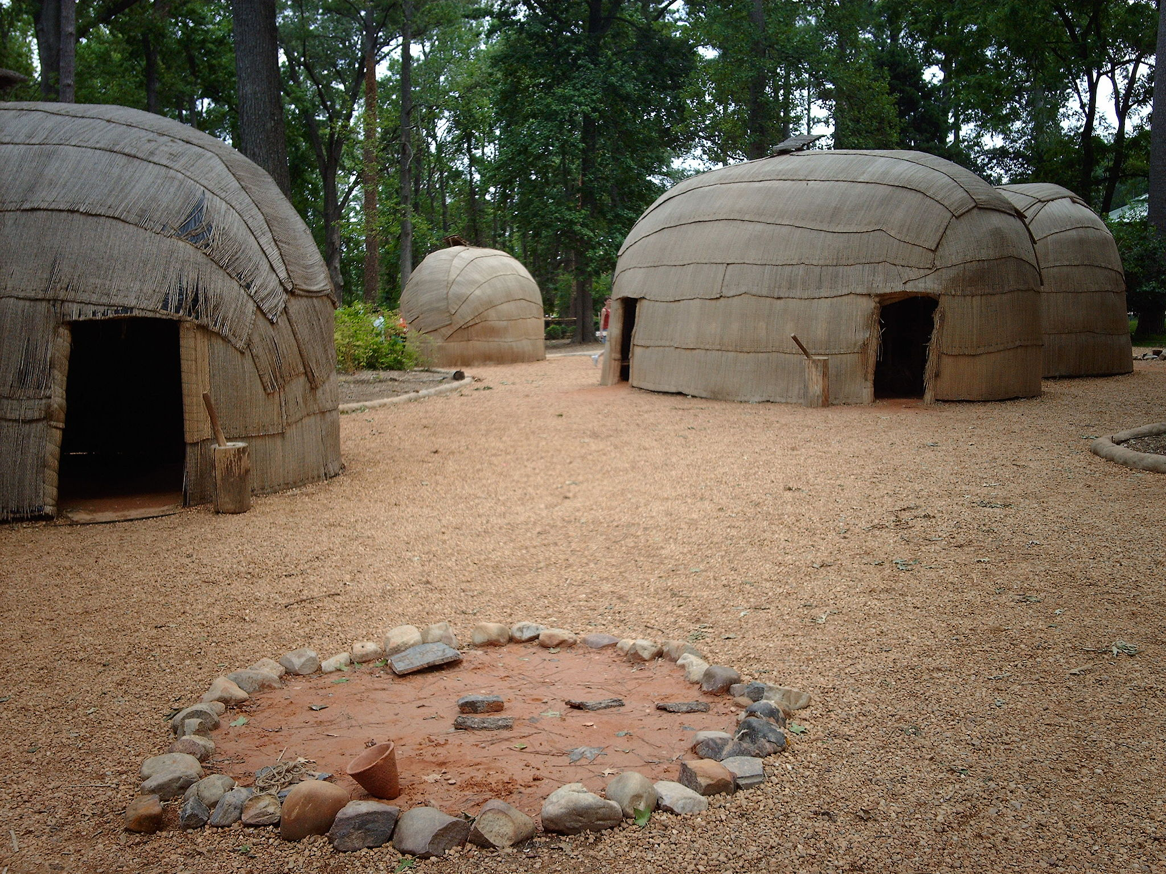
Initial Colony in 1607
Followed several failed colonies
Organized by the Virginia Company of London
  And taking orders from London
  Appointed local 7-member governing council
  Locally elected president
  Within a two years, only one member
Virginia Company suspends local rule by 1609 for 9 years
By Nationalparks. Nationalparks at en.wikipedia

Slide 17
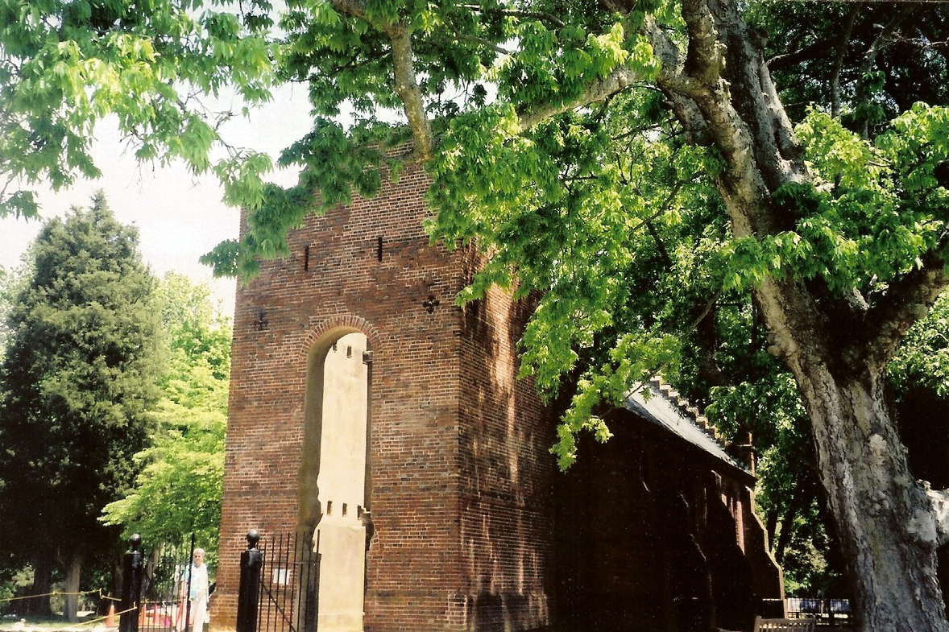
After 1618
New Governor and Council appointed by the London Company
Elected House of Burgesses
  Two members from every town
Together, can pass laws, and otherwise looks like a government
By 1624, Virginia is a Royal Colony
Ken Lund

Slide 18

Massachusetts
"Mayflower in Plymouth Harbor," by William Halsall, 1882

Slide 19
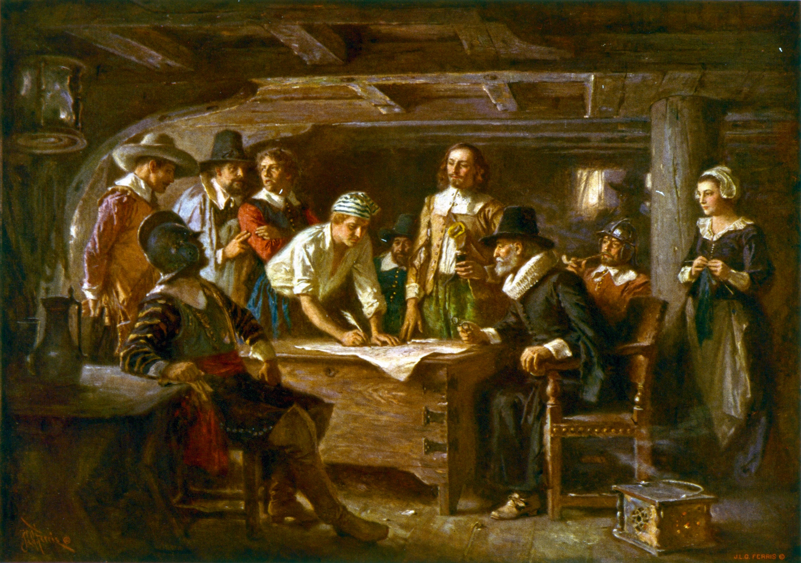
The Mayflower Compact
Mayflower destined for Virginia, 1620
Due to storms, landed in Mass. Bay
Intent to distinguish from Virginia
Original text lost
Not a form of government, itself
  Only a promise to collective establish and adhere to a government
  “We are a people.”
  Promised equal and just laws
"The Mayflower Compact 1620 cph.3g07155" by Jean Leon Gerome Ferris

Slide 20
Form of Government
Representative government
  Elected General Court
  Elected Governor
General Court would also act as judiciary
Technically, no outside control
Notes:
Left to their own devices, people will form their own government
That government will be more-or-less democratic and more-or-less representative
That’s easier to sell people on
People will hold to it
The General Court is still extant
So is the Alþingi

Slide 21
Layers of Government
Supernational
National
State
Local

Slide 22
Supernational
Examples
General Purpose
United Nations
NATO
ASEAN
World Bank / IMF
Coordination among nation-states
Usually issue-specific
Talk a lot

Slide 23
National and State (U.S.)
National
State
Law-making and policy-setting
National defense
Money printing and coin minting
Foreign policy
Post office
Regulating common goods
  Environment
  Communications
Law-making and policy-setting
Education and welfare
Public health
Transport regulation
Regulate public goods

Slide 24
Local Government
Code-making
Power is granted by the State
Administrative enactment of state authority
  Law enforcement
  Resource utilization
  Environmental services (trash, wastewater)
  Land records
  Planning and zoning
  Birth and death records
This sounds like what we need

Slide 25
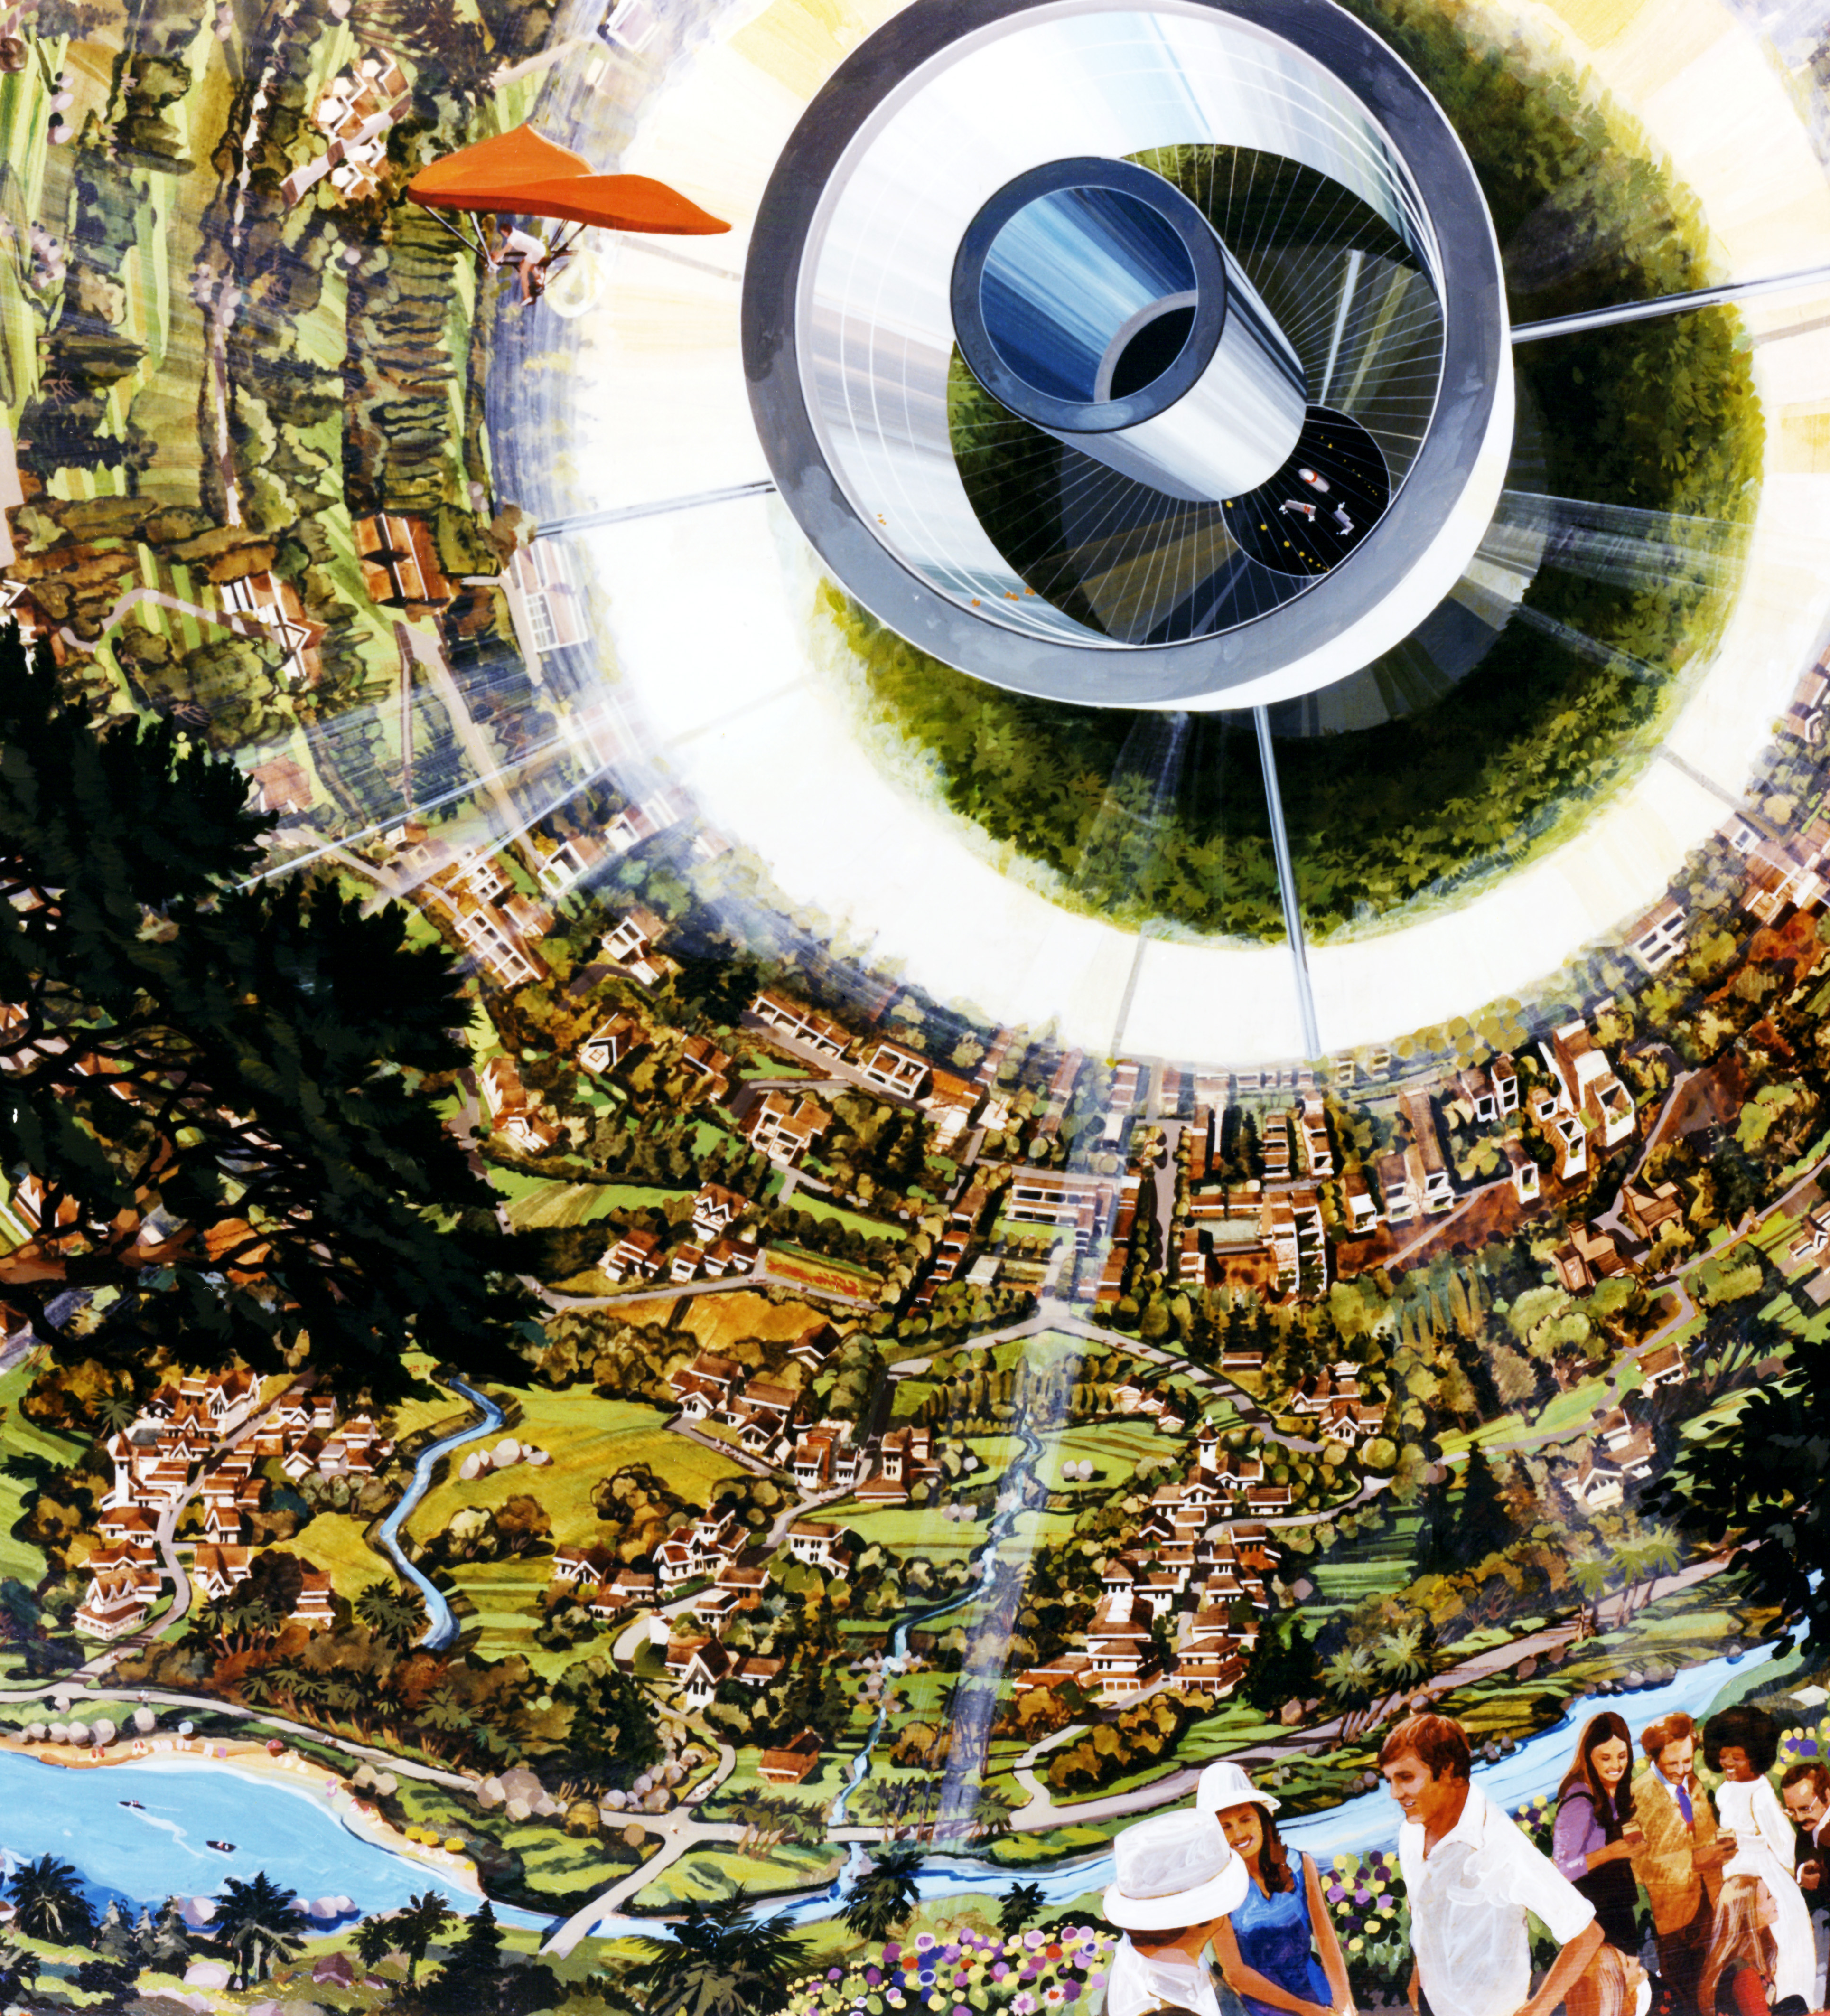
Applications to Colonization
What does all this mean
By Rick Guidice [Public domain], via Wikimedia Commons

Slide 26
Mars
Circumstances
  Relatively small, fixed set of people
  Long-term growth expected
  Desire to establish resource-independence
  Earth is, at minimum, 6 light-minutes away
Necessitate development of local government first
  Planning is essential
  Vital records
  Administrative management

Slide 27
Other Colonization Options
LEO/Moon
Generation Ships
Earth is no more than 3 light-seconds away
  4-day trip
Moon can be administratively managed from Earth
  Obviously, local services must still be provided
Going away, fast

Slide 28
Closing
What have we learned

Slide 29
Summary of Key Points
People will establish their government if left to their own devices
  That government will likely resemble a democracy
Different types of settlements will require different types of governance
The overwhelming set of governance concerns resemble local governments
Basic high-touch government is necessary to ensure stability and survival

Slide 30
Next Steps
What form of government should a colony have
How is that government operate
Is the government established on Earth beforehand
How will that government relate to Earth-bound governments?
  Will it be a client or subunit of some nation-state?
  Will it be a nation-state in it’s own right?
  Will there be an organized transition period?
How will immigration be handled, on both ends?
How will different colonies interact with each other?
Decisions to make

Slide 31
Immediate Attention
Handling existing landing sites
  Should they be treated as parks or otherwise preserved?
Can a shared communications platform be established?
Can a positioning system, for the benefit of everyone, be established?
Some things need immediate attention.

