Slide 1


A Computation and Communication Efficient Method for Distributed Nonconvex Problems in the Partial Participation Setting
Alexander Tyurin
Postdoc at KAUST
NeurIPS 2023

Slide 2
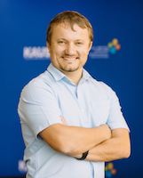
This is a joint work with
Peter Richtárik
Professor at KAUST

Slide 3
Distributed Stochastic Optimization Problem
We are solving the nonconvex distributed optimization problem:
# devices / machines
# model parametes /
features

Slide 4
Goal
We want to find a stationary point of the optimization problem:

Slide 5

Communication is the Bottleneck!
Technical Setup of the Problem

Slide 6




Compressed Communication
Notes:
Mention the classical SGD method

Slide 7
Unbiased Compression Operators
Example: RandK compressor
Random entry

Slide 8

Main Problem: Partial Participation
In each iteration, some devices do not participate randomly
Goal: Design a method that would have the optimal oracle complexity and the state-of-the-art communication complexity in the partial participation setting

Slide 9
New Method: DASHA-PP-MVR
The server aggregates information and does the step

Slide 10
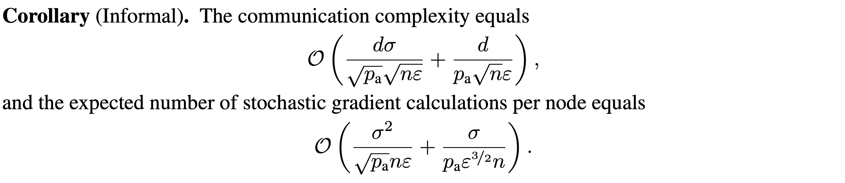
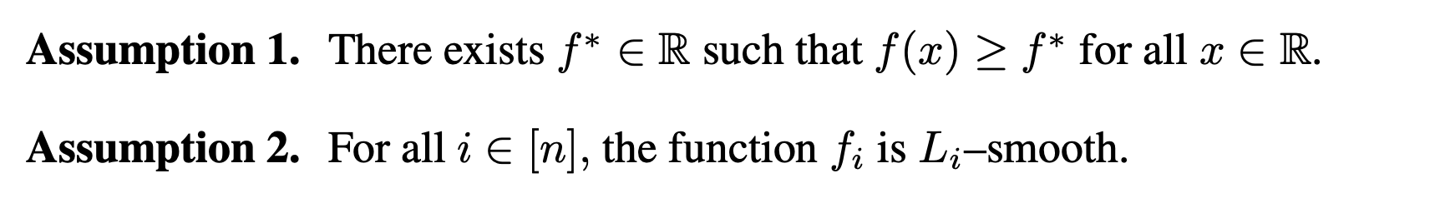
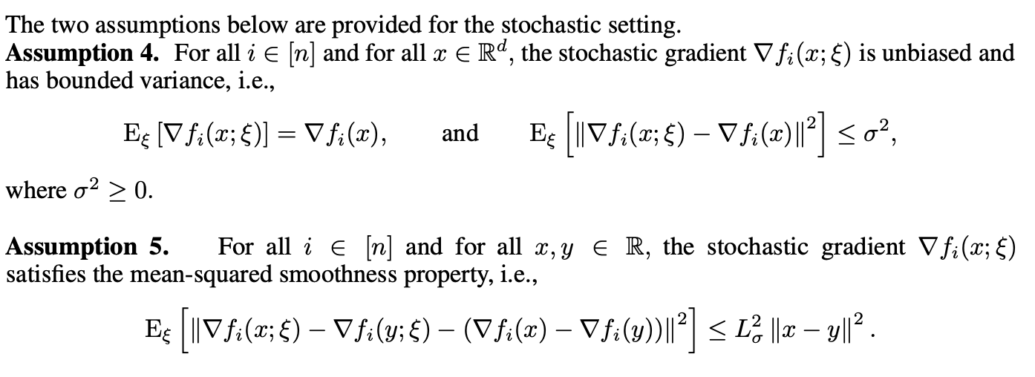
Theoretical Guarantees
SOTA communication complexity
optimal oracle complexity
Our assumptions are standard:

Slide 11
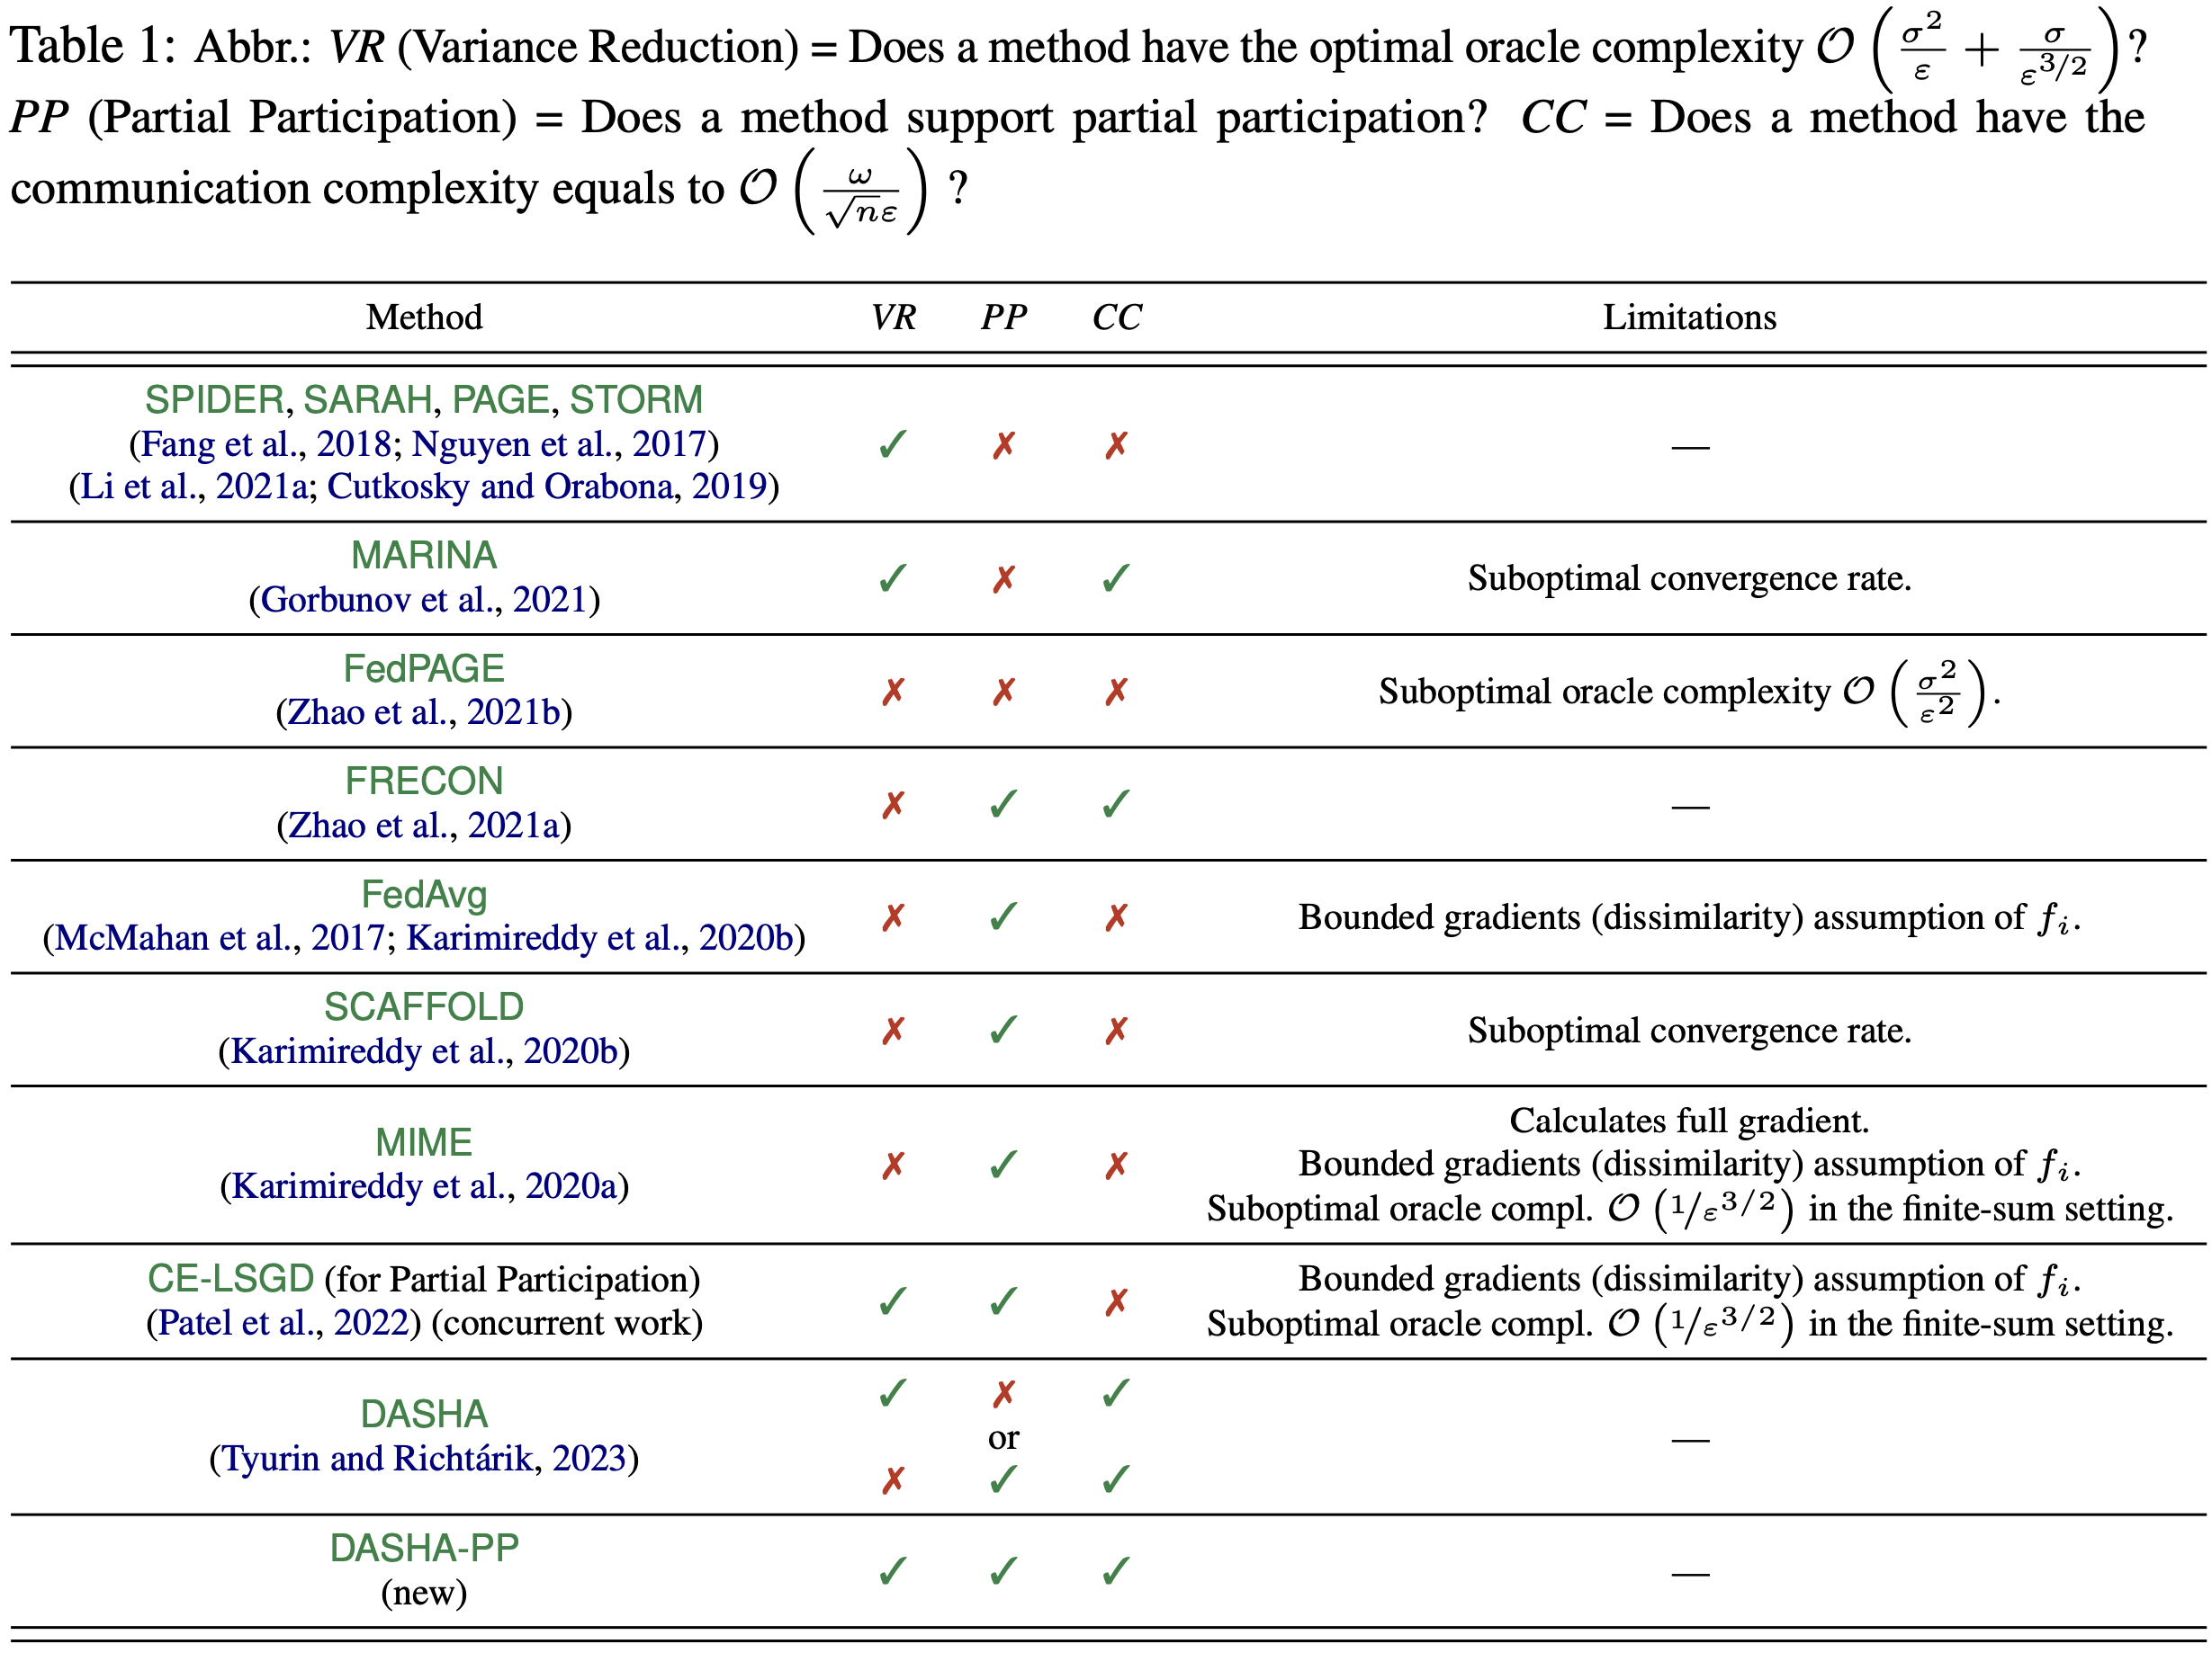
Comparison with Previous Methods

Slide 12
Thank you!
The same order results we also provide in the finite-sum setting:
local samples/functions
stored on devices

