Slide 1

DASHA: Distributed Nonconvex Optimization with Communication Compression and Optimal Oracle Complexity
Alexander Tyurin
Postdoc at KAUST
ICLR 2023

Slide 2
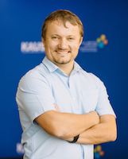
This is a joint work with
Peter Richtárik
Professor at KAUST

Slide 3
Optimization Problem
# workers / machines /
nodes
# model parameters / features

Slide 4
Optimization Solution In Nonconvex World
Goal:

Slide 5

Communication is the Bottleneck!
Technical Setup of the Problem

Slide 6
Unbiased Compression Operators
Example: RandK compressor
Random entry

Slide 7




Compressed Communication
Notes:
Mention the classical SGD method

Slide 8

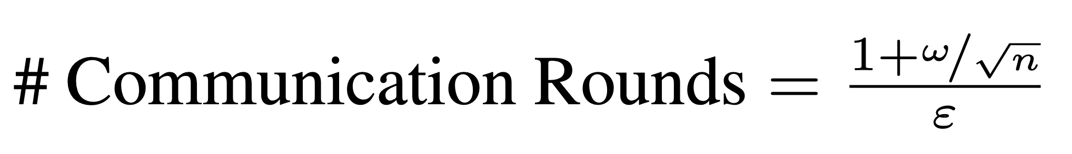
Previous Method: MARINA
server calculates
i^{th} node calculates
Can we avoid sending non-compressed gradients?
Can we design a method that will send only compressed vectors?
Eduard Gorbunov, Konstantin Burlachenko, Zhize Li, Peter Richtárik
MARINA: Faster Non-Convex Distributed Learning with Compression
ICML 2021

Slide 9
New Method: DASHA
An answer to the previous questions:
Yes, we can! Using a specially designed momentum correction.
Unlike the MARINA method, DASHA sends only compressed vectors.
DASHA does not require the participation of all workers.
Partial participation can be easily implemented.

Slide 10
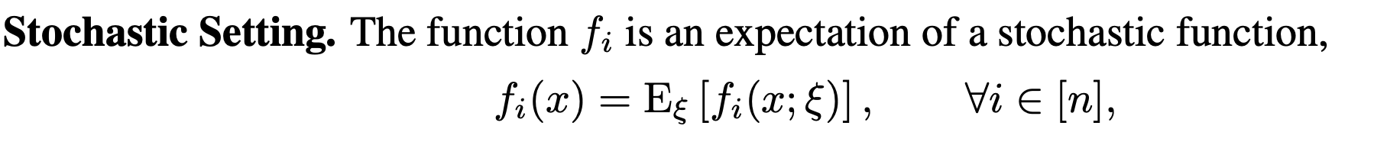
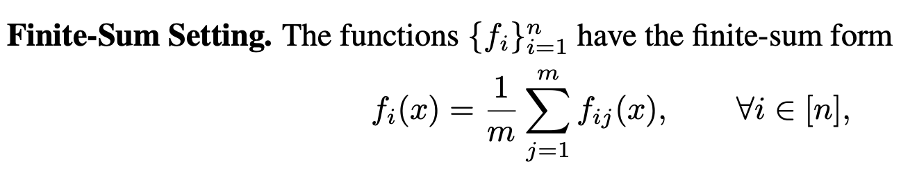
Stochastic and Finite-Sum Settings

Slide 11
DASHA-MVR: New Method for Stochastic Setting
DASHA’s momentum correction
Momentum Variance Reduction by (Cutkosky and Orabona, 2019)

Slide 12
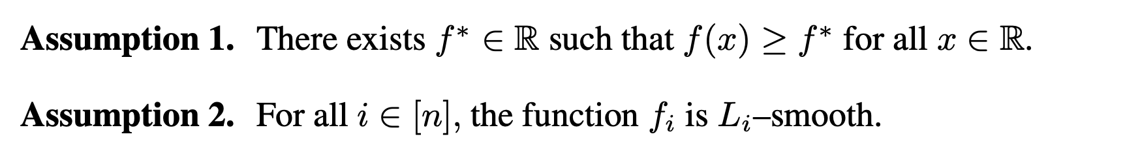
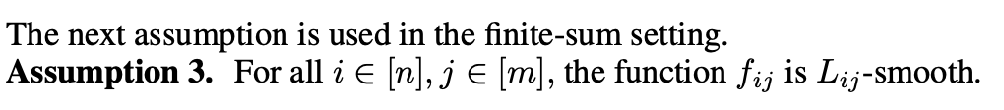
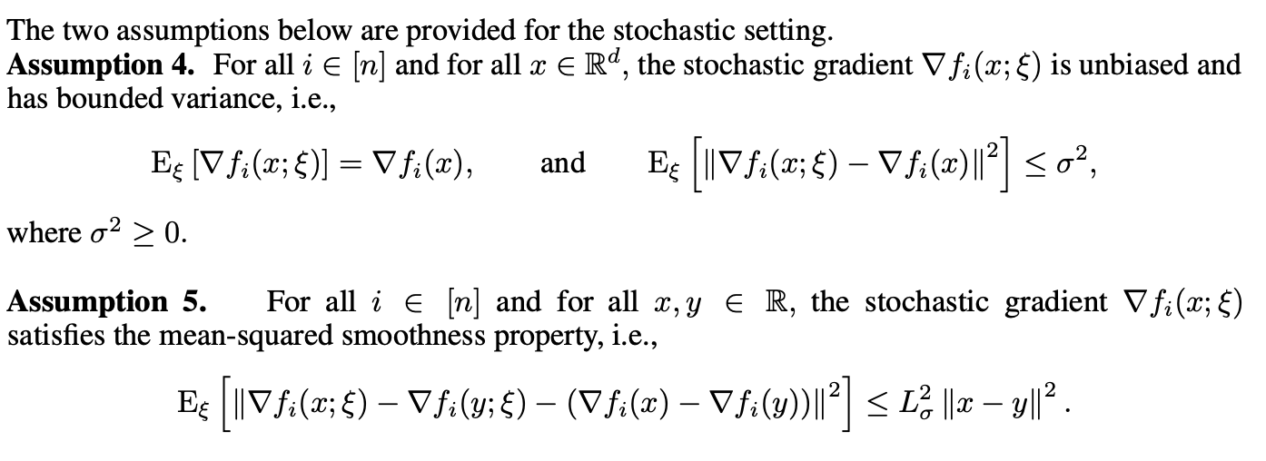
Assumptions

Slide 13
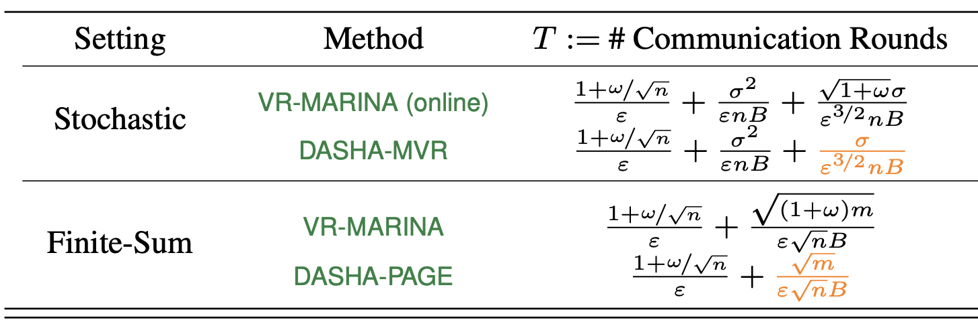
New SOTA Communication Complexities
A new method in the finite-sum setting.
We get improvement
- comression error

Slide 14
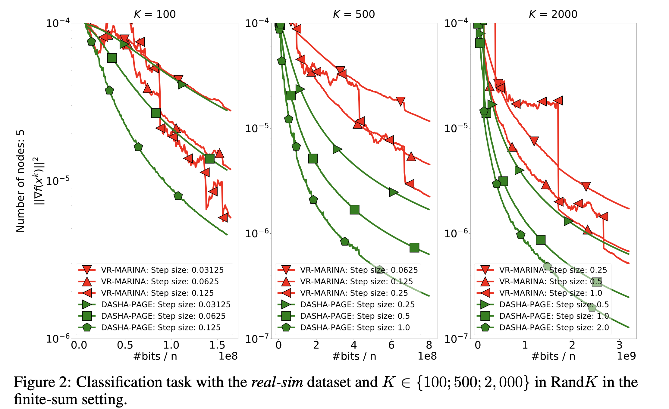
Experiments

Slide 15
Thank you! See you at Poster #107

