Slide 1


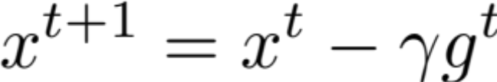
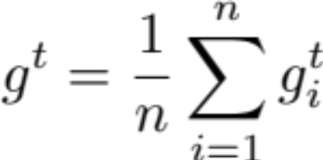
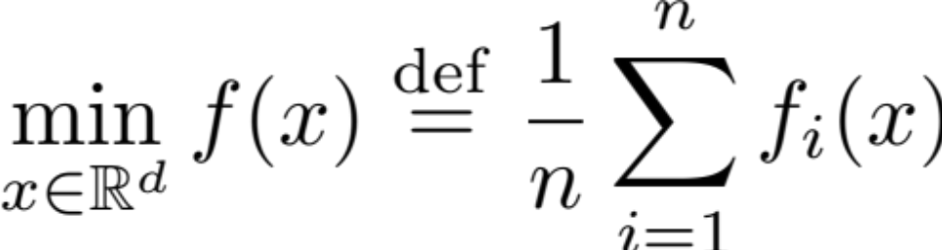





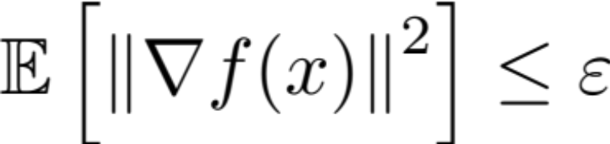



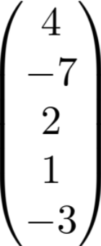

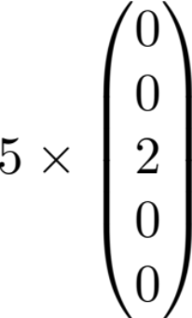


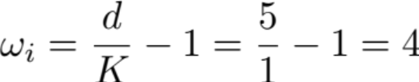




A Computation and Communication Efficient Method for Distributed Nonconvex Problems in the Partial Participation Setting
Alexander Tyurin and Peter Richtárik
5. Previous Method in Stochastic Setting: DASHA-MVR
KAUST, Saudi Arabia
The server aggregates information
1. Distributed Stochastic Optimization Problem
The nodes calculate new vectors and send the compressed vectors
We are solving the nonconvex distributed optimization problem:
# devices / machines
Momentum Variance Reduction [2]
DASHA’s momentum correction [1]
# model parametes /
features
5. Main Problem: Partial Participation
2. Goal
We want to find a stationary point of the optimization problem:
Some devices do not participate randomly
in each iteration
# bits transferred from devices to the orchestrating server
Goal: Design a method that would have the optimal oracle complexity and the state-of-the-art communication complexity in the partial participation setting
9. Experiments
3. Unbiased Compressor
Example: RandK compressor
Random entry
4. Compressed Communication Approach
References
[1] Alexander Tyurin, Peter Richtárik
DASHA: Distributed Nonconvex Optimization with Communication Compression
and Optimal Oracle Complexity
ICLR 2023
[2] Cutkosky, Ashok, and Francesco Orabona
Momentum-based variance reduction in non-convex SGD
NeurIPS 2019
Assumptions are standard. We only require smoothness and boundedness .
In the stochastic setting, we additionally require mean-squared smoothness and unbiased stochastic gradients with - bounded variance.
Clients send compressed vectors to the Server
Notes:
1.
& h_i^{t+1} = \nabla f_i(x^{t+1}, \xi_i^{t+1}) + (1 - b) (h_i^{t} - \nabla f_i(x^{t}, \xi_i^{t+1})) \\
& g_i^{t+1} = g_i^t + \cC_i\left(h_i^{t+1} - h_i^{t} - a (g^t_i - h^t_i)\right)
2.

