Slide 1
Democracy, Trust, and Transparency A Cross-National Data Visualization Study
Group 8 – Bhaskar Akkena, Ritvik Pandillapally, Karthik Pachabatla

Slide 2
Project Overview
Global dataset with 128 countries and 12 key variables , focused on governance, development, inequality, and trust
Tools used: Python (Seaborn) for deep analysis, Tableau for clean visual summaries
Goals:
Explore interrelations between democracy and press freedom
Examine how inequality impacts public trust
Investigate how development affects governance perception
Key findings at a glance:
More democracy correlates with more press freedom
Less inequality links to higher trust
Better development aligns with strong institutions

Slide 3
Research Questions
What is the relationship between democracy and press freedom?
How does economic inequality represented by the Gini Index influence public trust in institutions like government and media?
Are human development, healthcare, and institutional trust interconnected?

Slide 4
About the Dataset
Source: Country Information dataset (CSV format)
Covers variables such as:
Gini Index (economic inequality)
HDI (Human Development Index)
Press Freedom, Populism, Corruption Perceptions
Trust in news media, government, and science
128 countries represented with global geographic and political diversity
Use cases:
Academic analysis of democratic trends
Policy research on trust and governance

Slide 5
Why Python and Tableau?
Python (Seaborn/Matplotlib):
Ideal for detailed, reproducible statistical plots
Supported correlation heatmaps, histograms, and scatter analyses
Tableau:
Created visually polished bar charts and dashboards
Ideal for aggregated summaries and presentations
Combined Power:
Python = depth of analysis
Tableau = clarity and storytelling

Slide 6
Initial Observations
Gini Index and Trust in Government: strong negative correlation (r ≈ -0.43)
HDI and Corruption Perceptions: strong positive relationship
Trust in media and science: closely aligned
Some outliers challenge general trends (e.g., U.S., Turkey)

Slide 7
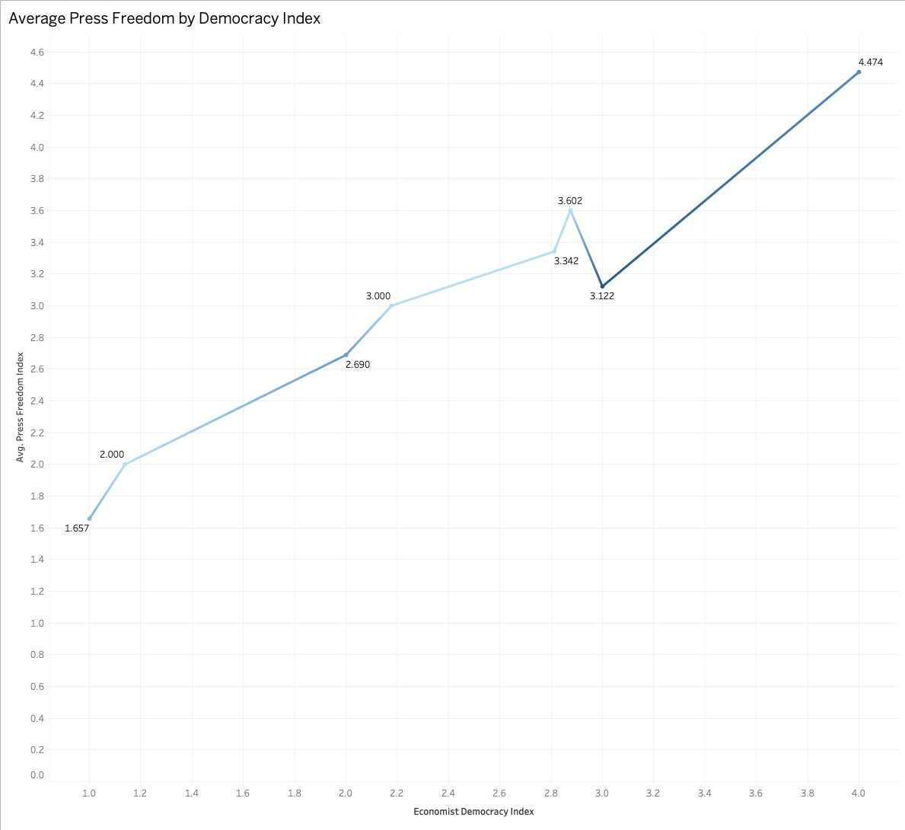
Press Freedom by Democracy Index
Higher democracy scores (3–4) link to higher average press freedom
Low-democracy countries (1–2) fall behind
Examples:
High: Norway, Finland
Low: Turkey, Russia

Slide 8
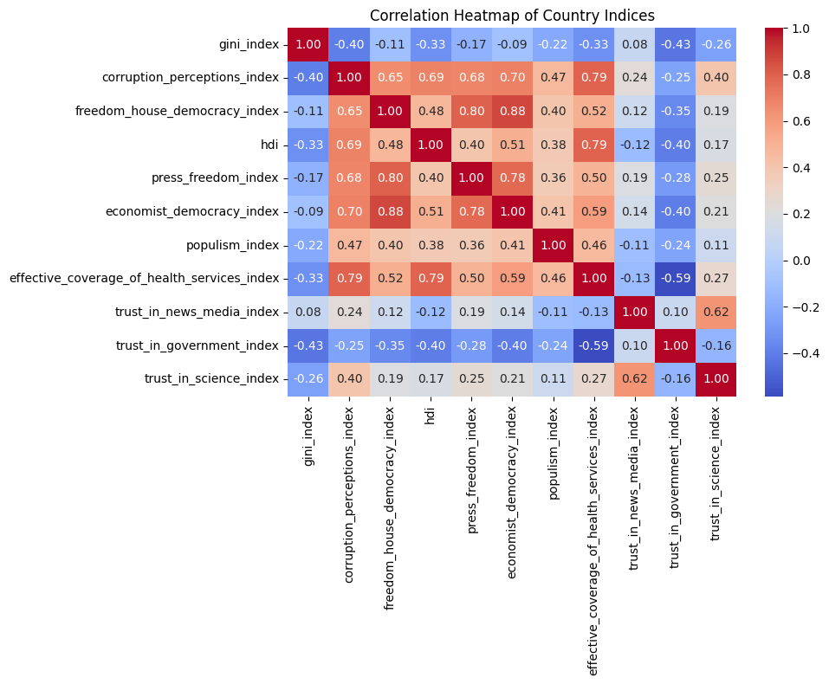
Correlation Heatmap
HDI vs Corruption Perceptions: r ≈ 0.48
Gini Index vs Trust in Government: r ≈ -0.43
Press Freedom vs Democracy Index: r ≈ 0.88

Slide 9
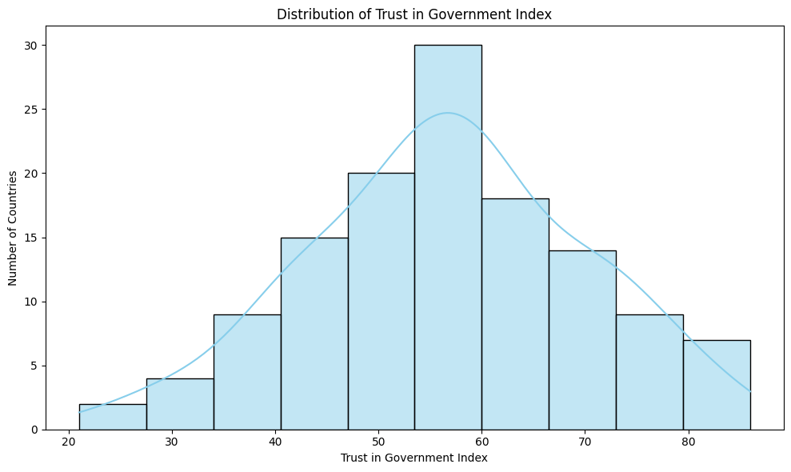
Trust in Government: Normal Distribution
Most countries cluster between trust scores of 45–70
Outliers:
Low: Lebanon, South Africa
High: Singapore, Switzerland

Slide 10
Key Results
Democracy is a strong predictor of press freedom
High inequality → low government trust
Development improves both service quality and institutional trust
Trust in media, science, and government often cluster together

Slide 11
Observations and Limitations
Some democracies suppress media (e.g., Hungary)
High democracy doesn’t guarantee high trust (e.g., U.S.)
Quantitative data can’t capture lived realities or media narratives
Suggest: longitudinal or regional follow-ups for deeper insight

Slide 12
Conclusion
Democracy aligns with transparency, trust, and service quality
Visualizations bring abstract governance metrics to life
Python offered statistical power; Tableau brought clarity
Future work: interactive dashboards, regional studies

Slide 13
References
Transparency International (2024)
Reporters Without Borders (2023)
Edelman Trust Barometer (2024)
Norris (2008) – Driving Democracy
World Bank WGI (2023)

Slide 14
Thank You

