Slide 1
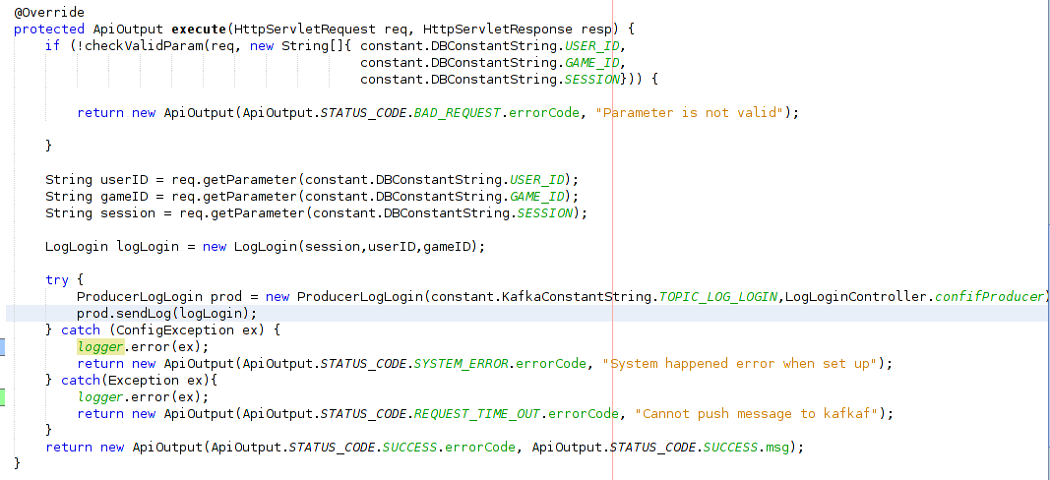
Kafka pushing – Log Login

Slide 2
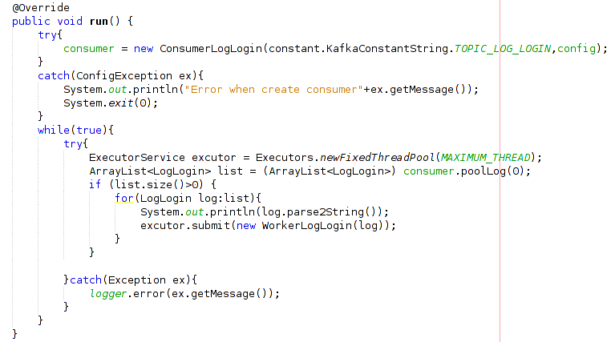
Kafka pooling – Log Login

Slide 3
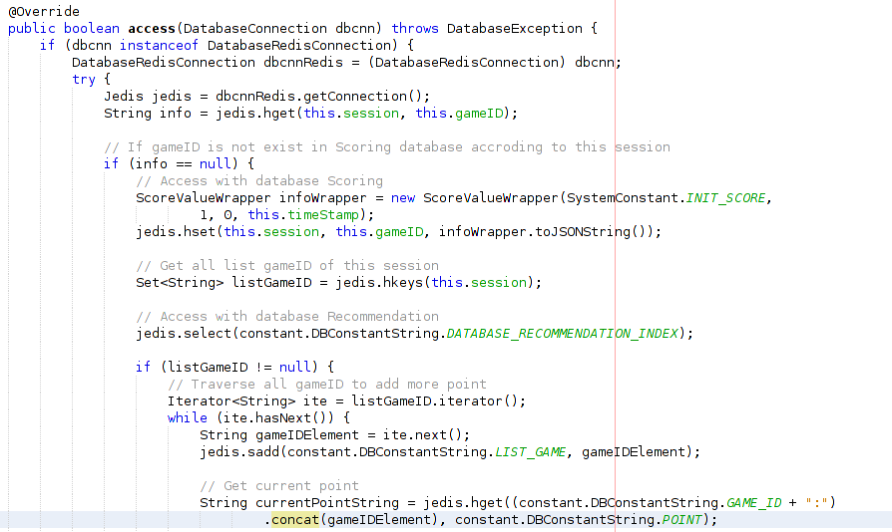
Access Log Login

Slide 4
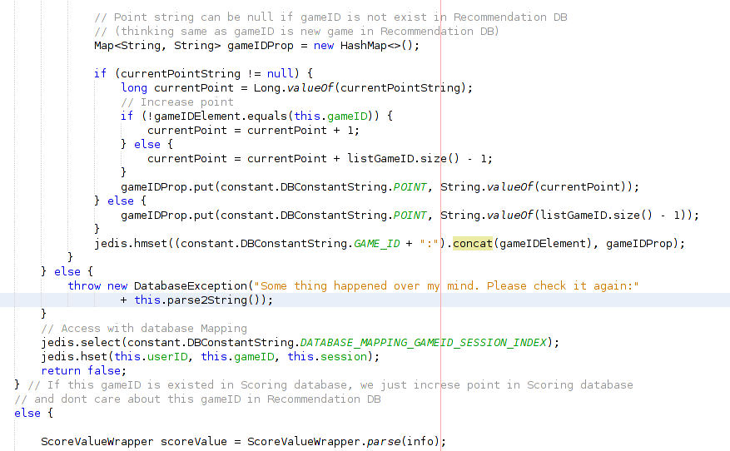
Access Log Login

Slide 5
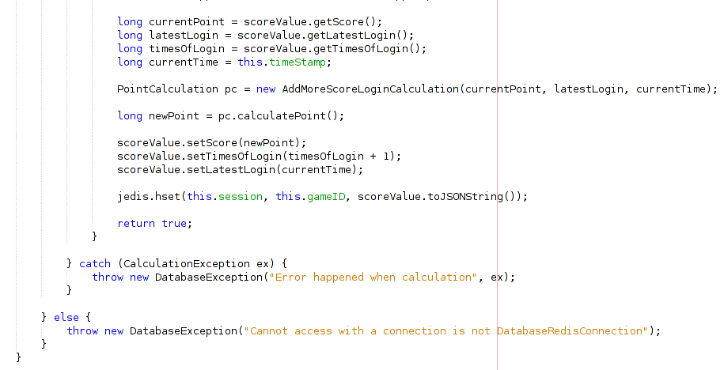
Access Log Login

Slide 6
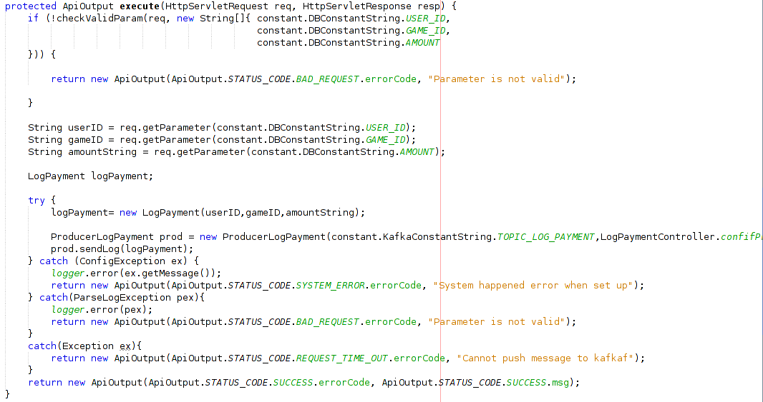
Kafka pushing – Log Payment

Slide 7
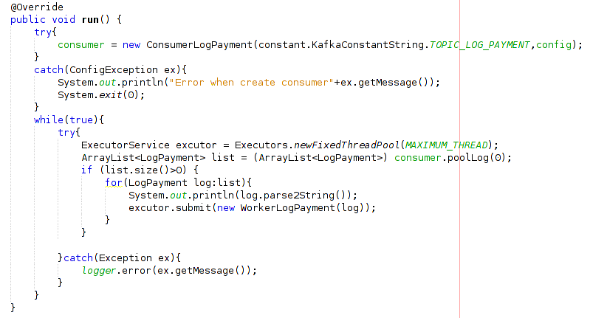
Kafka pooling – Log Payment

Slide 8
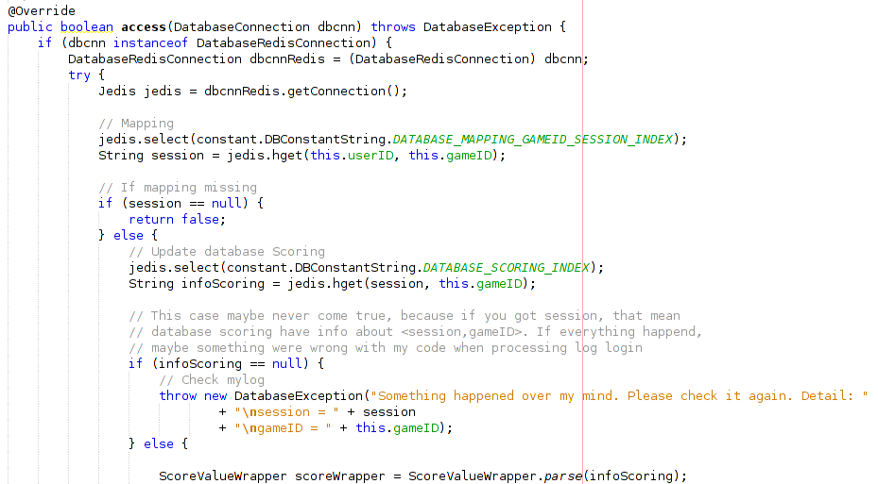
Access Log Payment

Slide 9
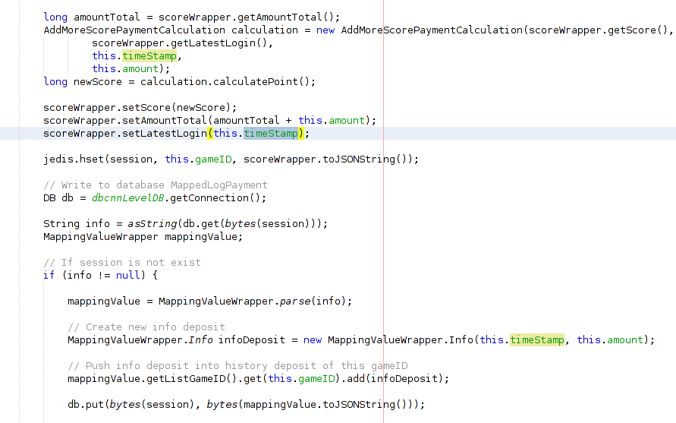
Access Log Payment

Slide 10
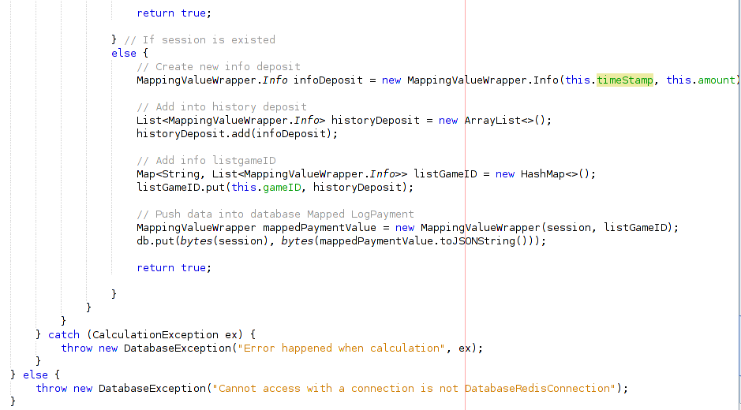
Access Log Payment

Slide 11
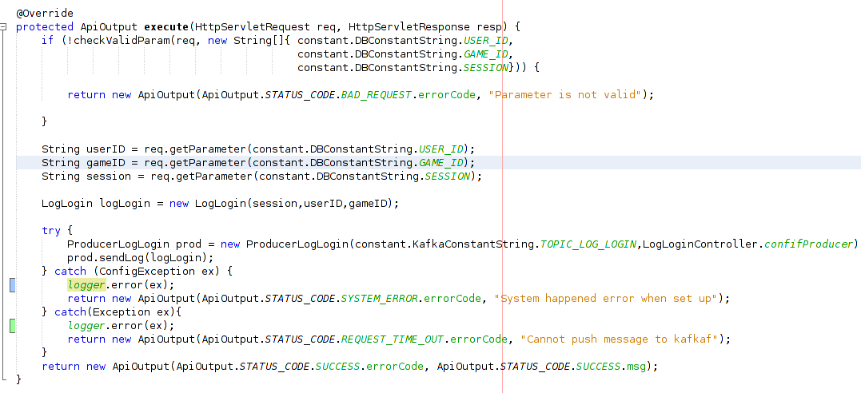
Kafka pushing – Landing Page

Slide 12
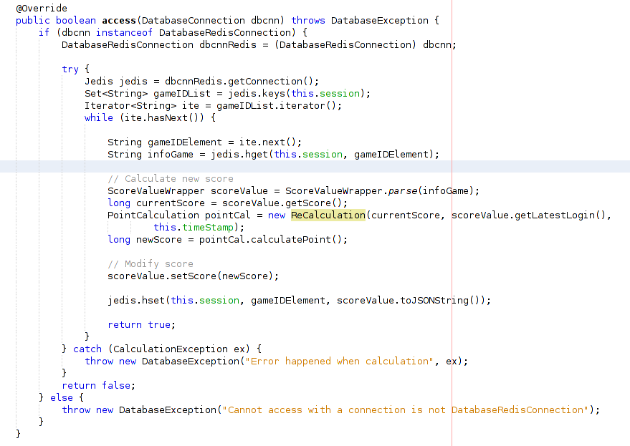
Worker Landing Page

Slide 13
Redis – query to get list rec.

Slide 14
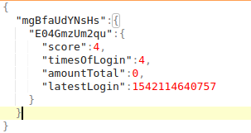
Redis – Database Scoring
session => <gameID, info(score, timesOfLogin, amountTotal, latestLogin)>
Example:

Slide 15

Redis – Database Mapping
userID => <gameID, session>
Example:

Slide 16
Redis – Database Recommendation
Listset:<gameID1,gameID2,...>
GameID:gameID1
GameID:gameID2
...

Slide 17
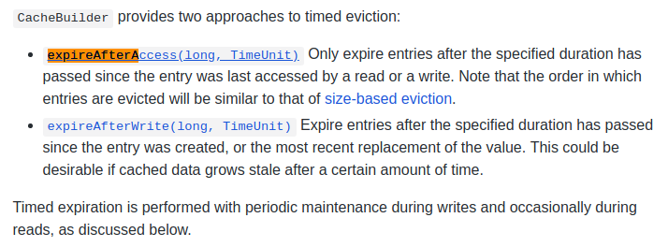
Expired After ...

Slide 18
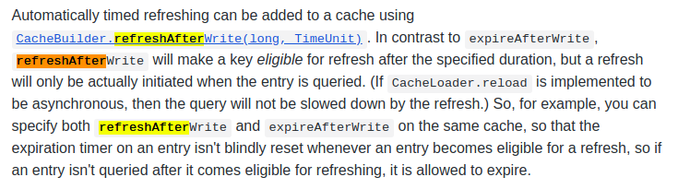
Refresh After Write

Slide 19
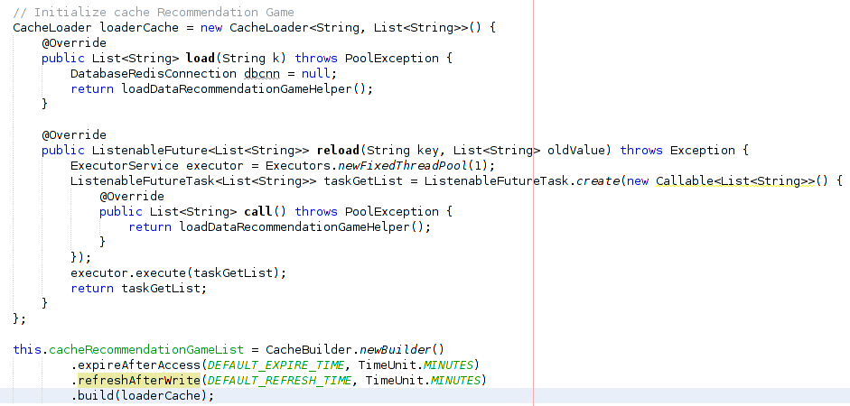
Load – Reload Cache Recom

Slide 20
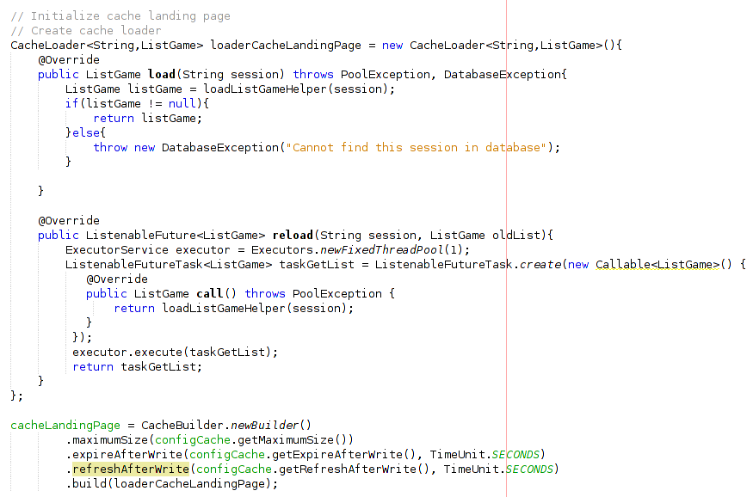
Load – Reload Cache Landing

Slide 21
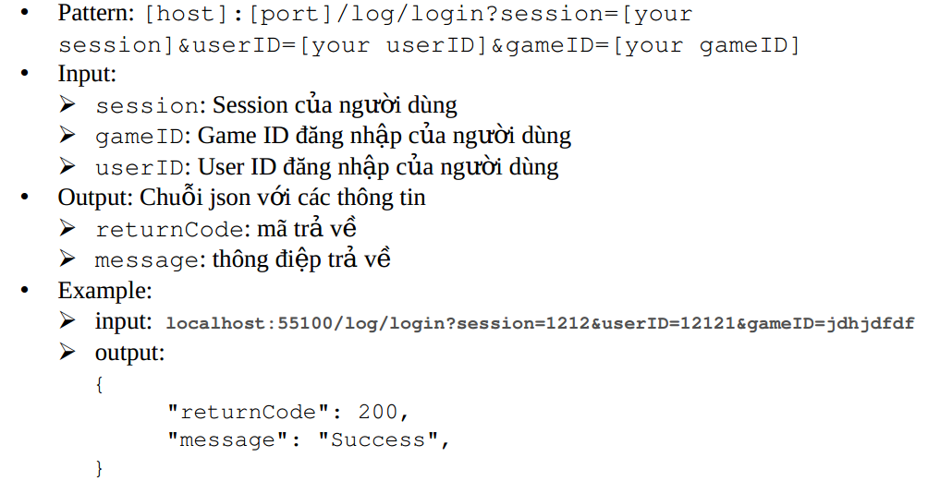
How Scribe connect to

Slide 22
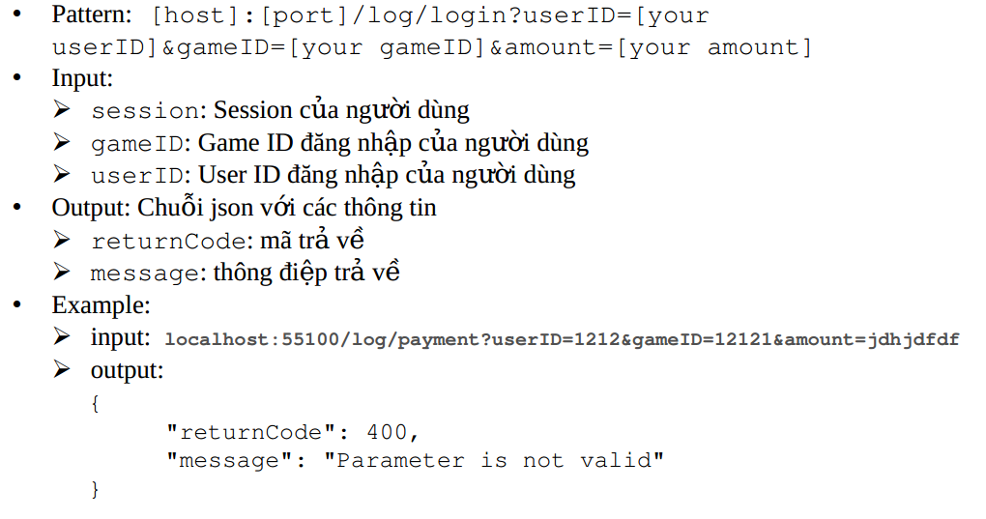
How Payment connect

Slide 23
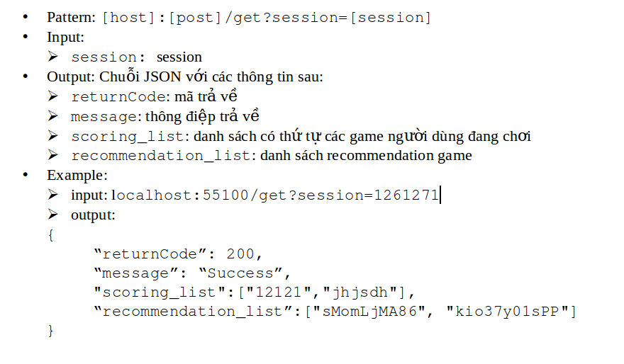
How Landing Page connect

Slide 24
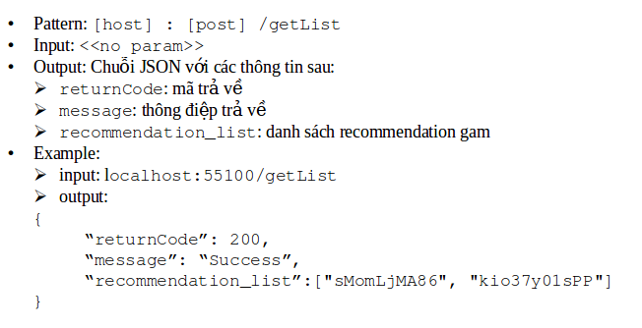
How Landing Page connect

Slide 25
How Landing Page connect

