Slide 1
CSCE 313 – Introduction to UNIx process
Reading Reference: Textbook Chapter 2
Tanzir Ahmed CSCE 313 Spring 2018

Slide 2
Outline
Process – Program in Action
Address Spaces
Learning about Process with ‘ps’
Miscellaneous questions about Process
Concurrent Processes
Context Switching

Slide 3
Prologue* with Questions
“How does Unix run programs? It looks easy enough: you log in, your shell prints a prompt, you type a command and press Enter. Soon a program runs.
When the program finishes, your shell prints a new prompt. How does that work?
What is the shell? What does a shell do? What does the kernel do? What is a program and what does it mean to run a program?”
* Understanding Linux/Unix Programming, by Bruce Molay

Slide 4
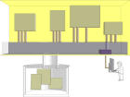
Process is Program in Action
processes
ps
ps –a
ps -l
ls
ls –a
ls -l
files
In Unix terminology
an executable program is a list of machine language instructions and data
a process is the memory space and settings with which the program runs
Data and programs are stored in files on the disk: programs run in processes

Slide 5
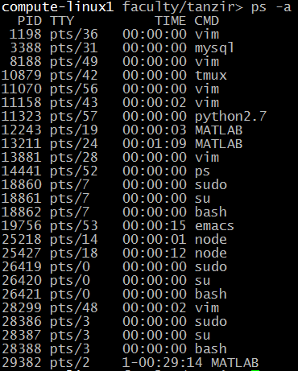

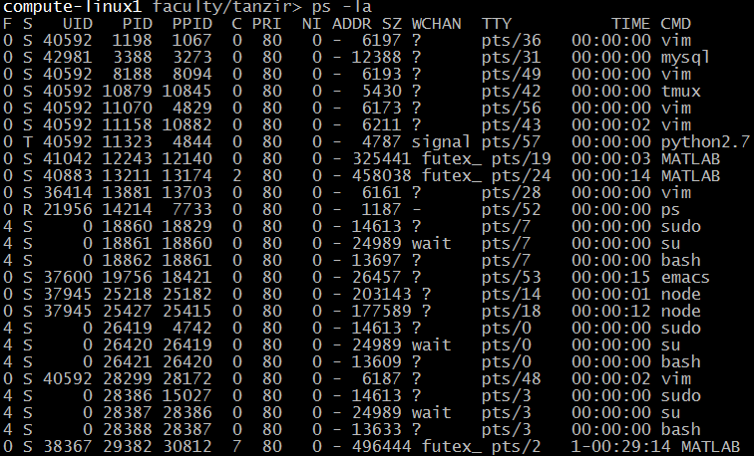
Learning about Processes with ‘ps’
Run these commands in your linux/unix system and then also read the ‘man’ pages
Notes:
F: flags (4 is super-user)
S: Process State (R is Running or Runnable, S is INT sleep, T is stopped)
C: % of CPU
PRI: Priority
NI: Nice Value
ADDR: Memory address - not used
SZ: Size virtual memory usage in pages
Wchan: wait channel where the process is sleeping

Slide 6
Processes
Definition: A process is an instance of a ‘running’ program
Process provides each program with two key abstractions:
Logical control flow
Each program seems to have exclusive use of the CPU
Private address space
Each program seems to have exclusive use of main memory
How are these illusions maintained?
Process executions interleaved (multitasking)
Private address spaces managed by virtual memory system (will describe that in a bit)

Slide 7
Logical Control Flows
Each process has its own logical control flow
Process A
Process B
Process C
Time

Slide 8
Concurrent Processes
Two processes run concurrently (are concurrent) if their flows overlap in time
Otherwise, they are sequential
Examples:
Concurrent: A & B, A & C
Sequential: B & C
Process A
Process B
Process C
Time

Slide 9
User View: Concurrent Processes
Control flows for concurrent processes are physically disjoint in time (except on multi-core machines)
However, we can think of concurrent processes as running in ‘parallel’ with each other
Process A
Process B
Process C
Time

Slide 10
Context Switching
Processes are managed by the kernel
Control flow passes from one process to another via a context switch
We will see the mechanism of context switch in a little bit
Process A
code
Process B
code
user code
kernel code
context switch
Time
user code
kernel code
context switch
user code

Slide 11
Process Image in Physical Memory
In reality, this is how* processes look in physical memory:
* A very simplified view, ignoring fragmentation completely

Slide 12
Private Address Space Illusion
But each process is made to believe that the memory looks like the following – thanks to Virtual Memory:
0xffffffff
user stack
(created at runtime)
%esp (stack pointer)
How big can this be?
memory mapped region for
shared libraries
Depends on machine architecture. For a 32 bit machine 2³² = 4GB
For a 64 bit machine 2⁶⁴ = 16EB
0x40000000
run-time heap
(managed by malloc)
brk
read/write segment
(.data, .bss)
loaded from the
executable file
read-only segment
(.init, .text, .rodata)
0x08048000
0
Kernel

Slide 13
Question
Is a process image really 2³² = 4GB long?
It would be nice for us, programmers
But typically, physical memory is quite limited
Virtual memory in action
What is then Virtual Memory?
For that, we now need to a little understanding on how memory is organized in a system

Slide 14
Memory Organization
Memory is logically divided into pages, which are nothing more than fixed sized and aligned regions of memory
Typical size: 4KB/page (but not always)
Pages on disk (akin to Memory Block) become Frames (akin to Cache Line) in memory
Memory frames are allocated and page->frame mapping is built only when necessary
On demand through page fault
0-4095
Page 0
4KB
4096-8191
Page 1
8KB
8192-12287
Page 2
12KB
12288-16383
Page 3
…

Slide 15
Mapping from Virtual Memory to Physical Memory
Virtual Memory
Physical Memory
Virtual Memory
0
0K
0
Page 0
Frame 0
Page 0
4K
4K
4K
Page 1
Frame 1
Page 1
8K
8K
8K
Page 2
12K
Frame 2
12K
12K
16K
Frame 3
Page Table #1
Page Table #2
2^64
2^64

Slide 16
Summarizing Virtual Memory
The private address space of a process is made up of pages
These pages can be spread according to the wish of the kernel
Contiguous memory in processes’ view are not necessarily contiguous in physical memory – they can be scattered, but stitched together by Virtual Memory system
The whole private address space does not need to be allocated all the time
Because physical memory is scarce
Actual pages can be allocated/mapped only when needed through page faults
Even mapped but inactive pages can be swapped back and forth memory and disk to make room for active pages

