Slide 1
Exceptions Control Flow
Reading Reference: Textbook Chapter 2
TANZIR AHMED CSCE 313, Spring 2018

Slide 2
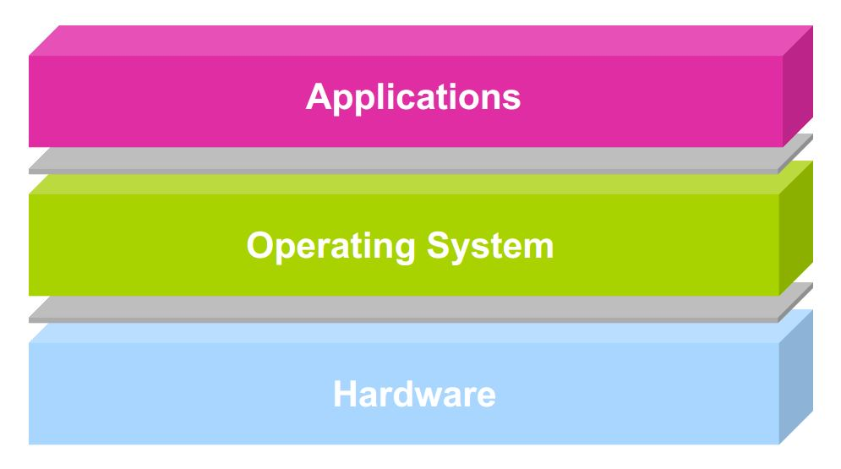
A Typical Computer System
The “all powerful” “all access” portion of OS Code is called the KERNEL

Slide 3
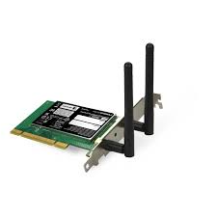



Scope of CSCE-313
user1
user2
user3
user4
Application Programs/Processes
return
System calls,
Exceptions
Privileged
Operations
Processor
Memory
INT
Character O/P
Bock I/O
storage
In this course we will be exploring the interfacing components on all three interfaces:
Application ←→ OS Kernel, OS Kernel ←→ CPU/Memory, CPU ←→ External Hardware

Slide 4
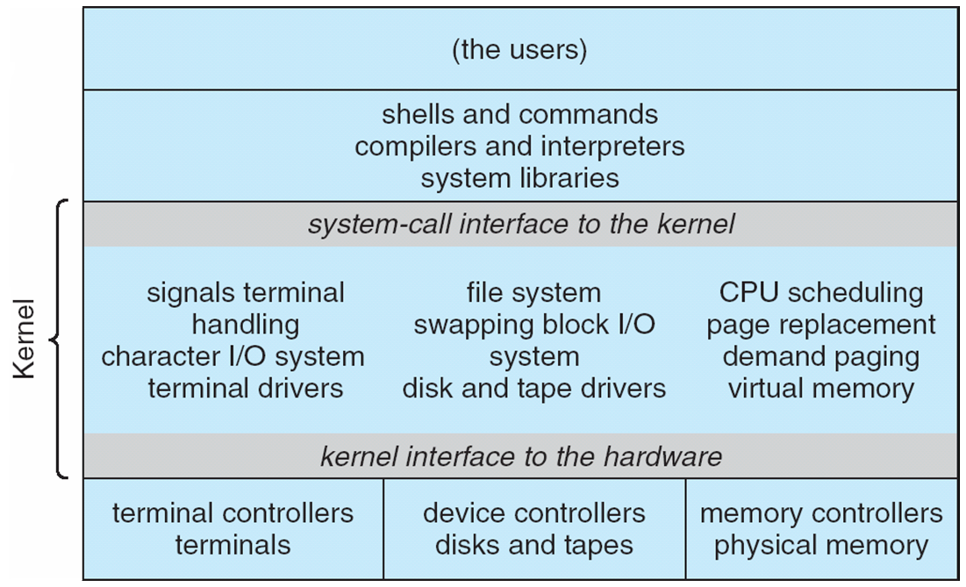
Traditional UNIX System Structure

Slide 5
A Real-Life Analogy (Approximate)
A Typical Coffee Shop | Computer System
Store | System
Customer | Process or Program or User Application
Barista/Cashier | Operating System Kernel, Privileged Code
Coffee Machine | CPU
Customer Order | System Call
Order item not on Menu | Exception
Telephone Call | Interrupt
Fire Alarm | Signal
Customers being served | Process Scheduling
Customer realizing at the counter that he needs to go to ATM to get money | Process Context Switching

Slide 6
Today’s Discussion
user1
user2
user3
user4
Application Programs/Processes
return
System calls,
Exceptions
Privileged
Operations
Processor
Memory
INT
Character O/P
Block I/O
INT
storage
Acknowledgment for Control Flow Slides: Prof. Keunning, HMC, FA’14

Slide 7
Control Flow
Computers do only one thing
From startup to shutdown, a CPU simply reads and executes (interprets) a sequence of instructions, one at a time
This sequence is the system’s physical control flow (or flow of control)
Physical control flow
<startup>
inst₁
inst₂
inst₃
…
inst_{n}
<shutdown>
Time

Slide 8
Altering the Control Flow
Program-assisted mechanisms for changing control flow:
Jumps and branches—react to changes in program state
Call and return using stack discipline—react to program state
Insufficient for a useful system
Difficult for the CPU to react to other changes in system state
Data arrives from a network adapter
Instruction divides by zero
User hits control-C at the keyboard
System needs mechanisms for “exception control flow”

Slide 9
Exception Control Flow
An exception is a transfer of control to the OS in response to some event (i.e., change in processor state)
User Process
OS
event
current
exception
next
exception processing
by exception handler
exception
return (optional)

Slide 10
Asynchronous Exceptions (Interrupts)
Caused by events external to processor (i.e., the current program)
Indicated by setting the processor’s interrupt pin(s)
Handler returns to “next” instruction after servicing
An important concept – Direct Memory Access (DMA)
CPU is not busy while data transfer (from disk, network, etc.) happens
Examples:
I/O interrupts
Key pressed on the keyboard
Arrival of packet from network, or disk
Hard-reset interrupt
Hitting reset button
Soft-reset interrupt
Hitting control-alt-delete to initiate restart on a PC

Slide 11
Interrupt Vectors
Exception
numbers
Each type of event has a unique exception number k
Index into jump table (a.k.a., interrupt vector)
Jump table entry k points to a function (exception handler).
Handler k is called each time exception k occurs.
code for
exception handler 0
interrupt
vector
code for
exception handler 1
0
1
code for
exception handler 2
2
...
n-1
...
code for
exception handler n-1

Slide 12
Synchronous Exceptions (Traps, Faults, Aborts)
Caused by events that occur as result of executing an instruction:
Traps
Intentional
Examples: system calls (e.g., printf, cout), breakpoint traps, special instructions
Returns control to “next” instruction
Faults
Unintentional but possibly recoverable
Examples: Page Faults
Either re-executes faulting (“current”) instruction or aborts

Slide 13
Synchronous Exceptions (Traps, Faults, Aborts)
Aborts
Unintentional and unrecoverable
Examples: parity error, machine check
Aborts current program or entire OS

Slide 14
Trap Example
Opening a File
User calls open(filename, options)
Function open executes system-call instruction: int $0x80
OS must find or create file, get it ready for reading or writing
Returns integer file descriptor
User Process
OS
int
exception
pop
Open file
return

Slide 15
Fault Example #1
int a[1000];
main ()
{
a[500] = 13;
}
Memory Reference
User writes to memory location
That portion (page) of user’s memory is not mapped yet (because memory pages are mapped only when necessary)
Page handler must load page into physical memory
Returns to faulting instruction
Successful on second try
User Process
OS
event
page fault
Create page and load into memory
return

Slide 16
Fault Example #2
Illegal Memory Reference
User writes to memory location
Address is not valid
Page handler detects invalid address
Sends SIGSEGV signal to user process
User process exits with “segmentation fault”
int a[1000];
main ()
{
a[5000] = 13;
}
User Process
OS
event
page fault
Detect invalid address
Signal process

Slide 17
Summarizing Control Flow Exceptions
Events that require nonstandard control flow
Are Synchronous (Traps, Faults, Aborts) OR Asynchronous (I/O Interrupts, Hard or Soft Reset etc.)
Generated Externally (interrupts) or Internally (traps and faults)
OS decides how to handle

Slide 18
Example: Web Server
syscall
syscall
syscall
RTU
RTU
wait
wait
interrupt
interrupt

Slide 19
In Closing
Today we learnt the importance and various forms of how applications eventually get the attention of underlying System Hardware and Software (privileged code to keep sanity, illusions, and glues)
We saw an interesting analogy with a coffee shop and also looked at some real CS System examples illustrating exception control flow.
Next, we will dive a little deeper into Dual Mode Operation. Read Chapter 2 in entirety to prepare for an interesting discussion.

