Slide 1
CSCE 313 – Architectural Support for OS
Reading Reference: Textbook Chapter 2
Tanzir Ahmed CSCE 313 Spring 2018
Jan 31, 2018

Slide 2
Theme of Today’s Discussion
Understand Dual-Mode Operation (User Mode versus Kernel Mode)
Cement our understanding of Architectural Support for dual mode operation and exception control flow

Slide 3
Quick Recap – Find Best Match for the Coffee Shop Analogy
Computer Systems
Analogy
System
Process
Interrupt
CPU
System Call
Telephone Ringing
Customer
Place an Order
Coffee Shop
Coffee Machine

Slide 4
Exceptions Recap – Find Best Match
Exception Type
Definition
Interrupt
System Call
Fault
Trap
Abort
Hard Reset
Asynchronous Event
Unintentional and Unrecoverable
Invoked by File I/O
Non-Resident Page in Memory
Breakpoint Instruction for Debug
Caused by arrival of packet from network

Slide 5
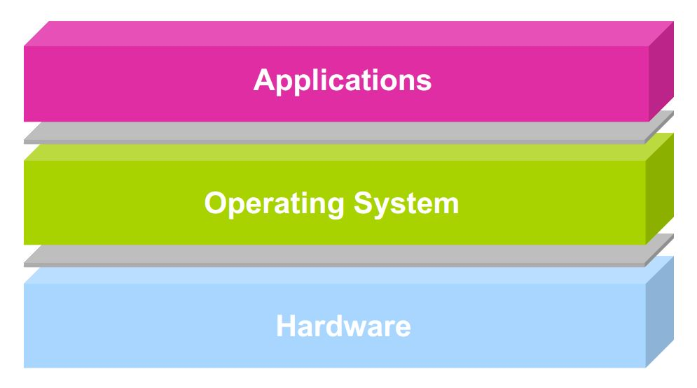
Architectural Support for OS
Operating systems mediate between applications and the physical hardware of the computer
Key goals of an OS are to enforce protection and resource sharing
If done well, applications can be oblivious to HW details

Slide 6
Challenge: Protection
Why do we execute code with restricted privileges?
Either because the code is buggy or if it might be malicious
Some examples:
A script running in a web browser
A program you just downloaded off the Internet
A program you just wrote that you haven’t tested yet

Slide 7
Challenge: Resource Sharing
How do we ensure that resources are fairly (and efficiently) shared amongst (and utilized by) user programs?
Some examples:
Many students running code on a department machine
Amazon.com servicing concurrent users
Playing a movie on a computer while typing a project report and printing a document
A process wants to open a 1TB file, but the disk storage is limited to 512MB

Slide 8
Architectural Features The features we design in HW to facilitate the OS to meet some key challenges
Protection Modes (user/kernel)
Privileged Instructions
Interrupts and Exceptions
System Calls
Timers (clock)
Memory Protection Mechanisms
I/O Control and Operation
Synchronization Primitives (e.g., atomic instructions)

Slide 9
Dual-mode Operation
Dual-mode operation: Kernel vs. User
The same CPU is sometimes in User mode and at other times, in Kernel mode
Kernel-mode: Execution with the full privileges of the hardware
E.g. Read/write to any memory, access any I/O device, read/write any disk sector, send/receive any packet
User-mode: Execution with Limited privileges
Only those granted by the operating system kernel
On the x86, mode stored in EFLAGS register, which tells:
Whether the instruction should be checked or not
If set (i.e., in user mode), each instruction is checked to see if allowed
E.g., HALT is never allowed in user mode
Can your binary have HALT instruction at all if it is compiled right??
If not set (i.e., in kernel mode), no check is performed

Slide 10
Dual-mode Operation
Safe control transfer
Mode separation does NOT mean that a user program cannot request a Kernel-mode operation
User mode to kernel mode switch is very common (e.g., printf/cout, writing to a file)
How do we switch from one mode to the other?
Such that the protection is not compromised

Slide 11
A Simple CPU Model
branch/jump address
… 100: ADD $rs, $rt, $rd
104: JEQ $r1, $r2, -100 …
+4
Program Counter (PC)
CPU Instruction Fetch & Exec
Select PC
Opcode (if branch/jump)

Slide 12
A CPU with Dual-Mode Operation
branch/jump address
+4
Program Counter (PC)
CPU Instruction Fetch & Exec
New PC
Select PC
Exception/ Interrupt Handler PC
New Mode
jump/branch?
Exception?
None?
Select Mode
Mode
Kernel
If trap?
RTU?
None?
User
Opcode

Slide 13
Dual-Mode Operation: Minimal Hardware Requirement
Privileged instructions
Subsect of instructions available only to the kernel
Limits on memory accesses
To prevent user code from overwriting the kernel or each other
Timer
To regain control from a user program periodically

Slide 14
Privileged Instructions - Examples
Only the OS should be able to
Directly access I/O devices (disks, printers..)
Allows OS to enforce security and fairness
User programs cannot possibly be fair to each other
Manipulate memory management state
E.g., page tables (Virtual-> Physical), protection bits, TLB entries, etc.
Although the processes use them all the time, processes should not be allowed to manipulate them – it would defeat the protection given by Virtual Memory
Adjust protected control registers
User ← → Kernel modes or Raise/Lower interrupt level
Execute the halt instruction (that shuts down the system)
A small cache for page tables

Slide 15
Question
What should happen if a user program attempts to execute a privileged instruction?

Slide 16
Memory Protection
A small cache for page tables
Memory management hardware provides protection. Examples:
Base and limit registers
Page table pointers, Page Protection, Translation Lookaside Buffer (TLB)
Manipulating memory management hardware uses protected (privileged) instructions

Slide 17
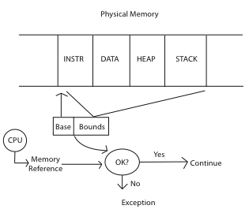
Memory Protection - Example

Slide 18
Memory Protection - Conclusion
Note that only base-bound checks are done only in the User mode, not in the Kernel model
Why??
Alternative thought: How about memory protection in software (i.e., in Kernel), not in h/w??

Slide 19
Hardware Timer
Operating system timer is a critical building block
Many resources are time-shared; e.g., CPU
Allows OS to prevent infinite loops
Fallback mechanism by which OS regains control
When timer expires, generates an interrupt
Handled by kernel, which controls resumption context
Basis for OS scheduler; more later…
Setting (and clearing) a timer is a privileged instruction

Slide 20
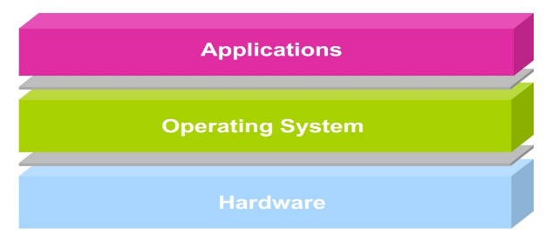
User → Kernel Mode Switch
From user-mode to kernel-mode
Interrupts
Triggered by timer and I/O devices
Checked by the CPU after every instruction
(Synchronous) Exceptions
Triggered by unexpected program behavior
Or malicious behavior!
System calls (traps) (aka protected procedure call)
Request by program for kernel to do some operation on its behalf
Only limited # of very carefully coded entry points

Slide 21
User-> Kernel Switch – Thoughts
Instead of interrupts being generated by I/O devices, can the OS poll the devices to detect activity??
Is there any issue with that?
How does a multi-processor system handles I/O interrupts?
Do all processors react, or only one?
How about other interrupts coming in while handling one interrupt??

Slide 22
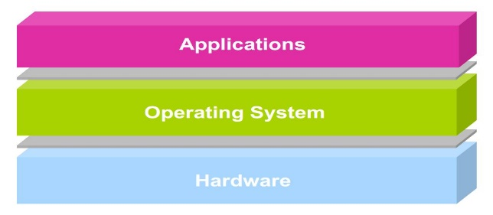
Kernel → User Mode Switch
From kernel-mode to user-mode
New process/new thread start
Jump to first instruction in program/thread
Return from interrupt, exception, system call
Resume suspended execution
Process/thread context switch
Resume some other process
User-level upcall
Asynchronous notification to user program by the kernel

Slide 23
Safe Mode Transfer – Interrupt Handling
The main idea is rather simple
Store everything about the currently running process (so that it can be resumed later)
Execute the handler
Return to the previous process by restoring the saved state
But the actual implementation is a bit more complicated
We first need to know which process info must be stored

Slide 24
Process State
To transparently replace the running process in the CPU, we need to store/retrieve some information:
Stack Pointer (SP) – points to the data
Program Counter (PC) – points to code
The Execution Flags register – contains processor state, e.g., overflow flag, if/else condition code (true/false) to make a jump
Also, the other general purpose registers
Because the current process might be using them
lw $a, 0($b)
add $a, $a, 1
sw $a, 0($b)
lw $a, 0($b)
add $a, $a, 1
sw $a, 0($b)

Slide 25
Main Problem of switching directly from User Code -> Interrupt Handler Code
The processor has only 1 set of SP, PC, EFLAGS etc.
Switching from User code to handler code means overwriting PC, SP etc. with the handle PC, SP etc.
But ALAS!!! We just lost the PC, SP for the user code
How can we ever recover those??
Quoting the Anderson book: “This is akin to rebuilding the car’s transmission while it barrels down the road 60mph”
Solution: Take hardware help
Clearly, any other code will also need PC, SP,..
Hardware does not need to use SP, PC to implement a logic

Slide 26
User to Interrupt Handler – Mechanism on x86
Hardware does the following:
Mask further interrupts (they are stored, not thrown away)
Save PC, SP, EFLAGS in some special registers in CPU
Change SP to point to the Kernel Interrupt Stack
Change mode to Kernel
Push PC, SP, EFLAGS in the special registers into the new stack the SP now points to (i.e., the Kernel Interrupt Stack)
Push the exception/interrupt code
Invoke the interrupt handler by vectoring through the Interrupt Vector Table (i.e., overwrite PC with the handler PC)
Software (i.e., the handler code) does the following:
Stores the rest of the general purpose registers being used by the interrupted process
Does the interrupt handling operation

Slide 27
Before
User-level Process
CPU
Kernel
foo (){ x = x + 1; y = y - 2; }
Registers
handler (){ pushad }
PC SP EFLAGS Other Regs
User Stack
Kernel Interrupt Stack
Interrupts Enabled

Slide 28
Hardware Action
User-level Process
CPU
Kernel
foo (){ x = x + 1; y = y - 2; }
Registers
handler (){ pushad }
PC SP EFLAGS Other Regs
User Stack
Kernel Interrupt Stack
Interrupts Disabled
Ex. Code
EFLAGS
PC
SP

Slide 29
As the Handler Starts
User-level Process
CPU
Kernel
foo (){ x = x + 1; y = y - 2; }
Registers
handler (){ pushad }
PC SP EFLAGS Other Regs
User Stack
Kernel Interrupt Stack
Interrupts Disabled
Other Regs
Ex. Code
EFLAGS
PC
SP

Slide 30
At the end of handler
Software does the following:
Handler code restores the saved general registers
Hardware does the following:
Restores PC, SP, EFLAGS
Switch to user mode

Slide 31
User-to-Kernel Mode – Handling System Calls
Locate arguments
In registers or on user stack
Copy arguments
From user memory into kernel memory
Protect kernel from malicious code evading checks
Validate arguments
Protect kernel from errors in user code
Copy results back
into user memory

Slide 32
System Calls
User Program
Kernel
foo(){ open(“test”,“rw”);
}
open_handler(arg1,arg2) { //do operation
}
(1)
(6)
(3)
(4)
User Stub
Kernel Stub
open(arg1,arg2){ push SYSOPEN trap return
}
(2)
open_handler_stub(){ //copy args from user memory //check args open_handler(arg1,arg2) //copy return value to user mem. return
}
(5)

Slide 33
Summary: User/Kernel (Privileged) Mode
User Mode
interrupt
FP exception
syscall
rtn
FP Exception error
rfi
Kernel Mode
exit
exec
Limited HW access
Full HW access
Notes:
Processor routinely checks for interrupts and if one is logged, it goes back to save the state of the process it is executing and enters the kernel to service the interrupt. The service is done by entering a interrupt vector table which contains the address of the specific interrupt service routine. Once the routine is serviced the kernel gives control back to the user process.
In multiprocessor systems, only one processor has to service the interrupt from an external device.
What happens when you move a mouse pointer? Each move or point or click registers as an interrupt which is noticed by the processor which moves the control back to the Kernel to service the interrupt routine and that shows up as an action to its associated process (e.g. move of mouse pointer in the active window, or highlight of a word selected, etc.)
An alternative to Interrupt would be “polling” where the Kernel would go in a round-robin fashion to check the status of each device to see if they have an interrupt.

Slide 34
Example: Web Server (Revisited)
syscall
syscall
syscall
RTU
RTU
wait
wait
interrupt
interrupt

Slide 35
Today’s Learnings
Architectural support for user and kernel modes in CPU execution, especially
Privileged Instructions
Protection
Timer
Interrupt/System Call handling
Most of the path switching User<->Kernel

Slide 36
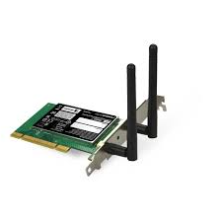



Next Lecture
Process and Programming Interface
user2
user3
user1
user2
user3
user4
user1
user4
Application Programs/Processes
System calls,
Exceptions
return
System calls,
Exceptions
Privileged
Operations
Processor
Memory
INT
Character O/P
Bock I/O
storage

