Slide 1
CSCE 313 – Unix fork and exec and the Programming Interface
Reading Reference:
Textbook: Chapter 3
Molay Reference Text: Chapter 8
Tanzir Ahmed CSCE 313 Spring 2018
Feb 9, 2018

Slide 2
Theme of Today’s Lecture
Talk a bit about Unix Shell
Introduce some key process control concepts
Executing a program from within another program
Creating a new process
Introducing Wait dependencies between parent and child processes

Slide 3
What is a Shell?
Shell is a program which
Runs programs
Manages inputs and outputs
Can be programmed
How about Windows Explorer in Windows or Ubuntu?
Effectively provides similar environments (i.e., can double click to launch a program)
Less programmable to some extent
Are these user apps or part of kernel?
User apps, because you can shut them down
Can crash, but the OS is OK

Slide 4
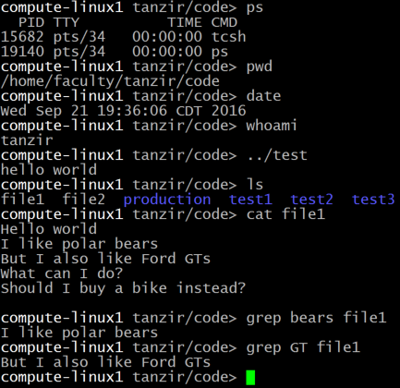
Shell – Running Programs
The commands ps, ls, grep, date, etc. are regular programs
The shell is just another user app (not kernel)
loads these programs into memory and runs them, with the help of System Calls

Slide 5
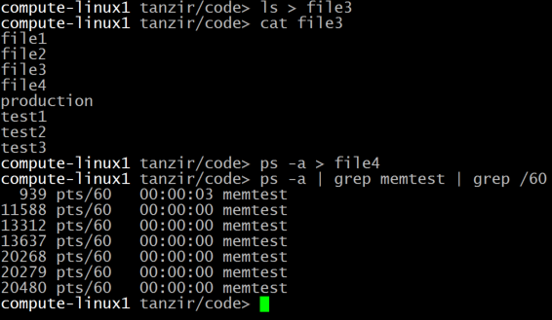
Shell – Managing I/O
Using ‘>’ (output redirect), ‘<’ (input redirect), ‘|’ (pipeline) etc. the output/input can be sent/recvd to/from a file , or to another process or even shell variables.
the default is standard output

Slide 6
If I ask you to write a Shell!!
I will do that for Programming Assignment 2
First thing to know:
How to run 1 program from another

Slide 7

How does a Program run another Program?
process
The current program makes a system call execvp(“othername”, arglist)
Kernel loads the “othername” executable from disk into the process
Kernel copies arglist into the process
Kernel calls main(arglist) of the othername program
1
3
array of strings
2
program to run

Slide 8
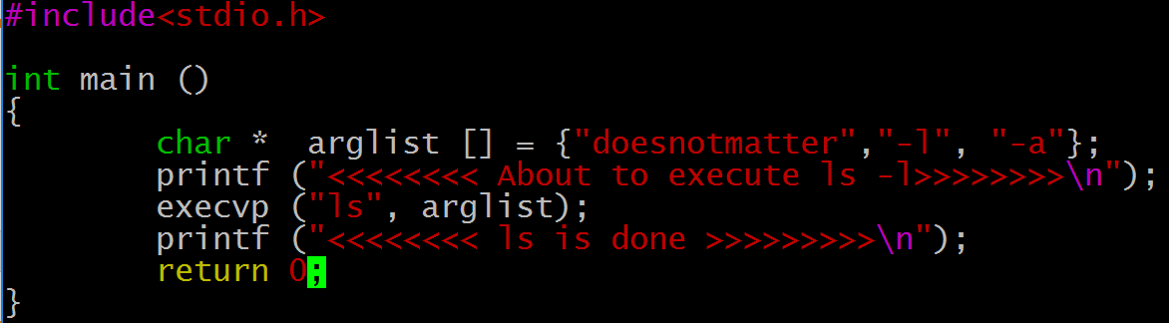
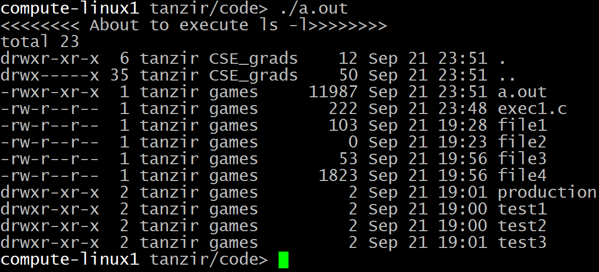
Example: One Program Running Another

Slide 9
Example: contd.
Where is the second message?
The exec system call clears out the machine language code of the current program from the current process and then in the now empty process puts the code of the program named in the exec call and then runs the new program
execvp does not return if it succeeds
execvp is like a brain transplant
Notes:
Reference: http://linux.about.com/library/cmd/blcmdl3_execvp.htm
Linux / Unix Command: execvp Command LibraryNAME
execl, execlp, execle, execv, execvp - execute a file SYNOPSIS
#include <unistd.h>extern char **environ;
int execl(const char *path, const char *arg, ...); int execlp(const char *file, const char *arg, ...); int execle(const char *path, const char *arg , ..., char * const envp[]); int execv(const char *path, char *const argv[]); int execvp(const char *file, char *const argv[]);
DESCRIPTION
The exec family of functions replaces the current process image with a new process image. The functions described in this manual page are front-ends for the function execve(2). (See the manual page for execve for detailed information about the replacement of the current process.)The initial argument for these functions is the pathname of a file which is to be executed.
The const char *arg and subsequent ellipses in the execl, execlp, and execle functions can be thought of as arg0, arg1, ..., argn. Together they describe a list of one or more pointers to null-terminated strings that represent the argument list available to the executed program. The first argument, by convention, should point to the file name associated with the file being executed. The list of arguments must be terminated by a NULL pointer.
The execv and execvp functions provide an array of pointers to null-terminated strings that represent the argument list available to the new program. The first argument, by convention, should point to the file name associated with the file being executed. The array of pointers mustbe terminated by a NULL pointer.
The execle function also specifies the environment of the executed process by following theNULL pointer that terminates the list of arguments in the parameter list or the pointer to the argv array with an additional parameter. This additional parameter is an array of pointers to null-terminated strings and must be terminated by a NULL pointer. The other functions take the environment for the new process image from the external variable environ in the current process.
Some of these functions have special semantics.
The functions execlp and execvp will duplicate the actions of the shell in searching for an executable file if the specified file name does not contain a slash (/) character. The search path is the path specified in the environment by the PATH variable. If this variable isn't specified, the default path ``:/bin:/usr/bin'' is used. In addition, certain errors are treated specially.
If permission is denied for a file (the attempted execve returned EACCES), these functions will continue searching the rest of the search path. If no other file is found, however, they will return with the global variable errno set to EACCES.
If the header of a file isn't recognized (the attempted execve returned ENOEXEC), these functions will execute the shell with the path of the file as its first argument. (If this attempt fails, no further searching is done.)
RETURN VALUE
If any of the exec functions returns, an error will have occurred. The return value is -1, and the global variable errno will be set to indicate the error.

Slide 10

How does the Shell Run Programs?
A. The user types a.out in the shell
D
B
$ a.out
New process
Shell
B. The shell creates a new process to run the program
Using syscall
process mgmt.
system
C. The shell loads the program
from the disk into the memory
Again, through syscall
C
D. The program runs in this new process until it is done
A
program
User
E. Shell regains control
Ref: Understanding Unix/Linux Programming by Bruce Molay

Slide 11
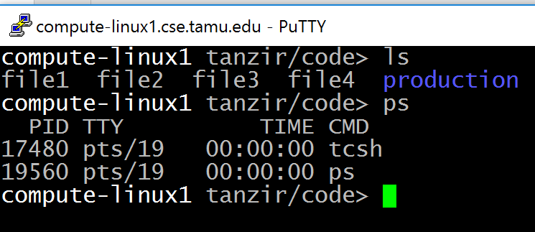
The Main Loop of a Shell
The shell consists of the following loop:
while (! end_of_input)
get command
execute command
wait for command to finish
Ref: Understanding Unix/Linux Programming by Bruce Molay

Slide 12
To Write a Shell, we need to…
Create a Process
Load and run a program in it.
Wait for Exit

Slide 13
How do we get a new process?
A process calls FORK to replicate itself
Usage: fork (); /* takes no arguments*/
After a process invokes fork, control passes to the KERNEL. The Kernel does this:
Allocates address space and data structures
Copies the original process into the new process
Adds the new process to the set of ready-to-run processes
So that the scheduler picks it up
Parent process
Child process
User
Before
fork()
After
Before
fork()
After
fork
Kernel
After Fork

Slide 14
How do we get a new process?
A process calls FORK to replicate itself
Usage: fork (); /* takes no arguments*/
After a process invokes fork, control passes to the KERNEL. The Kernel does this:
Allocates address space and data structures
Copies the original process into the new process
Adds the new process to the set of ready-to-run processes
Returns control back to both processes
User
Parent process
Child process
User
Before
fork()
After
Before
fork()
After
Before
fork()
After
Kernel
fork
fork
Kernel
Before Fork
After Fork

Slide 15
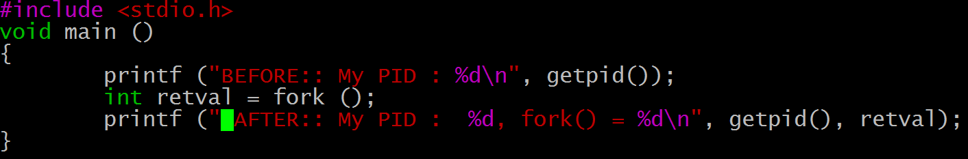
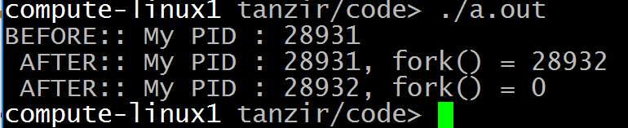
Example: Fork
Why is the “After” message printed twice but “Before” message only once?
Because Fork created a child process and both parent and child execute the rest of the code following the fork

Slide 16
Example: Fork
Why is the “After” message printed twice but “Before” message only once?
Parent process
Child process
Before
fork()
After
Before
fork()
After
Before
fork()
After
fork
fork
Before Fork
After Fork

Slide 17
wait: Synchronizing With Children
int wait(int *child_status)
Suspends current process until one of its children terminates
Return value is pid of child process that terminated
If child_status != NULL, then integer it points to will be set to indicate why child terminated

Slide 18
wait: Synchronizing With Children
Void wait_demo() {
int child_status;
if (fork() == 0) {
printf("HC: hello from child\n");
}
else {
printf("HP: hello from parent\n");
wait(&child_status);
printf("CT: child has terminated\n");
}
printf("Bye\n");
exit(0);
}
HC
Bye
HP
CT
Bye

Slide 19
Key Learnings Today
Shell Basics
Replacing Program Executed by Process
Call execv (or variant)
One call, (normally) no return
Spawning Processes
Call to fork
One call, two returns
Reaping Processes
Call wait

