Slide 1
Concurrency and Threads
Reading Reference:
Textbook: Chapter 4 (Section 4.1-4.4)
Tanzir Ahmed CSCE 313 Spring 2018
March 5, 2018

Slide 2
Today’s Conversation
Threads
A bit complex topic but central to our understanding of modern computer systems (HW and SW)
We will build concepts incrementally and tie the picture together at the end
Adapted from contemporary courses in OS/Systems taught at Berkeley, UW, TAMU,
UIUC, and Rice. Special acknowledgment to Profs Gu/Bettati at TAMU, Culler and
Joseph at Berkeley

Slide 3
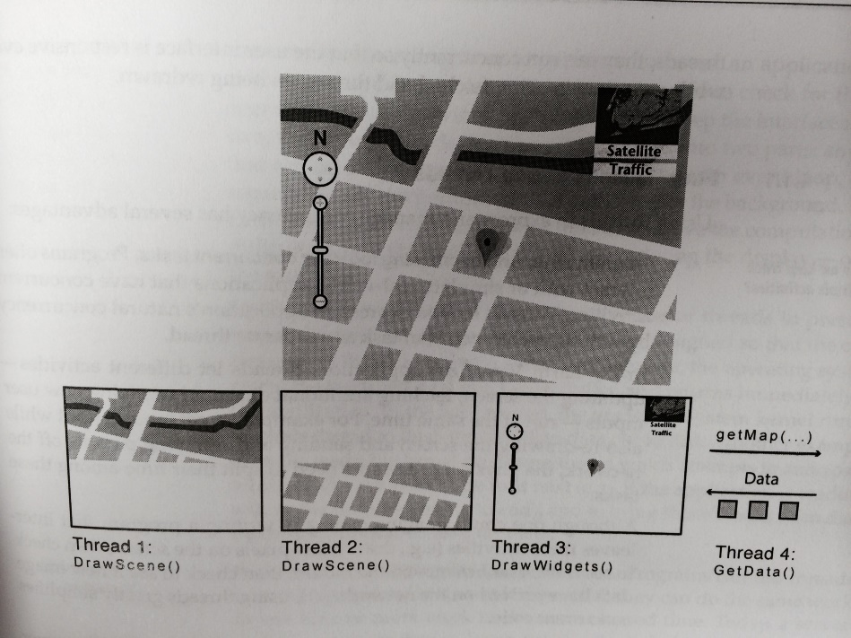
Let’s picture this scenario
Processes
thread
thread
thread
thread
Multiple programs (processes) doing their individual functions
Isolation is rather a trouble than a benefit
Paying the cost of context switching
What if we could reduce the cost of
Context switches
Sharing of data
Credit – NASA Earth Observatory
Two ‘threads’ each draw parts of the scene, a third ‘thread’ manages the user interface widgets, and a fourth ‘thread’ fetches new data from the remote server
In a ‘traditional program’ these will be sequenced
Key differentiation is “facilitated concurrency”.
A traditional program is a single ‘thread’
Inside a program, we can represent each concurrent task as “Thread”

Slide 4
Why Processes & Threads?
Goals:
Multiprogramming: Run multiple applications concurrently
Protection: Don’t want a bad application to crash system!
Solution:
Virtual Machine abstraction: give process illusion it owns machine (i.e., CPU, Memory, and IO device multiplexing)
Process: unit of execution and allocation
Challenge:
Process creation & switching expensive
Need concurrency within same app (e.g., web server)
Solution:
Thread: Decouple allocation and execution
Run multiple threads within same process
Notes:
Multiprogramming: Older idea than multi-tasking, run jobs concurrently (load several into memory), but not necessarily “interactively”.

Slide 5
Motivation for Threads
Process Context Switch has huge overhead. Requires switching:
CPU state (PC, PSW, all registers etc) - fast
Memory Address Space - SLOW
Assumption: memory access without cache is slow
A Memory Address Space comes with:
Virtual Memory System data
Page tables (mapping) and Translation Look-aside Buffer (TLB) (i.e., working as cache for mapping)
Actual memory content
Dirty (modified) pages that are updated only in cache, not in memory
Need to be updated in the memory before switch
All of these become obsolete when after a switch
All caches (L1, L2, ..), TLB become COLD
Require time to WARM UP as the new process runs

Slide 6
Thread Context Switch
Still requires:
The kernel scheduler to run, that overhead stays
Save the current CPU context, and load the next one
But, the old address space stays. Thus, no WARM UP required for:
Caches (L1, L2, L3, …)
TLB (cache for memory mapping)
Result: Thread Context Switch is much Faster than Process Context Switch
Saves time

Slide 7
Threads in Use
Operating systems need to be able to handle multiple things at once (MTAO)
processes, interrupts, background system maintenance
Servers need to handle MTAO
Multiple connections handled simultaneously in a Web Server
Parallel programs need to handle MTAO
To achieve better performance
Programs with user interfaces often need to handle MTAO
To achieve user responsiveness while doing computation
Network and disk bound programs need to handle MTAO
To hide network/disk latency

Slide 8
Putting it together: Process
(Unix) Process
A(int tmp) {
if (tmp<2)
B();
printf(tmp);
}
B() {
C();
}
C() {
A(2);
}
A(1);
…
Process
Memory
threads
Mem.
I/O State
(e.g., file, socket contexts)
…
IO
state
CPU
state
CPU
state
CPU state (PC, SP, registers..)

Slide 9
Putting it together: Processes
Process 1
Process 2
Process N
Process Switch overhead: high
CPU state: low
Memory/IO state: high
Process creation: high
Protection
CPU: yes
Memory/IO: yes
Sharing overhead: high (involves at least a context switch)
Mem.
Mem.
Mem.
IO
state
IO
state
…
IO
state
CPU
state
CPU
state
CPU
state
CPU sched.
OS
1 process at a time
CPU
(1 core)

Slide 10
Putting it together: Threads
One Process
threads
Thread Switch overhead: low
Only CPU state switched
Thread creation: low
Protection
CPU: yes
Memory/IO: No
Sharing overhead: low
No context switches
Only low-overhead thread-switches
Mem.
…
IO
state
CPU
state
CPU
state
CPU sched.
OS
1 thread at a time
CPU
(1 core)

Slide 11
Thread Abstraction
Infinite number of processors
Threads execute with variable speed
Programs must be designed to work with any schedule
Notes:
Execution model: each thread runs on a dedicated virtual processor with unpredictable and variable speed.

Slide 12
Programmer vs. Processor View

Slide 13
ATM Bank Server
ATM server problem:
Service a set of requests
Do so without corrupting database
Don’t hand out too much money

Slide 14
ATM bank server example
Suppose we wanted to implement a server process to handle requests from an ATM network:
BankServer() { while (TRUE) { ReceiveRequest(&op, &acctId, &amount); ProcessRequest(op, acctId, amount); } }
ProcessRequest(op, acctId, amount) { if (op == deposit) Deposit(acctId, amount); else if … }
Deposit(acctId, amount) { acct = GetAccount(acctId);/*may use disk I/O */ acct->balance += amount; StoreAccount(acct); /* Involves disk I/O */ }
How could we speed this up?
More than one request being processed at once
Multiple threads (multi-proc, or overlap comp and I/O)

Slide 15
Can Threads Help?
One thread per request!
Requests proceed to completion, blocking as required:
Deposit(acctId, amount) { acct = GetAccount(actId); /* May use disk I/O */ acct->balance += amount; StoreAccount(acct); /* Involves disk I/O */ }

Slide 16
Can Threads Help?
Unfortunately, shared state can get corrupted: Thread 1 Thread 2 load r1, acct->balance load r2, acct->balance add r2, amount2 store r2,acct->balance add r1, amount1 store r1, acct->balance

Slide 17
Problem is at the lowest level
Most of the time, threads are working on separate data, so scheduling doesn’t matter:
Thread A Thread B
x = 1; y = 2;
However, What about (Initially, y = 12):
Thread A Thread B
x = 1; y = 2;
x = y+1; y = y*2;
What are the possible values of x?
Thread A Thread B
x = 1;
x = y+1;
y = 2;
y = y*2
x=13
Notes:
X could be (13, 5, 3)

Slide 18
Problem is at the lowest level
Most of the time, threads are working on separate data, so scheduling doesn’t matter:
Thread A Thread B
x = 1; y = 2;
However, What about (Initially, y = 12):
Thread A Thread B
x = 1; y = 2;
x = y+1; y = y*2;
What are the possible values of x?
Thread A Thread B
y = 2;
y = y*2;
x = 1;
x = y+1;
x=5
Notes:
X could be (13, 5, 3)

Slide 19
Problem is at the lowest level
Most of the time, threads are working on separate data, so scheduling doesn’t matter:
Thread A Thread B
x = 1; y = 2;
However, What about (Initially, y = 12):
Thread A Thread B
x = 1; y = 2;
x = y+1; y = y*2;
What are the possible values of x?
Thread A Thread B y = 2;
x = 1;
x = y+1;
y= y*2;
x=3
Notes:
X could be (13, 5, 3)

Slide 20
Summary
Threading is great for performance
Threading is tricky and carry hazards!
Let us look at an example.

