Slide 1
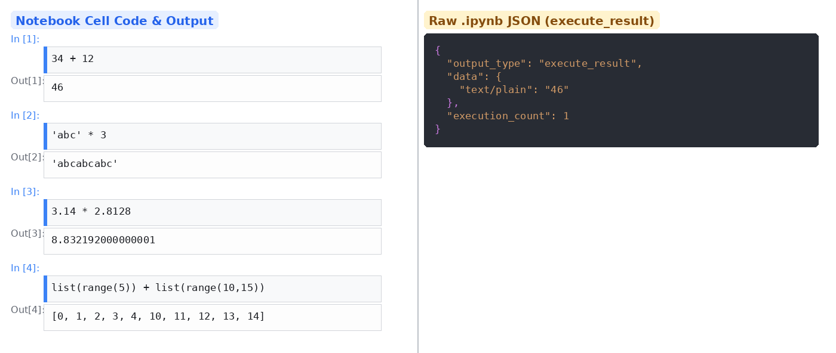
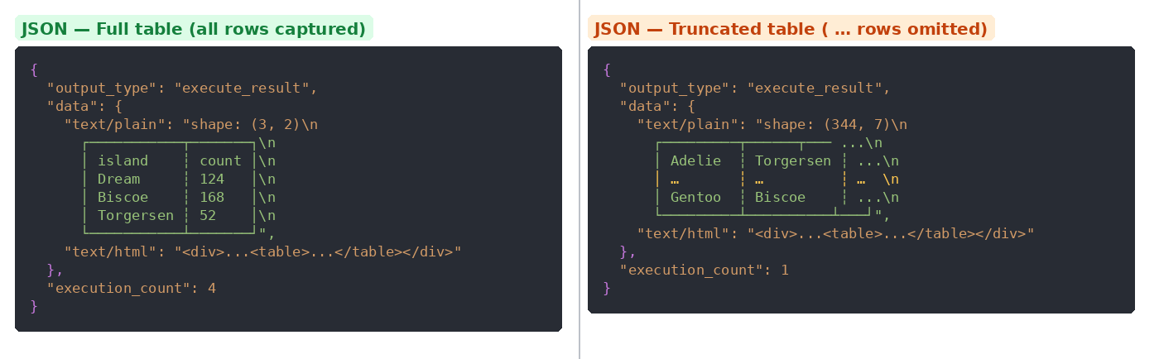
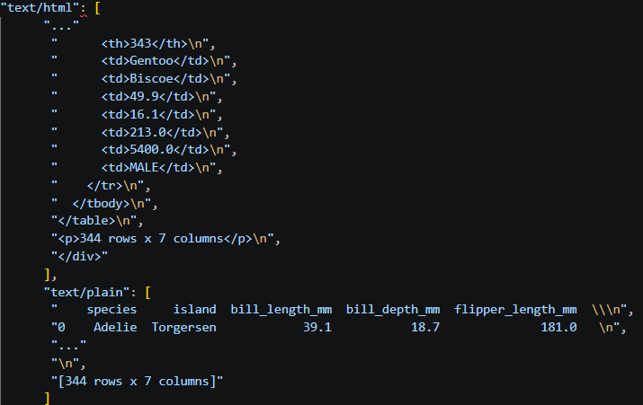
Evaluating the Reproducibility of Computational Notebooks
Jakobi McFadden, Sang Pham, David Koop Department of Computer Science, College of Liberal Arts & Sciences, Northern Illinois University
Introduction
Findings
Conclusion and
Future Work
Jupyter Notebooks are web-based computational notebooks used to run code split into cells
In all sciences, reproducibility–the ability to independently achieve the same results–is important in building trust
When a notebook is executed, output is both displayed below the cell of code that produced it and saved in the notebook
There are many factors involved in re-executing a notebook from years ago that may lead to different results
We can compare the saved outputs, but it is not always straightforward to determine if outputs match or are similar.
Approach
We developed and tested techniques for comparing notebook cell outputs. Jupyter stores each cell output in JSON, tagging it with a MIME type (e.g., text/plain, text/html). Some cell outputs (e.g., DataFrames) appear as multiple MIME types. The MIME type used determines how we extract and compare the data.
- This project developed an automated system for testing the reproducibility of Jupyter notebook outputs across a variety of Python data types.​
In the cases studied, we are operating under the assumption that all data is available in the outputs, libraries are installed, and
▶ Basic Types — int, float, str, list
Research Goal
How do we more accurately evaluate the reproducibility of results in computational notebooks?
Extraction: data["text/plain"] is read directly from each output.
Comparison: Straightforward equality check, does the before output == after output. (See basic JSON figure above.)
Methods
▶ Polars DataFrames
Existing studies of notebook reproducibility ([1],[2],3]) use binary comparison (an exact match is required) to evaluate reproducibility. There is evidence that this may be too stringent in some cases [4].
We were examined cases where Jupyter notebooks had external configuration changes that meant their outputs did not always match upon re-execution.
Our framework re-executes the original notebook, capturing fresh outputs for each cell, then compares them against the saved outputs cell by cell
For basic data types (integers, floats, strings, lists), comparison is usually straightforward, outputs are extracted and tested for direct equality, but some rounding errors can be evaluated using isclose() checks
For NumPy Arrays: Numeric computation differences and output configuration parameters can affect results. We can compare the visible sections.
For Polars DataFrames:
We use pl.from_repr() to reconstruct the saved DataFrame from its text representation, then compare it with the rerun output
If from_repr() fails due to truncated column values, we fall back to BeautifulSoup to parse the HTML output and compare shape, columns, and cell values
For Pandas DataFrames:
We parse the saved Pandas DataFrame using read_html() to reconstruct the DataFrame object, use the .eq() method to compare frame cells and compute a confidence score that indicates their similiarity based on visible output.
Acknowledgements
Thanks to the Office of Student Engagement and Experiential Learning for supporting this work.
Primary path: pl.from_repr() reconstructs a live DataFrame from text/plain.
Fallback: When from_repr fails, BeautifulSoup parses the text/html table.
Confidence score: 0.2 × shape + 0.8 × (matched cells / total). Handles truncated tables (shown with …).
▶ Pandas DataFrames
References
JSON – HTML and plain text representation
Primary path: pd.read_html reconstructs a live DataFrame from text/html.
Confidence score: How many trues and falses are found in our .eq table, 1 being true and any other value being less than 1 shows how close the two DataFrames are to being true.
[1] Pimentel, J.F., et al. "A Large-scale Study about Quality and Reproducibility of Jupyter Notebooks." MSR 2019.
[2] Pimentel, J.F., et al. "Understanding and Improving the Quality and Reproducibility of Jupyter Notebooks." EMSE 2021.
[3] Wang, J., et al. "Assessing and Restoring Reproducibility of Jupyter Notebooks." ASE 2020.
[4] Hossain, A. S. M. S., et al. "Similarity-Based Assessment of Computational Reproducibility in Jupyter Notebooks." ACM REP 2025.

