Slide 1
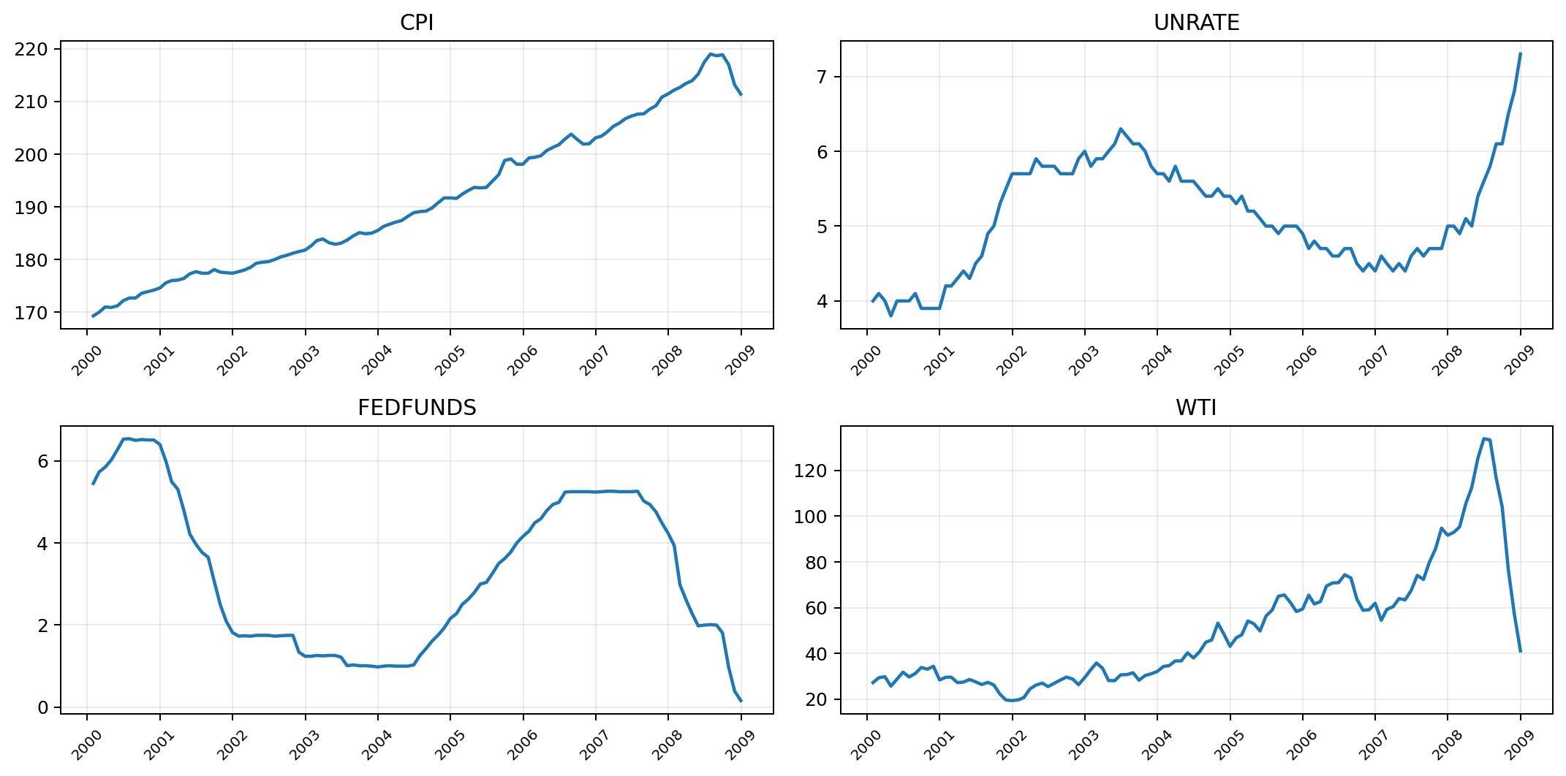
Finance & Economics
Time-Series Analysis
Data Science Bootcamp Project
Objective
Analyze historical financial and economic indicators (2000–2008) to identify trends, relationships, and predictive patterns using time-series analysis.
6
108
0
Economic indicators
Market behavior
Future trends
monthly series
monthly rows
raw missing
Midterm focus: clean and align the dataset before forecasting.
Notes:
[Sources] - User-uploaded notebook: /mnt/data/bootcamp_project.ipynb - User-uploaded FRED CSV files in /mnt/data

Slide 2
Problem Statement
Financial markets and the global economy are deeply interconnected.
Who benefits?
Key indicators such as GDP growth, inflation rates, interest rates, and stock market performance influence one another in complex ways.
Policymakers
Monitor inflation, growth, and rate conditions.
Challenge
Investors
Track cycles, volatility, and market timing signals.
Understanding these relationships is difficult, but essential for policy, investing, and business decisions.
Goal
Businesses
Plan pricing, production, and financing decisions.
Use data analysis and modeling to uncover patterns and support better decision-making.

Slide 3
Project Objectives
1
Analyze economic and financial data from 2000–2008.
2
Identify trends and correlations between indicators.
3
Detect anomalies and irregular patterns.
4
Prepare the dataset for predictive modeling.
5
Build a foundation for time-series forecasting.
Goal: move from raw files to forecasting-ready data

Slide 4
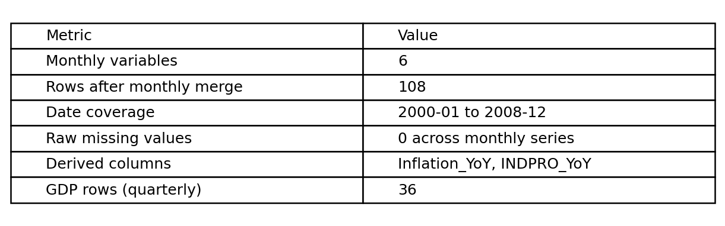
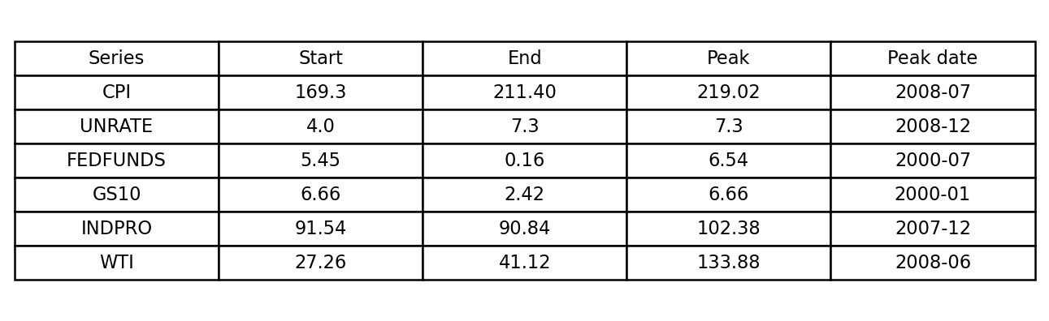
Dataset Overview
Dataset
Finance & Economics Time-Series Dataset
Time Period
2000 – 2008
GDP (kept separately as quarterly)
Inflation proxy: CPI and Inflation_YoY
Interest rates: FEDFUNDS and GS10
Economic indicators: UNRATE, INDPRO, WTI
Stock market index can be added later as an extension
Data Type
Time-series data collected at regular intervals.
Notes:
[Sources] - User-uploaded notebook and CSV files in /mnt/data

Slide 5
Task 1: Dataset Exploration
Objective
Understand the structure and characteristics of the dataset before modeling.
Steps Performed
Examined dataset shape and dimensions.
Identified time range and frequency.
Reviewed key variables.
Generated summary statistics.
Visualized trends using time-series plots.
Why This Matters
Good analysis starts with understanding the data.
Notes:
[Sources] - Plot recreated from user-uploaded CSV files in /mnt/data

Slide 6
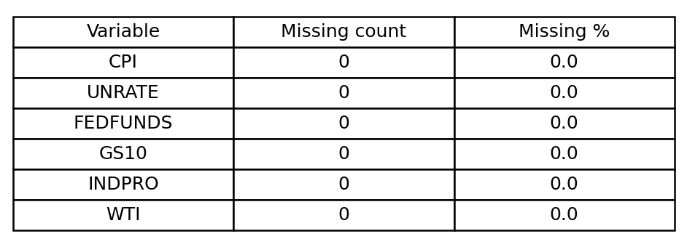
Identifying Data Issues
During exploration, we checked for
Actual finding in this notebook
Missing values
Outliers
Inconsistent data entries
Sudden spikes or drops
Data gaps in time periods
Common Causes
Result: the six monthly FRED series had 0 raw missing values after filtering to 2000–2008 and merging by month.
Reporting delays
Measurement errors
System failures
Market disruptions
Main issue to manage later: GDP is quarterly, so it does not align naturally with the monthly table.
Notes:
[Sources] - Missing-value results from user-uploaded notebook and CSV files

Slide 7
Task 2: Data Cleaning & Preprocessing
Objective
Prepare the dataset for accurate analysis and modeling.
1
2
3
4
5
Handling missing values
Fixing inconsistent records
Standardizing data formats
Aligning time intervals
Ensuring data quality
Notebook output saved as finance_econ_cleaned_2000_2008.csv

Slide 8
Handling Missing Data
Methods Used
Actual result in the notebook
Interpolation
Forward Fill
Backward Fill
Data transformation
Why This Matters
Missing data can distort trends, reduce model accuracy, and lead to incorrect conclusions.
For the six monthly series, the raw merged dataset had no missing values in 2000–2008.
The fill methods remain in the code as a safeguard for future extensions.
The main expected NaN values come from year-over-year transformations in the first 12 months.
Notes:
[Sources] - Missing-value results from user-uploaded notebook and CSV files

Slide 9
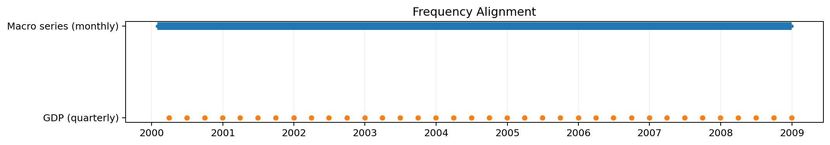
Time Index Alignment
Financial and economic data often come in different frequencies.
Examples
Stock prices → Daily
Inflation → Monthly
GDP → Quarterly
Result
Solution
Consistent dataset
Easier comparison
Reliable modeling
108 monthly observations
We aligned the current core indicators to a common monthly frequency and kept GDP separate for later quarterly analysis.
Notes:
[Sources] - Frequency chart recreated from user-uploaded CSV files

Slide 10
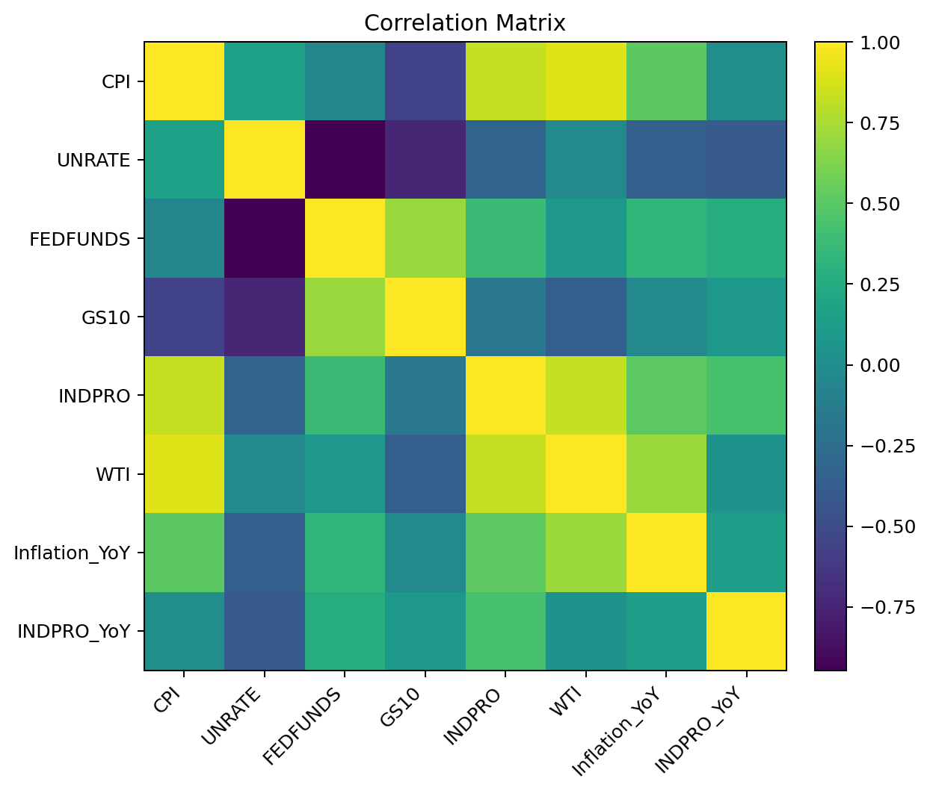
Key Takeaways
Financial and economic indicators are interconnected.
Data quality is critical for reliable analysis.
Time-series preprocessing improves model performance.
Clean data enables better forecasting.
Next Step
Build predictive models such as ARIMA, VAR, or other forecasting approaches for the cleaned dataset.
Preview of the final-stage direction:
use the cleaned monthly table to test stationarity, inspect lags, and compare forecasting models.
Notes:
[Sources] - Correlation heatmap recreated from user-uploaded CSV files

