Slide 1

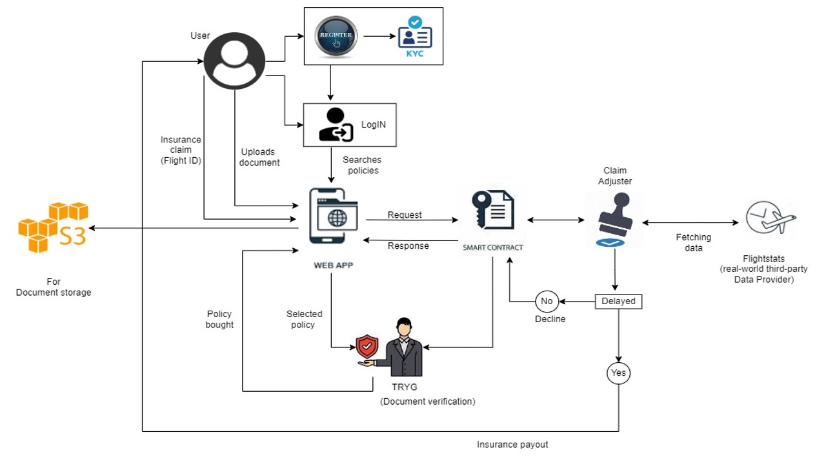
Travel Insurance
BANKING & FINANCE
INSURANCE
CUSTOMER REQUIREMENT
Business Problem
Traditional travel insurance policies are often associated with lengthy processes and high administrative costs, resulting in slow claims processing and low customer satisfaction.​
With travel insurance using blockchain, policies are recorded on a decentralized blockchain ledger, which allows for secure and transparent management of policy data and it will provide efficient way to manage insurance policies and claims.
Smart contracts are self-executing contracts with the terms of the agreement between the policyholder and the insurer being directly written into lines of code.
The code and the agreements contained therein exists on a decentralized blockchain network, which automatically executes payment when certain pre-determined conditions are met. ​
HCLTech Approach
Blockchain could facilitate a decentralized claims processing system, where multiple parties could verify and approve claims, rather than relying on a centralized authority.
This would increase transparency and reduce the risk of fraud or errors.
Benefits
Blockchain Ledger Details
Payment Instructions | Insurance Instructions | User KYC Details | Policy Details | Transaction Details

