Slide 1



Amazon Sales Report Analysis
KARAN MODI (100860930)

Slide 2

Introduction
Dataset contains 18,170 records regarding sales reports are included in the dataset, which has 25 columns. Some the important columns are:
Order Number, Date, Status, and Completion: monitoring the status and specifics of orders. It helps to tract the lifecycle of orders.
Sales Channel, Courier Status, and Ship-service-level: Provides information about supplying logistical data.
Size, Style, SKU, and Category: Describing the product in detail.
Amount, Real Price, Promotion IDs, and Business-to-business: Pertaining to pricing and sales.
This Dataset provides the information about the online sales with meaningful information about the sales providers with their profit, amount and sales status along with user’s age and location.

Slide 3
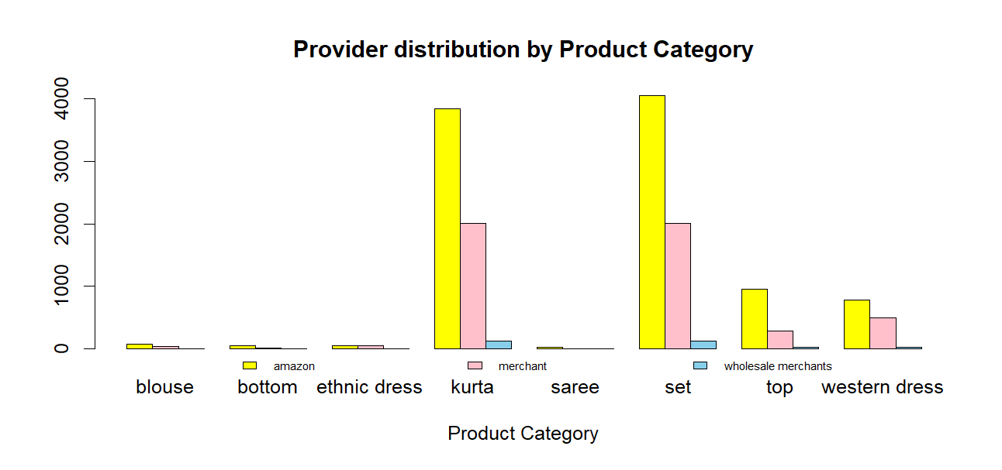
Provider Distribution by category
The graph "Provider Distribution by Product Category" displays the distribution of product providers (Amazon, Merchant, Wholesale Merchants) across various product categories.
Kurta and Set categories dominate with the highest sales, primarily fulfilled by Amazon (yellow bars).
Merchants (pink bars) contribute significantly but remain secondary.
Top and Western Dress:
These categories have moderate sales, with Amazon leading, followed by Merchants.
Other Categories (Blouse, Bottom, Ethnic Dress, Saree):
These categories show minimal sales, with a smaller contribution from all providers.

Slide 4
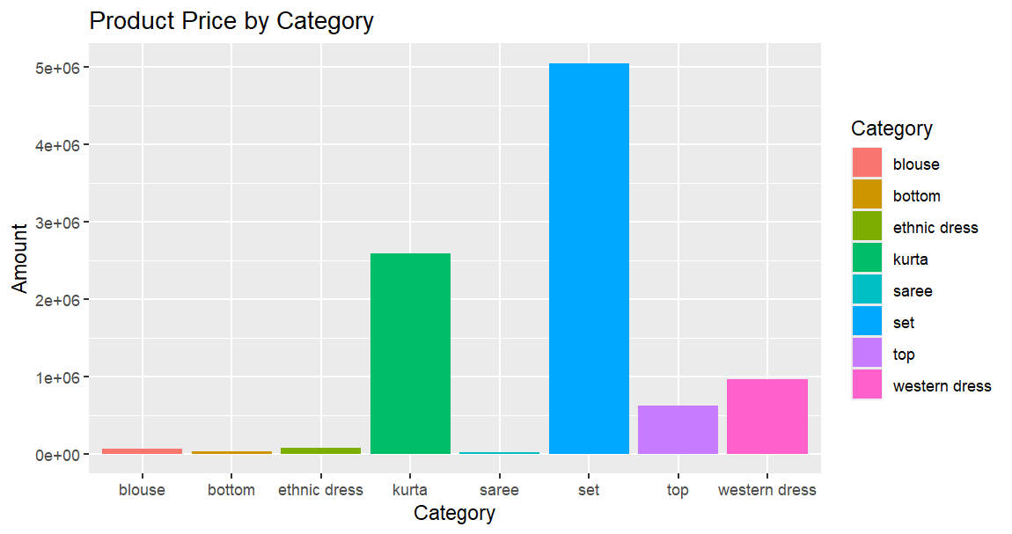
Price by category
“Product Price by Category” compares the prices of various clothing items.
The x-axis lists categories like blouse, bottom, ethnic dress, kurta, saree, set, top, and western dress, while the y-axis shows prices in an exponential format (1e+06).
Saree: Significantly higher price, close to 4e+06.
Kurta: Second highest, slightly above 2e+06.
Other Categories: All below 1e+06
The graph highlights a substantial price difference among clothing categories, with sarees being the most expensive.

Slide 5
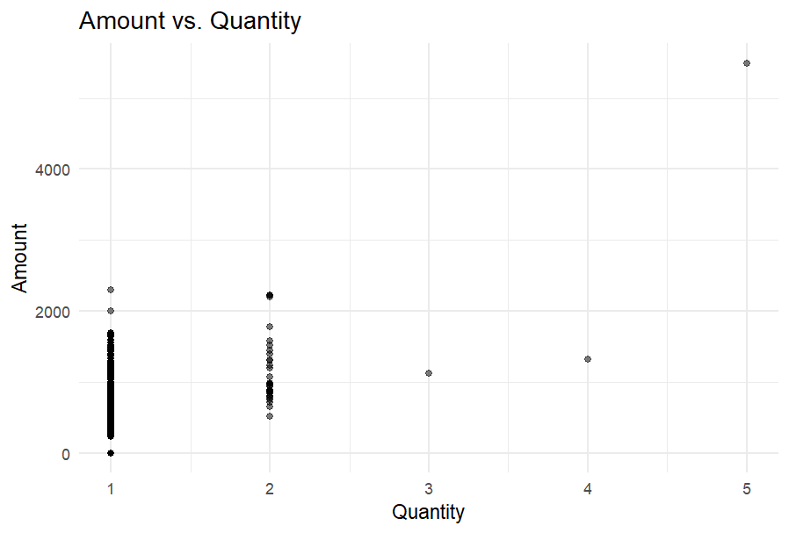
Amount Vs Quantity
“Amount vs. Quantity” shows the relationship between the quantity of items and their corresponding amounts.
Axes:
X-axis (Quantity): Ranges from 0 to 5.
Y-axis (Amount): Ranges from 0 to 4000.
Data Points:
Most points are clustered between Quantity values of 1 and 2 and Amount values near zero.
A few outliers reach up to an Amount of 2500.

Slide 6
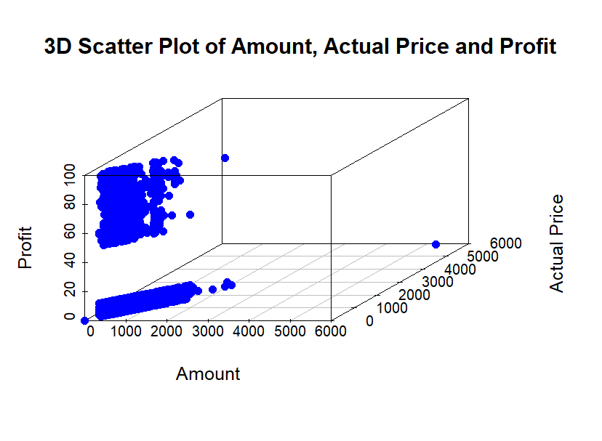
3D Plot of amount, actual price, and profit
X-axis (Amount): Ranges from 0 to 6000.
Y-axis (Actual Price): Ranges from 0 to 6000.
Z-axis (Profit): Ranges from 0 to 4000.
Data Points:
Most points are clustered in the lower left corner, indicating low amounts, actual prices, and profits.
A notable outlier shows higher values for all three variables

Slide 7
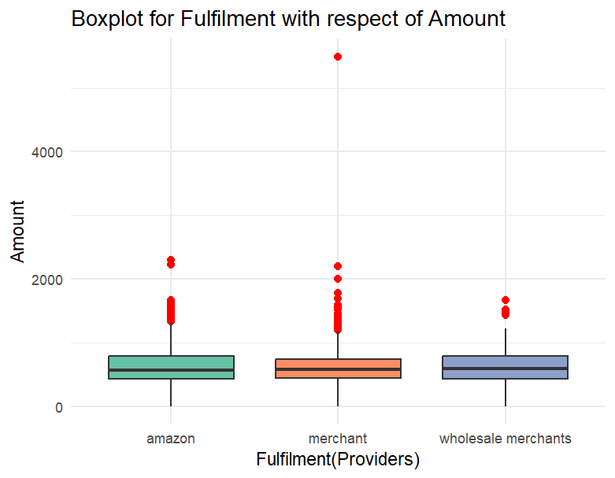
Boxplot for Fulfilment with respect of Amount
X-axis (Fulfilment Providers): Categories include amazon, merchant, and wholesale merchants.
Y-axis (Amount): Ranges from 0 to 4000.
Boxplots:
Amazon: Smallest range, less variability, several high-value outliers.
Merchant: Greater variability, higher fulfilment amounts, several high-value outliers.
Wholesale Merchants: Similar range to merchants but with a lower median and fewer outliers.

Slide 8

Text mining
Text mining results from sales review data of electronic products, specifically memory cards.
Prominent Words: “card,” “memory,” “phone,” “storage,” “32gb,” “speed,” “Samsung,” “tablet,” “music,” “Sandisk.”
Visualization: Larger words indicate higher frequency in reviews, highlighting key aspects customers focus on.
The word cloud effectively summarizes common themes in customer feedback, useful for analyzing market trends and improving product features.

Slide 9

Insights
Online dominates fulfillment across most product categories, particularly in Kurta and Set. Merchants contribute to a lesser extent, while Wholesale Merchants have a minimal presence.
lower Amount values for smaller Quantities, with some variation as Quantity increases. Pattern indicates a potential relationship.
Most transactions involve low amounts and prices, resulting in lower profits. However, higher amounts and prices can lead to significantly higher profits, as indicated by the outlier.
Distinct characteristics in fulfilment amounts among providers. Merchants show higher variability and potential for higher values, while Amazon has less variability but includes some high-value outliers. Wholesale merchants have a similar distribution to merchants but generally lower values.

Slide 10
Thank you!
KARAN MODI (100860930)

