Slide 1
Cyber Security
Engr. Ringko Kabiraj
Analyst (Server & Cloud Security)
National Data Center, BCC
HCNA, RHCSA, RHCE, CEH, CHFI, CLOUD, VIRTUALIZATION, CTFL@ISTQB, Agile@ISTQB, NCP, ECA Certified

Slide 2
Introduction
Security is freedom from, or resilience against, potential harm (or other unwanted coercive change) caused by others.
Cyber security is the practice of defending computers, servers, mobile devices, electronic systems, networks, and data from malicious attacks.
Cyber security refers to the technologies and processes designed to protect computers, networks and data from unauthorized access and attacks delivered via the internet by cyber criminals

Slide 3
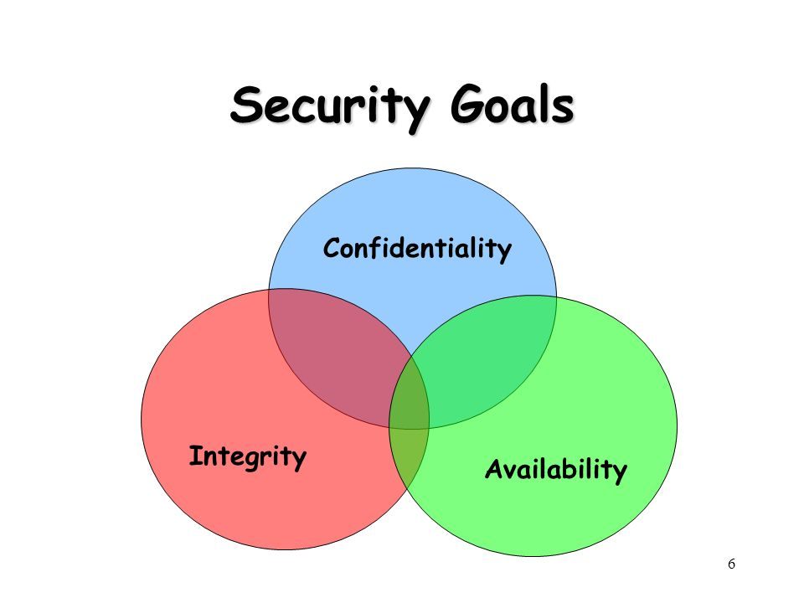

Slide 4
Types of Cyber Crime
Hacking
Phishing
Denial of Service (DoS)
Distributed Denial of Service (DDoS)
Spam Email
Spyware, Adware
Malware (Trojan, Virus, Worms etc. )
Ransomware

Slide 5
CHALLENGES OF CYBER SECURITY
Network security: The process of protecting the network from unwanted users, attacks and intrusions.
Application security: Apps require constant updates and testing to ensure these programs are secure from attacks.
Endpoint security: Remote access is a necessary part of business, but can also be a weak point for data. Endpoint security is the process of protecting remote access to a company’s network.
Data security: Inside of networks and applications is data. Protecting company and customer information is a separate layer of security.
IoT Security: Internet of Things Security (IoT Security) comprises protecting the internet-enabled devices that connect on wireless networks.

Slide 6
CHALLENGES OF CYBER SECURITY
Identity management: Essentially, this is a process of understanding the access every individual has in an organization.
Database and infrastructure security: Everything in a network involves databases and physical equipment. Protecting these devices is equally important.
Cloud security: Many files are in digital environments or “the cloud”. Protecting data in a 100% online environment presents a large amount of challenges.
Mobile security: Smart phones and tablets involve virtually every type of security challenge in and of themselves.
Disaster recovery/business continuity planning: In the event of a breach, natural disaster or other event data must be protected and business must go on.

Slide 7
Hacking & Types
Hacking:
Hacking is the process of gaining unauthorized access into a computer system, or group of computer systems. This is done through cracking of passwords and codes which gives access to the systems.
Types:
Black Hat
White Hat
Grey Hat

Slide 8
Types of Hacking
Website/Application Hacking
Network Hacking
Ethical Hacking
Password Hacking
Online Banking Hacking
Computer Hacking
DNS Poisoning
SQL Injection
DOS
DDOS
Ransomware
XSS

Slide 9
Foundations of Security
Cloud Security
Web Security
Securing Operating Systems
Encryption
Data Backup and Disaster Recovery
Internet Security
Secure Network Connections
Secure Email Communications
Social Engineering and Identity Theft
Security on Social Networking Sites
Securing Mobile Devices
Latest Cyber Attacks and role of Bangladesh Government

Slide 10



