Slide 1


Perception and Computer Vision (IS 106)
Introduction to Computer Vision and Image Processing
Caburnay, Carlo R. BSCS4-B

Slide 2


What is computer vision?
Computer vision is a field of artificial intelligence (AI) that uses machine learning and neural networks to teach computers and systems to derive meaningful information from digital images, videos and other visual inputs—and to make recommendations or take actions when they see defects or issues. If AI enables computers to think, computer vision enables them to see, observe and understand
Computer vision works much the same as human vision, except humans have a head start. Human sight has the advantage of lifetimes of context to train how to tell objects apart, how far away they are, whether they are moving or something is wrong with an image.

Slide 3
What is computer vision?
Computer vision trains machines to perform these functions, but it must do it in much less time with cameras, data and algorithms rather than retinas, optic nerves and a visual cortex. Because a system trained to inspect products or watch a production asset can analyze thousands of products or processes a minute, noticing imperceptible defects or issues, it can quickly surpass human capabilities.

Slide 4

The Role of Image Processing in AI
Enhancement of Image Quality
Image processing techniques, like filtering and noise reduction, help improve the quality of images by removing distortions or enhancing specific features.
Ex. clarity of X-ray or MRI scans
Feature Extraction
AI systems rely on image processing to extract meaningful features from raw image data, such as edges, textures, and patterns. Ex. in facial recognition, detecting features like eyes, nose, and mouth is crucial for identifying individuals.

Slide 5

The Role of Image Processing in AI
Image Manipulation:
Image manipulation involves transforming images through techniques like rotation, scaling, or adjusting brightness. This allows AI systems to handle various image perspectives and lighting conditions.
Ex. in autonomous vehicles, manipulating image data helps the system recognize objects under different conditions like rain or night.
Image Segmentation
Image processing divides an image into meaningful parts or objects. This segmentation helps AI systems focus on specific objects or regions. Ex. In satellite imagery, AI can segment land areas to differentiate between forests, water bodies, and urban areas.

Slide 6
The Role of Image Processing in AI
Efficient Data Analysis
AI systems need processed images to perform efficient analysis. By reducing image complexity and highlighting important features, image processing enables faster and more accurate analysis.
Ex. In security surveillance, AI systems can analyze processed video frames to detect suspicious activity more efficiently.

Slide 7
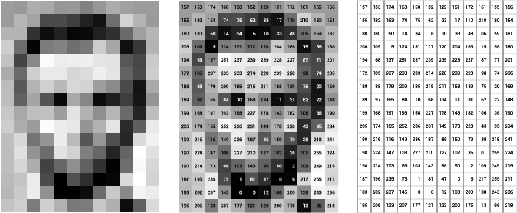
Image Processing Techniques in AI
Filtering
Filtering is used to enhance or suppress parts of an image by modifying pixel values.
Improves image quality by removing noise, smoothing, or sharpening the image.
Types of Filters:
Gaussian Filter: Reduces noise and smoothens the image.
Sharpening Filter: Enhances edges and makes features more distinct.

Slide 8
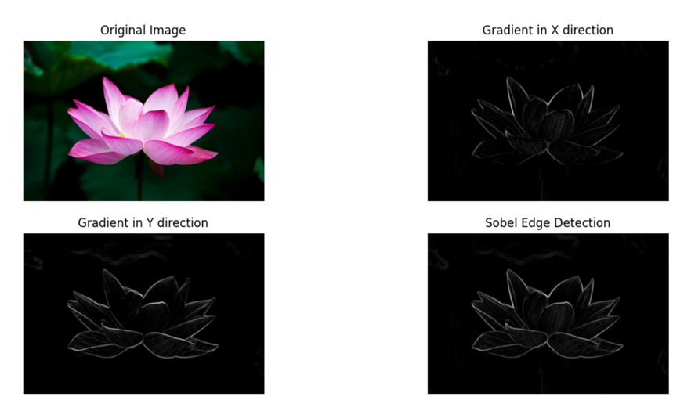
Image Processing Techniques in AI
Edge Detection
Detects the boundaries within an image where there is a sharp change in intensity (edge).
Helps identify object shapes and boundaries, crucial for object recognition.
Common Algorithms
Canny Edge Detection: A multi-stage process that detects edges with precision.
Sobel Operator: Identifies gradients and highlights areas of significant change.

Slide 9
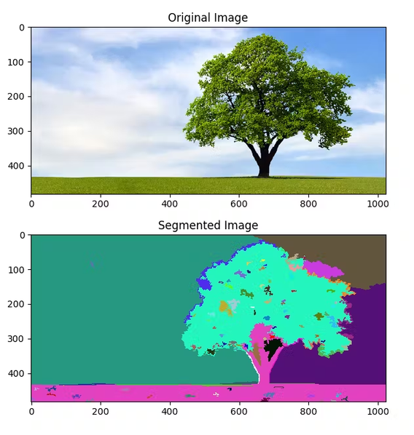
Image Processing Techniques in AI
Segmentation
Segmentation divides an image into meaningful regions, such as separating objects from the background.Improves image quality by removing noise, smoothing, or sharpening the image.
Allows AI systems to focus on and analyze specific parts of an image.
Segmentation Techniques:
Thresholding: Classifies pixels based on intensity to separate foreground and background.
Watershed Algorithm: Treats pixel values as topographic surface and separates regions.
K-means Clustering: Groups pixels based on color and intensity similarity.

Slide 10


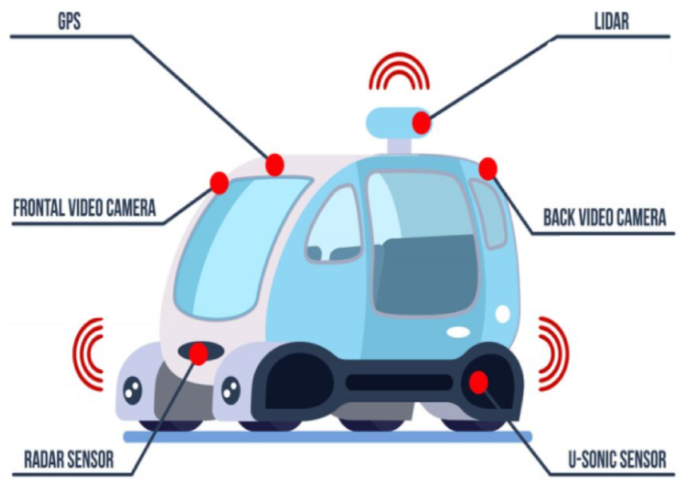
AI in Autonomous Vehicles
Case Study Selection: Autonomous Vehicles
Autonomous vehicles (self-driving cars) use AI and sensors to navigate and operate without human input.
AI that aims to improve road safety, reduce human error, and provide efficient transportation.
Role of Computer Vision:
Autonomous vehicles rely heavily on computer vision to "see" and interpret the environment, such as detecting other vehicles, pedestrians, traffic signs, and obstacles.

Slide 11
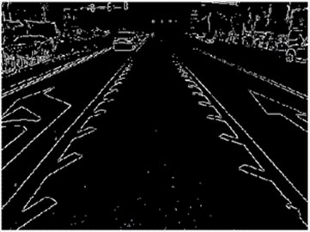
Key Image Processing Techniques in Autonomous Vehicles
1. Edge Detection
Identifies lane boundaries and road edges, helping the vehicle stay within the correct lane.
Example: The Sobel or Canny edge detection algorithms are applied to identify lane markings
Visual Example: Show an image of lane markings highlighted by edge detection.
Case Study Selection: Autonomous Vehicles

Slide 12
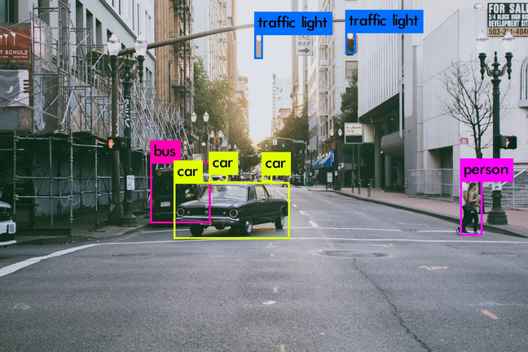
Key Image Processing Techniques in Autonomous Vehicles
2. Segmentation
Divides the visual field into regions to separate pedestrians, vehicles, and other objects from the background (road, buildings).
Example: The YOLO (You Only Look Once) algorithm is often used for real-time object detection.
Visual Example: Show detected objects in an image, such as a car recognizing stop signs or pedestrians.
Case Study Selection: Autonomous Vehicles

Slide 13
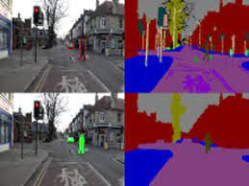
Key Image Processing Techniques in Autonomous Vehicles
3. Object Detection
Recognizes objects such as traffic signs, vehicles, or pedestrians and interprets their meaning (e.g., recognizing a stop sign).
Example: Segmentation techniques isolate important objects like pedestrians and other vehicles.
Visual Example: Show an example of image segmentation separating cars and pedestrians.
Case Study Selection: Autonomous Vehicles

Slide 14

Simple Problem: Lane Detection in Autonomous Vehicles
Detect lane markings on a road to guide an autonomous vehicle.
Lane detection ensures the vehicle stays in its lane, preventing accidents and ensuring safe navigation.

Slide 15
Simple Problem: Lane Detection in Autonomous Vehicles
Canny edge detection algorithm.
Step 1: Grayscale Conversion – Converts the input road image to grayscale to simplify processing.
Step 2: Gaussian Blur – Applies a blur to reduce noise and smooth the image for better edge detection.
Step 3: Edge Detection (Canny) – Identifies the edges (lane markings) based on changes in intensity.
Step 4: Hough Line Transform – Extracts straight lines from the detected edges to represent lane boundaries.

Slide 16

Conclusion
Image Processing is Essential: It enables AI systems to interpret visual data by enhancing, manipulating, and analyzing images.
Core Techniques Matter: Techniques like filtering, edge detection, and segmentation allow AI to extract meaningful information, such as identifying objects, recognizing patterns, and making decisions.

Slide 17
Conclusion
Autonomous Vehicles: Lane detection, obstacle recognition, and traffic sign detection are crucial for safe and efficient navigation.
Medical Imaging: AI systems use image processing for tasks like detecting diseases and analyzing X-rays or MRI scans.

Slide 18
Reflection
What I learned from this lesson is how AI, particularly in computer vision and image processing, works and what it can do. I saw that each technique used has its own specific function. For example, in autonomous vehicles, various functions contribute to safety, such as lane detection, which helps self-driving cars stay within their lanes by recognizing road markings. AI is incredibly powerful because it can be trained to improve accuracy and performance over time. This study highlighted the effectiveness of AI in enhancing technology and safety in practical applications.

Slide 19
Perception and Computer Vision (IS 106)
Thank you !
Caburnay, Carlo R.
BSCS-4B

