Slide 1

CASE STUDY
Locations for ASIAN FINE dine RESTAURANTS IN london

Slide 2
Introduction
An Asian fine-dining chain that serves Ramen, Pad Thai and other assorted dishes from East and South East Asia wants to make its foray into London and wants to find ideal locations for opening its restaurants.
The chain wants to open its restaurants in areas which do not already have a wide number of Asian restaurants
The restaurants need to be as close to Central London due to ease of commute.
The restaurants should be close to as possible to other rich areas, which have malls, business centres or tourists attractions, to attract the appropriate crowd.

Slide 3
Data
We need the following data for London neighborhoods:
Not filled with Asian or Fine-Dining restaurants.
Are closer to Central London.
Are in expensive areas or areas with high amounts of movement.
Are as close to Central London as possible.
The data is collected using the Google maps geocoding API and Foursquare API

Slide 4
Methodology
We find neighbourhoods that are the closest from London Center (less than 10 km)
We cluster the neighborhoods based on similarity.
We pick the neighborhoods which have high foot-traffic are posh and do not have many Asian fine dining restaurants.

Slide 5
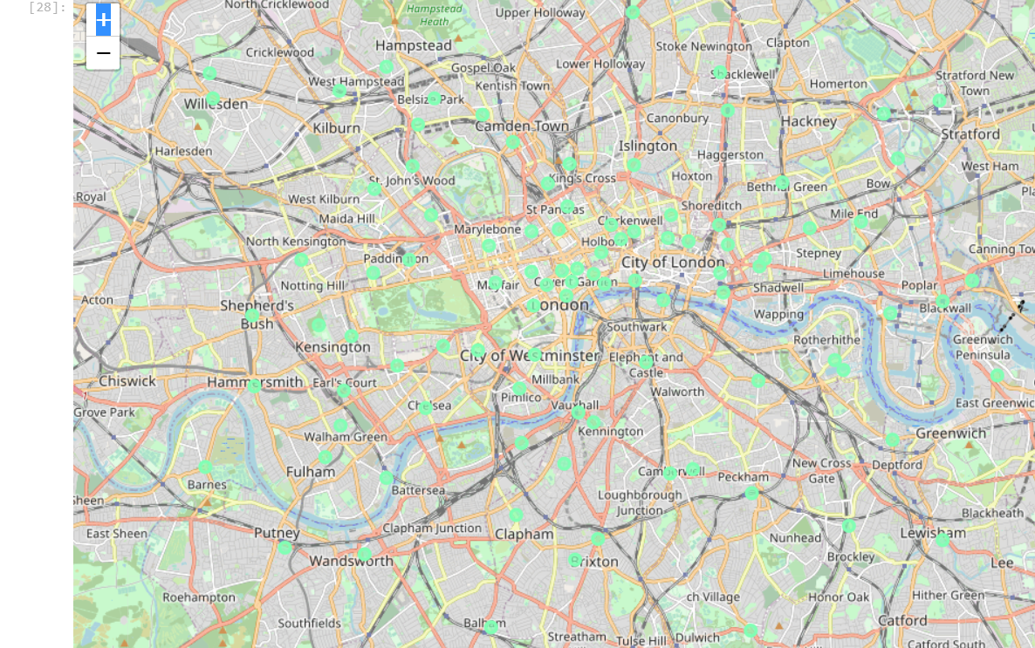
Results
Clustering the neighborhoods reveals cluster 3 to be ideal for Asian Fine Dining restaurants.
We further reduce the distance from center to less than 10 km
The following figure shows the areas suitable for opening a restautrant.

