Slide 1

SMART KART
TRANSFORMING SHOPPING INTO AN EXPERIENCE
Shivansh Jain | 19bai1034
Kaushik Sivashankar| 19bai1052
Mohit Singh Bisht | 19bai1074

Slide 2
Introduction
Smart Kart aims to be a secure, robust smart shopping cart product with innovative distributed product recommendation features and contactless payment systems inbuilt.

Slide 3
Objective
Our inspiration for making this project was to eradicate the long lines in shopping malls and supermarkets and to lead customers directly to the products they most likely need. Since with a smart kart customers can now simply pickup the items they need, scan them on the rfid reader and make their payment directly via our cart, shopping can now be efficient and hassle free

Slide 4
Literature Survey
1) Grab: Fast and Accurate Sensor Processing for Cashier-Free Shopping
Disadvantages:
No specific security consideration
No product recommendation
Advantages:
Good business analysis
Great accuracy

Slide 5
2) A Secure RFID Deactivation/Activation Mechanism for Supporting Customer Service and Consumer Shopping
Disadvantages
No product recommendation system
No business analysis
Advantages
Good security protection
After sales service

Slide 6
3) Smart Shopping Cart
Disadvantage:
Very simple architecture
Its using Arduino which is bulky and has no inbuilt wireless capabilities
Costly
Advantages:
Freely available components

Slide 7
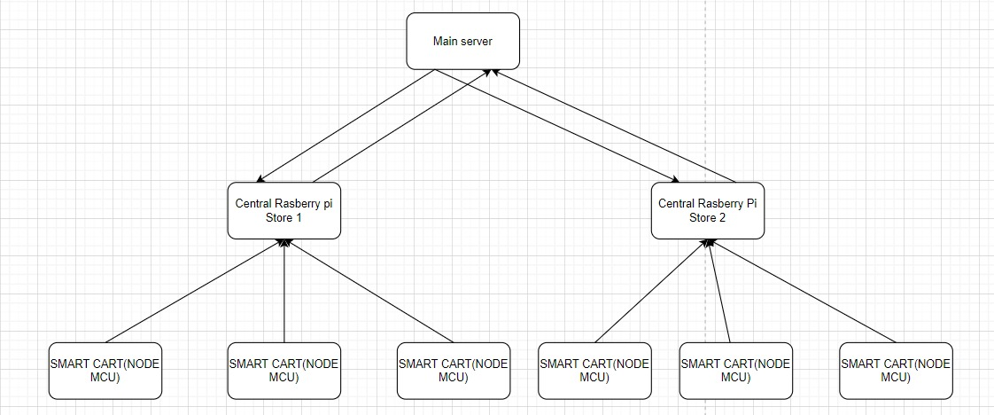
Architecture Diagram

Slide 8
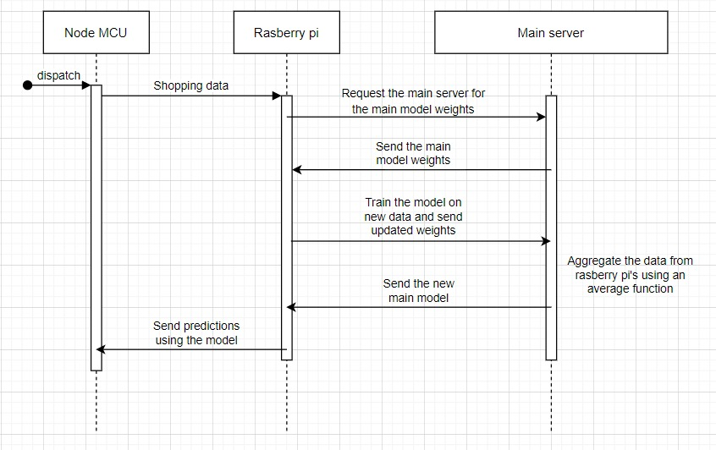

Slide 9
Methodology
First we have stations in shopping malls from where this cart can be picked up (similar to normal trolley stands).
2. Every item will have an RFID tag if the customer wants to add the product he/she can just scan the tag and the item will be added to their bill.
3. Similarly using the delete button the customer can remove specific item/s.

Slide 10
4. After everything is collected, we move to the payment. Payment is accepted either through UPI or Online Payment.
5. After the payment is completed the cart resets so the next customer can use it

Slide 11
WORK DONE SO FAR
Functional Backend APIs running on a RaspberryPi for add item, delete item and show bill endpoints.
Persistent db of item metadata and scripts to add items to db.
A physical circuit prototype, with all components except LCD display.

Slide 12
ROADMAP DELIVERABLES
Payment system with QR code or Wireless RFID enabled credit cards (needs to be looked into).
Membership card:- A key based authentication system where customers can scan their membership card which will also allow them to access various exclusive offers such as a gift on purchases of above Rs. 10k

Slide 13
-> A Product Recommendation System using Federated Learning:-
FL allows devices to learn a shared prediction model collaboratively while maintaining the training data on the computer rather than uploading and storing it on a central server. The main model for recommending products is stored in a main server the client will call for the model(weights ) of the main model and train the model again on the new data and send the updated weights to the server. The shopping data in the RaspberryPi is used to create the local client model, which is then forwarded to a central server for aggregation, and the local data is immediately deleted.

Slide 14
-> Using data for business analytics:- All the karts will send the products bought data to an Rasberry pi inside the store where the data is temporarily stored and can be used analytics such as predict the amount of a particular product required during festival season etc.
->Security :- The membership cards will hold the user’s key, which will be used to authenticate the user with our authentication server. This server will return a JWT token which will be used to authenticate the user with the product APIs.

Slide 15
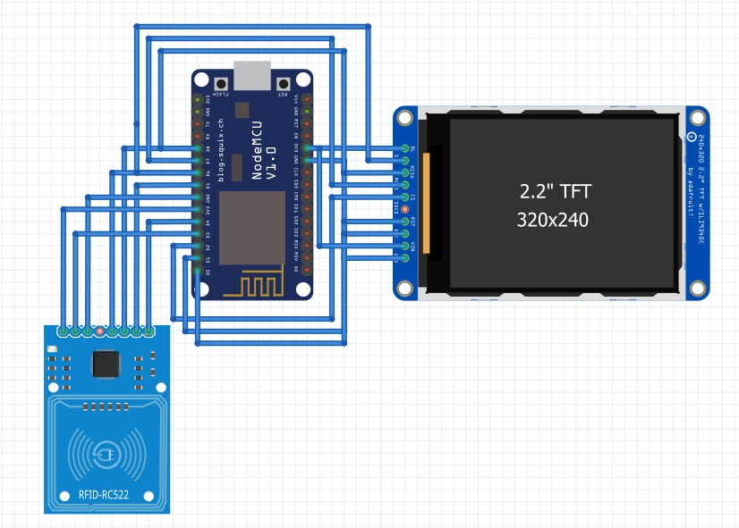
CIRCUIT DESIGN

Slide 16
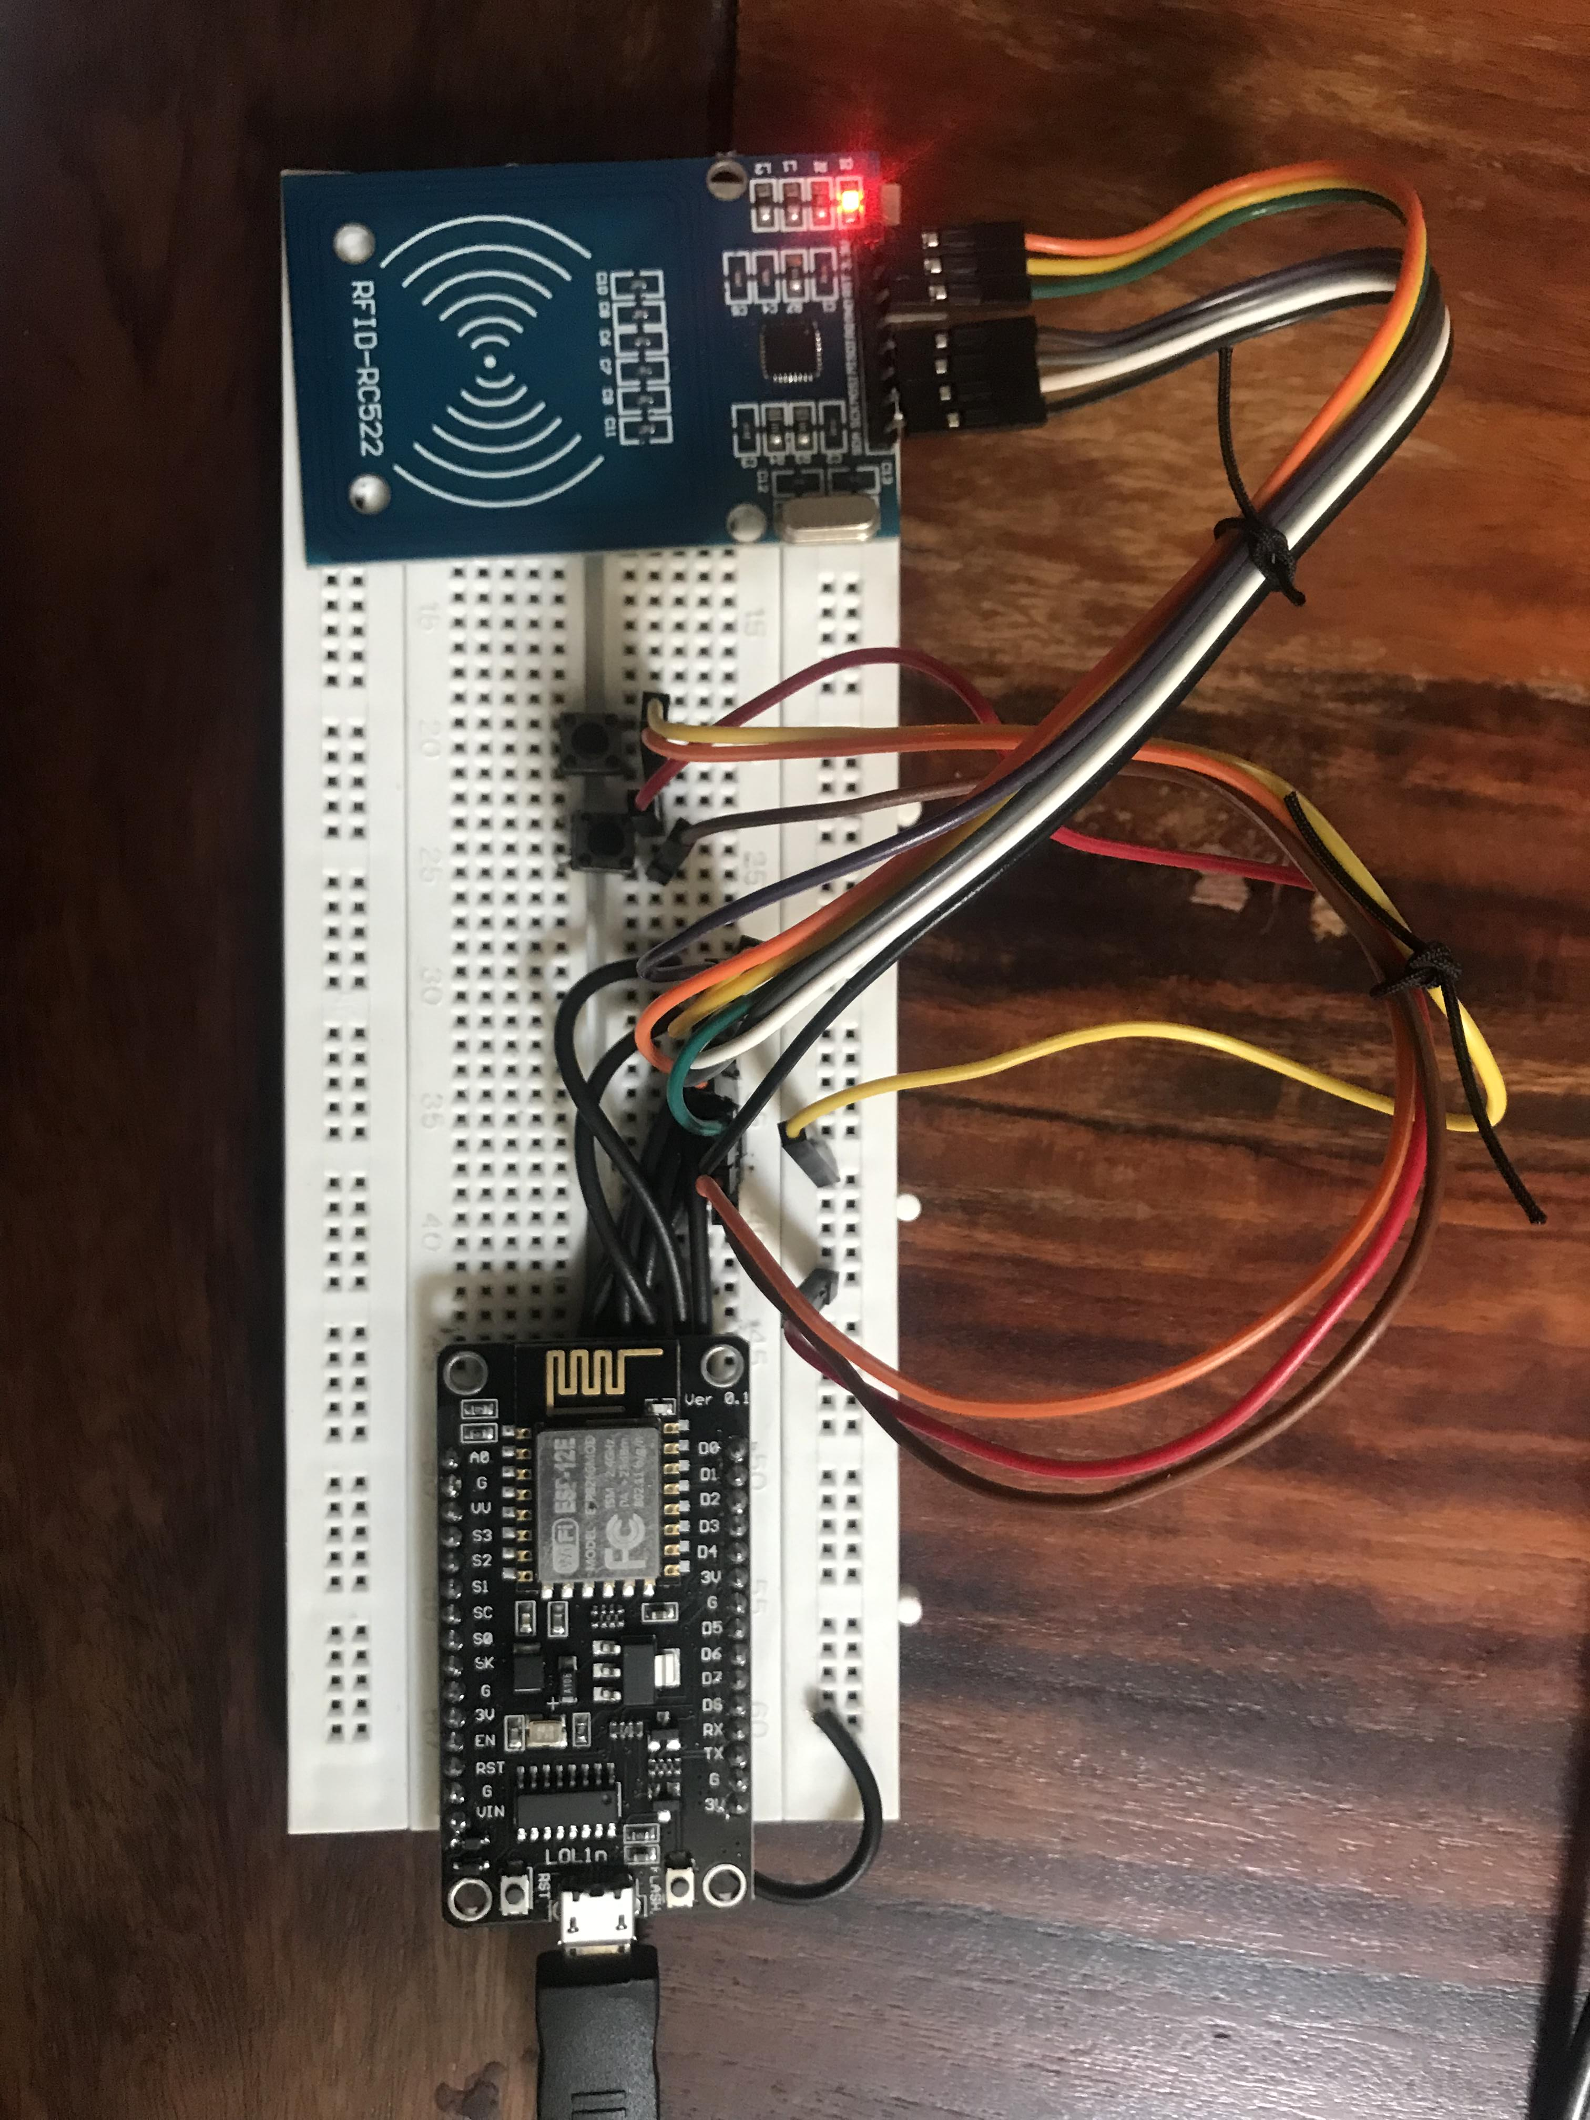
PROTOTYPE CIRCUIT

Slide 17
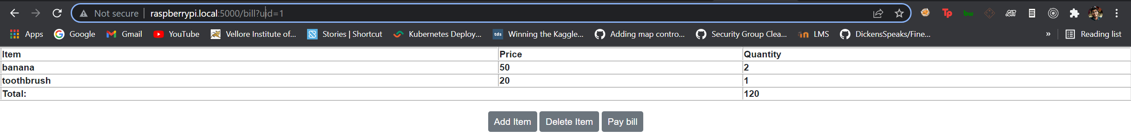
PROTOTYPE UI (WILL BE SHOWN ON ONBOARD LED)

Slide 18
References
https://arxiv.org/abs/2001.01033v1
https://arxiv.org/abs/1105.3790v1
https://arxiv.org/abs/2102.01625v1

