Slide 1
Steganography detection with ML
Illia Andrieiev

Slide 2
Steganography
Steganography is the practice of hiding a secret message inside of something that is not secret. The purpose of steganography is to conceal and deceive. Where cryptography is a science that largely enables privacy, steganography is a practice that enables secrecy – and deceit.

Slide 3
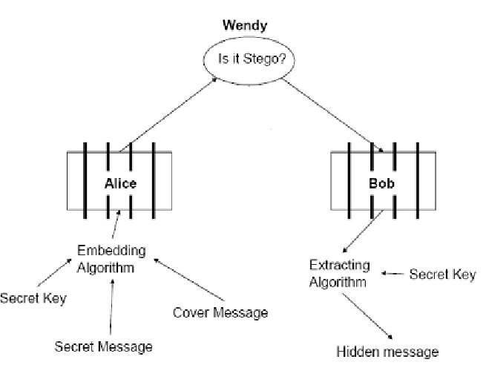
Problem statement

Slide 4
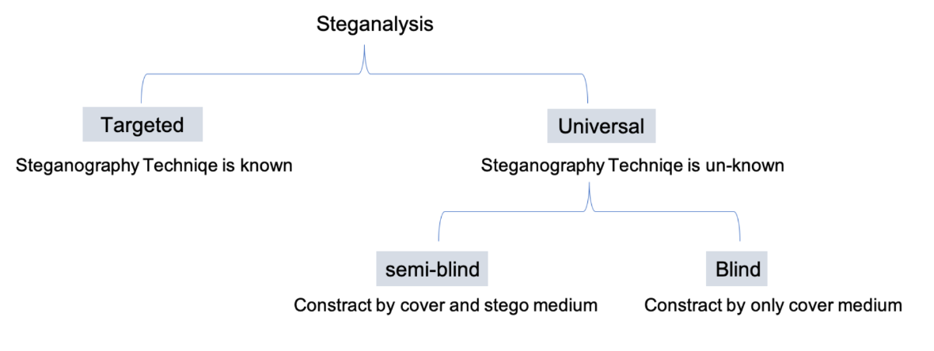
Problem statement

Slide 5
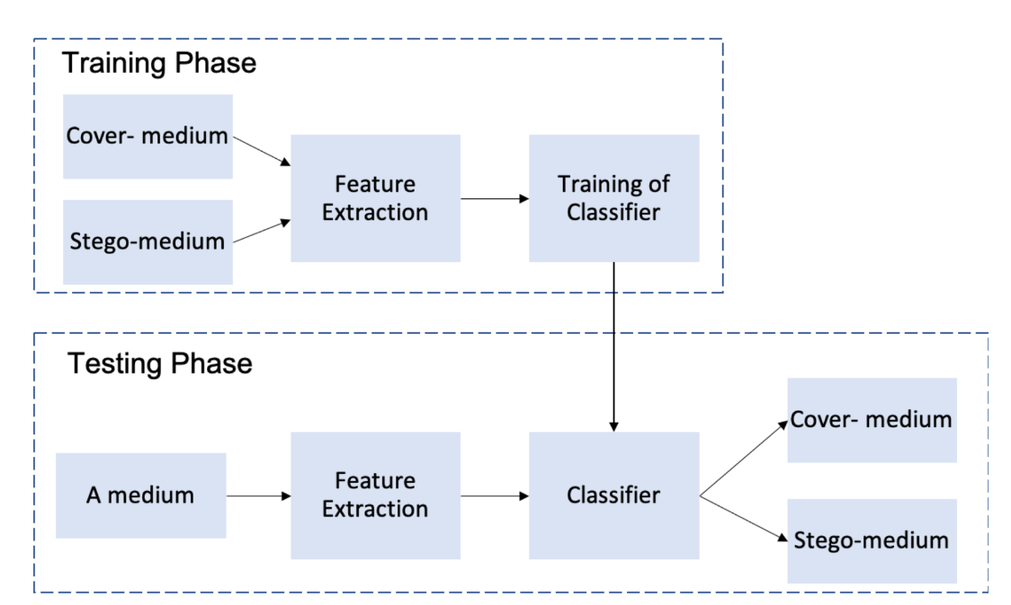
Project scheme

Slide 6
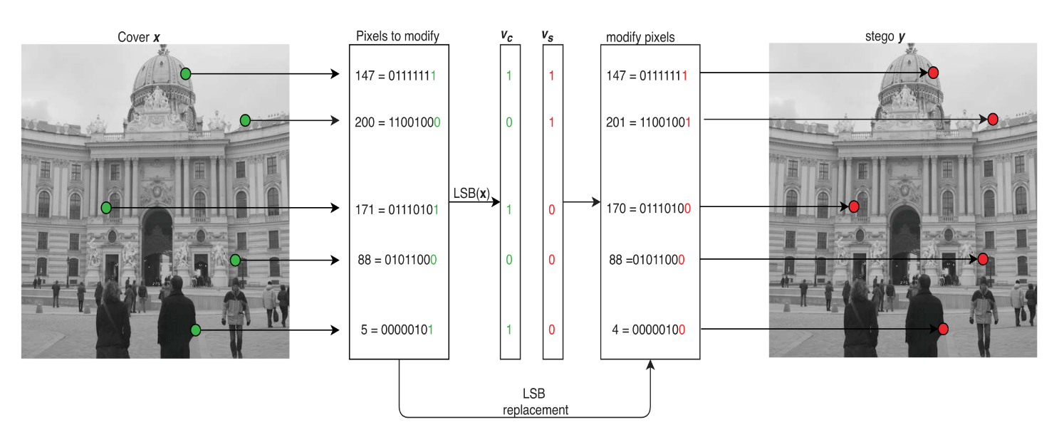
Example algorithm

Slide 7
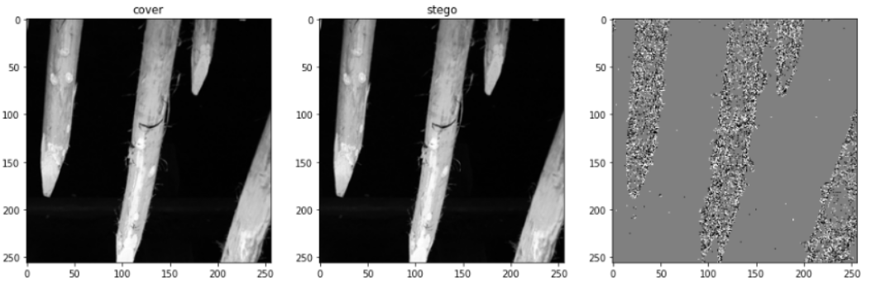
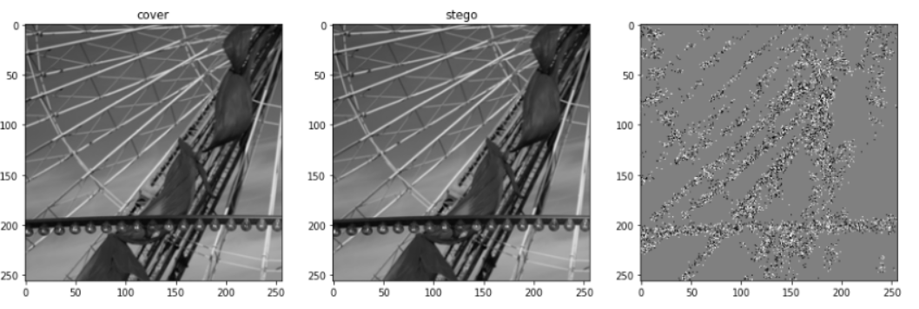
Adaptive Steganography

Slide 8
Adaptive steganography
determine which positions are best for the embedding,
encode the message,
embed the message.

Slide 9
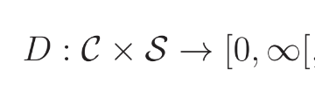

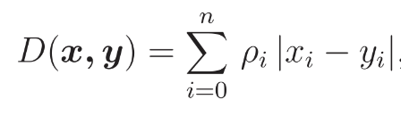


Adaptive steganography

Slide 10
Adaptive algorithms (Spatial domain)
HUGO
WOW
S-UNIWARD

Slide 11
Dataset generation
Bossbase 1.01 - 10 000 grayscale pictures 512x512
Split each picture into 4 equal parts
train/test split with proportions 60%/40%
Create corresponding stego pair with random adaptive algorithm (uniform distribution).

Slide 12
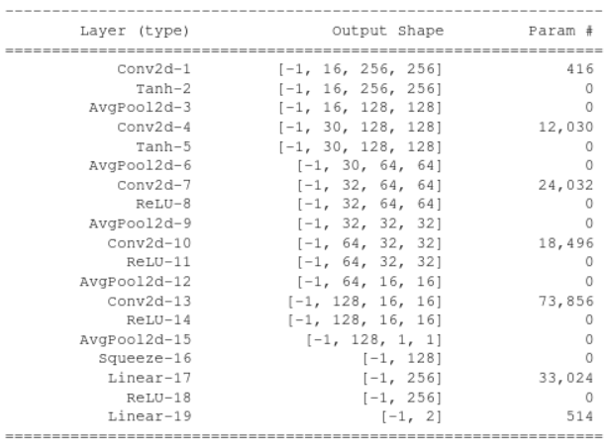
Baseline CNN

Slide 13
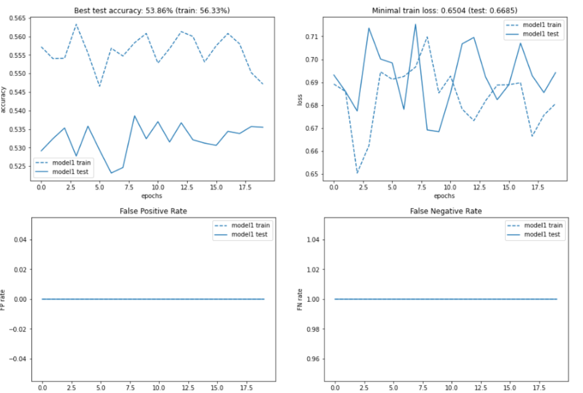
Baseline CNN

Slide 14
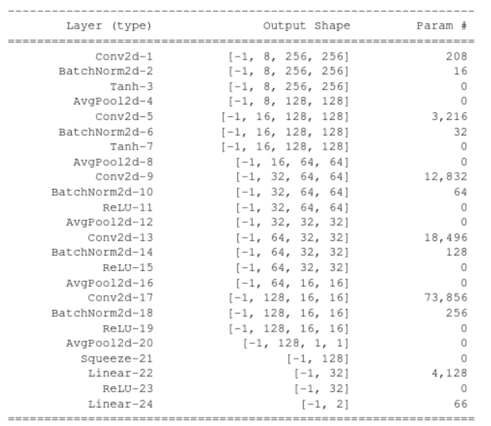
Baseline CNN + Batch Normalization

Slide 15
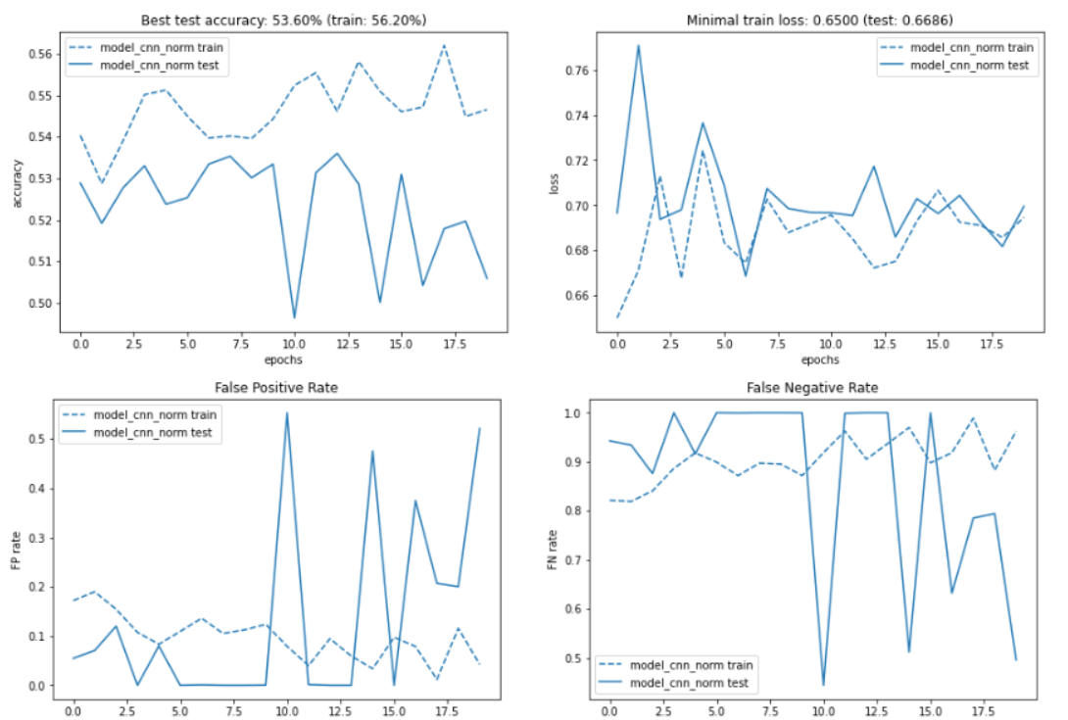
Baseline CNN + Batch Normalization

Slide 16
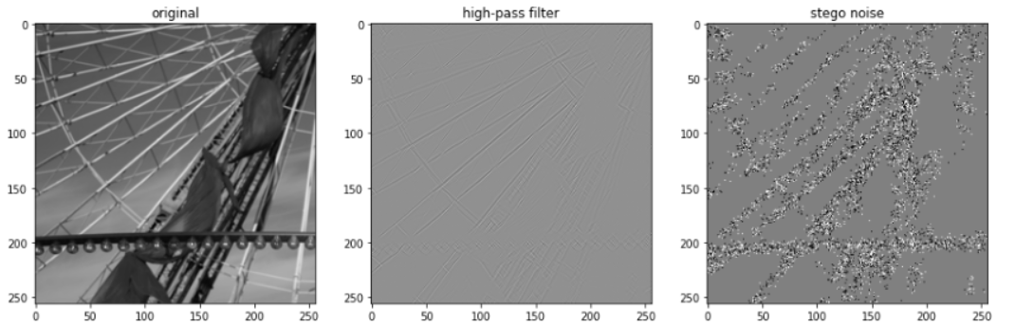
High-Pass filtering

Slide 17
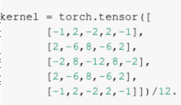

High-Pass Filtering

Slide 18
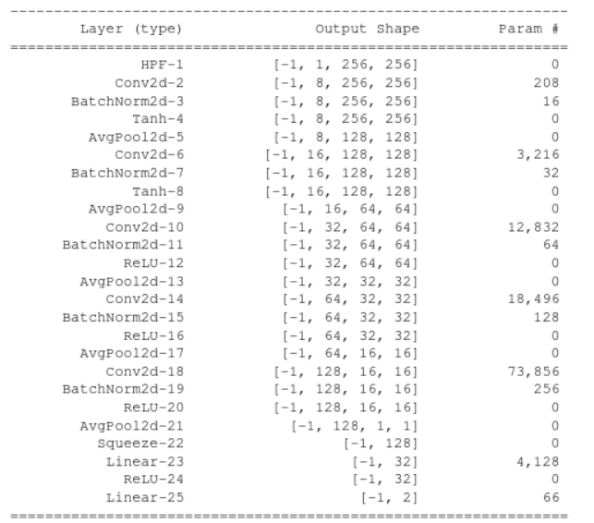
CNN + BN + High-Pass filtering

Slide 19
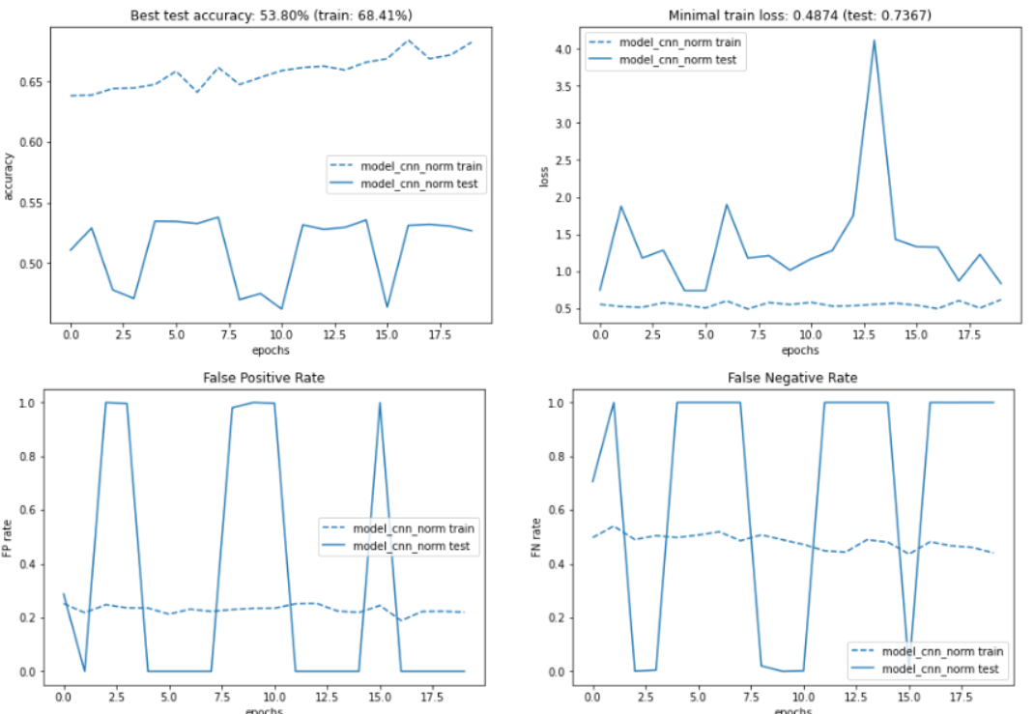
CNN + BN + High-Pass filtering

Slide 20
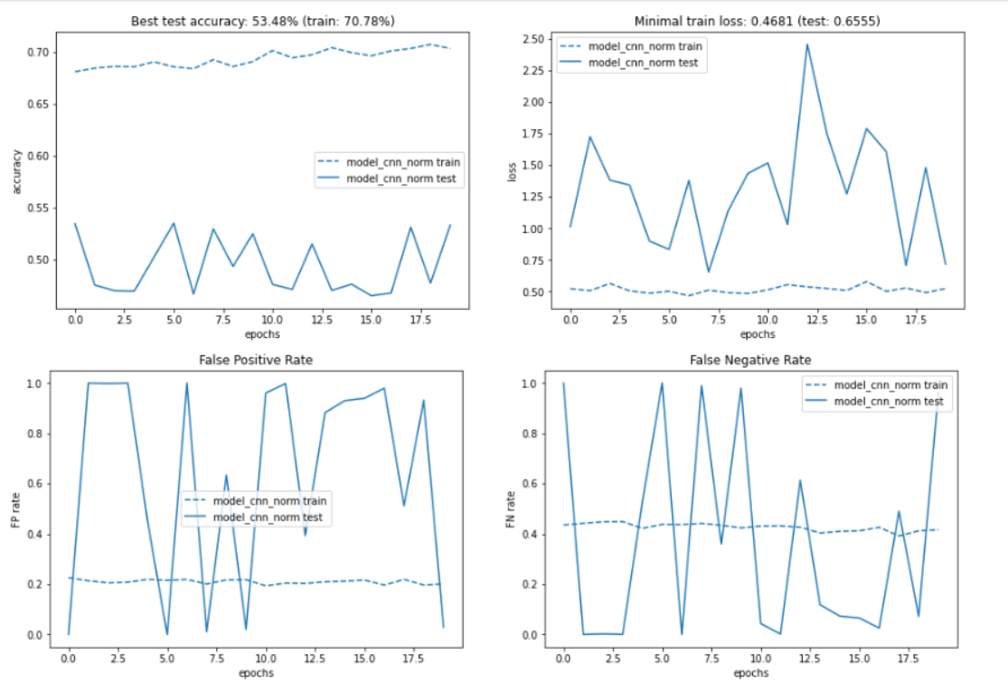
… + Samper!

Slide 21
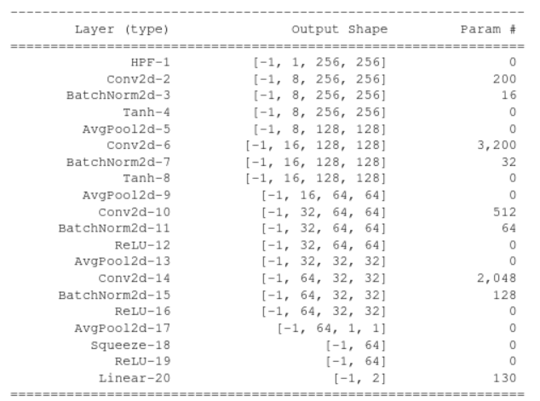
CNN + BN + High-Pass filtering, but regularized

Slide 22
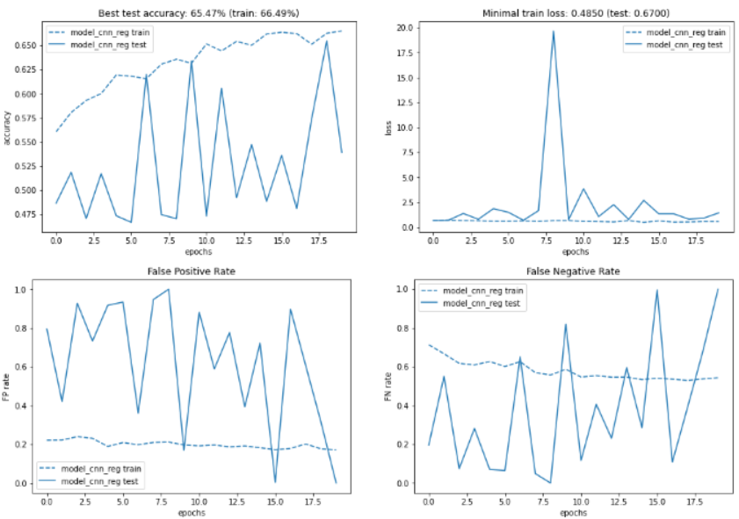
CNN + BN + High-Pass filtering, but regularized

