Slide 1
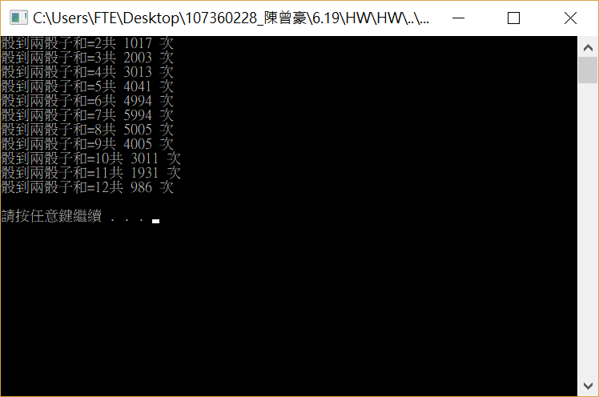
#include <stdio.h>
#include <stdlib.h>
#include <time.h>
int main()
{
int target[14] = {0};
int a, b, c;
srand(time(0));
for (int j = 1; j <= 36000; j++)
{
a = rand() % 6 + 1;
b = rand() % 6 + 1;
c = a + b;
target[c]++;
}
for (int i = 2; i <= 12; i++)
{
printf("骰到兩骰子和=%d共 %d 次 \n" , i , target[i]);
}
printf("\n");
system("pause");
return 0;
}

Slide 2
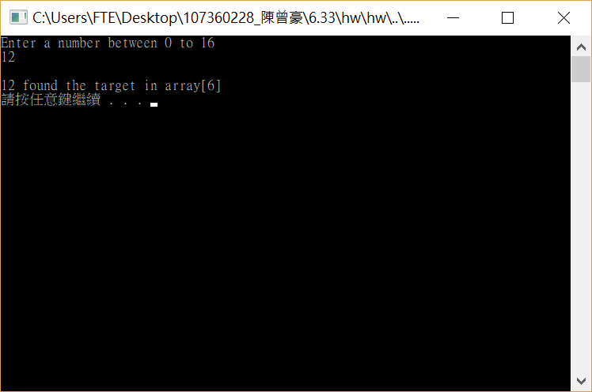

#include<stdio.h>
#include<stdlib.h>
int binarySearch(const int b[], int t, int low, int high)
{
if (t % 2 == 1)
{
return -1;
}
int middle;
middle = (low + high) / 2;
if (t == b[middle])
{
return middle;
}
if (t < b[middle])
{
return binarySearch(b, t, low, middle - 1);
}
if (t > b[middle])
{
return binarySearch(b, t, middle - 1,high);
}
}
int main(void)
{
int target, result,deck[9];
for (int i = 0; i < 9; i++)
{
deck[i] = 2 * i;
}
//0 2 4 6 8 10 12 14 16
printf("Enter a number between 0 to 16\n");
scanf_s("%d", &target);
result = binarySearch(deck,target,0,8);
if (result != -1)
{
printf("\n%d found the target in array[%d]\n", target, result);
}
else
{
printf("\n%d not found\n",target);
}
system("pause");
return 0;
}

Slide 3
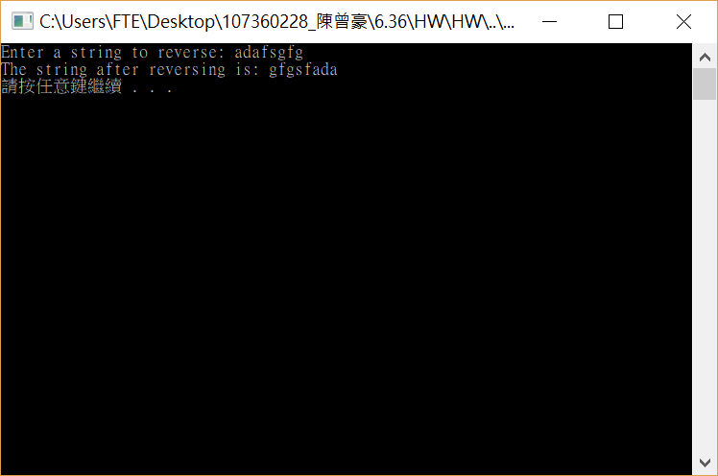
#include <stdio.h>
#include <string.h>
void reverse(char[], int, int);
int main()
{
char str1[20];
int size;
printf("Enter a string to reverse: ");
scanf_s("%s", str1, 20);
size = strlen(str1);
reverse(str1, 0, size - 1);
printf("The string after reversing is: %s\n", str1);
system("Pause");
return 0;
}
void reverse(char str1[], int index, int size)
{
char temp;
temp = str1[index];
str1[index] = str1[size - index];
str1[size - index] = temp;
if (index == size / 2)
{
return;
}
reverse(str1, index + 1, size);
}

Slide 4
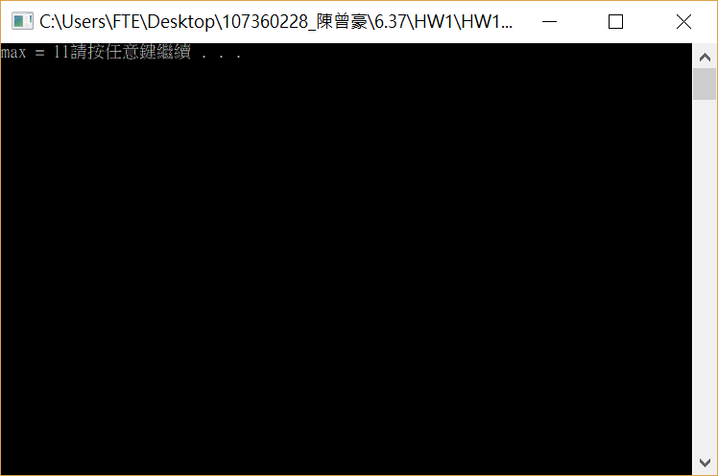
#include <stdio.h>
#include <stdlib.h>
int reverse(const int a[], int i, int m)
{
if (i == 7)
{
return m;
}
if (m < a[i + 1])
{
m = a[i + 1];
}
return reverse(a, i + 1, m);
}
int main()
{
int i = 0, array[8] = { 10 , 2 , 5 ,4 , 6 ,8 ,11 };
int max = array[1];
max = reverse(array, i, max);
printf("max = %d", max);
system("pause");
return 0;
}

