Slide 1
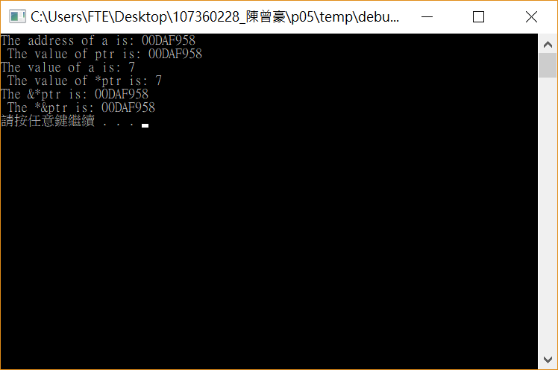
#include <stdio.h>
#include <stdlib.h>
int main()
{
int a=7;
int *ptr;
ptr = &a;
printf("The address of a is: %p \n The value of ptr is: %p\n", &a ,ptr);
printf("The value of a is: %d \n The value of *ptr is: %d\n", a, *ptr);
printf("The &*ptr is: %p \n The *&ptr is: %p\n", &*ptr, *&ptr);
system("pause");
return 0;
}

Slide 2
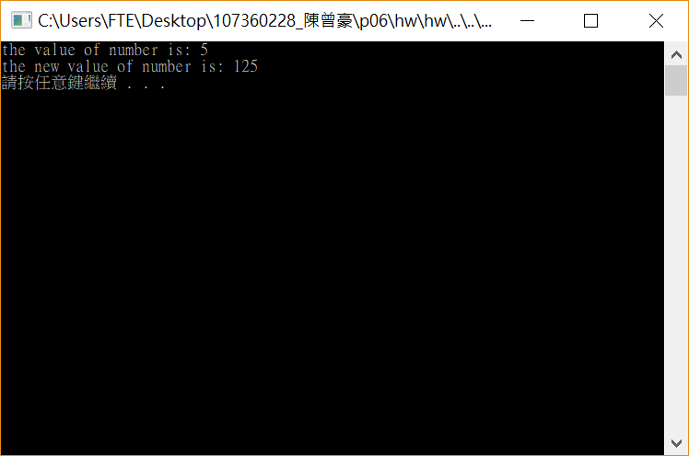
#include <stdio.h>
#include <stdlib.h>
intcubebyvalue(int n)
{
return n * n * n;
}
int main()
{
int number = 5;
printf("the value of number is: %d\n", number);
number = cubebyvalue(number);
printf("the new value of number is: %d\n", number);
system("pause");
return 0;
}

Slide 3
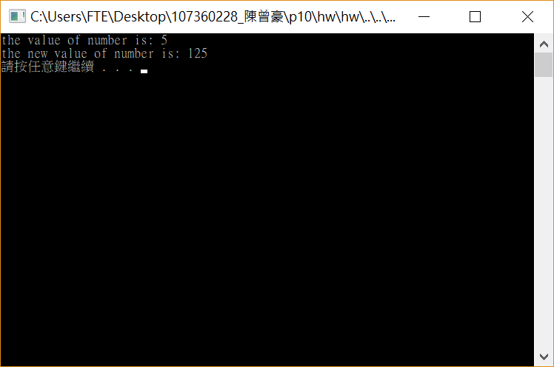
#include <stdio.h>
#include <stdlib.h>
void cubebyAddress(int *nptr)
{
*nptr = *nptr * *nptr * *nptr;
}
int main()
{
int number = 5;
printf("the value of number is: %d\n", number);
cubebyAddress(&number);
printf("the new value of number is: %d\n", number);
system("pause");
return 0;
}

Slide 4

#include <stdio.h>
#include <stdlib.h>
void cubebyReference(int &n)
{
n = n * n * n;
}
int main()
{
int number = 5;
printf("the value of number is: %d\n", number);
cubebyReference (number);
printf("the new value of number is: %d\n", number);
system("pause");
return 0;
}

Slide 5

#include <stdio.h>
#include <stdlib.h>
#define SIZE 10
void swap(int *element1Ptr, int *element2Ptr)
{
int c;
c = *element1Ptr;
*element1Ptr = *element2Ptr;
*element2Ptr = c;
}
void bubbleSort(int * const array, const int size)
{
int c;
for (int i = 0; i < size - 1; i++)
{
for (int j = 0; j < size - 1; j++)
{
if (array[j] > array[j + 1])
{
swap(&array[j], &array[j + 1]);
/*c = array[j];
array[j] = array[j + 1];
array[j + 1] = c;*/
}
}
}
}
int main()
{
int a[SIZE] = { 2,6,4,8,10,12,89,68,45,37 };
printf("Data items in original order\n");
for (int i = 0; i < SIZE; i++)
{
printf("%4d", a[i]);
}
bubbleSort(a, SIZE);
printf("\nDate items in ascending order\n");
for (int i = 0; i < SIZE; i++)
{
printf("%4d", a[i]);
}
printf("\n");
system("pause");
return 0;
}

Slide 6
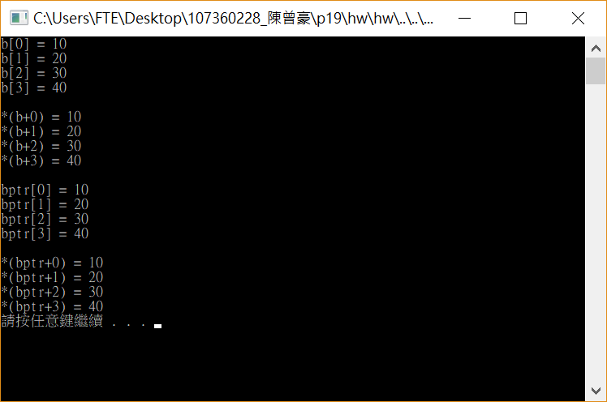
#include <stdio.h>
#include <stdlib.h>
int main()
{
int b[] = { 10,20,30,40 };
//int *bptr = b;
int *bptr;
bptr = &b;
for ( int i = 0; i < 4; i++)
{
printf("b[%d] = %d\n",i,b[i]);
}
printf("\n");
for (int i = 0; i < 4; i++)
{
printf("*(b+%d) = %d\n", i, *(b+i));
}
printf("\n");
for (int i = 0; i < 4; i++)
{
printf("bptr[%d] = %d\n", i, bptr[i]);
}
printf("\n");
for (int i = 0; i < 4; i++)
{
printf("*(bptr+%d) = %d\n", i, *(bptr + i));
}
system("pause");
return 0;
}

Slide 7
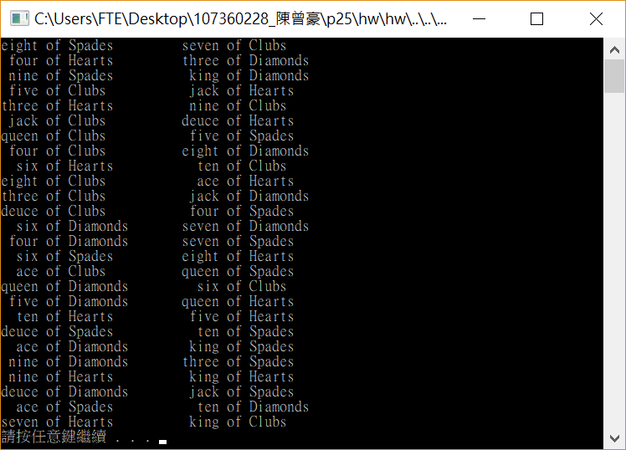
#include <stdio.h>
#include <stdlib.h>
#include <time.h>
void shuffle(int wdeck[][13])
{
int row, column, card;
for (card = 1; card <= 52; card++)
{
do
{
row = rand() % 4;
column = rand() % 13;
} while (wdeck[row][column] != 0);
wdeck[row][column] = card;
}
}
void deal(const int wdeck[][13], const int *wface[], const int *wsuit[])
{
int row, column, card;
for (card = 1; card <= 52; card++)
{
for (row = 0; row <= 3; row++)
{
for (column = 0; column <= 12; column++)
{
if (wdeck[row][column] == card)
{
printf("%5s of %-8s%c", wface[column], wsuit[row], card % 2 == 0 ? '\n' : '\t');
}
}
}
}
}
int main(void)
{
const char *suit[4] = { "Hearts", "Diamonds", "Clubs", "Spades" };
const char *face[13] = { "ace","deuce" ,"three", "four", "five" ,"six", "seven", "eight", "nine","ten","jack","queen","king" };
int deck[4][13] = { 0 };
srand(time(NULL));
shuffle(deck);
deal(deck, face, suit);
system("pause");
return 0;
}

