Slide 1
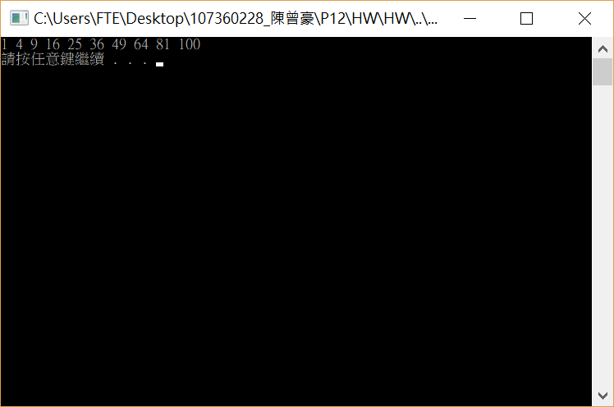

Slide 2
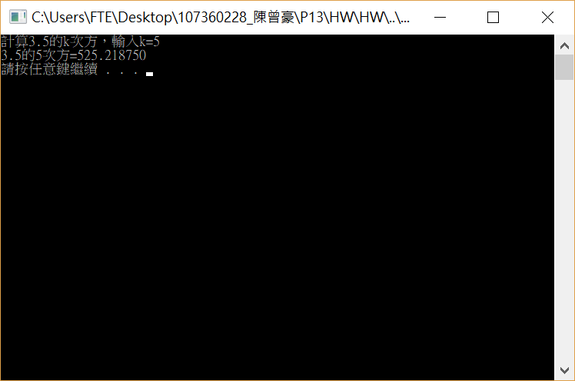
#include <stdio.h>
#include <stdlib.h>
double Power(double,int);
void main(void)
{
int k;
double A;
printf("計算3.5的k次方，輸入k=");
scanf_s("%d", &k);
A = Power(3.5, k);
printf("3.5的%d次方=%lf\n", k, A);
system("pause");
}
double Power(double x,int n)
{
double PowerXn = 1;
for (int i = 1; i <= n; i++)
{
PowerXn = PowerXn * x;
}
return PowerXn;
}

Slide 3


Slide 4

#include <stdio.h>
#include <stdlib.h>
#include <math.h>
int main(void)
{
system("pause");
}
#include <stdio.h>
#include <stdlib.h>
#include <math.h>
int main(void)
{
for ( int i = 1; i <= 10; i++)
{
printf("%2.2f ", sqrt(i));
}
printf("\n");
system("pause");
return 0;
}

Slide 5
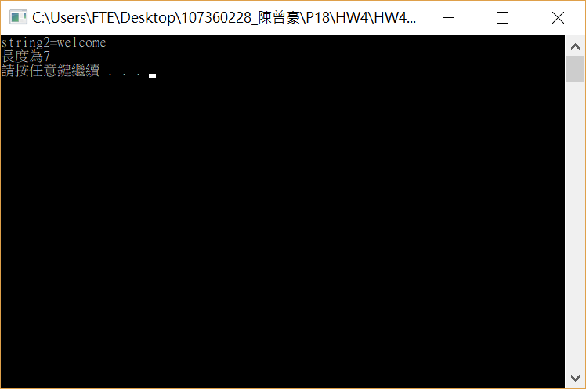
#include <stdio.h>
#include <stdlib.h>
#include <string.h>
int main(void)
{
char string1[60] = "welcome";
char string2[60];
int len;
strcpy(string2, string1);
printf("string2=%s\n", string2);
len = strlen(string2);
printf("長度為%d\n", len);
system("pause");
return 0;
}

Slide 6
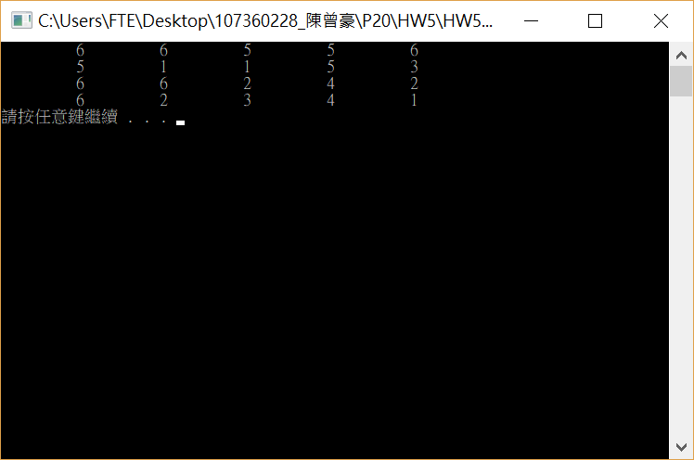

Slide 7
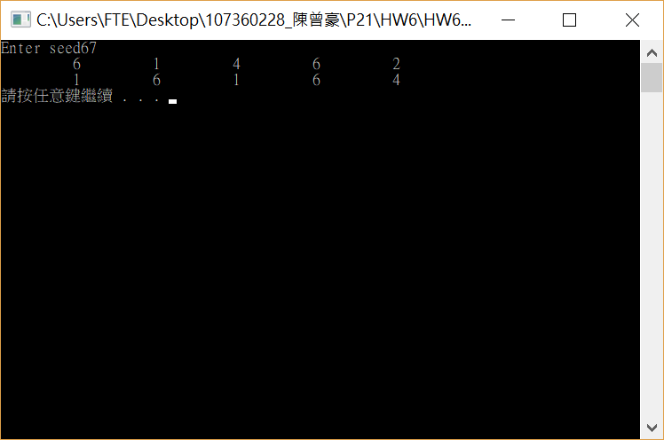


Slide 8
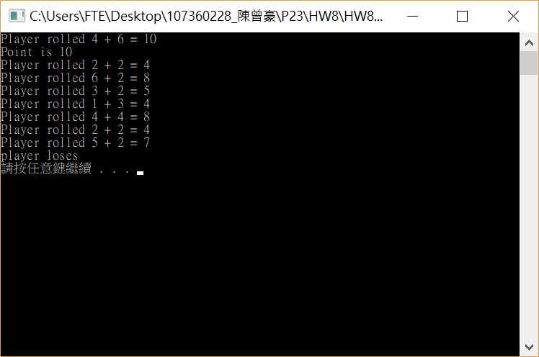


Slide 9
