Slide 1
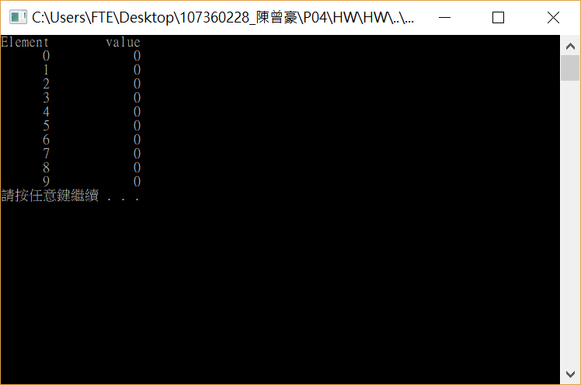
#include <stdio.h>
#include <stdlib.h>
int main()
{
int n[20];
for (int i = 0; i < 10; i++)
{
n[i] = 0;
}
printf("%s%13s\n", "Element", "value");
for (int i = 0; i < 10; i++)
{
printf("%7d%13d\n",i,n[i]);
}
system("pause");
return 0;
}

Slide 2

#include <stdio.h>
#include <stdlib.h>
int main()
{
int n[10] = {37,40,50,20,4,5,67,132,44,55};
/*for (int i = 0; i < 10; i++)
{
n[i] = 0;
}*/
printf("%s%13s\n", "Element", "value");
for (int i = 0; i < 10; i++)
{
printf("%7d%13d\n", i, n[i]);
}
system("pause");
return 0;
}

Slide 3

#include <stdio.h>
#include <stdlib.h>
int main()
{
int n[10] ;
for (int i = 0; i < 10; i++)
{
n[i] = 2+2*i;
}
printf("%s%13s\n", "Element", "value");
for (int i = 0; i < 10; i++)
{
printf("%7d%13d\n", i, n[i]);
}
system("pause");
return 0;
}

Slide 4
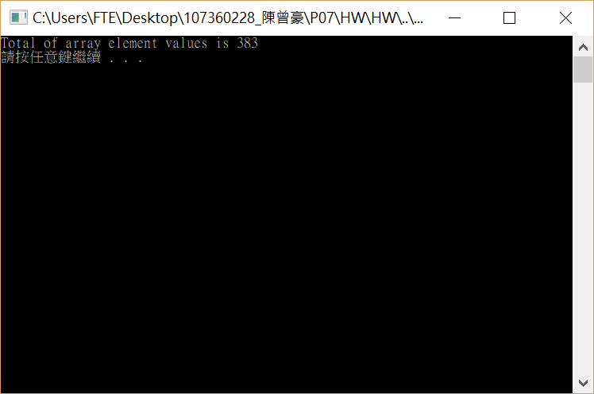
#include <stdio.h>
#include <stdlib.h>
#define SIZE 12
int main()
{
int n[SIZE] = {1,3,5,4,7,2,99,16,45,67,89,45};
int total = 0;
for (int i = 0; i < SIZE; i++)
{
total += n[i];
}
printf("Total of array element values is %d\n", total);
system("pause");
return 0;
}

Slide 5
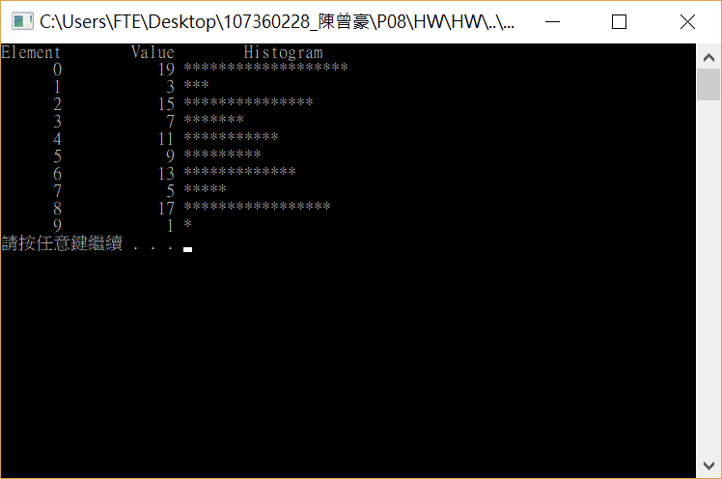
#include <stdio.h>
#include <stdlib.h>
#define SIZE 10
int main()
{
int n[SIZE] = {19,3,15,7,11,9,13,5,17,1 };
printf("%s%13s%17s\n","Element","Value","Histogram");
for (int i = 0; i < SIZE; i++)
{
printf("%7d%13d ",i,n[i]);
for (int j = 1; j <= n[i]; j++)
{
printf("%c", '*');
}
printf("\n");
}
system("pause");
return 0;
}

Slide 6
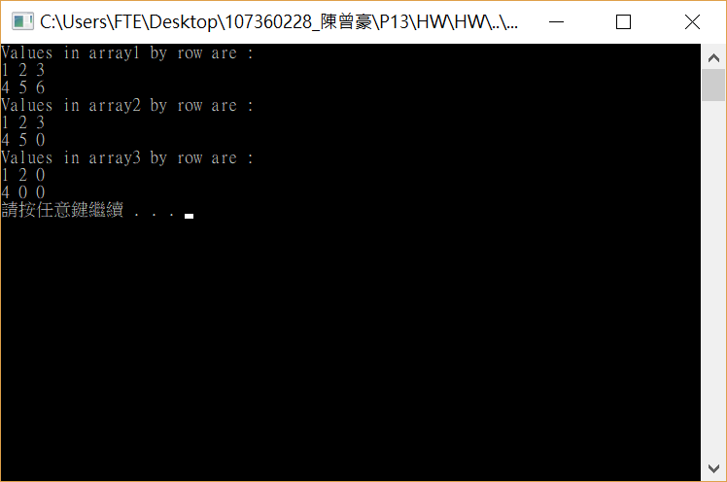
#include <stdio.h>
#include <stdlib.h>
void printArray(const int a[][3])
{
for (int i = 0; i < 2; i++)
{
for (int j = 0; j < 3; j++)
{
printf("%d ", a[i][j]);
}
printf("\n");
}
}
int main()
{
int array1[2][3] = { {1,2,3},{4,5,6} };
int array2[2][3] = { 1,2,3,4,5 };
int array3[2][3] = { {1,2},{4} };
printf("Values in array1 by row are : \n");
printArray(array1);
printf("Values in array2 by row are : \n");
printArray(array2);
printf("Values in array3 by row are : \n");
printArray(array3);
system("pause");
return 0;
}

Slide 7
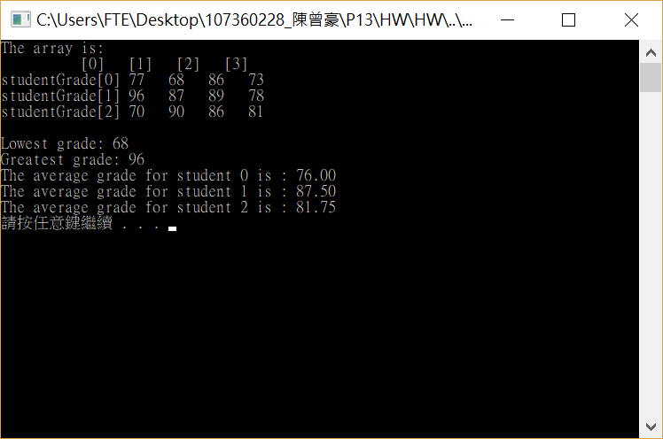
#include <stdio.h>
#include <stdlib.h>
#define STUDENTS 3
#define EXAMS 4
int minimum(const int grades[][EXAMS], int pupils, int tests)
{
int A=100;
for (int i = 0; i < pupils; i++)
{
for ( int j = 0; j < tests; j++)
{
if (grades[i][j] < A)
{
A = grades[i][j];
}
}
}
return A;
}
int maximum(const int grades[][EXAMS], int pupils, int tests) {
int A = 0;
for (int i = 0; i < pupils; i++)
{
for (int j = 0; j < tests; j++)
{
if (grades[i][j] > A)
{
A = grades[i][j];
}
}
}
return A;
}
double average(const int setOfGrades[], int tests)
{
int total = 0;
for (int i = 0; i < tests; i++)
{
total = total + setOfGrades[i];
}
return (double)total / tests ;
}
void printArray(const int grades[][EXAMS], int pupils, int tests)
{
printf(" [0] [1] [2] [3]");
for (int i = 0; i < pupils; i++)
{
printf("\nstudentGrade[%d] ", i);
for (int j = 0; j < tests; j++)
{
printf("%-5d", grades[i][j]);
}
}
}
int main()
{
int student;
const int studentGrades[STUDENTS][EXAMS] =
{
{77,68,86,73},
{96,87,89,78},
{70,90,86,81}};
printf("The array is:\n");
printArray(studentGrades, STUDENTS, EXAMS);
printf("\n\nLowest grade: %d\n", minimum(studentGrades, STUDENTS, EXAMS));
printf("Greatest grade: %d\n", maximum(studentGrades, STUDENTS, EXAMS));
for (student = 0; student <= 2; student++)
{
printf("The average grade for student %d is : %.2f\n", student, average(studentGrades[student], EXAMS));
}
system("pause");
return 0;
}

Slide 8
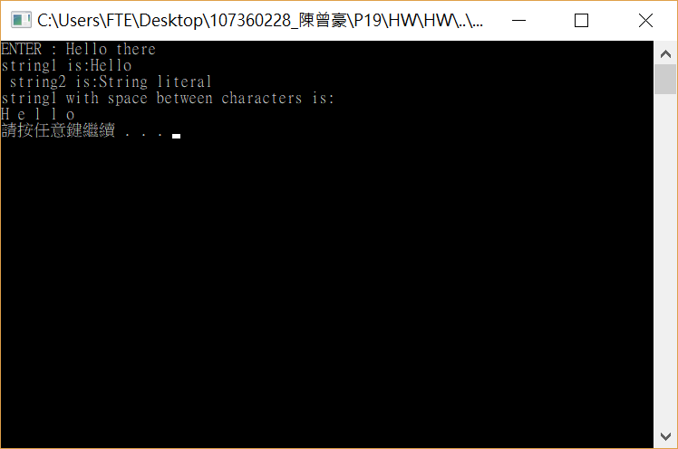
#include <stdio.h>
#include <stdlib.h>
int main()
{
char string1[20];
char string2[]="String literal";
printf("ENTER : ");
scanf_s("%s", string1,20);
printf("string1 is:%s \n string2 is:%s\n", string1, string2);
printf("string1 with space between characters is:\n" );
for (int i = 0; string1[i] != '\0'; i++)
{
printf("%c ", string1[i]);
}
printf("\n");
system("pause");
return 0;
}

Slide 9
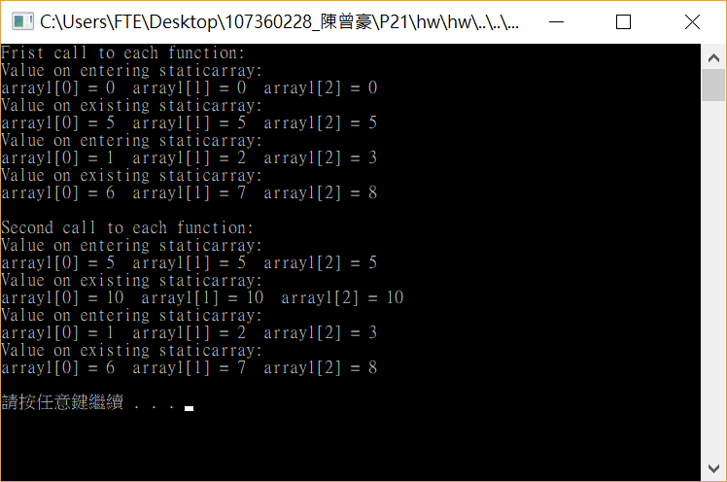
#include <stdio.h>
#include <stdlib.h>
void staticArrayinit()
{
static int array1[3];
printf("Value on entering staticarray:\n");
for (int i = 0; i < 3; i++)
{
printf("array1[%d] = %d ", i, array1[i]);
}
printf("\n");
printf("Value on existing staticarray:\n");
for (int i = 0; i < 3; i++)
{
printf("array1[%d] = %d ", i, array1[i]+=5);
}
printf("\n");
}
void automativArrayinit()
{
int array1[3] = {1,2,3};
printf("Value on entering staticarray:\n");
for (int i = 0; i < 3; i++)
{
printf("array1[%d] = %d ", i, array1[i]);
}
printf("\n");
printf("Value on existing staticarray:\n");
for (int i = 0; i < 3; i++)
{
printf("array1[%d] = %d ", i, array1[i] += 5);
}
printf("\n");
}
int main()
{
printf("Frist call to each function:\n");
staticArrayinit();
automativArrayinit();
printf("\nSecond call to each function:\n");
staticArrayinit();
automativArrayinit();
printf("\n");
system("pause");
return 0;
}

Slide 10
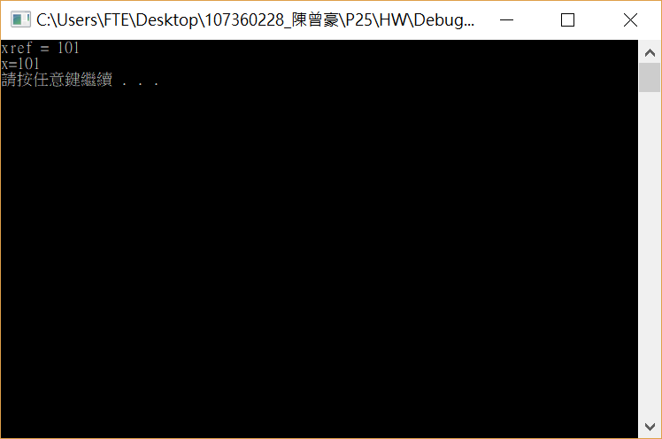
#include <stdio.h>
#include <stdlib.h>
int address(int &xref)
{
xref++;
printf("xref = %d\n", xref);
return xref;
}
void main()
{
int x = 100;
address(x);
//printf("xptr=%d\n", address(x));
printf("x=%d\n", x);
system("pause");
}

Slide 11
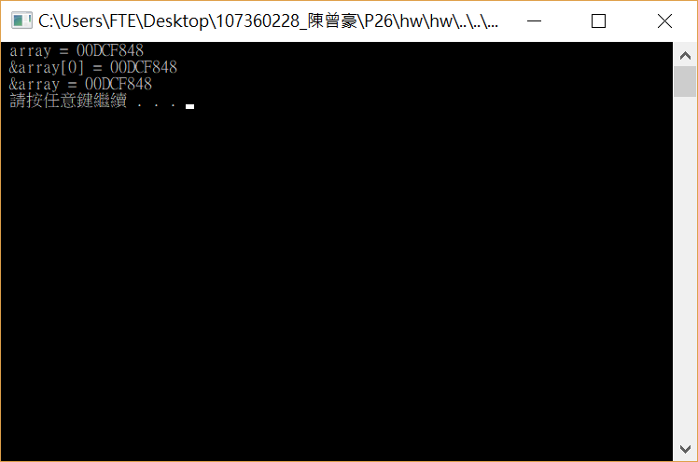
#include <stdio.h>
#include <stdlib.h>
int main()
{
char array[5];
printf(" array = %p \n &array[0] = %p \n &array = %p \n ",
array, &array[0], &array);
system("pause");
return 0;
}

Slide 12
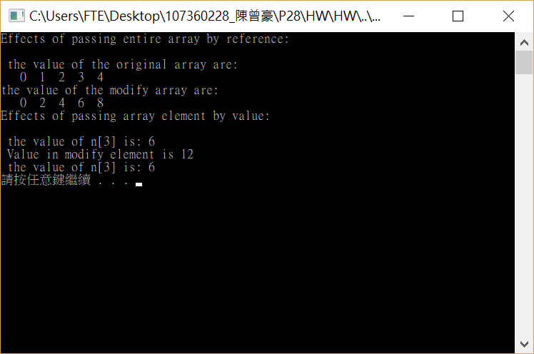
#include <stdio.h>
#include <stdlib.h>
#define SIZE 5
void modifyArray(int b[], int x)
{
for (int i = 0; i < x; i++)
{
b[i] *= 2;
}
}
void modifyElement(int e)
{
printf("Value in modify element is %d\n", e * 2);
}
int main()
{
int n[SIZE] = { 0,1,2,3,4 };
printf("Effects of passing entire array by reference: \n\n the value of the original array are: \n ");
for (int i = 0; i < SIZE; i++)
{
printf("%3d", n[i]);
}
printf("\n");
modifyArray(n, SIZE);
printf("the value of the modify array are: \n ");
for (int i = 0; i < SIZE; i++)
{
printf("%3d", n[i]);
}
printf("\nEffects of passing array element by value: \n\n the value of n[3] is: %d\n ",n[3]);
modifyElement(n[3]);
printf(" the value of n[3] is: %d\n", n[3]);
system("pause");
return 0;
}

Slide 13
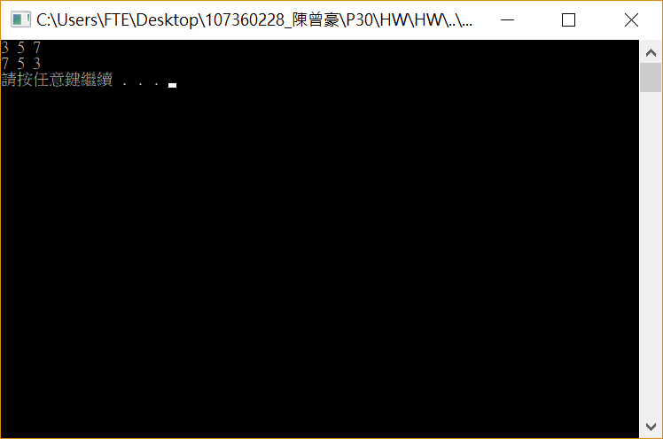
#include <stdio.h>
#include <stdlib.h>
void inverse(int *b)
{
int tmp[3], i;
for ( i = 0; i < 3; i++)
{
tmp[2 - i] = b[i];
}
for (i = 0; i < 3; i++)
{
b[i] = tmp[i];
}
}
int main()
{
intn[3] = { 3,5,7 };
for (int i = 0; i < 3; i++)
{
printf("%d ", n[i]);
}
printf("\n");
inverse(n);
for (int i = 0; i < 3; i++)
{
printf("%d ", n[i]);
}
printf("\n");
system("pause");
return 0;
}

Slide 14
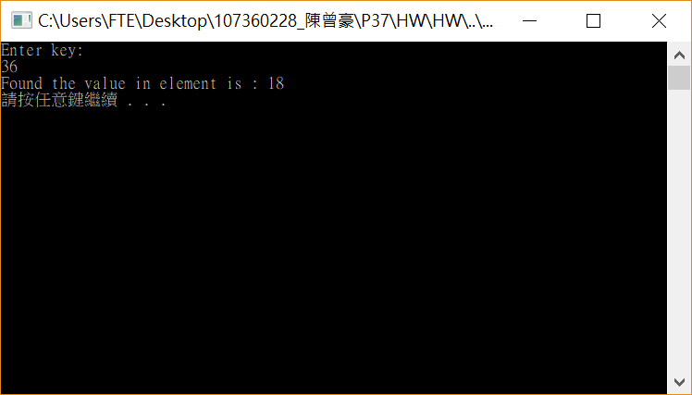
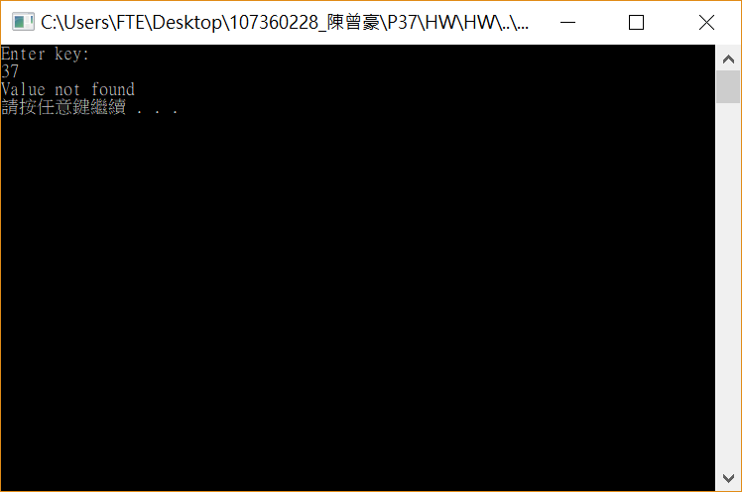
#include <stdio.h>
#include <stdlib.h>
#define SIZE 100
int linearSearch(const int array[], int key, int size)
{
for (int i = 0; i < size; i++)
{
if (array[i] == key )
{
return i;
}
}
return -1;
}
int main()
{
int n[SIZE];
int x,key,ele;
for (int i = 0; i < SIZE; i++)
{
n[i] = 2 * i;
}
printf("Enter key:\n");
scanf_s("%d", &key);
ele = linearSearch(n,key,SIZE);
if (ele != -1)
{
printf("Found the value in element is : %d\n", ele);
}
else
{
printf("Value not found\n");
}
system("pause");
return 0;
}

Slide 15
#include <stdio.h>
#include <stdlib.h>
int main()
{
int n[5] = { 26,5,81,7,63 },g;
for (int i = 0; i < 4; i++)
{
printf("Loop %d : ", i);
for (int j = 0; j< 4; j++)
{
if (n[j] > n[j + 1])
{
g = n[j + 1];
n[j + 1] = n[j];
n[j] = g;
}
}
for (int k = 0; k < 5; k++)
{
printf("%d,", n[k]);
}
printf("\n");
}
system("pause");
return 0;
}

