Slide 1
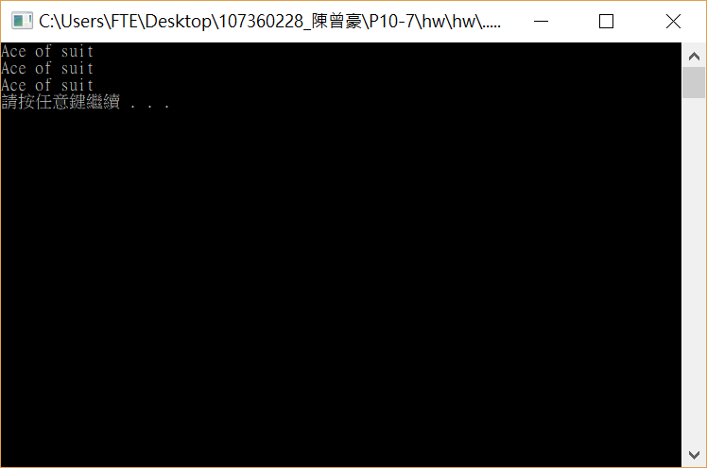
#include <stdio.h>
#include <stdlib.h>
typedef struct card
{
char* face;
char* suit;
}c;
int main()
{
c aCard;
c *cardptr;
aCard.face = "Ace";
aCard.suit = "suit";
cardptr = &aCard;
printf("%s of %s\n%s of %s\n%s of %s\n", aCard.face, aCard.suit,cardptr->face,cardptr->suit,(*cardptr).face,(*cardptr).suit);
system("pause");
return 0;
}

Slide 2
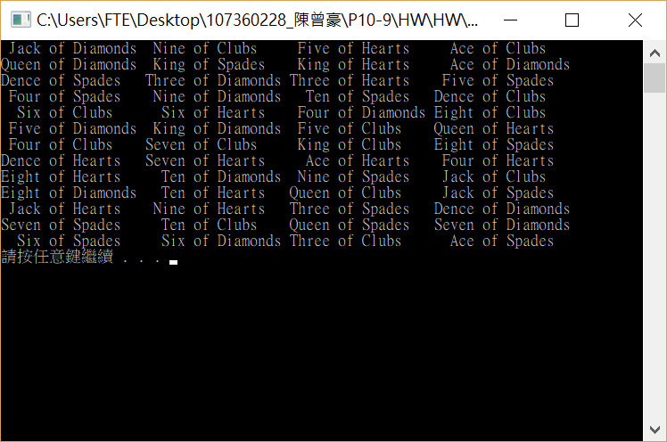
#include <stdio.h>
#include <stdlib.h>
#include <time.h>
typedef struct card
{
char* face;
char* suit;
}card;
void deal(const card* const wDeck)
{
for (int i = 0; i < 52; i++)
{
printf("%5s of %-8s%s", wDeck[i].face, wDeck[i].suit, (i + 1) % 4 ? " " : "\n");
}
}
void shuffle(card* const wDeck)
{
int j;
card temp;
for (int i = 0; i < 52; i++)
{
j = rand() % 52;
temp = wDeck[i];
wDeck[i] = wDeck[j];
wDeck[j] = temp;
}
}
void fillDeck(card* const wDeck, const char* wFace[], const char* wSuit[])
{
int i;
for (i = 0; i < 52; i++)
{
wDeck[i].face = wFace[i % 13];
wDeck[i].suit = wSuit[i / 13];
}
}
int main()
{
card deck[52];
const char *face[] = { "Ace","Dence","Three","Four","Five","Six","Seven","Eight",
"Nine","Ten","Jack","Queen","King" };
const char *suit[] = { "Hearts","Diamonds","Clubs","Spades" };
srand(time(NULL));
fillDeck(deck, face, suit);
shuffle(deck);
deal(deck);
system("pause");
return 0;
}

Slide 3
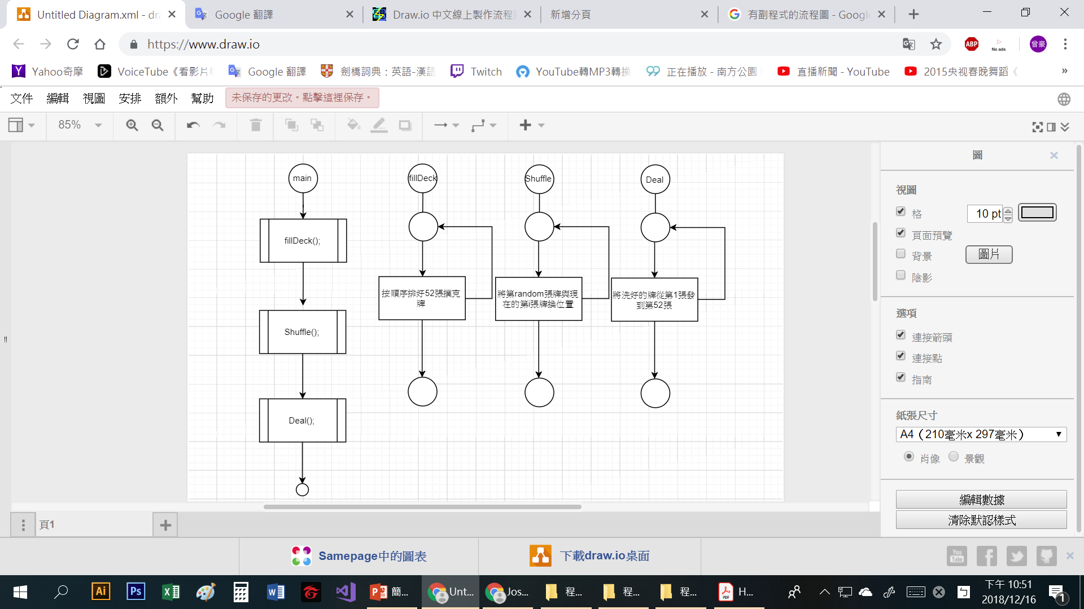
Homework5第七題是用二維陣列來裝填52張牌，以X軸指標陣列決定數字，以Y軸指標陣列決定花色，但這個程式利用資料結構，只需設一維陣列(52個)，然後這52個空間各有兩個指標變數分別是決定花色和數字。
這樣應用資料結構可以讓程式更好往下發展，如做成某些撲克遊戲等等，因為呈現牌的方式變成只用一維的方式表達(如第23張，而不是第[1][10]張)。

