Slide 1
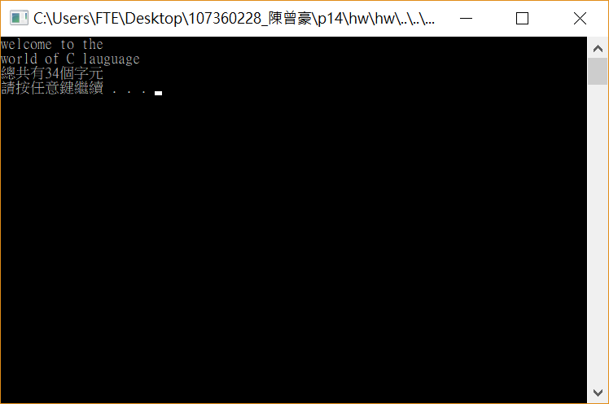
#include <stdio.h>
#include <stdlib.h>
int main()
{
FILE *fptr;
char ch;
int count = 0,err;
err = fopen_s(&fptr, "C://Users/FTE/Desktop/107360228_陳曾豪/welcome.txt", "r");
if (fptr != NULL)
{
while ((ch = getc(fptr)) != EOF)
{
printf("%c", ch);
count++;
}
fclose(fptr);
printf("\n總共有%d個字元\n", count);
}
else
{
printf("開檔失敗\n");
}
system("pause");
return 0;
}

Slide 2
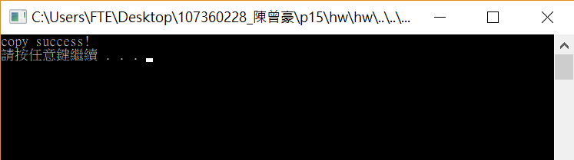
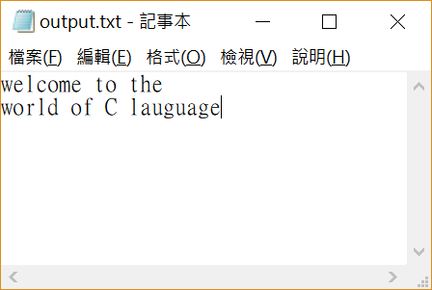
#include <stdio.h>
#include <stdlib.h>
int main()
{
FILE *fptr, *fptr2;
char ch;
int err,err2;
err = fopen_s(&fptr, "C://Users/FTE/Desktop/107360228_陳曾豪/welcome.txt", "r");
err2 = fopen_s(&fptr2, "C://Users/FTE/Desktop/107360228_陳曾豪/output.txt", "w");
if ((fptr != NULL) && (fptr2 != NULL))
{
while ((ch = getc(fptr)) != EOF)
{
putc(ch, fptr2);
}
fclose(fptr);
fclose(fptr2);
printf("copy success!\n");
}
else
{
printf("開檔失敗\n");
}
system("pause");
return 0;
}

Slide 3
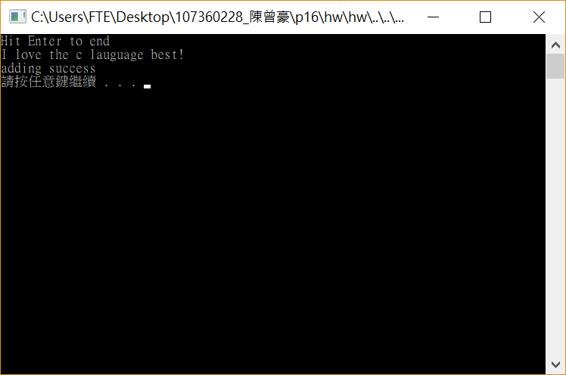

#include <stdio.h>
#include <stdlib.h>
#include <conio.h>
#define ENTER 13
#define MAX 80
int main()
{
FILE *fptr;
char str[MAX],ch;
int i = 0,err;
err = fopen_s(&fptr, "C://Users/FTE/Desktop/107360228_陳曾豪/output.txt", "a");
printf("Hit Enter to end\n");
while ((ch = getchar()) && ch != '\n' && i < MAX)
{
str[i++] = ch;
}
putc('\n', fptr);
fwrite(str, sizeof(char), i, fptr);
fclose(fptr);
printf("\nadding success\n");
system("pause");
return 0;
}

Slide 4

#include <stdio.h>
#include <stdlib.h>
#define MAX 80
int main()
{
FILE *fptr;
char str[MAX];
int bytes,err;
err = fopen_s(&fptr, "C://Users/FTE/Desktop/107360228_陳曾豪/output.txt", "r");
while (!feof(fptr))
{
bytes = fread(str, sizeof(char), MAX - 1, fptr);
str[bytes] = '\0';
printf("%s", str);
}
fclose(fptr);
system("pause");
return 0;
}

Slide 5
