Slide 1
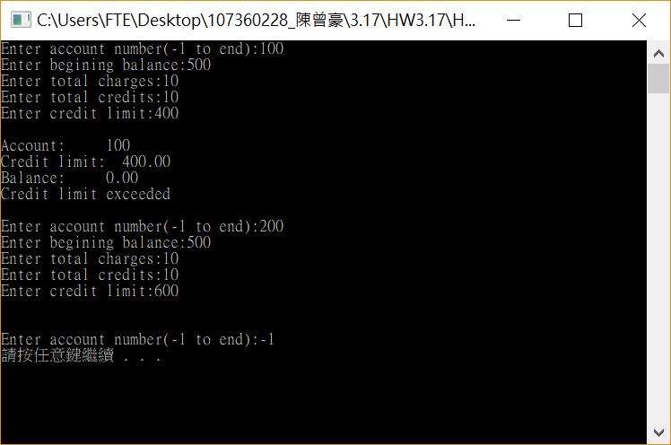
#include <stdio.h>
#include <stdlib.h>
int main(void)
{
int number , x;
double Bblance;
double charge;
double credit;
double limit;
for (int i = 0; i < 20; i++)
{
printf("Enter account number(-1 to end):");
scanf_s("%d", &number);
if (number == -1)
{
break;
}
else
{
printf("Enter begining balance:");
scanf_s("%lf", &Bblance);
printf("Enter total charges:");
scanf_s("%lf", &charge);
printf("Enter total credits:");
scanf_s("%lf", &credit);
printf("Enter credit limit:");
scanf_s("%lf", &limit);
printf("\n");
x = Bblance + charge - credit;
if (x > limit)
{
printf("Account: %d\n", number);
printf("Credit limit: %2.2f\n", limit);
printf("Balance: %2.2f\n", x);
printf("Credit limit exceeded\n");
}
}
printf("\n");
}
system("pause");
return 0;
}
就是個簡單的應用

Slide 2
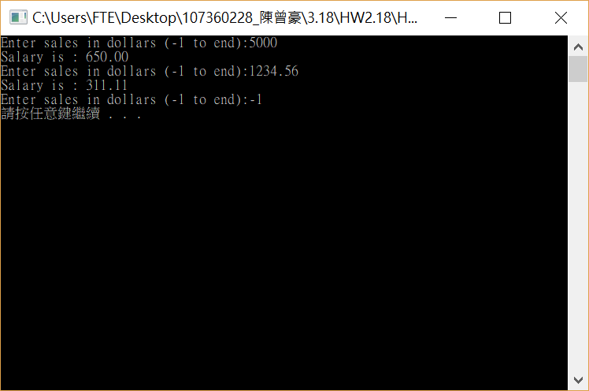
#include <stdio.h>
#include <stdlib.h>
int main(void)
{
double sale;
double salary;
for (int i = 0; i < 20; i++)
{
printf("Enter sales in dollars (-1 to end):");
scanf_s("%lf", &sale);
if (sale == -1)
{
break;
}
else
{
salary = 200 + (sale * 9 / 100);
printf("Salary is : %2.2f", salary);
}
printf("\n");
}
system("pause");
return 0;
}
也是個簡單的應用

Slide 3
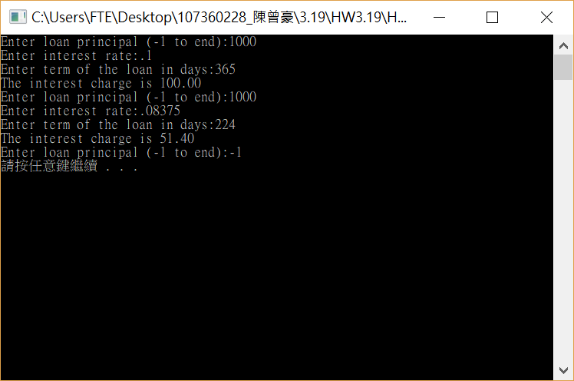
#include <stdio.h>
#include <stdlib.h>
int main(void)
{
double loan;
double rate;
int day;
double interest;
for (int i = 0; i < 20; i++)
{
printf("Enter loan principal (-1 to end):");
scanf_s("%lf", &loan);
if (loan == -1)
{
break;
}
else
{
printf("Enter interest rate:");
scanf_s("%lf", &rate);
printf("Enter term of the loan in days:");
scanf_s("%d", &day);
interest = loan * rate * day / 365;
printf("The interest charge is %2.2f", interest);
}
printf("\n");
}
system("pause");
return 0;
}
也是個簡單的應用

Slide 4
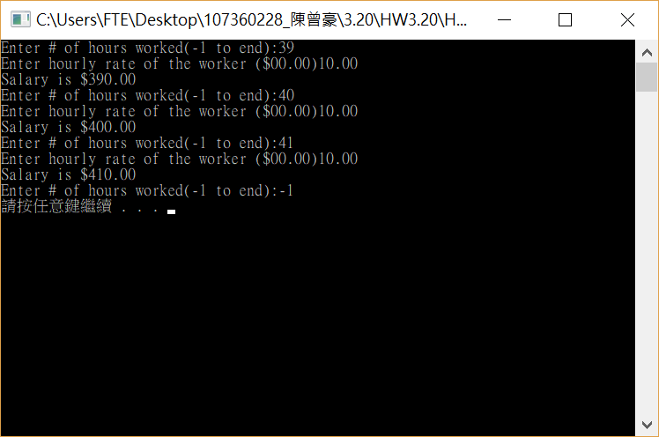
#include <stdio.h>
#include <stdlib.h>
int main(void)
{
int hour;
double rate;
double salary;
for (int i = 0; i < 20; i++)
{
printf("Enter # of hours worked(-1 to end):");
scanf_s("%d", &hour);
if (hour == -1)
{
break;
}
else
{
printf("Enter hourly rate of the worker ($00.00)");
scanf_s("%lf", &rate);
salary = hour * rate;
printf("Salary is $%2.2f", salary);
}
printf("\n");
}
system("pause");
return 0;
}

Slide 5

#include <stdio.h>
#include <stdlib.h>
int main(void)
{
int n, m;
printf("length = ");
scanf_s("%d", &n);
printf("breadth = ");
scanf_s("%d", &m);
for (int i = 1; i <= n; i++)
{
if (i == 1 || i == n)
{
for (int j = 1; j <= m; j++)
{
printf("*");
}
}
else
{
for (int k = 1; k <= m ; k++)
{
if (k == 1 || k == m )
{
printf("*");
}
else
{
printf(" ");
}
}
}
printf("\n");
}
system("pause");
return 0;
}

Slide 6
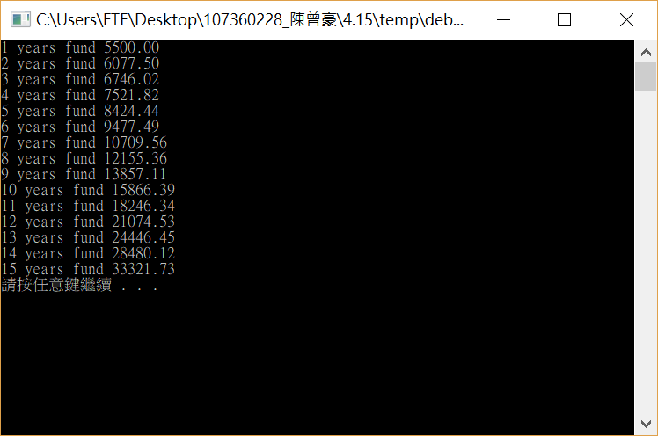
#include <stdio.h>
#include <stdlib.h>
int main(void)
{
double n;
double interest;
double rate;
n = 5000;
rate = 0.095;
for (int i = 1; i <= 15; i++)
{
rate = rate + 0.005;
n = n * rate + n;
printf("%d years fund %2.2f", i, n);
printf("\n");
}
system("pause");
return 0;
}

Slide 7
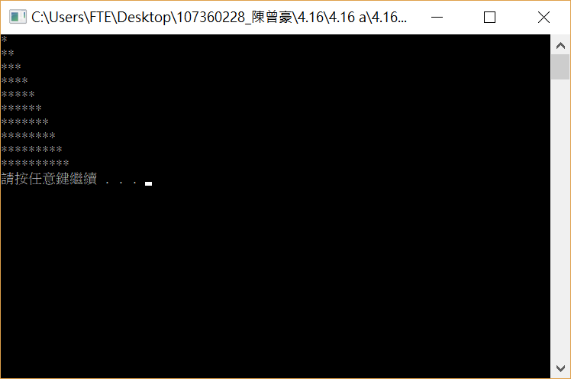
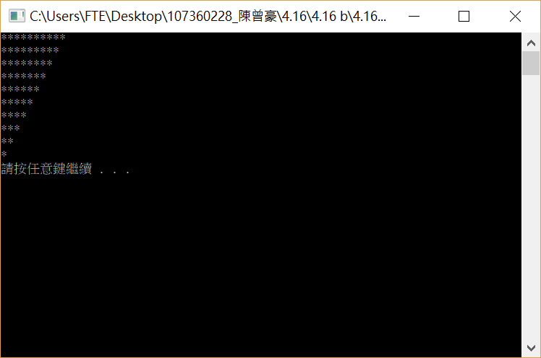
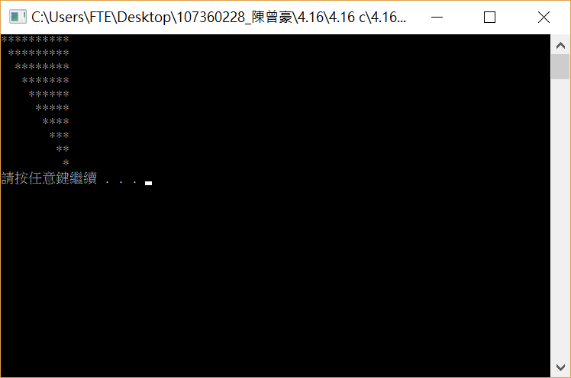


Slide 8
#include <stdio.h>
#include <stdlib.h>
int main(void)
{
for (int i = 1; i <= 10; i++)
{
for (int j = 1; j <=i ; j++)
{
printf("*");
}
printf("\n");
}
system("pause");
return 0;
}
#include <stdio.h>
#include <stdlib.h>
int main(void)
{
for (int i = 1; i <= 10; i++)
{
for (int j = 9; j >= i; j--)
{
printf(" ");
}
for (int k = 1; k <= i ; k++)
{
printf("*");
}
printf("\n");
}
system("pause");
return 0;
}
#include <stdio.h>
#include <stdlib.h>
int main(void)
{
for (int i = 1; i <= 10; i++)
{
for (int j = 10; j >= i; j--)
{
printf("*");
}
printf("\n");
}
system("pause");
return 0;
}
#include <stdio.h>
#include <stdlib.h>
int main(void)
{
for (int i = 1; i <= 10; i++)
{
for (int k = 1; k <= i-1 ; k++)
{
printf(" ");
}
for (int j = 10; j >= i; j--)
{
printf("*");
}
printf("\n");
}
system("pause");
return 0;
}

Slide 9
#include <stdio.h>
#include <stdlib.h>
int main(void)
{
for (int i = 1; i <= 500; i++)
{
for (int j = 1; j < i; j++)
{
for (int k = j; k < i; k++)
{
if (i * i == j * j + k * k)
{
printf("%d^2 = %d^2 + %d^2\n", i, j, k);
}
}
}
}
system("pause");
return 0;
}
我發現如果直接用i =1 to 500
只會出現斜邊 150 到 500 的所有可能。
#include <stdio.h>
#include <stdlib.h>
int main(void)
{
for (int i = 1; i <= 150; i++)
{
for (int j = 1; j < i; j++)
{
for (int k = j; k < i; k++)
{
if (i * i == j * j + k * k)
{
printf("%d^2 = %d^2 + %d^2\n", i, j, k);
}
}
}
}
system("pause");
return 0;
}

Slide 10
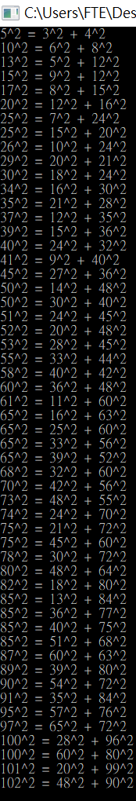
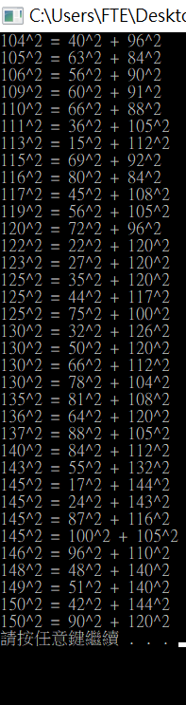
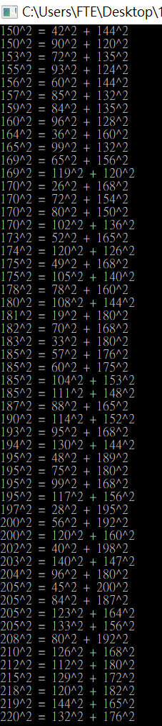

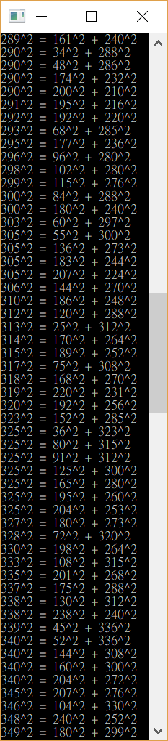
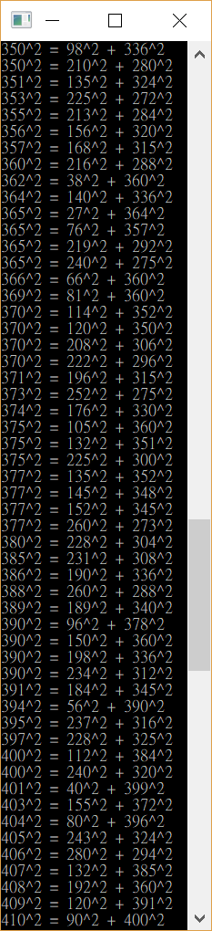
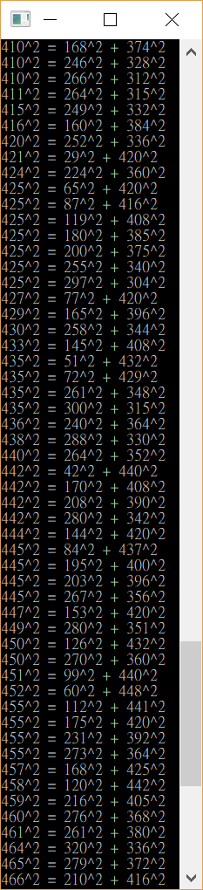
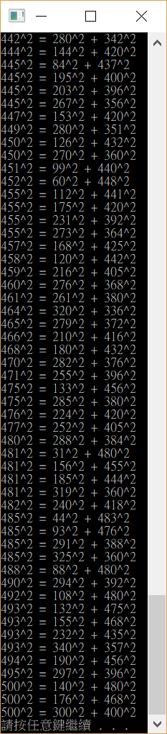

Slide 11
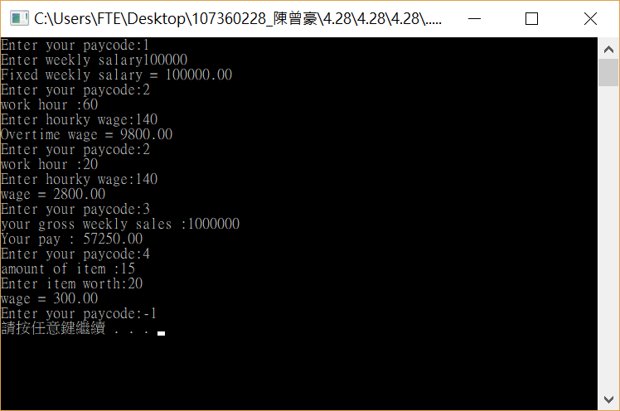
#include <stdio.h>
#include <stdlib.h>
int main(void)
{
int item,hour,paycode,overtime;
double wage;
double sales;
double salary;
for (int i = 1; i <= 20; i++)
{
printf("Enter your paycode:");
scanf_s("%d", &paycode);
if (paycode == -1)
{
break;
}
if (paycode == 1)
{
printf("Enter weekly salary");
scanf_s("%lf", &salary);
printf("Fixed weekly salary = %2.2f\n" , salary );
}
if (paycode == 2)
{
printf("work hour :");
scanf_s("%d", &hour);
printf("Enter hourky wage:");
scanf_s("%lf", &salary);
if (hour > 40)
{
wage = salary * 40 + 1.5 * (hour - 40) * salary;
printf("Overtime wage = %2.2f \n", wage);
}
else
{
wage = hour * salary;
printf("wage = %2.2f\n", wage);
}
}
if (paycode == 3)
{
printf("your gross weekly sales :");
scanf_s("%lf", &sales);
wage = 250 + sales * 5.7 / 100;
printf("Your pay : %2.2f\n",wage);
}
if (paycode == 4)
{
printf("amount of item :");
scanf_s("%d", &item);
printf("Enter item worth:");
scanf_s("%lf", &salary);
wage = salary * item;
printf("wage = %2.2f \n", wage);
}
}
system("pause");
return 0;
}

Slide 12
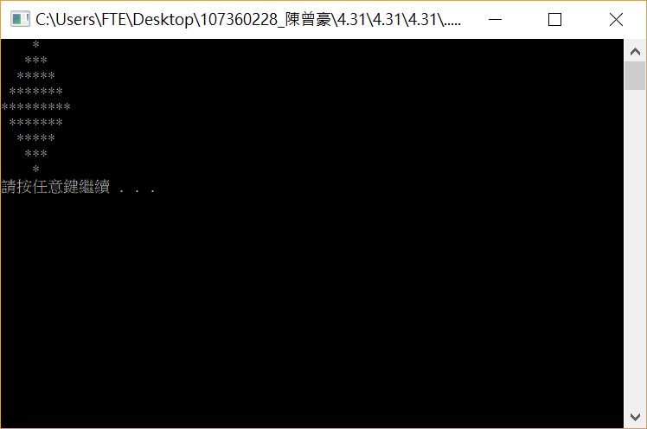
#include <stdio.h>
#include <stdlib.h>
int main(void)
{
for (int i = 1; i <= 5; i++)
{
for (int j = 1; j <= 5-i; j++)
{
printf(" ");
}
for (int k = 1; k <= 2*i - 1 ; k++)
{
printf("*");
}
printf("\n");
}
for (int i = 4; i >= 1; i--)
{
for (int j = 1; j <= 5 - i; j++)
{
printf(" ");
}
for (int k = 1; k <= 2 * i - 1; k++)
{
printf("*");
}
printf("\n");
}
system("pause");
return 0;
}
總結一下，我從這次作業學到很多商業英文，也學到很多for迴圈的應用。

Slide 13
