Slide 1
Layer analysis calculation results

Slide 2
Parameters
Num. cells | Z units | T (K) | kbT | dep. rate (ML/min) | dep. time (min) | post anneal(min) | prefactor | transform | keep defect | Cal. time (s)
5 | 5 | 550.0 | 0.0474 | 0.4 | 5.0 | 0.0 | 1.0E+13 | pass | True | 11 m 12 s
 | Ag-Si | Si(1-2) | Si(2-3) | Si(3-4) | Si(4-5) | Si(5-6) | Si(intra) | Si(inter) | Ag(top) | Trans.
Energy | -1.5 | -1.5 | -1.5 | -1.5 | -1.5 | -1.5 | -1.5 | -1.5 | -1.5 | -0.3

Slide 3
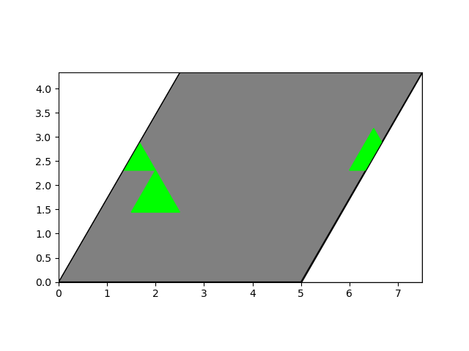
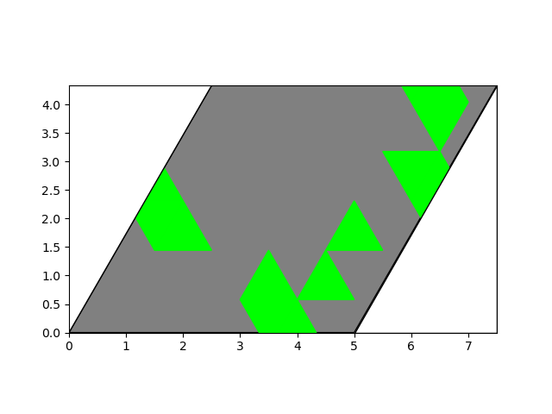
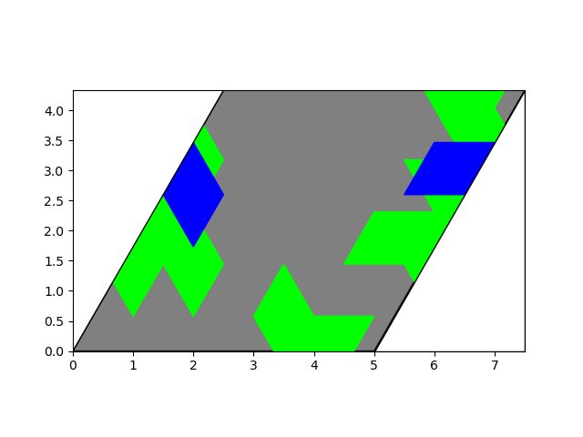
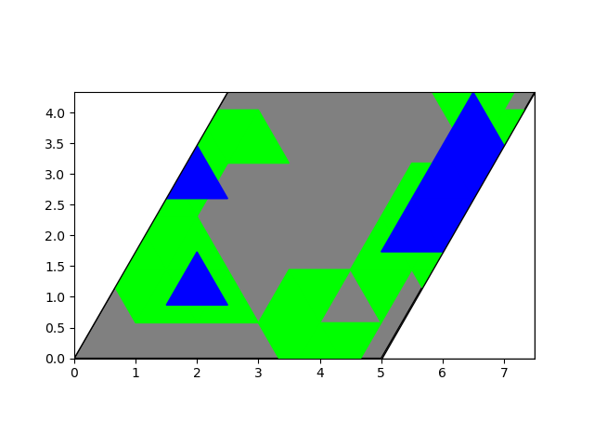
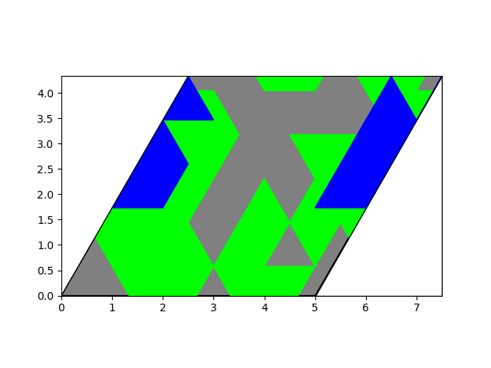
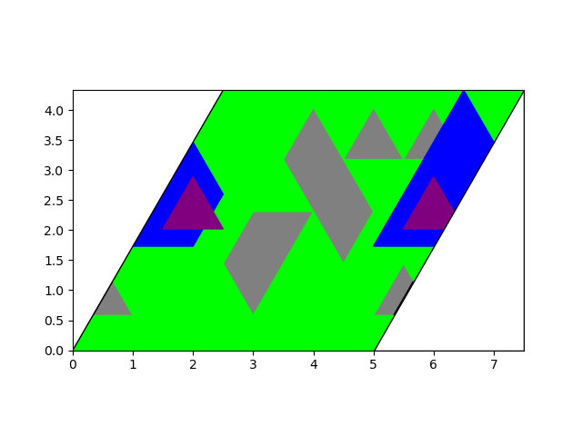
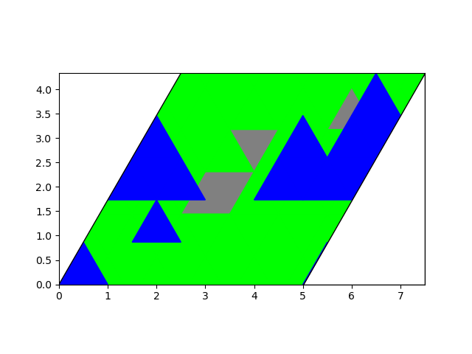
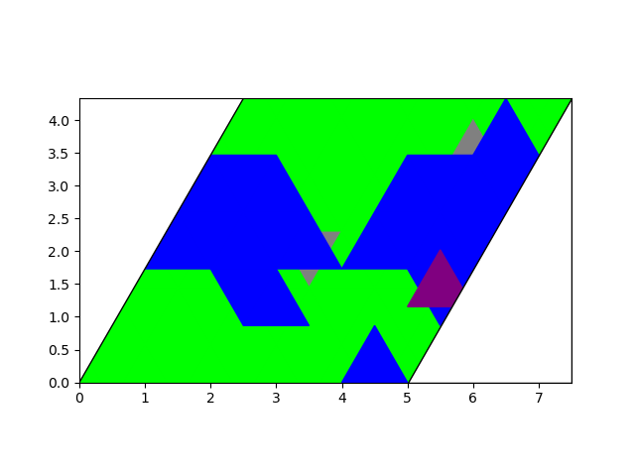
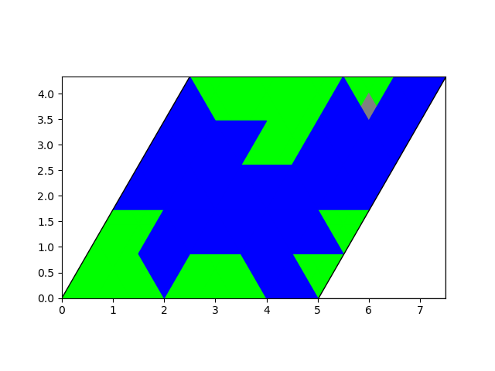
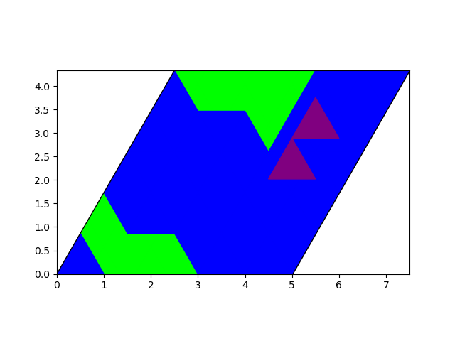
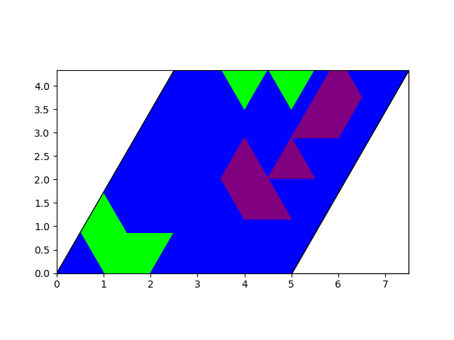
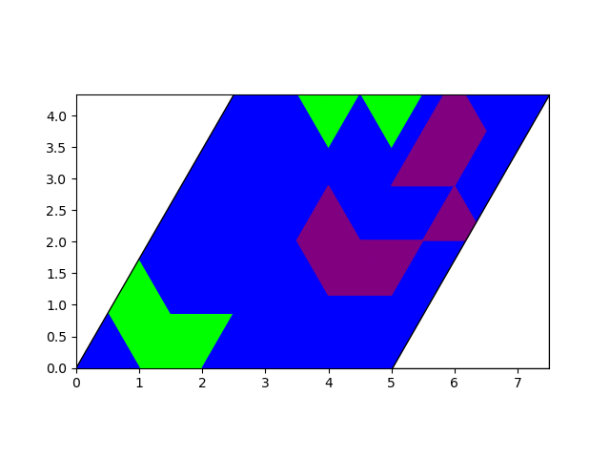
Results
5 s, 0.04 ML
29 s, 0.20 ML
59 s, 0.40 ML
89 s, 0.60 ML
119 s, 0.80 ML
149 s, 1.00 ML
179 s, 1.20 ML
209 s, 1.40 ML
239 s, 1.60 ML
269 s, 1.80 ML
299 s, 2.00 ML
302 s, 2.02 ML

Slide 4
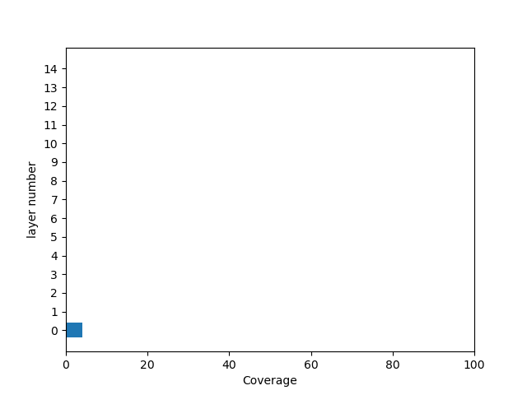
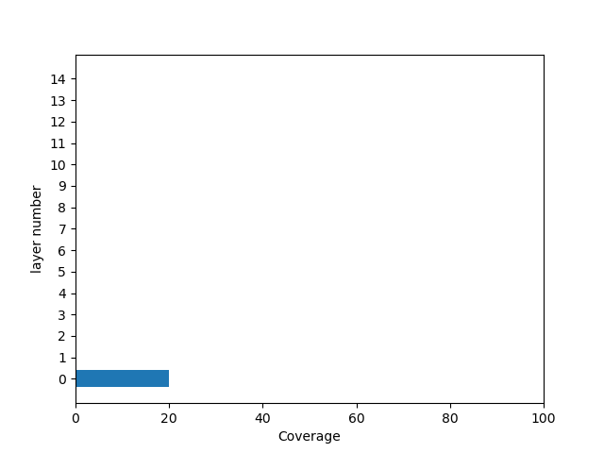
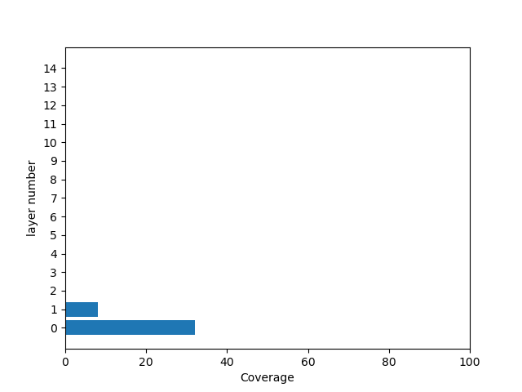
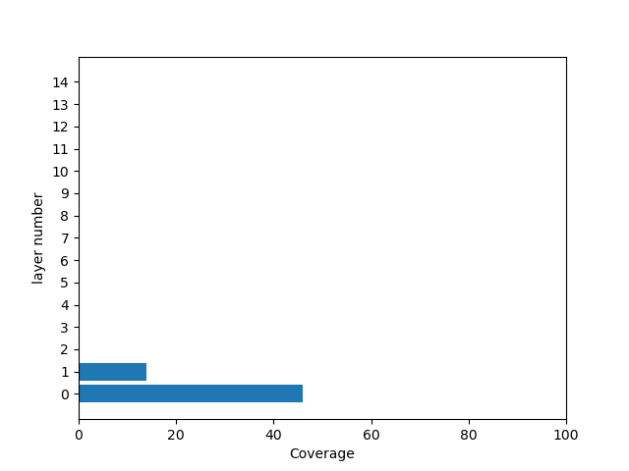
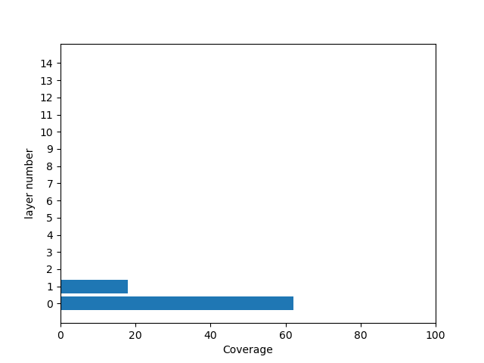
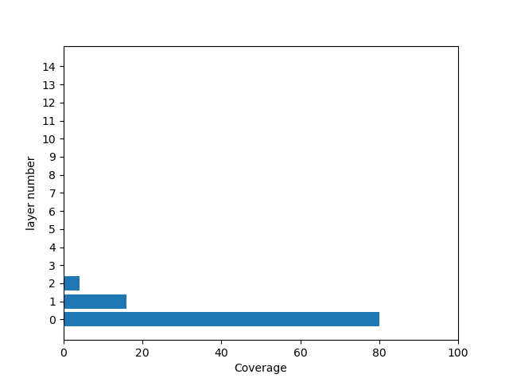
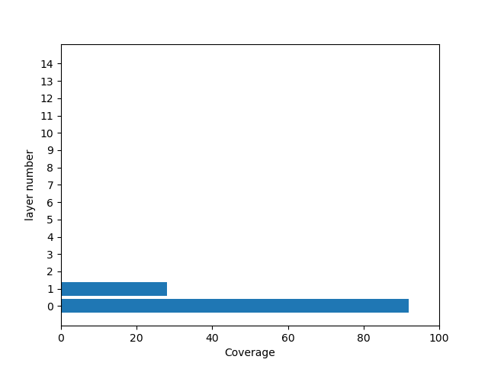
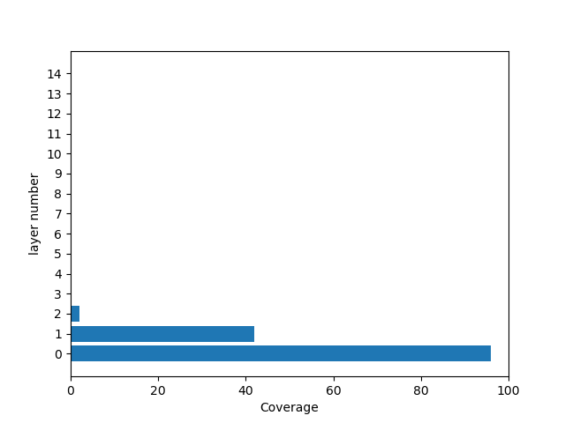
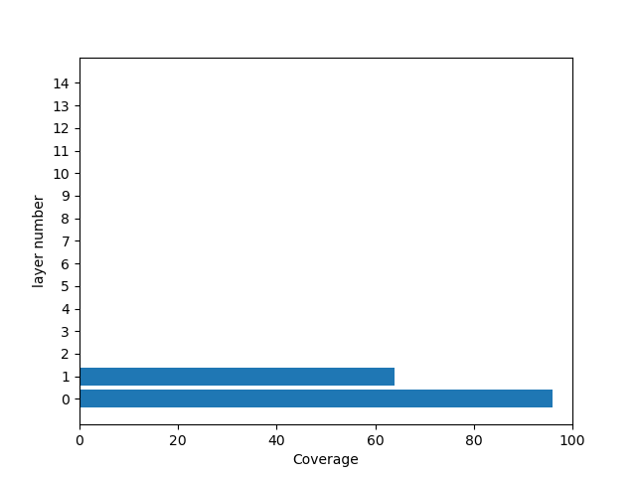
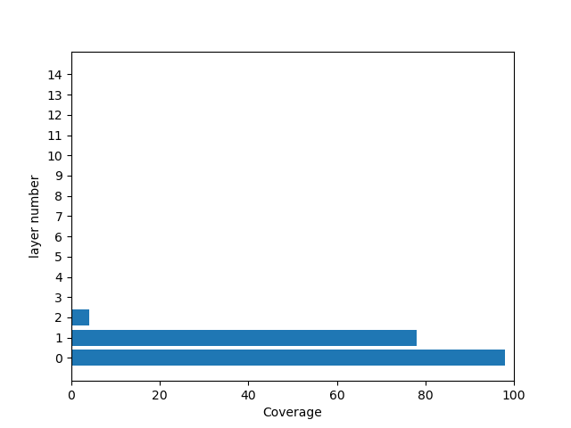
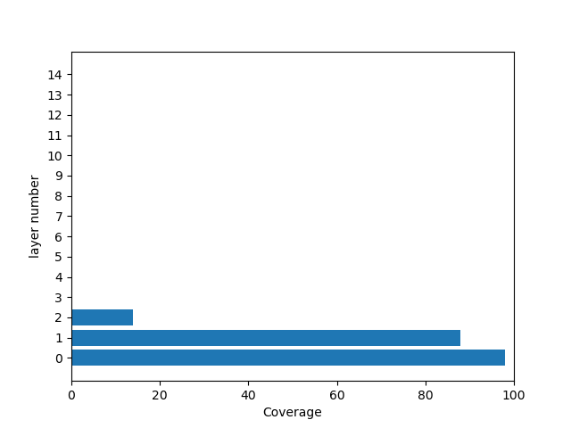

Results: layer analysis
5 s, 0.04 ML
29 s, 0.20 ML
59 s, 0.40 ML
89 s, 0.60 ML
119 s, 0.80 ML
149 s, 1.00 ML
179 s, 1.20 ML
209 s, 1.40 ML
239 s, 1.60 ML
269 s, 1.80 ML
299 s, 2.00 ML
302 s, 2.02 ML

Slide 5
Parameters
Num. cells | Z units | T (K) | kbT | dep. rate (ML/min) | dep. time (min) | post anneal(min) | prefactor | transform | keep defect | Cal. time (s)
5 | 5 | 550.0 | 0.0474 | 0.4 | 5.0 | 0.0 | 1.0E+13 | pass | True | 11 m 15 s
 | Ag-Si | Si(1-2) | Si(2-3) | Si(3-4) | Si(4-5) | Si(5-6) | Si(intra) | Si(inter) | Ag(top) | Trans.
Energy | -1.5 | -1.5 | -1.5 | -1.5 | -1.5 | -1.5 | -1.5 | -1.5 | -1.5 | -0.3

Slide 6
Results
5 s, 0.04 ML
29 s, 0.20 ML
59 s, 0.40 ML
89 s, 0.60 ML
119 s, 0.80 ML
149 s, 1.00 ML
179 s, 1.20 ML
209 s, 1.40 ML
239 s, 1.60 ML
269 s, 1.80 ML
299 s, 2.00 ML
302 s, 2.02 ML

Slide 7
Results
302 s, 2.02 ML

Slide 8
Results: layer analysis
5 s, 0.04 ML
29 s, 0.20 ML
59 s, 0.40 ML
89 s, 0.60 ML
119 s, 0.80 ML
149 s, 1.00 ML
179 s, 1.20 ML
209 s, 1.40 ML
239 s, 1.60 ML
269 s, 1.80 ML
299 s, 2.00 ML
302 s, 2.02 ML

Slide 9
Results: layer analysis
302 s, 2.02 ML

