Slide 1
Layer analysis calculation results

Slide 2
Parameters
Num. cells | Z units | T (K) | kbT | dep. rate (ML/min) | dep. time (min) | prefactor | Cal. time (s) | Finishing time
20 | 5 | 550.0 | 0.0474 | 0.1 | 20.0 | 1.0E+13 | 11388 m 15 s | 2021/08/31/ 10:04:24
Keep defects | Put at first | Cut event | Rate limit | Subtract a bond from diffusion | Transformation | Method | time/event (ms)
False | True | False | False | True | False | Rejection_free
1 | 10 | 3000000 | 1000.0 |  | 100 |  | 1.67
 | Si(1st) | Si(2nd) | Si(3rd) | Si(else)
Diffusion (eV) | 1.06 | 0.96 | 0.96 | 0.96
Binding (eV) | 0.2 | 0.2 | 0.2 | 0.2
Comment: pre 13

Slide 3
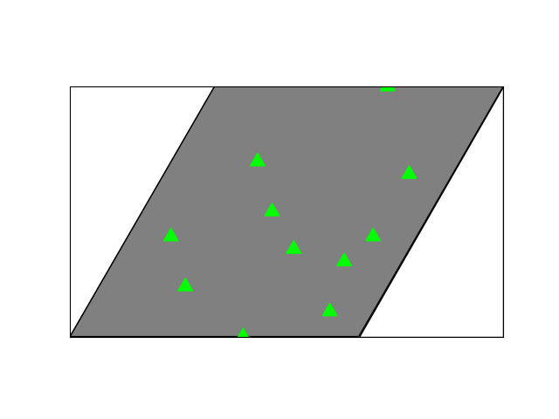
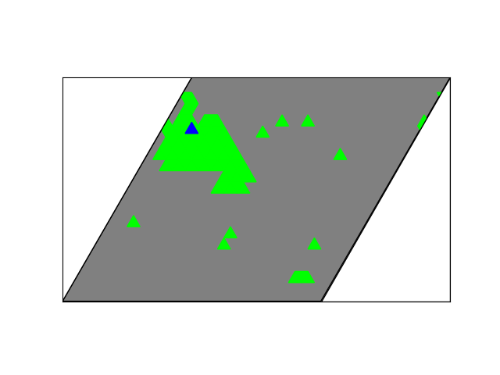
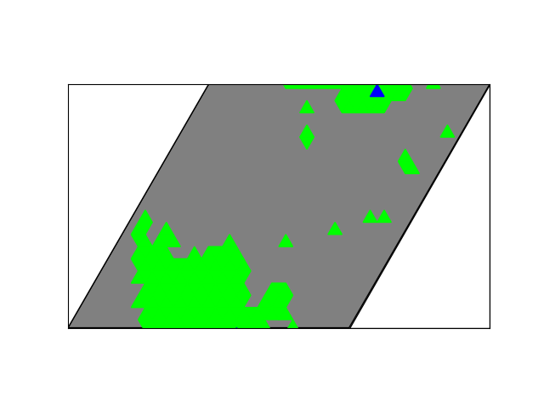
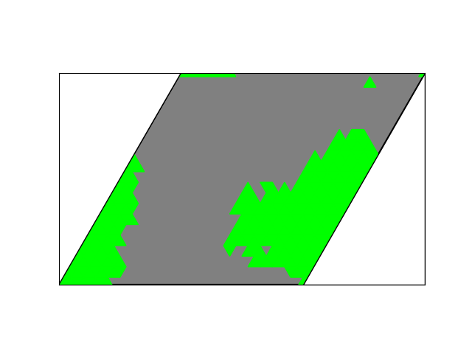
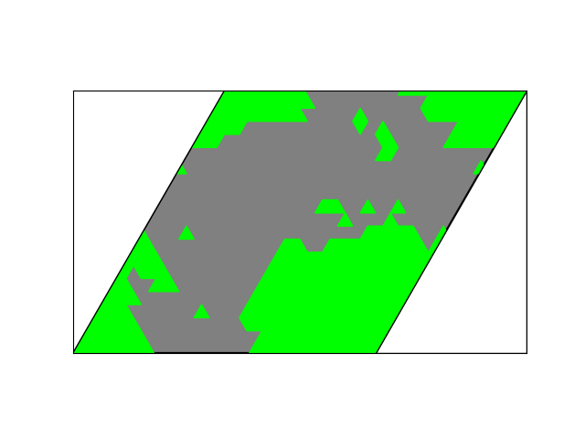
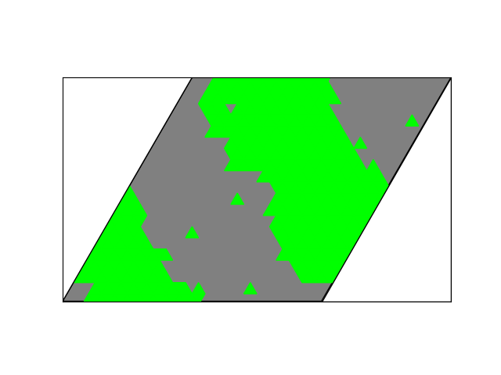
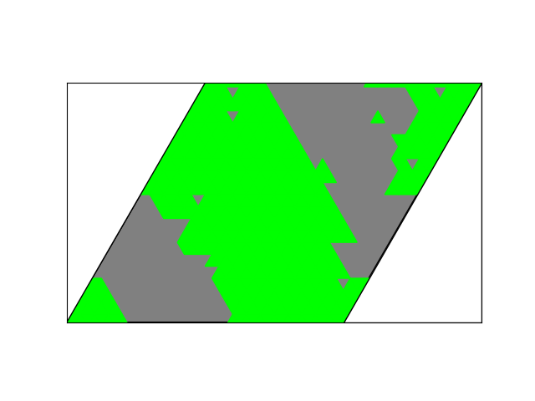
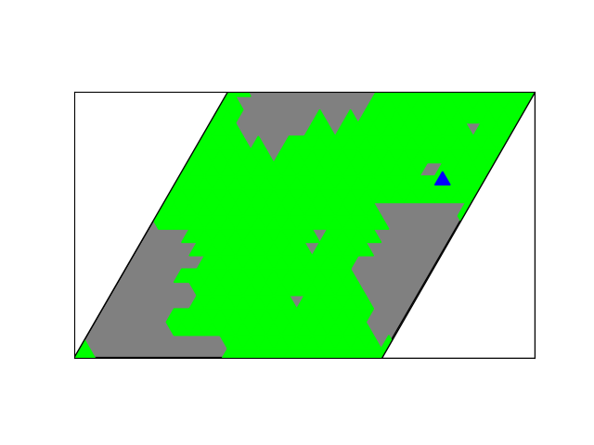
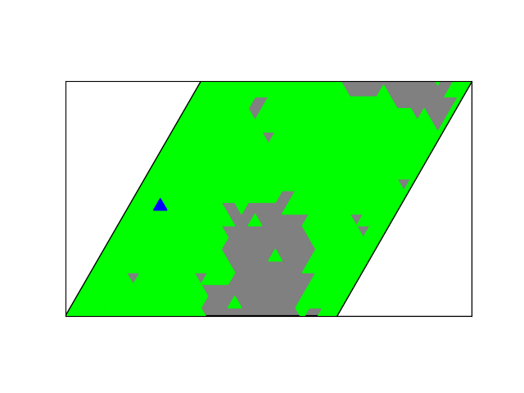
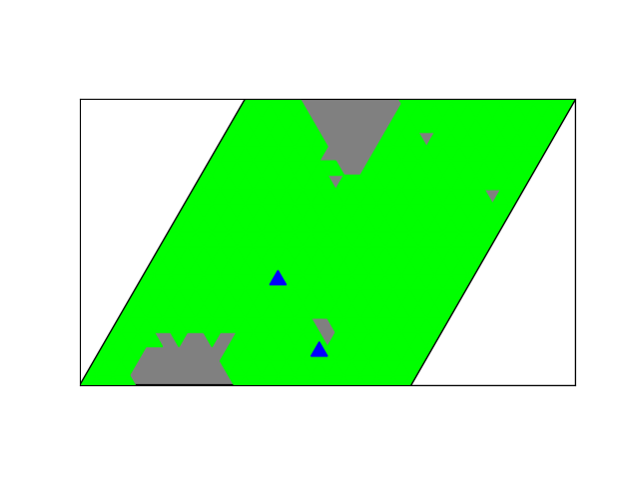
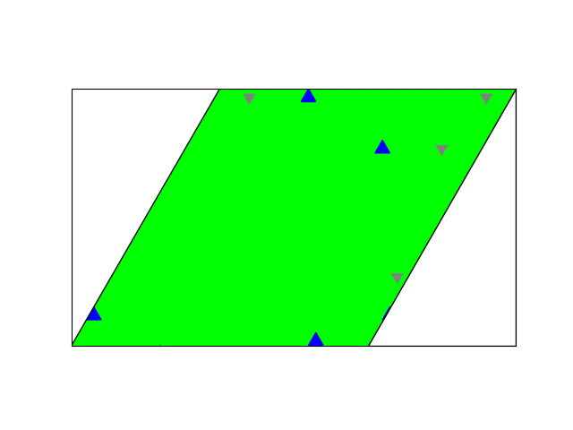
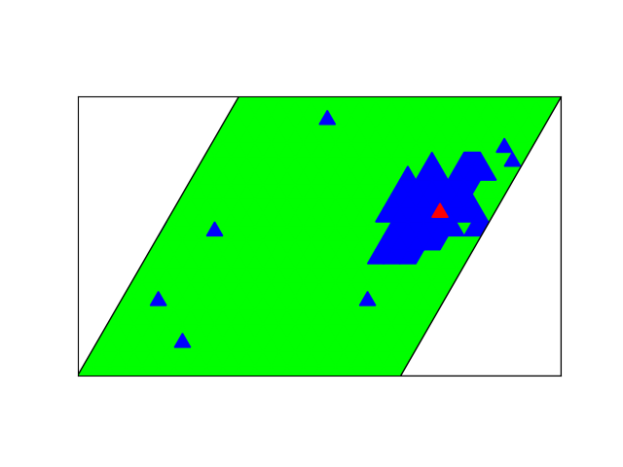
Results
7 s, 0.01 ML
59 s, 0.10 ML
119 s, 0.20 ML
179 s, 0.30 ML
239 s, 0.40 ML
299 s, 0.50 ML
359 s, 0.60 ML
419 s, 0.70 ML
479 s, 0.80 ML
539 s, 0.90 ML
599 s, 1.00 ML
659 s, 1.10 ML

Slide 4
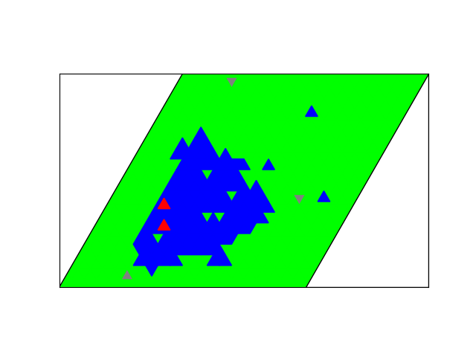
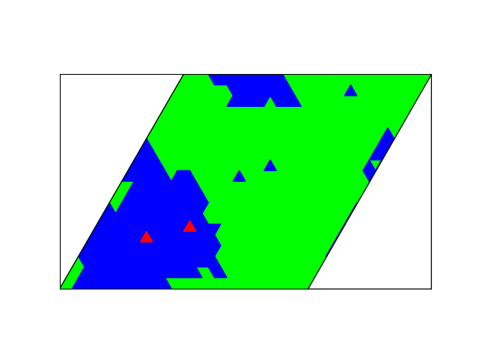
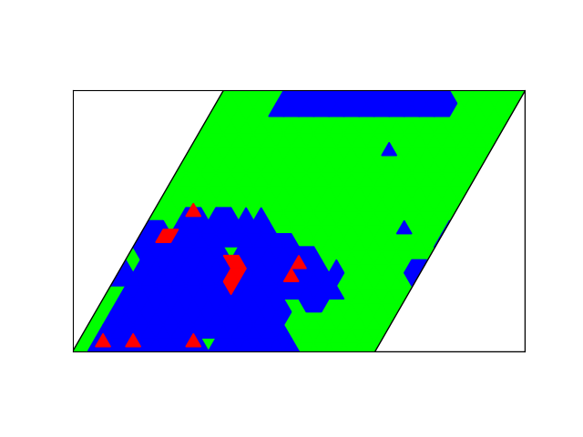
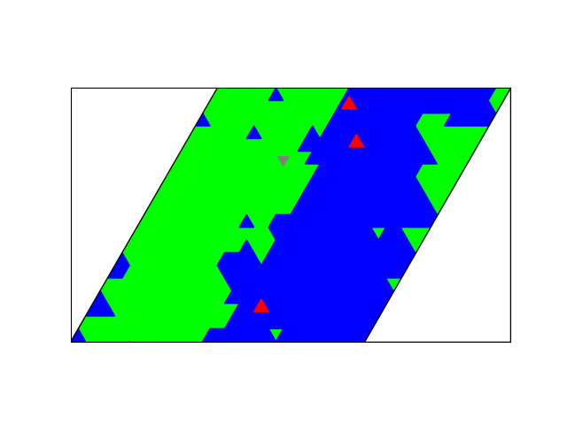
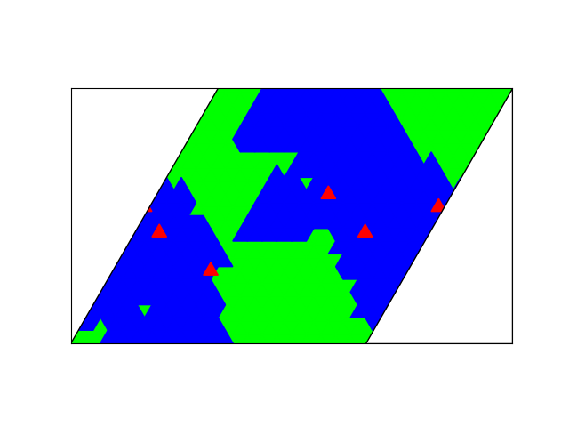
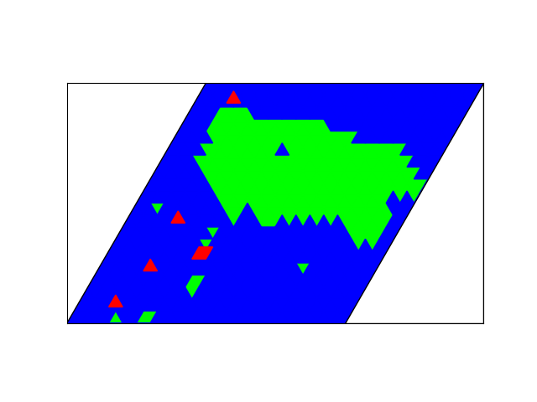
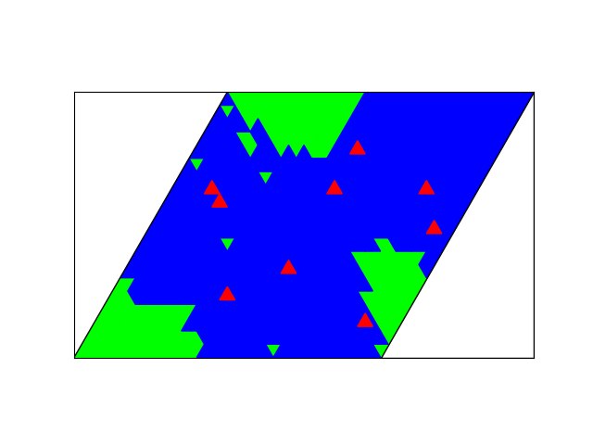
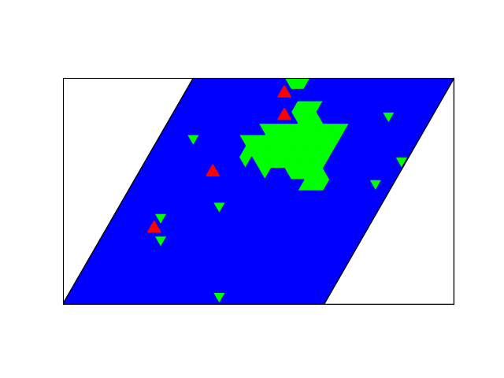
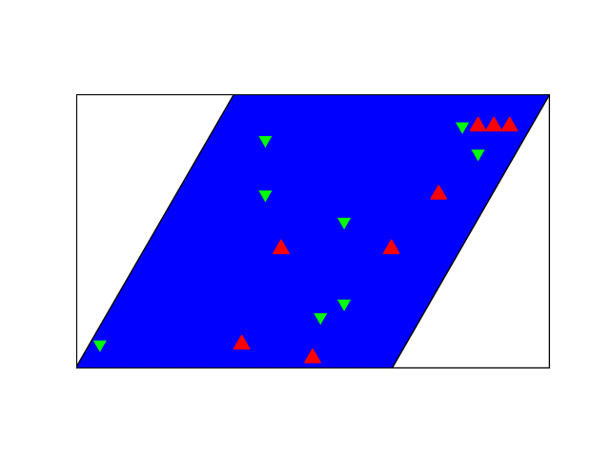
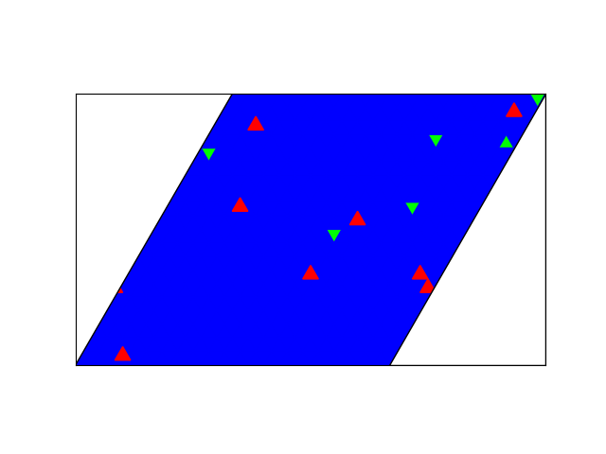
Results
719 s, 1.20 ML
779 s, 1.30 ML
839 s, 1.40 ML
899 s, 1.50 ML
959 s, 1.60 ML
1019 s, 1.70 ML
1079 s, 1.80 ML
1139 s, 1.90 ML
1199 s, 2.00 ML
1201 s, 2.00 ML

Slide 5
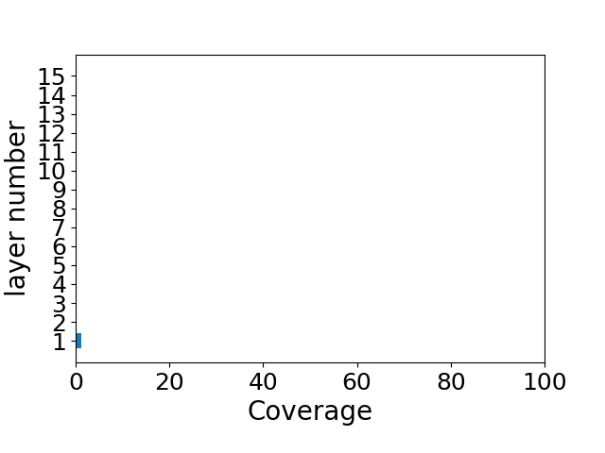
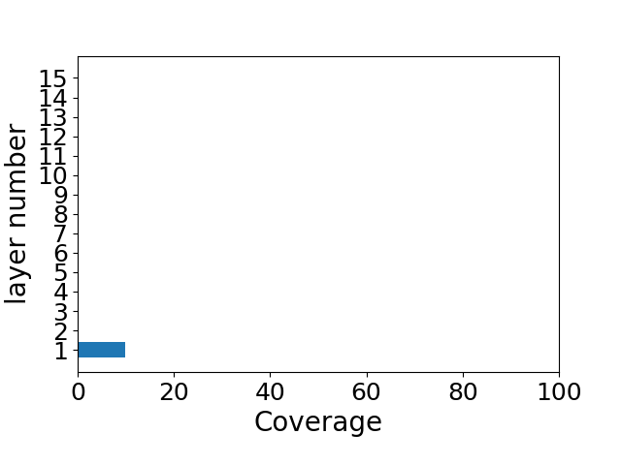
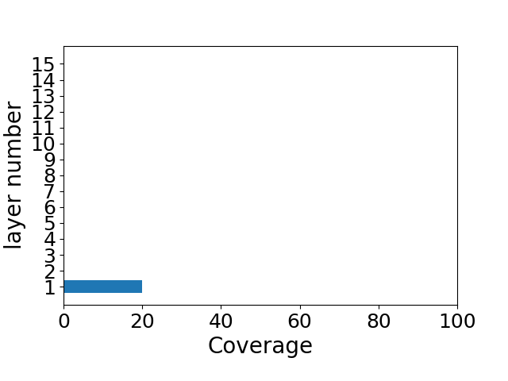
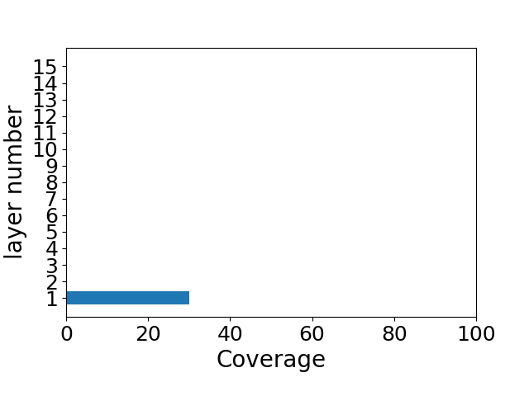
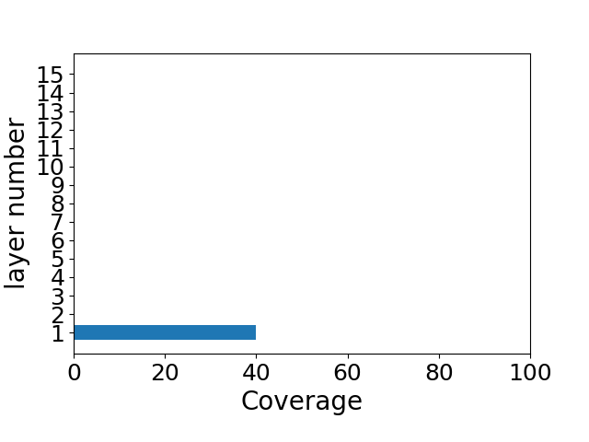
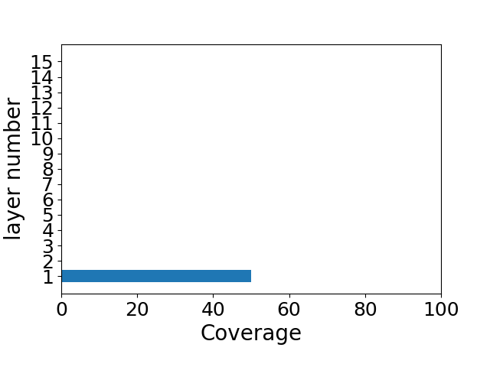
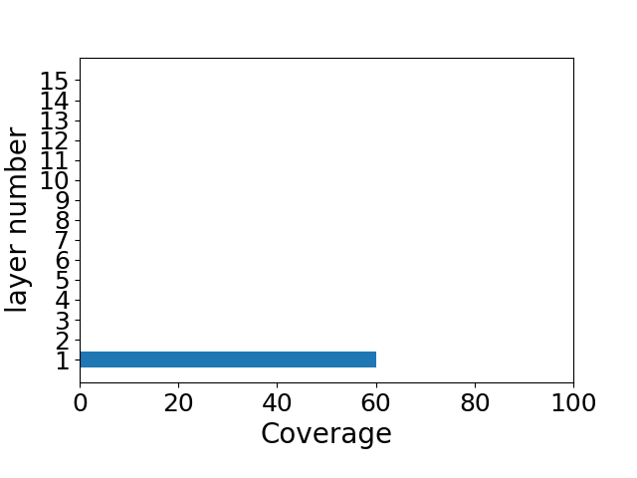
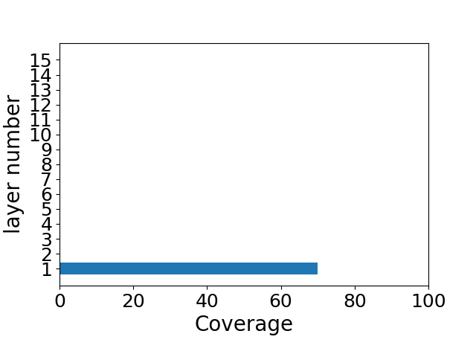
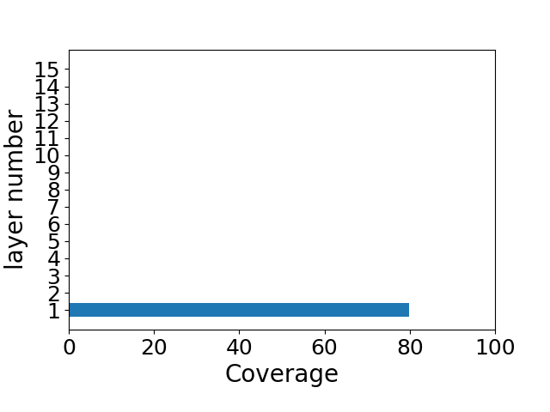
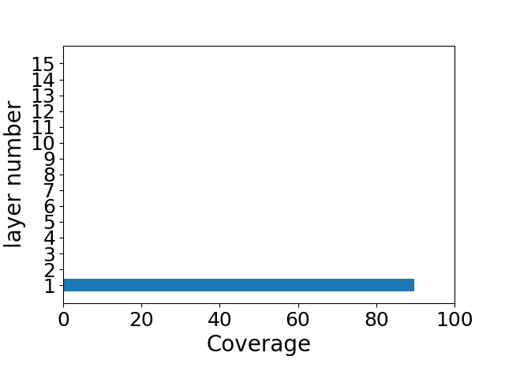
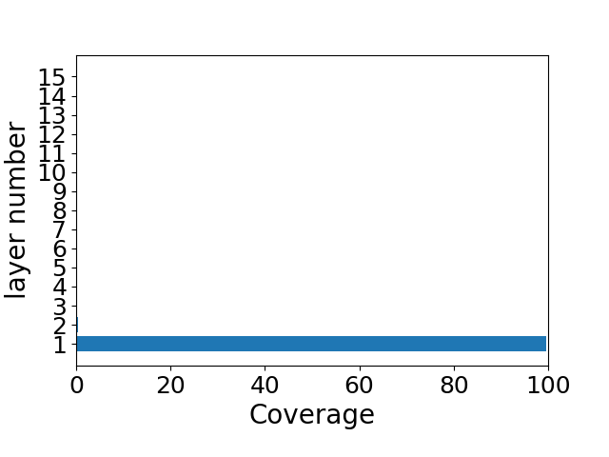
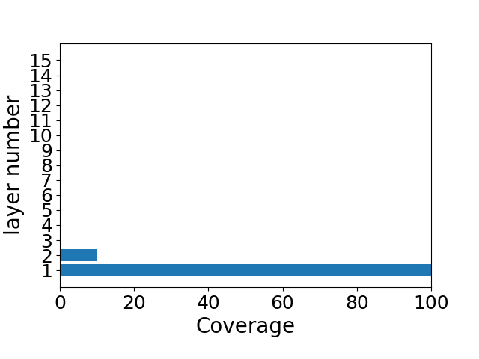
Results: layer analysis
7 s, 0.01 ML
59 s, 0.10 ML
119 s, 0.20 ML
179 s, 0.30 ML
239 s, 0.40 ML
299 s, 0.50 ML
359 s, 0.60 ML
419 s, 0.70 ML
479 s, 0.80 ML
539 s, 0.90 ML
599 s, 1.00 ML
659 s, 1.10 ML

Slide 6
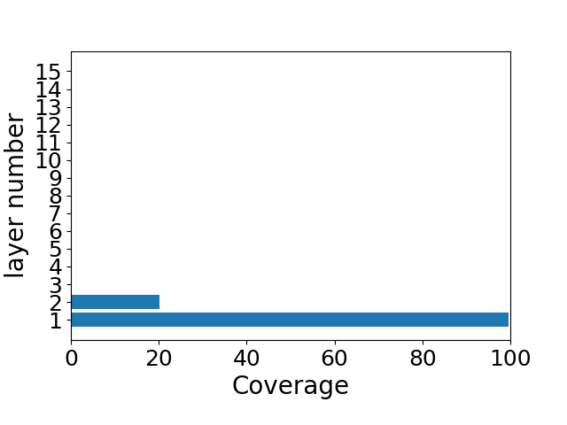
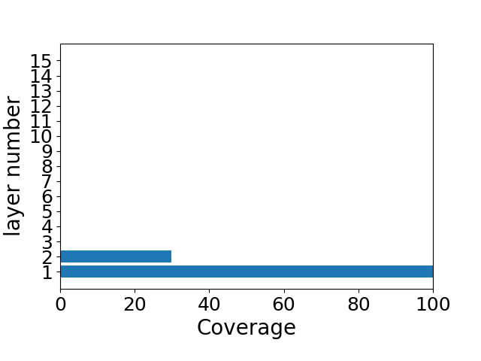
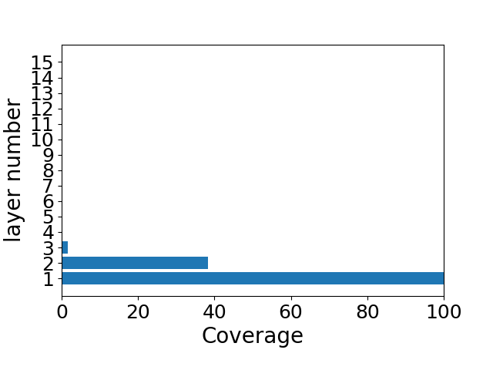
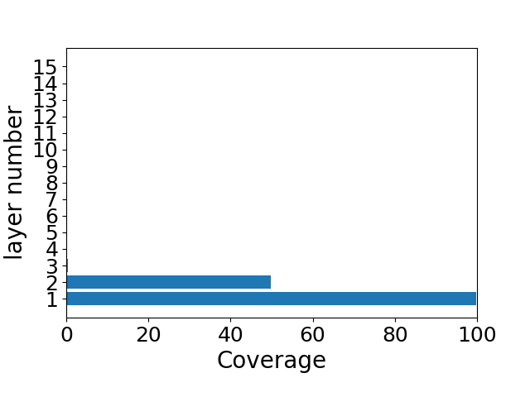
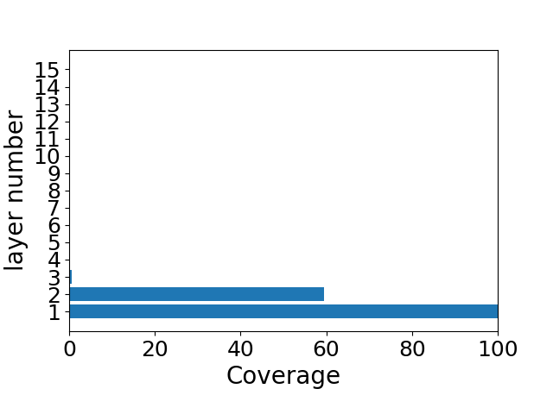

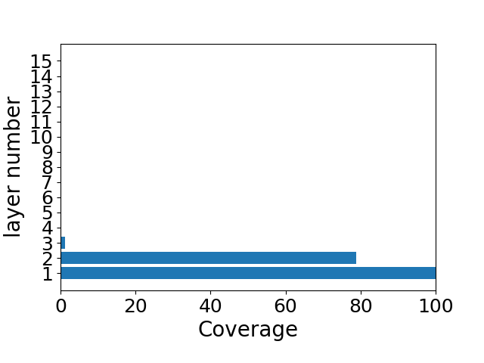
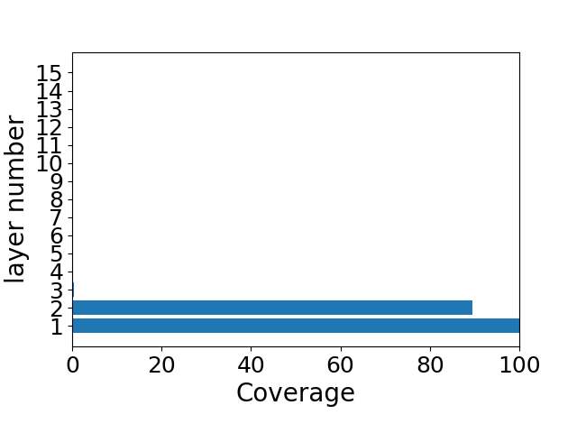
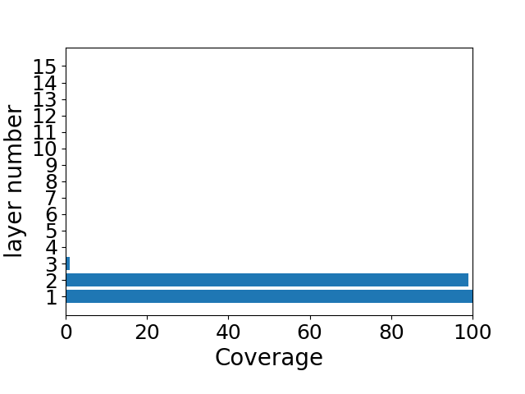

Results: layer analysis
719 s, 1.20 ML
779 s, 1.30 ML
839 s, 1.40 ML
899 s, 1.50 ML
959 s, 1.60 ML
1019 s, 1.70 ML
1079 s, 1.80 ML
1139 s, 1.90 ML
1199 s, 2.00 ML
1201 s, 2.00 ML

Slide 7
Growth mode
Coverage | 0.0125 | 0.1 | 0.2 | 0.3 | 0.4 | 0.5 | 0.6 | 0.7
Ag | 98.75 | 89.88 | 79.38 | 69.62 | 59.38 | 49.0 | 38.75 | 29.62
1st layer | 1.25 | 10.0 | 20.5 | 30.38 | 40.62 | 51.0 | 61.25 | 70.25
2nd layer | 0.0 | 0.12 | 0.12 | 0.0 | 0.0 | 0.0 | 0.0 | 0.12
Multi layer | 0.0 | 0.0 | 0.0 | 0.0 | 0.0 | 0.0 | 0.0 | 0.0
Coverage | 0.8 | 0.9 | 1.0 | 1.1 | 1.2 | 1.3 | 1.4 | 1.5
Ag | 19.62 | 9.62 | 0.5 | 0.0 | 0.25 | 0.0 | 0.0 | 0.12
1st layer | 80.25 | 90.12 | 99.0 | 90.12 | 79.38 | 69.5 | 61.25 | 49.75
2nd layer | 0.12 | 0.25 | 0.5 | 9.75 | 20.12 | 30.25 | 36.62 | 49.75
Multi layer | 0.0 | 0.0 | 0.0 | 0.12 | 0.25 | 0.25 | 2.12 | 0.38
Coverage | 1.6 | 1.7 | 1.8 | 1.9 | 2.0 | 2.0025
Ag | 0.0 | 0.0 | 0.0 | 0.0 | 0.0 | 0.0
1st layer | 39.88 | 30.25 | 20.5 | 10.25 | 1.0 | 0.62
2nd layer | 59.5 | 68.88 | 78.38 | 89.25 | 98.0 | 98.38
Multi layer | 0.62 | 0.88 | 1.12 | 0.5 | 1.0 | 1.0
Mode | First layer at 1ML | Second layer at 2ML | First layer/100-Multi at 2ML
FM | 99.0 | 98.0 | 1.0101010101010102

Slide 8
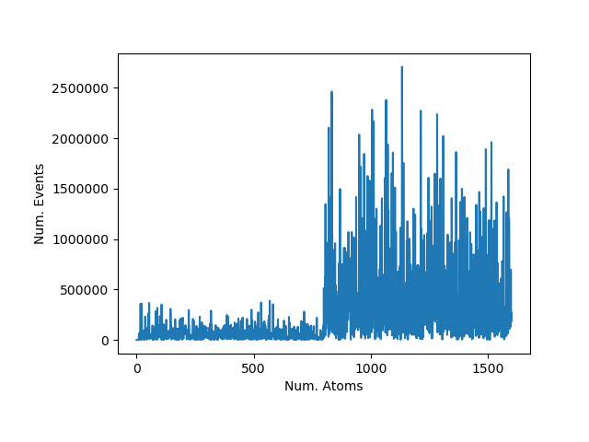
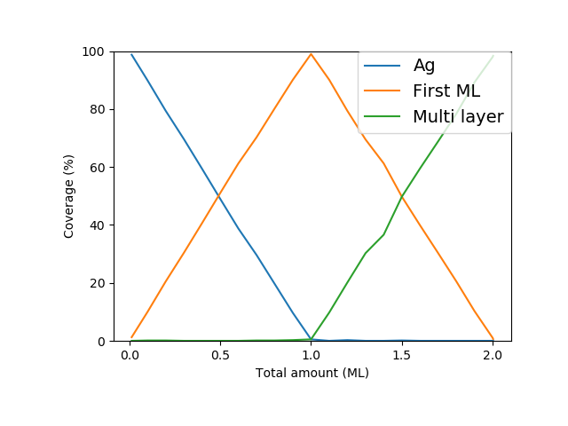
Number of events per deposition Change of coverage

