Slide 1


Slide 2
Instructions
Reference slide– Remove before submission
1. Use the given template for your idea submission.
1. Follow file naming format: Team name_Idea Name.pptx
Ensure the spell check is done before submitting
Use standard Arial font, alignment and relevant images (as required)

Slide 3


Team details
TEAM NAME: +One
Kaushal Kulkarni College: Pune Institute of Computer Technology Stream: Electronics and Telecommunication Year of graduation: 2024
All fields are mandatory

Slide 4
Problem statement and description
Problem statement : Develop a software to provide actionable insights and recommendations for businesses and organizations, enabling them to reduce their environmental footprint, optimize resource usage, and contribute to a more sustainable and transparent future.
Key points:
The project aims to confront pressing environmental challenges by leveraging the capabilities of generative AI. It seeks to develop a sophisticated system capable of collecting and analyzing data from diverse sources, such as energy consumption, waste generation, and resource utilization. By doing so, it can identify inefficiencies, predict environmental impacts, and recommend sustainable practices.
This software intends to promote circular economy principles. It will include features that enable businesses and organizations to optimize resource utilization, reduce waste, and enhance recycling efforts. By facilitating the adoption of circular economy practices, this solution contributes to a more sustainable and responsible consumption pattern.
It will provide a user-friendly dashboard for businesses to visualize and understand the data-driven insights. Customization options allow organizations to set and track sustainability goals, while reporting features enable them to monitor progress over time.

Slide 5
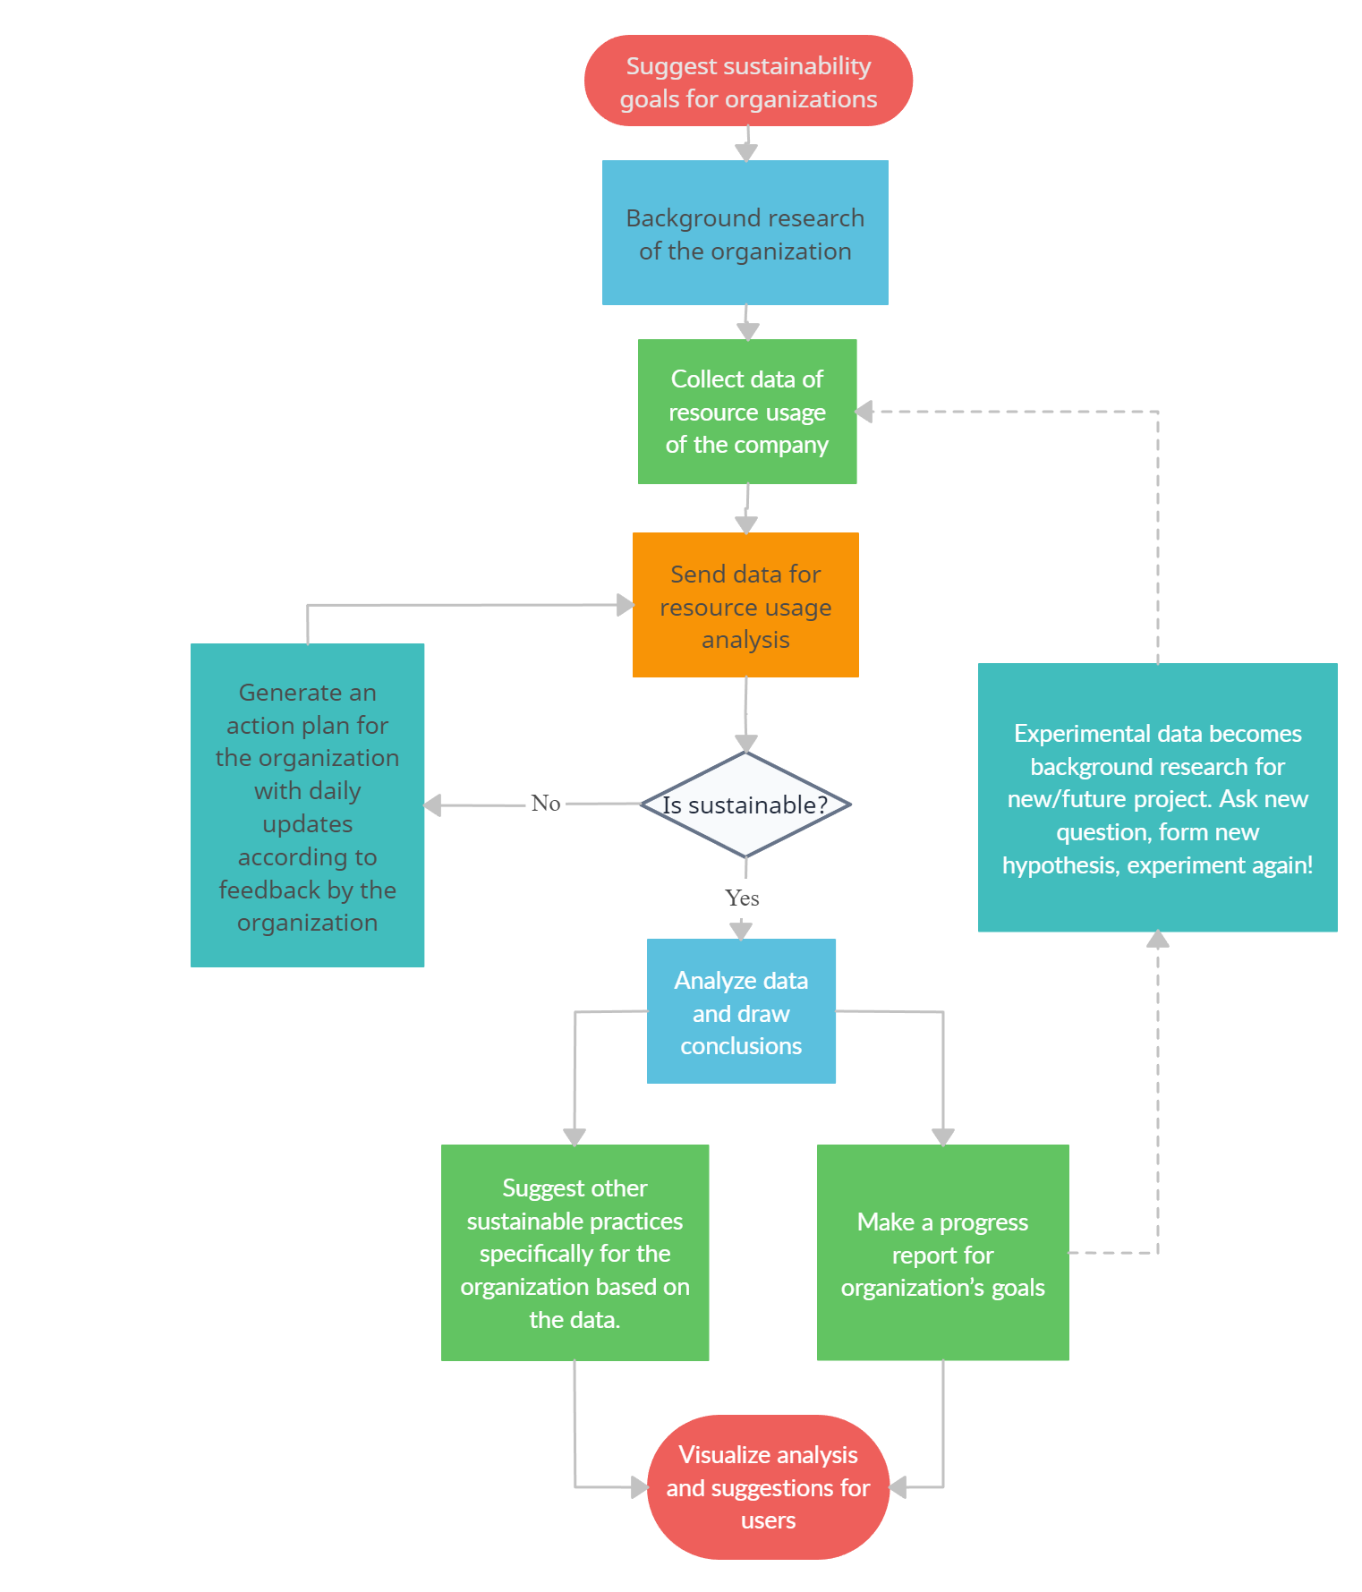
Proposed solution and flowchart
Data Collection and Preprocessing: Users select specific data sources relevant to their organization or goals. The platform collects and preprocesses data of the organization, preparing it for analysis.
AI Analysis: Advanced AI models are applied to the collected data. These models analyze the data to identify patterns, inefficiencies, and potential areas for sustainability improvements.
Sustainability Recommendations: Based on the AI analysis, the platform generates specific sustainability recommendations. These recommendations are presented to users as actionable insights, providing guidance on how to improve sustainability practices.
Customization: Users have the option to customize their sustainability goals. They can set objectives aligned with their organization's values and objectives, fine-tuning the recommendations.
Reporting: The platform generates sustainability reports based on user data and AI analysis. Users can review these reports to track their progress over time, making data-driven decisions.
Data Transparency: To ensure transparency and trust, the platform provides features that explain how AI-generated recommendations were derived. Users can gain insights into the reasoning behind the sustainability suggestions.
Dashboard: Upon login, users are directed to their personalized dashboard. Here, they can initiate the data analysis process and configure their sustainability preferences.

Slide 6
How does your innovation accelerate change with the power of Technology?
Tech stack:
Python
Django
ReactJS
Tensorflow
Supervised machine learning
Power BI
Pandas
Numpy
Generative adversarial networks
Recurrent Neural Networks
Git/GitHub
The platform leverages advanced AI and data analytics to process vast amounts of data quickly and accurately. This empowers users to make informed decisions based on real-time insights, accelerating their ability to address environmental challenges and improve sustainability practices.
Improved efficiency and resource utilization, directly contributing to sustainability goals.
Technology facilitates transparency in how sustainability recommendations are generated. Users can understand the rationale behind AI- generated suggestions, building trust in the platform's guidance and accelerating adoption.
The platform's technology allows users to access and manage sustainability initiatives remotely, making it convenient and accessible across geographies and time zones, thereby accelerating global sustainability efforts.
This idea has the potential to bring about significant positive changes in the environment by addressing several critical aspects of sustainability:
Reduction in Environmental Footprint
Promotion of Circular Economy
Energy Efficiency
Waste Reduction
Natural Resource Conservation
Ecosystem Preservation
Mitigation of Climate Change
Education and Awareness

Slide 7
How is your solution different/unique from other solutions in market (150 words)
The incorporation of generative AI models sets this platform apart. Generative AI enables advanced data analysis, anomaly detection, and prediction capabilities, allowing for more accurate and insightful sustainability recommendations.
The platform's emphasis on user customization distinguishes it.
Strong focus on circular economy practices
Prioritizes transparency in how AI-generated recommendations are derived.
Its integration with existing systems and scalability make it adaptable to businesses of all sizes and industries.
The user-friendly dashboard and data visualization tools make it accessible and intuitive for users with varying levels of technical expertise.
Through transparency, reporting, and explanations of AI recommendations, the platform serves as an educational tool. It helps users understand the environmental impact of their decisions and fosters responsible behavior.
PATENT FILED: No
Do you have a working model/prototype: No (Partially ready)
If not, will you be able to show working prototype during finale. Yes

Slide 8


Thank you!

