Slide 1
Leveraging Kubernetes mechanisms for adaptive and cost-efficient resource management
Stef Verreydt, Emad Heydari eni, Eddy Truyen, Bert Lagaisse, Wouter Joosen
Containers ‘19

Slide 2
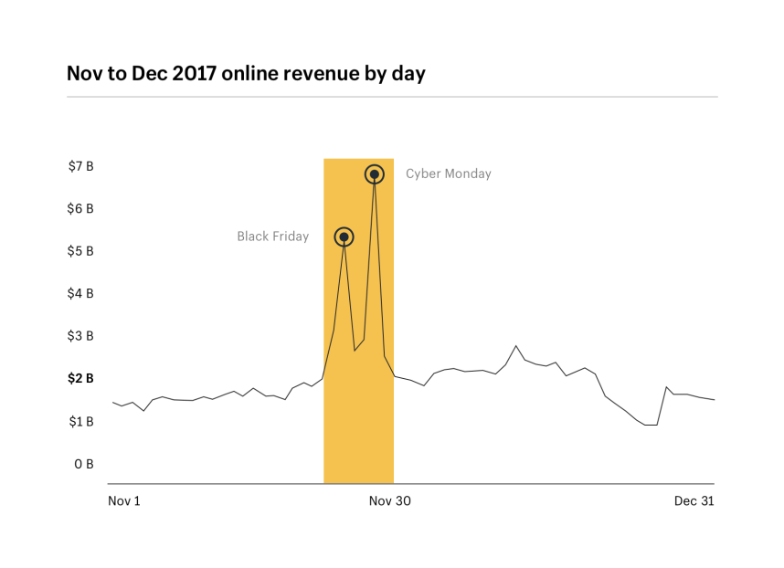
Motivation
SaaS provider: minimize operational costs while meeting customer requirements
https://www.shopify.com/enterprise/holiday-shopping-online
Notes:
In general, SaaS providers aim for a high performance using as few resources as possible.

Slide 3
Motivation
Kubernetes became de facto standard for container orchestration in a very short time
Kubernetes evolves quickly
Companies often don’t have required knowledge in-house
Documentation is not always clear
Notes:
To manage applications in the cloud, container orchestration frameworks like Kubernetes can be used.

Slide 4
Kubernetes
HPA: Horizontal Pod Auto-scaler
Threshold based → purely reactive
VPA: Vertical Pod Autoscaler
Needs to restart Pod
Current state: Beta
Notes:
In general, managing resources for changing workloads is done via auto-scalers
Reactive may not be sufficient
Restarting pod may not be optimal

Slide 5
Kubernetes
Requests and limits:
Request: resources a container is guaranteed to get
Σcontainer requests ≤ node resources
Limit: maximum amount of resources used by container
Σcontainer limits may be higher than total node resources
→ Oversubscription
Overprovisioned resources divided according to relative weight of the requests

Slide 6
Caravel (2019)
Scheduler co-scheduling stateful and stateless applications in containerized environments
Stateful containers require more care to schedule when compared to stateless applications
Prioritize stateful containers
Tolerate bursty behavior of stateful containers
This paper: achieve similar behavior using Kubernetes mechanisms
U. Deshpande. Caravel: Burst tolerant scheduling for containerized stateful applications. In 2019 IEEE 39th International Conference on Distributed Computing Systems (ICDCS), Nov. 2019
Notes:
Most recent research related to auto-scaling in Kubernetes is focussed towards building custom auto-scalers on top of Kubernetes, not on the Kubernetes mechanisms themselves.

Slide 7
HyScale (2018)
Mentions how requests and limits can be used to “induce a form of vertical scaling”
But only compares the hybrid solution to the HPA
This paper: combine HPA with requests and limits
J. P. Wong, A. Kwan, and H.-A. Jacobsen. Hyscale: Hybrid scaling of dockerized microservices architectures. Master’s thesis, University of Toronto, Toronto, ON, 2018

Slide 8
Motivation
Researchers/developers seem to know about the Kubernetes features
But they don’t use them
Why?
Not performing as expected?
Unclear how to use them?

Slide 9
Approach
Series of experiments:
Requests and limits
HPA
Seasonal and bursty workloads
Focus on CPU intensive workloads
Monitor both resource usage and application performance

Slide 10
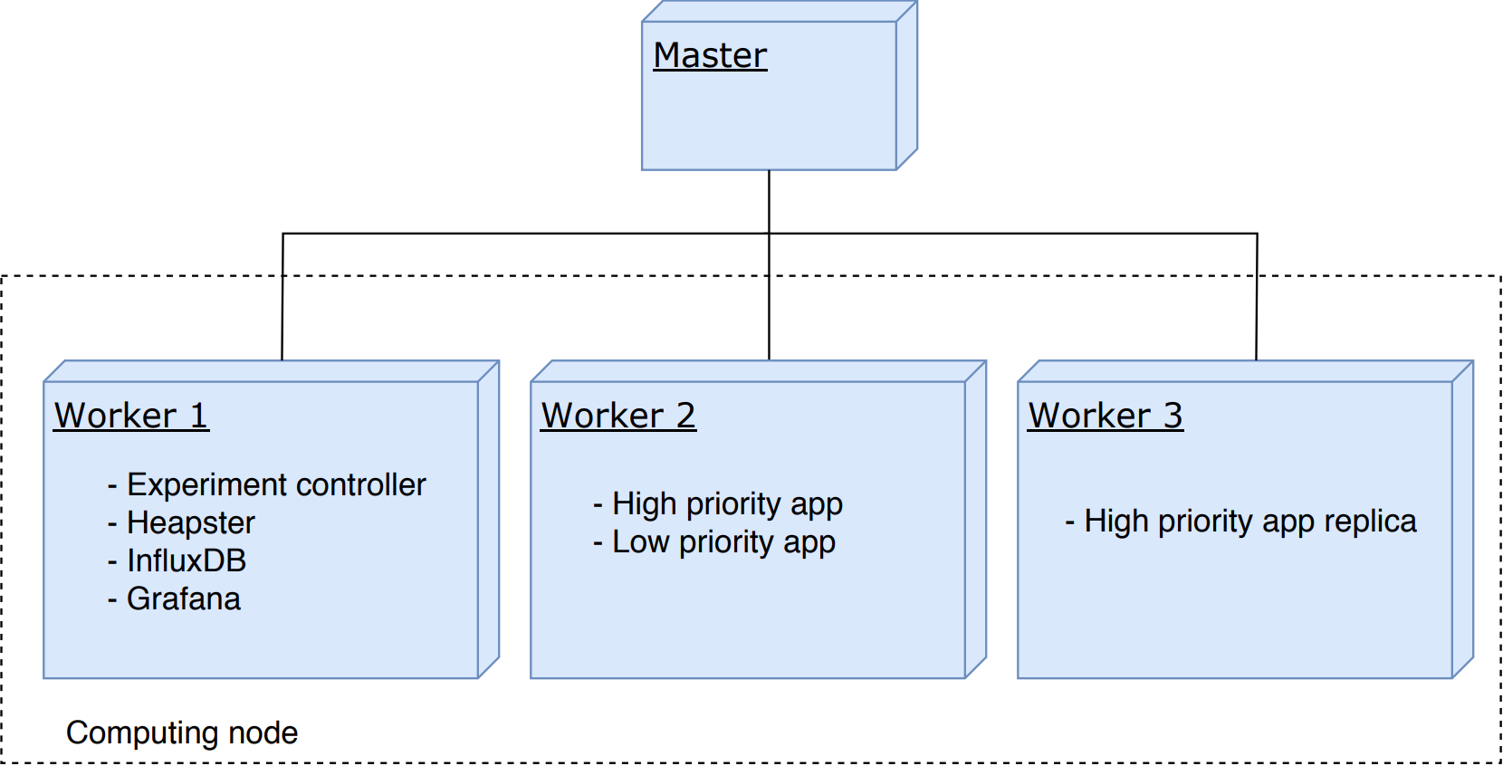
Approach
Cluster setup
Notes:
Same computing node
CPU pinning

Slide 11
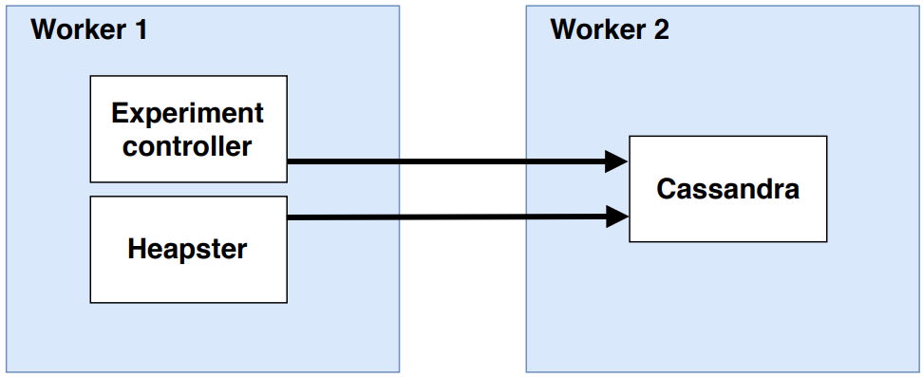
Experiment 1
Requests and limits
SLO: 95% of the requests sent to the Cassandra application must be handled within 150ms, as measured by the experiment controller.
Notes:
Validated the request and limit mechanism and recorded the baseline performance of the Cassandra application
LINEARLY INCREASING WORKLOAD
Request = 1.5 CPU
No limit set

Slide 12
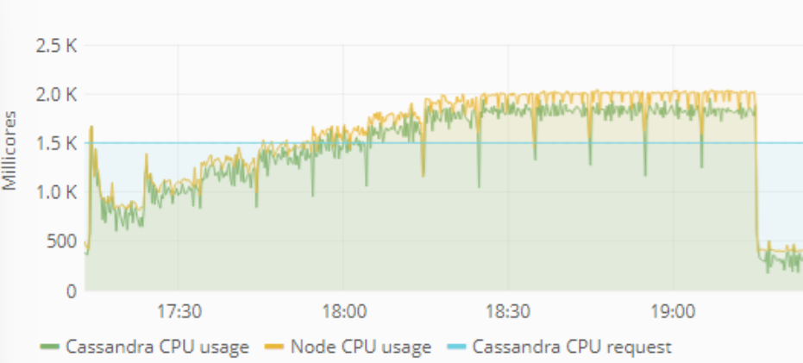
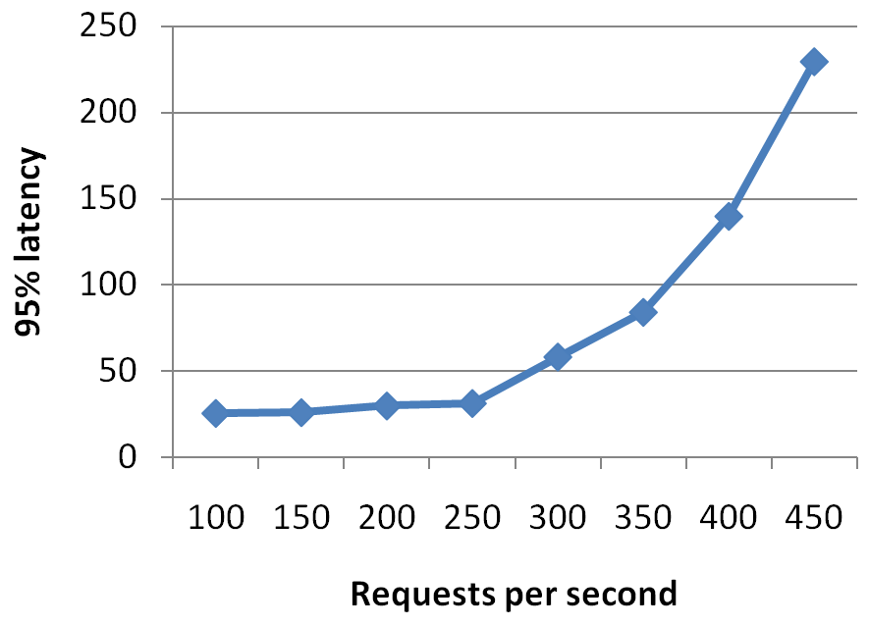
Experiment 1
Requests and limits
Notes:
Request set to 1.5 CPU
Cassandra can use all available resources as there is no other pod in the node

Slide 13
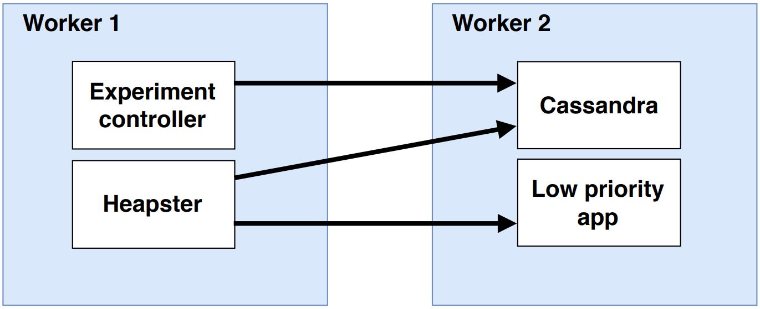
Experiment 2
Co-location
Low priority pod added
Two tests
Equal requests
High and low requests
Notes:
Low priority pod is a simple application performing a multiplication in a loop
Single threaded -> uses 1 CPU constantly, if it is allowed to
AGAIN LINEARLY INCREASING WORKLOAD

Slide 14
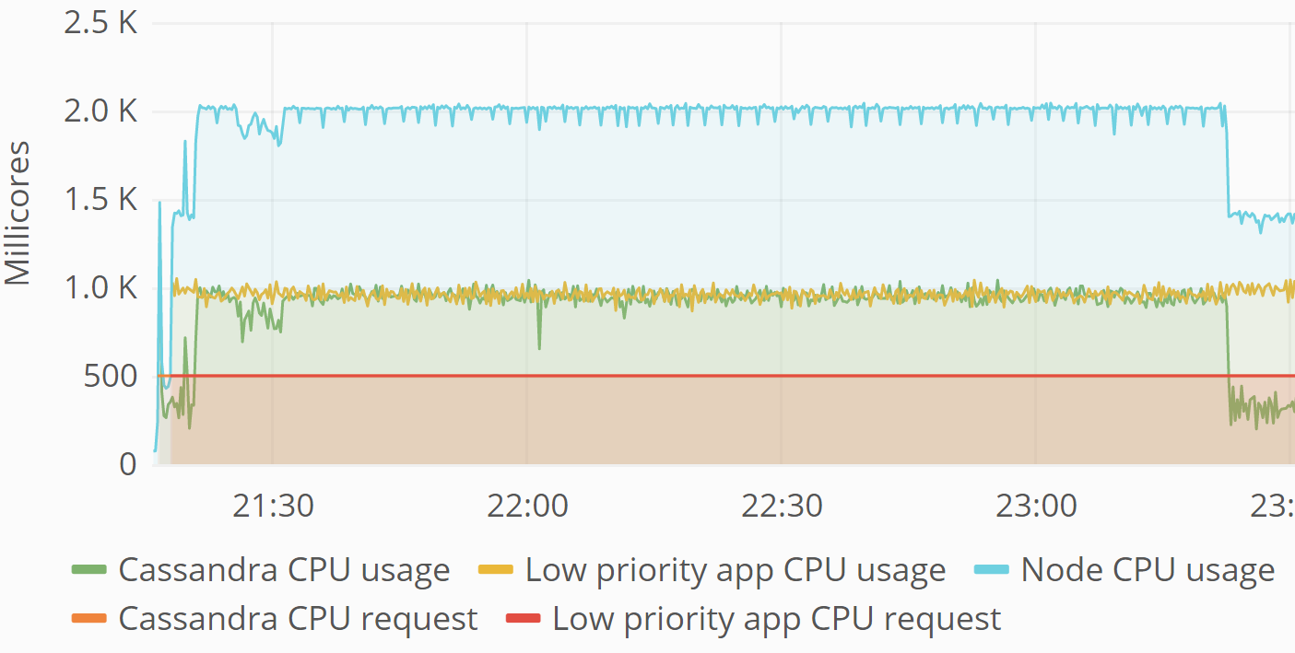
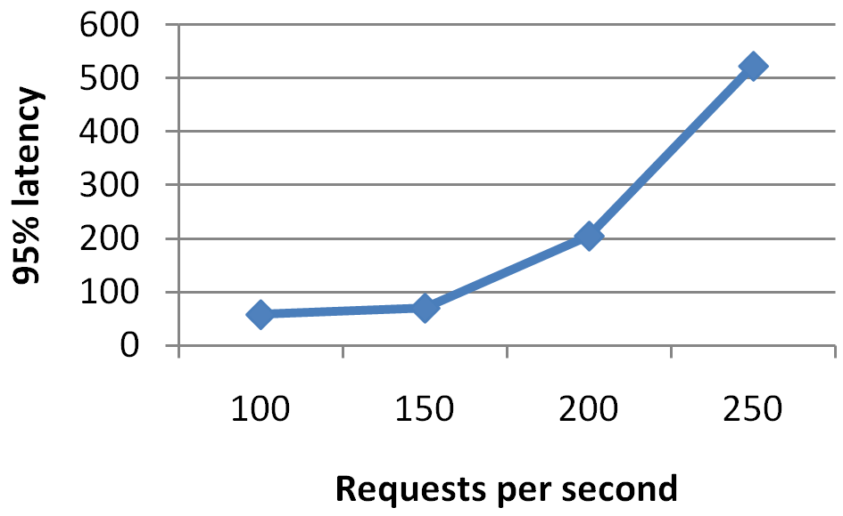
Experiment 2
Co-location: equal requests
Notes:
Linearly increasing workload
Resources are divided equally among the pods
Performance of the Cassandra application suffers

Slide 15
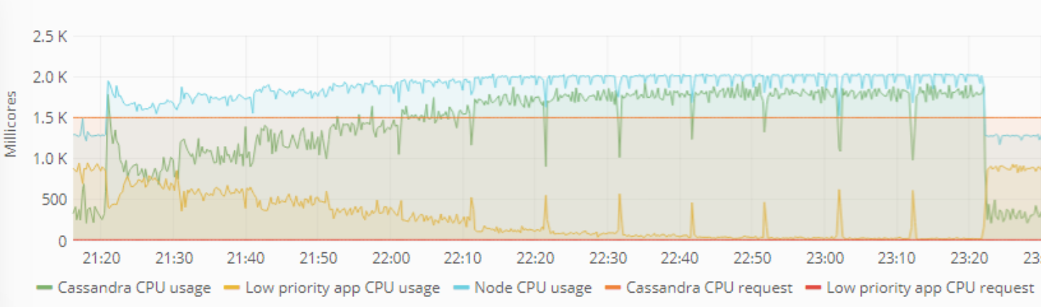
Experiment 2
Co-location: priorities
Notes:
Linearly increasing workload
Cassandra request = 1.5 CPU
Low priority pod request = 10m (minimal allowed value)

Slide 16
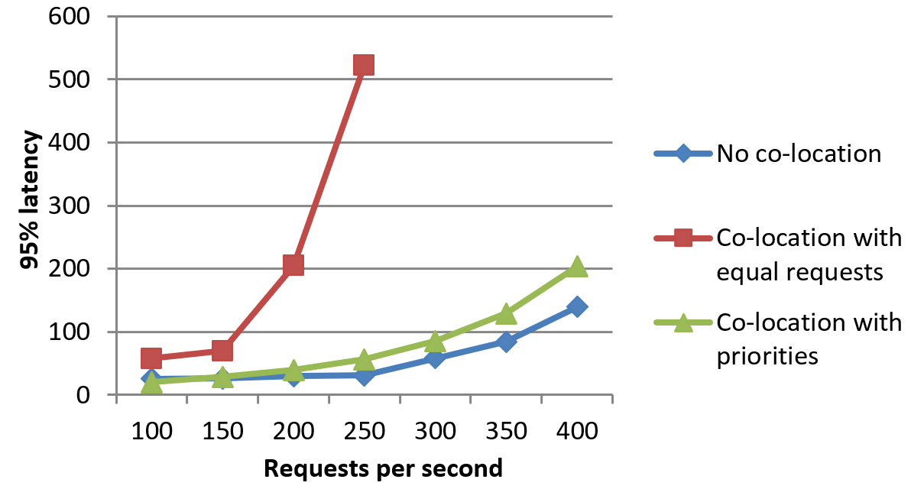
Experiment 2
Co-location: seasonal workloads

Slide 17
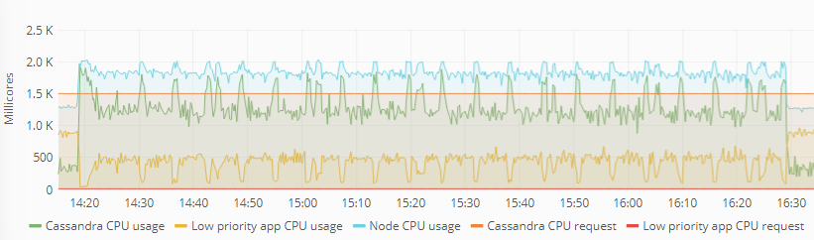
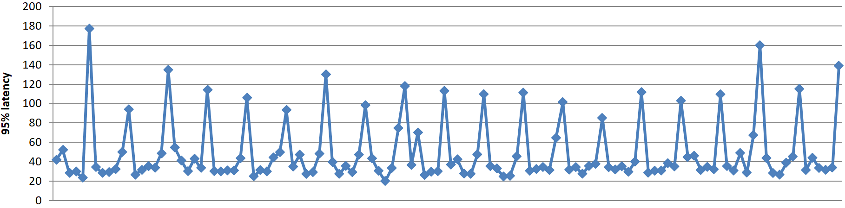
Experiment 3
Co-location: bursty workloads
Notes:
20 bursts

Slide 18
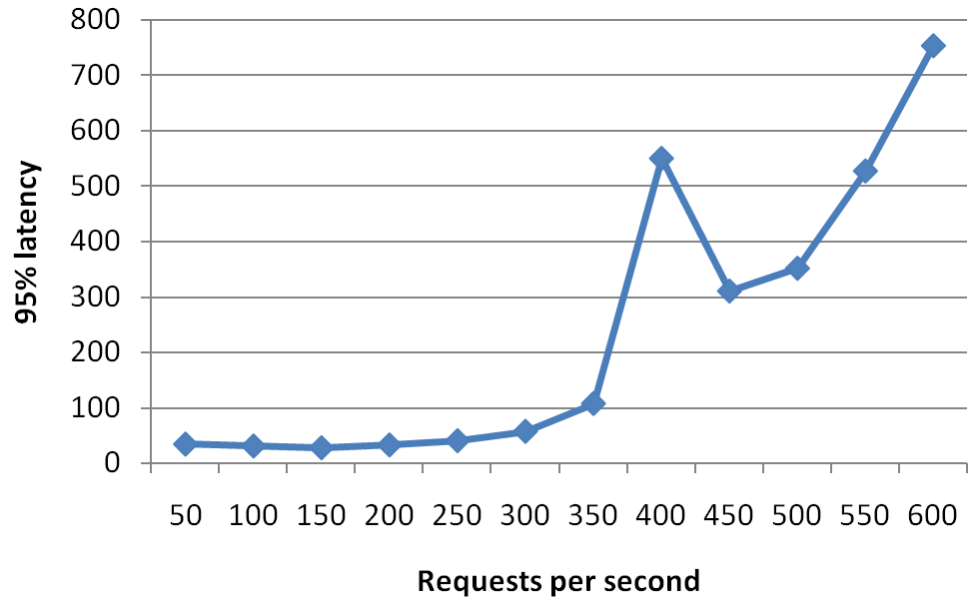
Experiment 4
HPA
Scale at 110% of the request (1.65 CPU)
Notes:
Removed low priority pod
Expected that the SLO got violated at a higher amount of requests per second
Instead -> increase in latencies

Slide 19
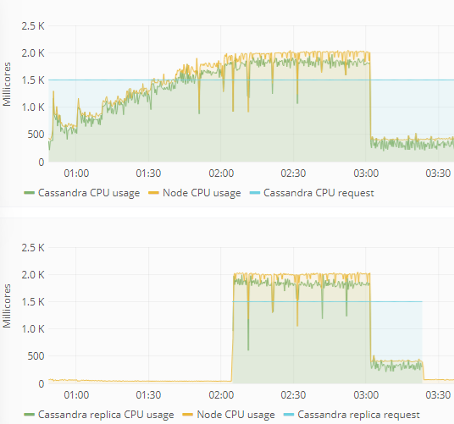
Experiment 4
HPA
Notes:
New replica is added at the correct time
(when threshold is breached)
Expected the CPU usage to drop since requests are divided equally among replicas

Slide 20
Experiment 4
HPA
Why?
Truyen et al. : Kubernetes introduces overhead when running Cassandra
Overhead increases significantly when replicas are added
Not caused by the HPA, but by Kubernetes itself
Truyen et al. : Performance overhead of container orchestration frameworks for management of multi-tenant database deployments (2019)
Notes:
Overhead NOT present when using docker containers without Kubernetes

Slide 21
Experiment 5
HPA
Artificial SaaS application replaces Cassandra
Two tests:
Linearly increasing workload without HPA
Linearly increasing workload with HPA
Notes:
…
Inspect impact of HPA

Slide 22
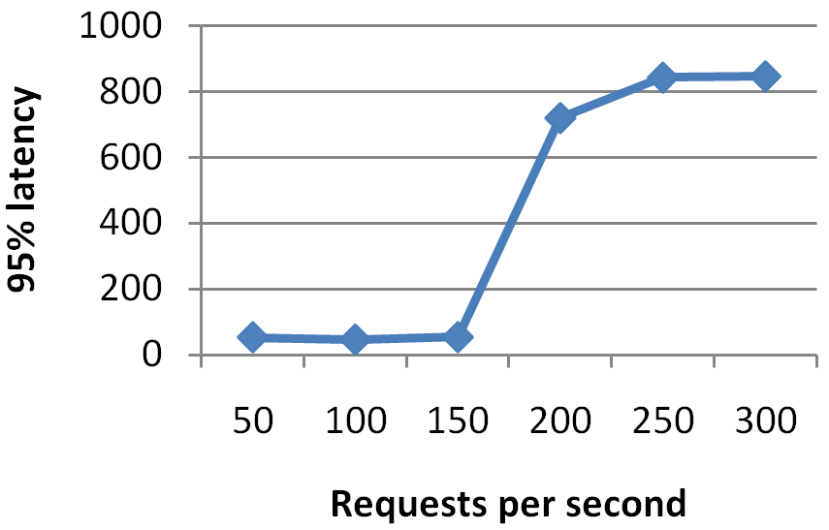
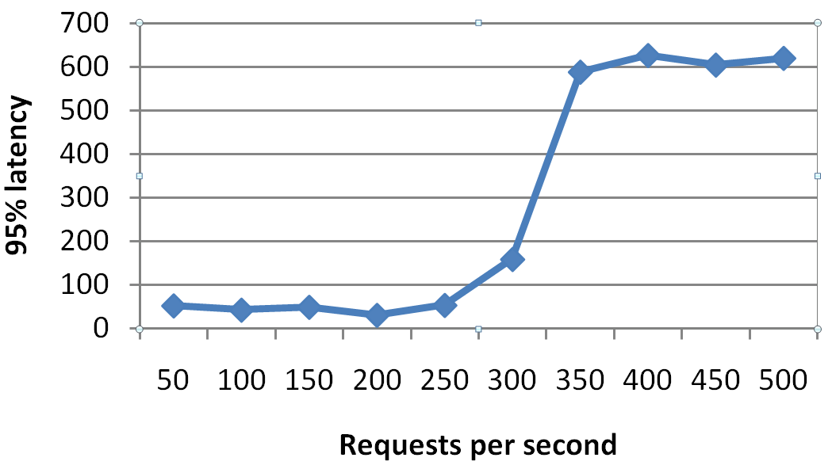
Experiment 5
HPA
No HPA
HPA
Notes:
Works as expected, performance increases significantly (doubles)

Slide 23
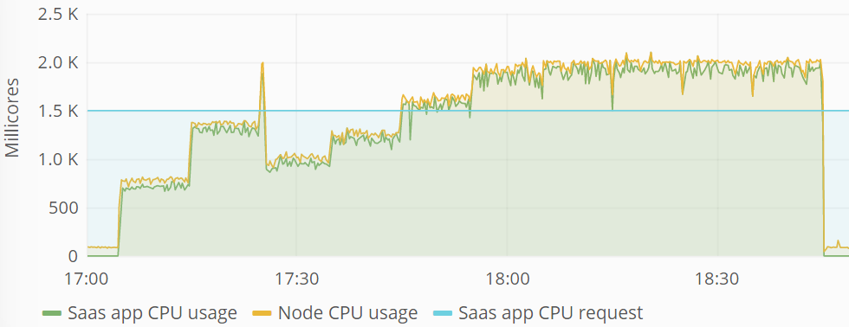
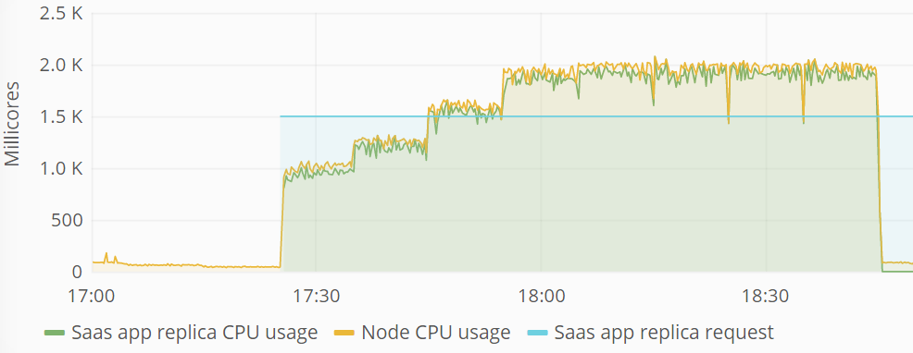
Experiment 5
HPA
Notes:
Requests are indeed divided among replicas

Slide 24
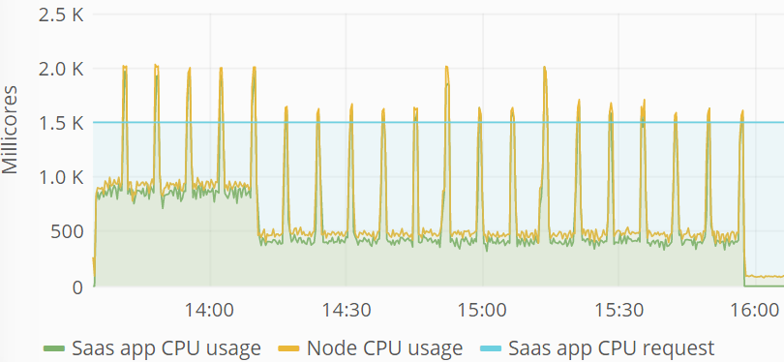
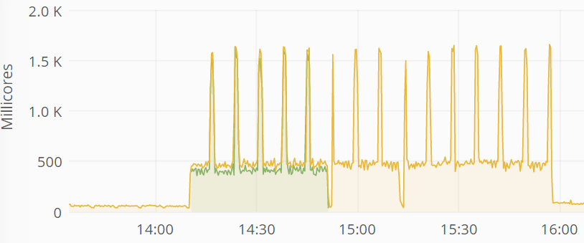
Experiment 6
HPA: bursty workloads
Notes:
Inconsistent scaling decisions
No replica added during first few bursts
While threshold is clearly breached
No replica removed inbetween bursts

Slide 25
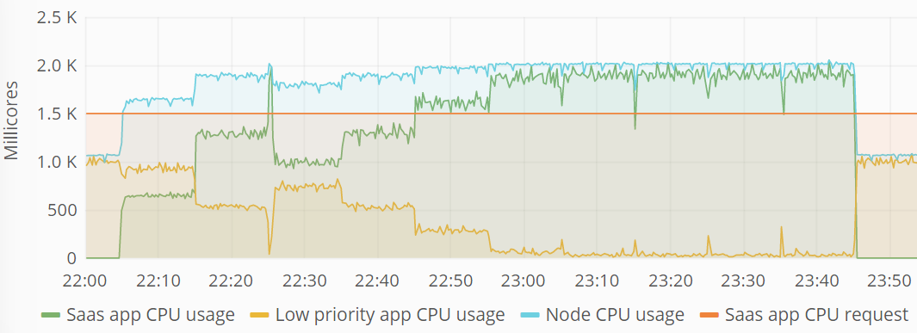
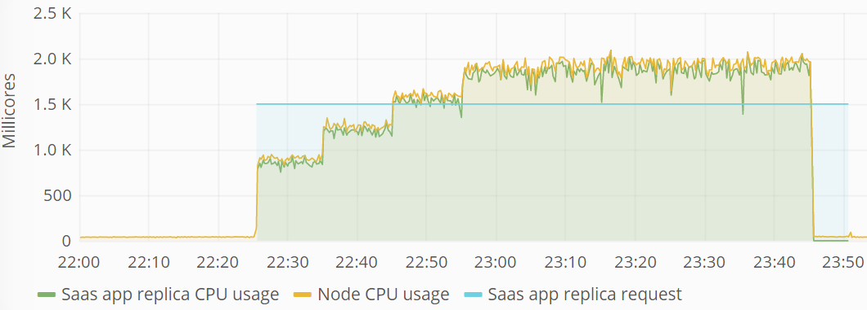
Experiment 7
Combining HPA and co-location

Slide 26
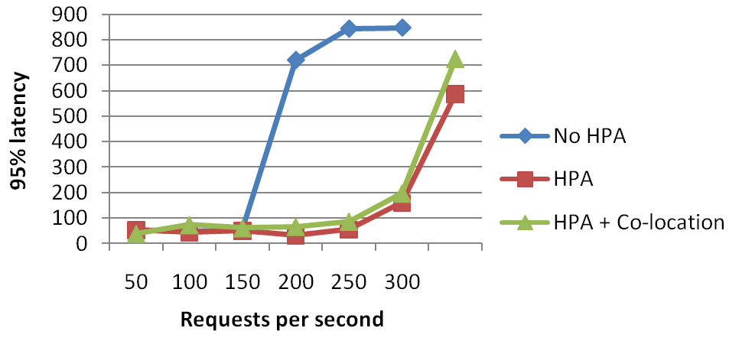
Experiment 7
Combining HPA and co-location

Slide 27
Conclusion
 | Vertical scaling + co-location | HPA | Vertical scaling + HPA + co-location
Cassandra (stateful + LB) | + | - | -
SaaS app (stateless) | + | + | +

Slide 28
Conclusion
https://www.shopify.com/enterprise/holiday-shopping-online
Notes:
Short bursts handled by ‘vertical scaling’ through requests and limits
Gradually increasing workloads handled by (HPA)

Slide 29
Future work
Further evaluate the HPA for bursty workloads
Investigate the performance impact of scaling applications with a longer start-up time
Describe the effects of using the Kubernetes mechanisms when the workload is memory intensive

Slide 30
Thank you!
https://distrinet.cs.kuleuven.be/

