Slide 1
Docker¹ and Kubernetes²-Part I
Eddy Truyen, Dimitri Van Landuyt, Bert Lagaisse, Wouter Joosen
¹ partially based on Kubernetes Course from a DevOps guru (Kubernetes + Docker) by Tao et al.
² partially based on Microservices in Action by Pereira et al., and Kubernetes Design Patterns and Extensions by Yilmaz O.

Slide 2
Main highlights from previous lecture
DevOps
Fast updates & high quality
Aspects
Organizational:
Small teams with Dev and Ops to break down chinese wall between development / staging / production environments
Architectural:
Microservices’ coordination architecture to limit inter-team coordination
Amazon rules
Continuous deployment might require architectural change
Infrastructure-as-Code requires architectural change of infrastructure code

Slide 3
Main highlights from previous lecture
DevOps consequences of Cloud platforms
Dev/Staging/Production environments can be easily created and kept consistent
Virtual machine images are the output of the Dev environment
VM sprawl
Continuous deployment: Canary deployment, Blue/green deployments, Rolling upgrades
Customers of services only see stable network address
continuous deployment transparency
recovery of failed VMs
Infrastructure-as-Code:
declarative management API with MAPE-K loop
hides complexity of imperative configuration of IaaS services

Slide 4
Terminology
Container runtime vs Container orchestration
Container-runtime
Docker: Easy-to-use tool and run-time for linux containers
Docker image: portable, light-weight application component
Container orchestration (CO) frameworks
Kubernetes, Docker Swarm, Mesos
Deploy and manage a distributed application as a set of containers across a set of nodes
Primarily designed for elastically scalable services

Slide 5
Introduction to Linux containers
Difference between Linux containers and Application containers
Not-really self-contained
Dependencies
Application server version
Libraries
Complex wiring of non-functional services
Huge cost
Container Architecture
APPLICATION-
SPECIFIC
FUNCTIONALITY
LOCAL/REMOTE
INVOCATIONS
Naming
Security
GLUE
CODE
EVENT
LOOP
Persistence
Transactions
DECLARATIVE CONFIGURATION
IDE
Events
APPLICATION SERVER

Slide 6
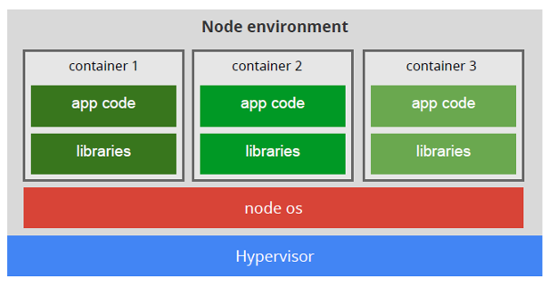
Introduction to Linux containers
Difference between containers and virtual machines
Linux containers
Light-weight virtualization based on linux kernel isolation mechanism
Multiple containers run on a shared OS

Slide 7
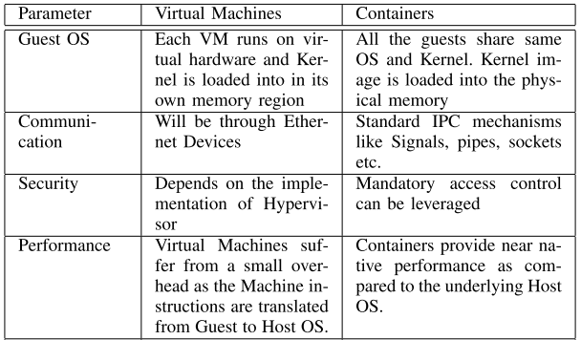
Introduction to Linux containers
Detailed comparison: virtual machines vs containers¹
¹ R. Dua, “Virtualization vs Containerization to support PaaS,” 2014.

Slide 8
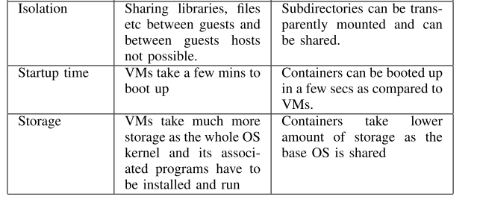
Introduction to Linux containers
Detailed comparison: virtual machines vs containers¹
¹ R. Dua, “Virtualization vs Containerization to support PaaS,” 2014.

Slide 9
Introduction to Linux containers
Linux kernel isolation features
Filesystem isolation
chroot
Resource isolation
cgroups
Kernel namespaces
Pid namespaces
Network namespaces
Access control:
Privileged containers
Linux capabilities
Seccomp, AppArmor..
¹ R. Dua, “Virtualization vs Containerization to support PaaS,” 2014.

Slide 10
Docker technology
Overview
Is one implementation of container-based virtualization technologies
Easy-to-use
Innovative Docker registry
Efficient storage and management of images
Docker daemon
More networking options

Slide 11
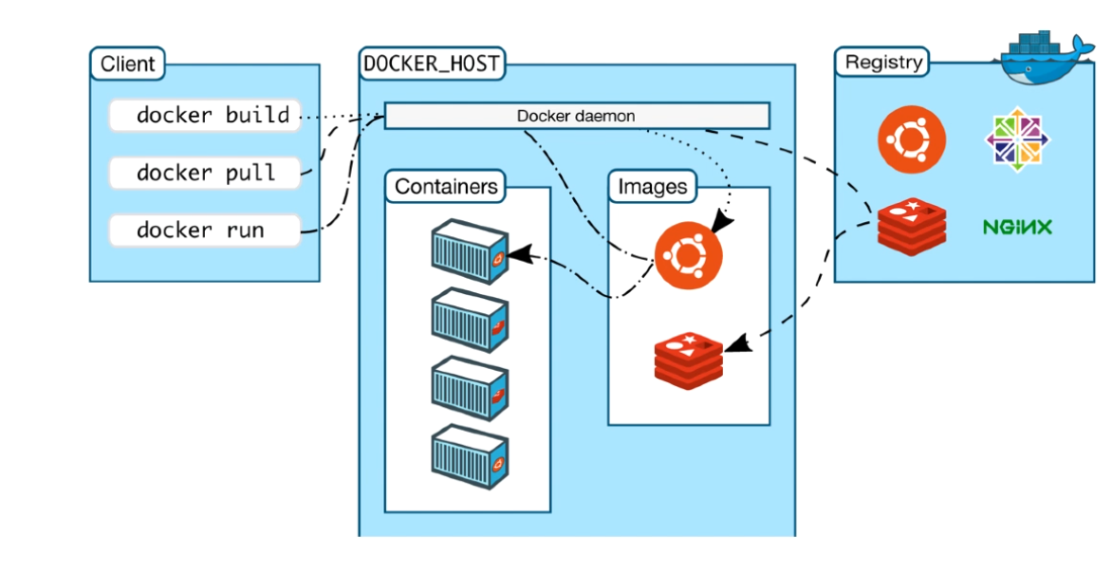
Docker technology
Client-server architecture

Slide 12
Docker technology
Docker commands
docker pull tomcat:8.0
docker run –it tomcat:8.0
docker run –d tomcat:8.0
docker run –d –p 8888:8080 tomcat:8.0
docker run --device=/dev/sda:/dev/xvdc –rm –it fdisk /dev/xvdc
docker ps
docker inspect
docker logs
docker run –net=bridge/host/container:id/none
docker commit <container id> <repository name>/<image name>
docker push <repository name>/<image name>

Slide 13
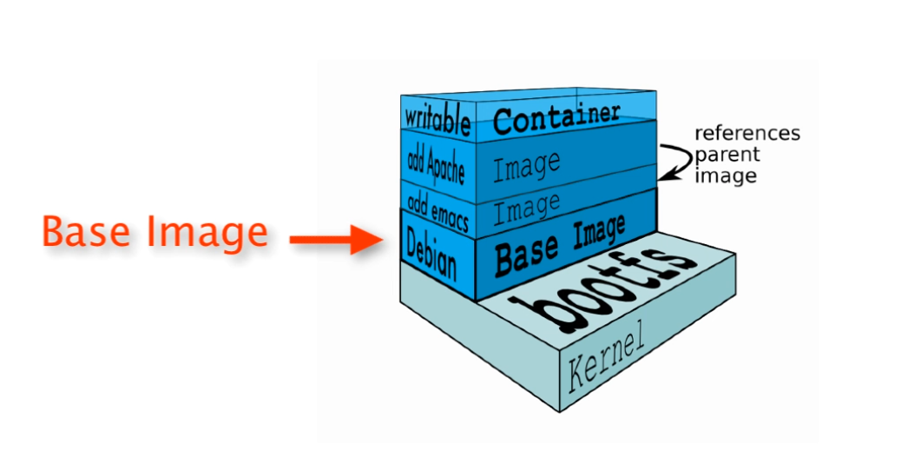
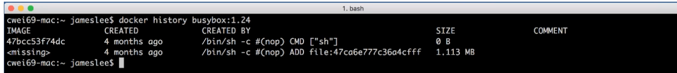
Introduction to Docker containers
Image layers

Slide 14
Introduction to Docker containers
Dockerfile and instructions
A Dockerfile is a text document that contains all the instructions users provide to assemble an image
Each instruction will create a new image layer to the image
Instructions specify what to do when building the image
RUN command
COPY
ADD

Slide 15
Dockerfile in-depth
Chain RUN instructions
Each RUN command will execute the command on the top writable layer of the container, then commit the container as a new image
The new image is used for the next step in the Dockerfile. So each RUN instruction will create a new image layer
It is recommend to chain the RUN instructions in the Dockerfile to reduce the number of image layers it creates
RUN apt-get update & apt-get install -y openssh-client

Slide 16
Containerize a Hello World Application
Cassandra
Demo

Slide 17
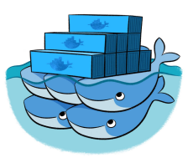


Introduction to Kubernetes
Container orchestration frameworks
Offer an API for deploying and managing a distributed application as a set of containers
Kubernetes, Docker Swarm
Mesos
Scheduling of different frameworks (e.g. Hadoop and Kubernetes) on top of shared data center
Mesos Marathon: Groups of apps and their dependencies

Slide 18
Introduction to Kubernetes
Explaining the popularity of Docker+Kubernetes
Docker and Kubernetes have reached adoption level according to neutral technology channels [1],[2]
Moreover, the Linux Foundation has pushed
Docker’s containerd architecture and the associated OCI specification as the de-facto standard for container runtimes[3]
Kubernetes as the de-facto standard for container orchestration[4]
Kubernetes
has the largest community on GitHub[5].
Many Kubernetes-as-a-Service offerings (Amazon, Microsoft Azure, Google)
Companies behind competing CO frameworks also offer support for Kubernetes (Mesos, Docker)
[1] thoughtworks.com, “Technology Radar vol. 17, Insights into the technology and trends shaping the future,” 2017.
[2] OpenStack, “User Survey -- A snapshot of the OpenStack users’ attitudes and deployments,” 2017.
[3] The Cloud Native Computing Foundation, “General Availability of containerd 1.0 is Here!”, 2017. [Online]. Available: https://www.cncf.io/blog/2017/12/05/general-availability-containerd-1-0/. [Accessed: 27-Mar-2018].
[4] The Cloud Native Computing Foundation,“Cloud Native Computing Foundation Launches Certified Kubernetes Program with 32 Conformant Distributions and Platforms,” 2017. [Online]. Available: https://www.cncf.io/announcement/2017/11/13/cloud-native-computing-foundation-launches-certified-kubernetes-program-32-conformant-distributions-platforms/. [Accessed: 27-Mar-2018].
[5] GitHub, “The State of the Octoverse 2017 -- Ten most-discussed repositories.” 2018. https://octoverse.github.com. [Accessed: 03-05-2018]

Slide 19
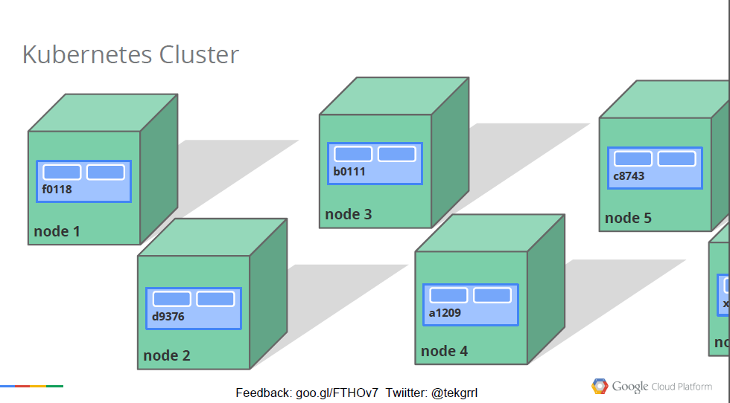
Introduction to Kubernetes
Master-Node architecture

Slide 20
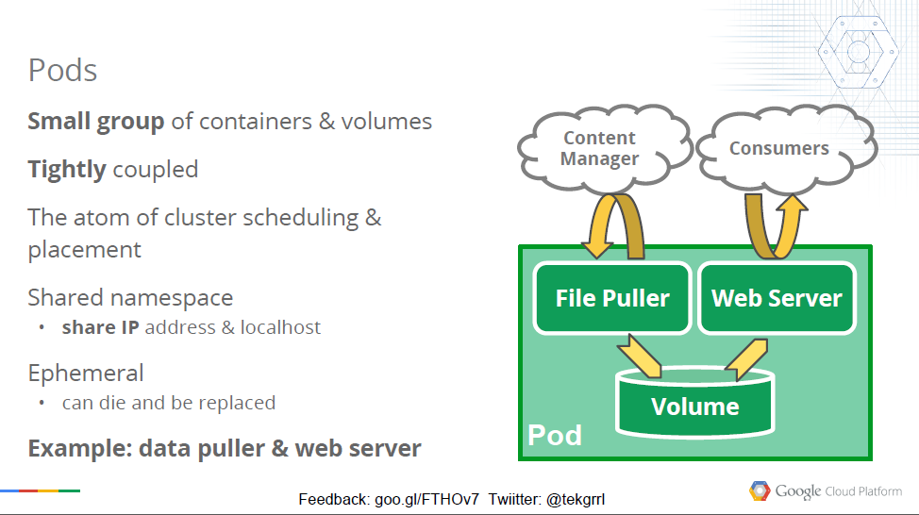
Introduction to Kubernetes
Pods and Volumes

Slide 21
Introduction to Kubernetes
Container networking model
Each Pod has a transient Cluster IP
Each Pod can communicate to each Pod without Network Address Translation (NAT)
Each Node can communicate to each pod
Many different ways to implement this model
Networking plugin architecture CNI
Popular networking plugins: flannel, calico, weave
Basic of container networking implementation
https://github.com/kristenjacobs/container-networking/blob/master/slides/201812-kubecon/slides.pdf
https://youtu.be/6v_BDHIgOY8

Slide 22
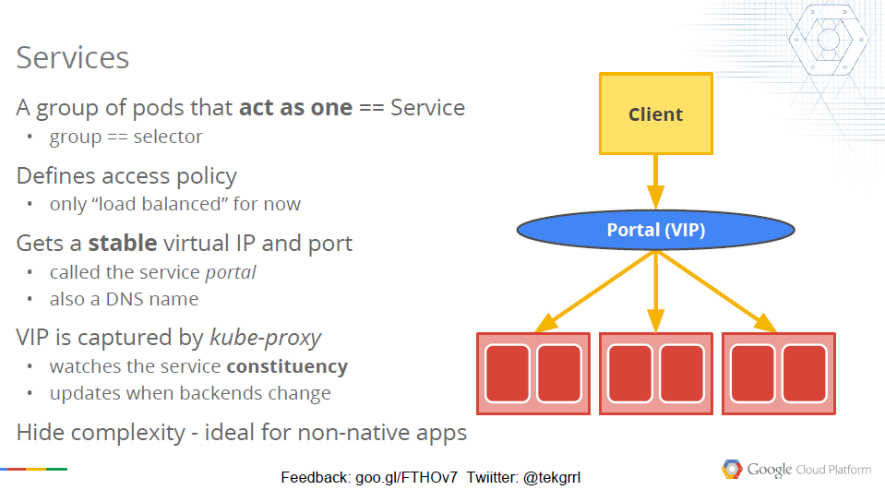
Introduction to Kubernetes
Services

Slide 23
Functional aspects of Kubernetes
Def. Functional aspect: a set of related use cases that have the same stakeholder(s) and the same type of functionality in common
Cluster administrator: A person who installs, configures, controls and monitors container clusters.
cluster architecture and setup
customization of container orchestration framework components
container networking
resource quota management
securing clusters
Application Manager: A person who develops, deploys, configures, controls or monitors an application that runs in a container cluster.
application configuration and deployment
container QoS management
securing containers
Both stakeholders:
cluster and application management

Slide 24
Cluster architecture and setup
Sub-aspects
Declarative configuration management
Architectural patterns
Master-worker architecture
Versioned HTTP API and client libraries
Highly-available master design
Generic automated setup of HA masters (only in commercial products)
Installation methods and deployment tools
Local development (Vagrant, Minikube )
Linux packaging + Docker (kubeadm)
Cloud orchestration tools (gcloud)
Hosted solutions (GKE, AKS, EKS)
Independent cloud orchestration tools (Ubuntu, Openshift, Rancher, Gardener)

Slide 25
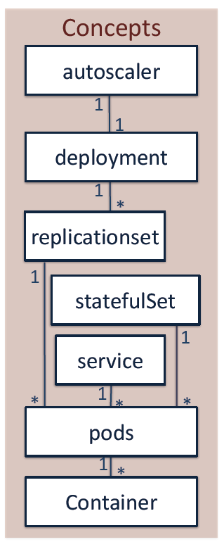
Cluster architecture and setup
Declarative configuration management
apiVersion: v1
kind: Service
metadata:
labels:
name: flower
name: flwr-service
spec:
ports:
- port: 5555
selector:
app: taskQueue
component: flower
type: LoadBalancer
apiVersion: v1
kind: ReplicationSet
spec:
replicas: 1
selector:
component: flower
template:
metadata:
labels:
app: taskQueue
component: flower
spec:
containers:
- image: endocode/flower
name: flower
resources:
limits:
cpu: 100m

Slide 26
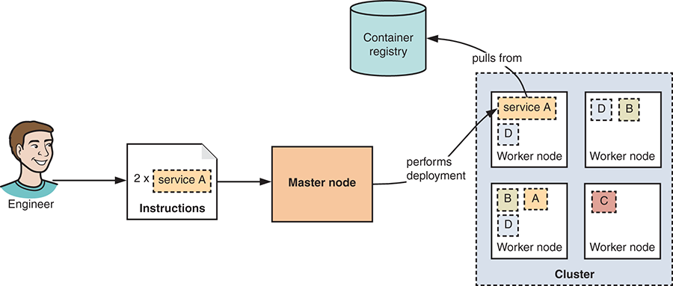
Cluster architecture and setup
Declarative configuration management

Slide 27
Cluster architecture and setup
Sub-aspects
Declarative configuration management
Architectural patterns
Master-worker architecture
Versioned HTTP API and client libraries
Highly-available master design
Generic automated setup of HA masters (only in commercial products)
Installation methods and deployment tools
Local development (Vagrant, Minikube )
Linux packaging + Docker (kubeadm)
Cloud orchestration tools (gcloud)
Hosted solutions (GKE, AKS, EKS)
Independent cloud orchestration tools (Ubuntu, Openshift, Rancher, Gardener)

Slide 28
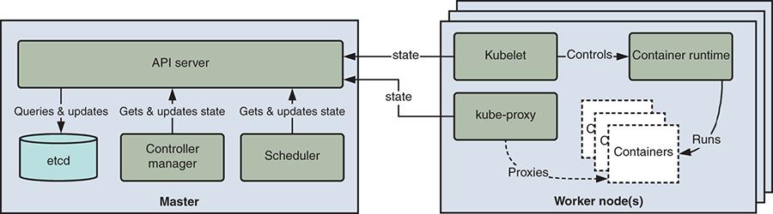
Cluster architecture and setup
System architecture Kubernetes

Slide 29
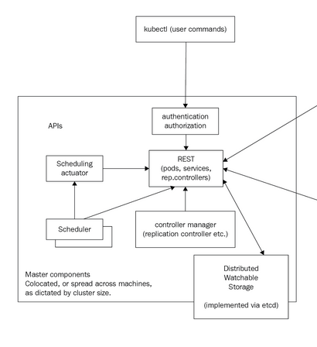
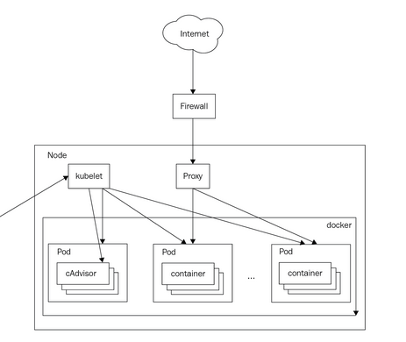
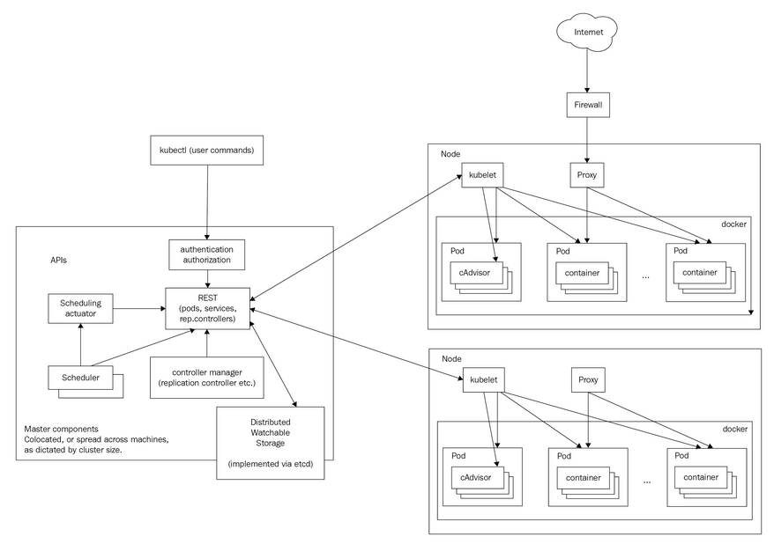
Cluster architecture and setup
System architecture Kubernetes

Slide 30
Cluster architecture and setup
Sub-aspects
Declarative configuration management
Architectural patterns
Master-worker architecture
Versioned HTTP API and client libraries
Highly-available master design
Generic automated setup of HA masters (only in commercial products)
Installation methods and deployment tools
Local development (Vagrant, Minikube )
Linux packaging + Docker (kubeadm)
Cloud orchestration tools (gcloud)
Hosted solutions (GKE, AKS, EKS)
Independent cloud orchestration tools (Ubuntu, Openshift, Rancher, Gardener)

Slide 31
Cluster architecture and setup
Versioned API and clients
Several sets of REST APIs are offered for different purposes and audiences through API groups
Some API groups are enabled by default such as the core group
Other groups can be enabled/disabled via the --runtime-config flag when running the API server
--runtime-config=batch/v1=false,batch/v2alpha=true
all API endpoints belong to a group and are versioned, and often have an alpha or beta notation too. For example:
/api/batch/v1, batch is the group and v1 is the version
/api/v2alpha1, core is the default (unnamed) group, v2alpha1 is the version
You can access the API through the kubectl Command Line Interface (CLI), through client libraries, or directly through REST API calls
More information:
https://kubernetes.io/docs/reference/using-api/api-overview/#api-groups
https://kubernetes.io/docs/reference/generated/kubernetes-api/v1.17/

Slide 32
Cluster architecture and setup
Sub-aspects
Declarative configuration management
Architectural patterns
Master-worker architecture
Versioned HTTP API and client libraries
Highly-available master design
Generic automated setup of HA masters (only in commercial products)
Installation methods and deployment tools
Local development (Vagrant, Minikube )
Linux packaging + Docker (kubeadm)
Cloud orchestration tools (gcloud)
Hosted solutions (GKE, AKS, EKS)
Independent cloud orchestration tools (Ubuntu, Openshift, Rancher, Gardener)

Slide 33
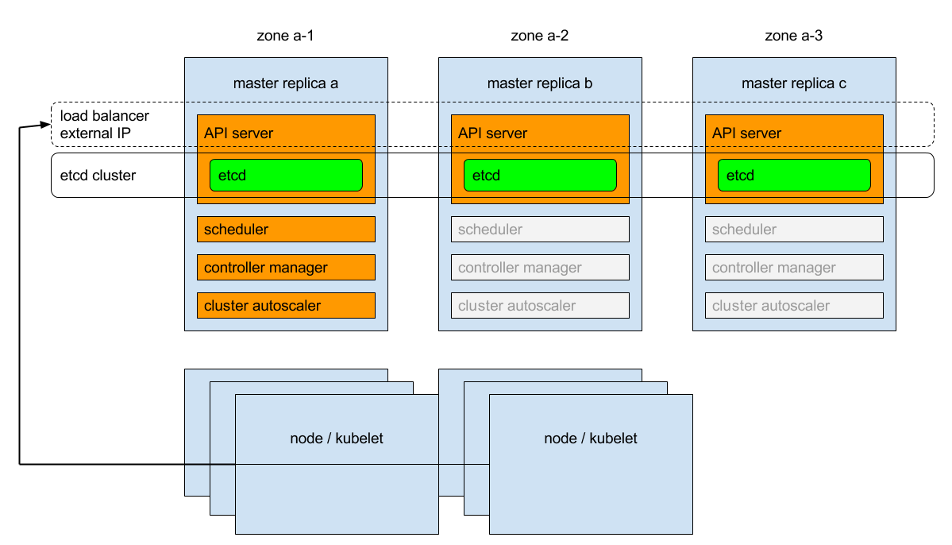
(Automated) HA-master setup
Architectural guidelines
https://kubernetes.io/docs/tasks/administer-cluster/highly-available-master/

Slide 34
(Automated) HA master setup
Commercial vendors only offer automated HA setup
A fully automated HA framework does not exist in the open-source distribution of Kubernetes (in opposition to many other container orchestration frameworks such as Docker Swarm and Mesos DC/OS)
However a large number of public cloud provider and a very limited number of tools include support for an automated HA setup procedure. E.g.:
Amazon Elastic Container Service for Kubernetes (EKS) and Google Kubernetes Engine (GKE)
RedHat Openshift v4, https://www.redhat.com/en/openshift-4
Ubuntu using Juju charms, https://ubuntu.com/kubernetes

Slide 35
Cluster architecture and setup
Sub-aspects
Declarative configuration management
Architectural patterns
Master-worker architecture
Versioned HTTP API and client libraries
Highly-available master design
Generic automated setup of HA masters (only in commercial products)
Installation methods and deployment tools
Local development (Vagrant, Minikube )
Linux packaging + Docker (kubeadm)
Cloud orchestration tools (gcloud)
Hosted solutions (GKE, AKS, EKS)
Independent cloud orchestration tools (Ubuntu, Openshift, Rancher, Gardener)

Slide 36
Functional aspects of Kubernetes
Def. Functional aspect: a set of related use cases that have the same stakeholder(s) and the same type of functionality in common
Cluster administrator: A person who installs, configures, controls and monitors container clusters.
cluster architecture and setup
customization of container orchestration framework components
container networking
resource quota management
securing clusters
Application Manager: A person who develops, deploys, configures, controls or monitors an application that runs in a container cluster.
application configuration and deployment
container QoS management
securing containers
Both stakeholders:
cluster and application management

Slide 37
Application configuration and deployment
Sub-aspects
Stateless service-oriented workloads
ReplicaSets
Exposing services of Pods
Rolling upgrades
Configuration and customization of rolling upgrade process
Blue-green deployments
Persistent volumes and stateful applications
External, Local, Shared volumes
Plugin architecture for volume drivers
Services networking model for stateful applications
StatefulSet
Reusable container configuration

Slide 38
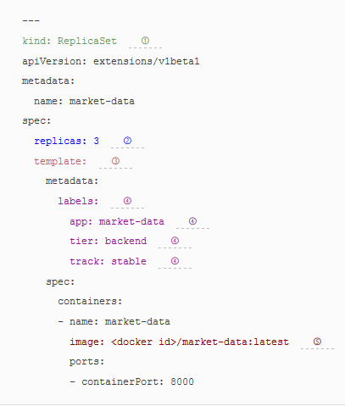
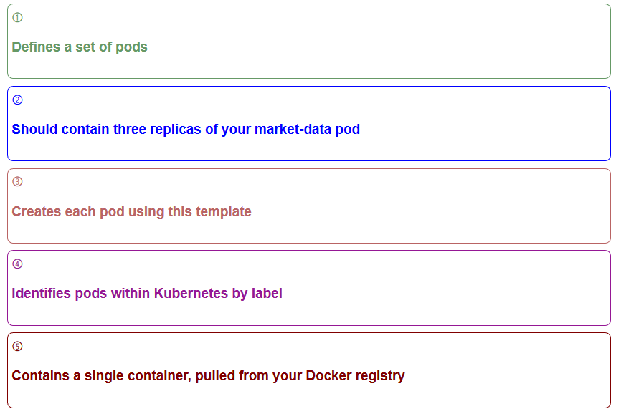
Application configuration and deployment
ReplicaSets

Slide 39
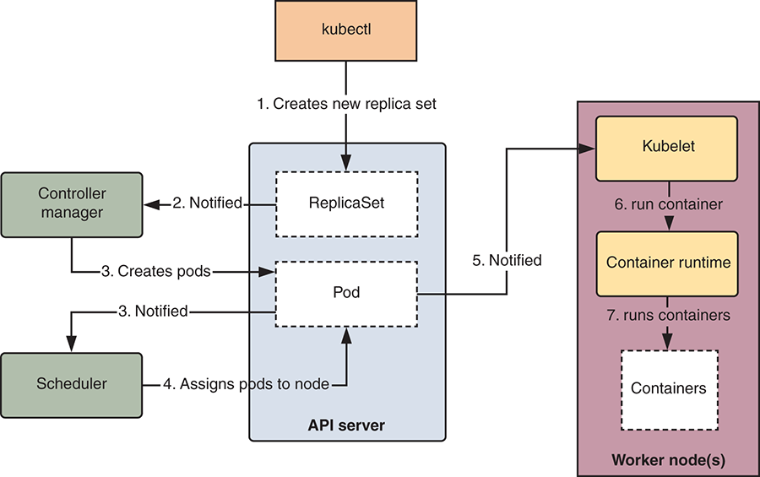
Application configuration and deployment
ReplicaSets: a look under the hood

Slide 40
Application configuration and deployment
Sub-aspects
Stateless service-oriented workloads
ReplicaSets
Exposing services of Pods
Rolling upgrades
Configuration and customization of rolling upgrade process
Blue-green deployments
Persistent volumes and stateful applications
External, Local, Shared volumes
Plugin architecture for volume drivers
Services networking model for stateful applications
StatefulSet
Reusable container configuration

Slide 41
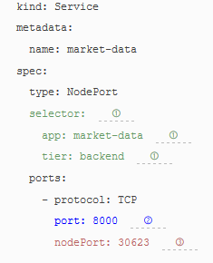
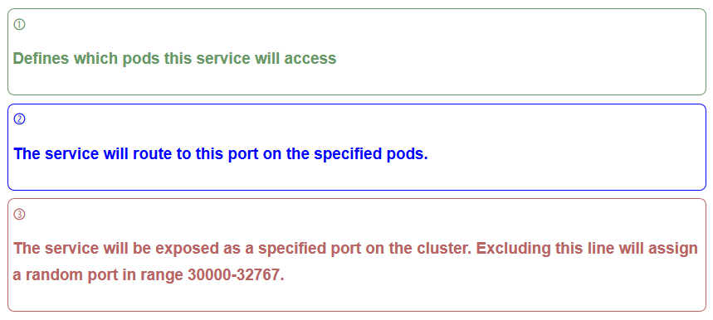
Application configuration and deployment
Exposing services and load balancing

Slide 42
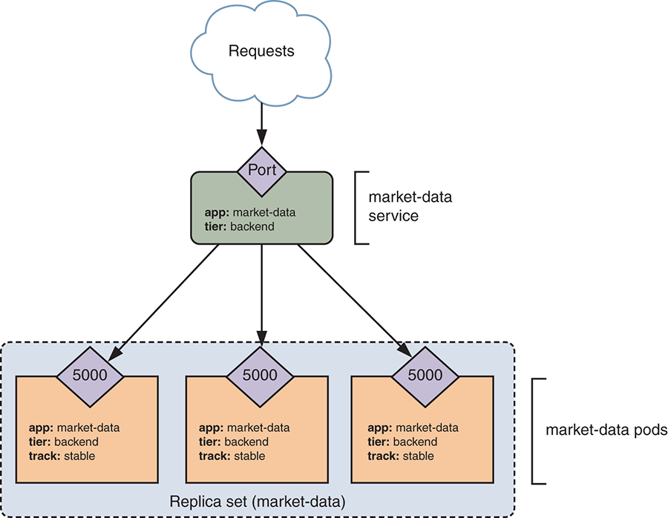
Application configuration and deployment
Exposing services and Load balancing

Slide 43
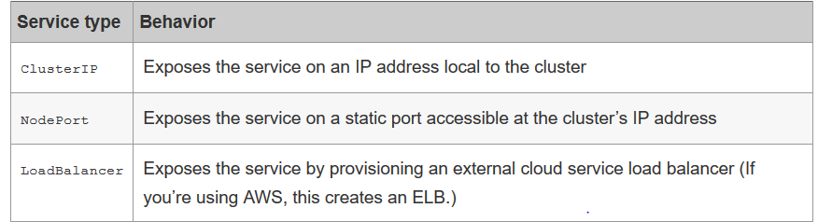
Application configuration and deployment
Types of services in Kubernetes

Slide 44
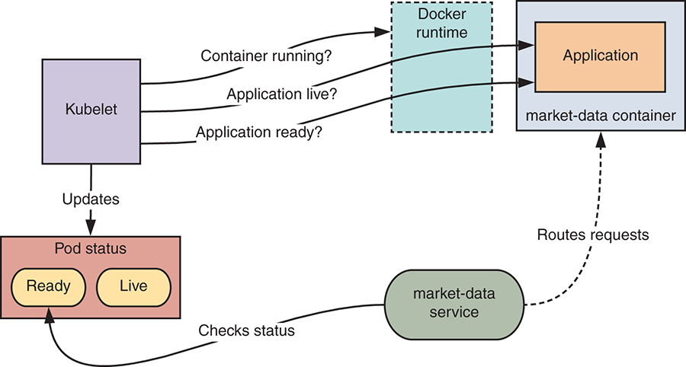
Application configuration and deployment
Health checks: liveliness and readiness probes

Slide 45
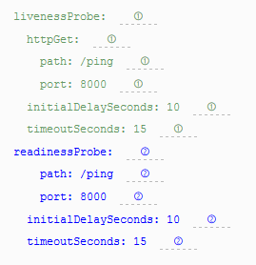
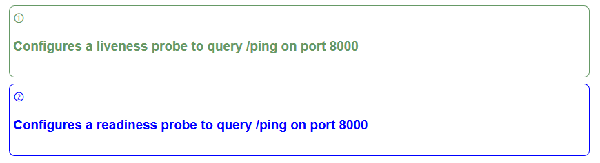
Application configuration and deployment
Health checks: liveliness and readiness probes
Probes in replicaset yaml file

Slide 46
Application configuration and deployment
Sub-aspects
Stateless service-oriented workloads
ReplicaSets
Exposing services of Pods
Rolling upgrades
Configuration and customization of rolling upgrade process
Blue-green deployments
Persistent volumes and stateful applications
External, Local, Shared volumes
Plugin architecture for volume drivers
Services networking model for stateful applications
StatefulSet
Reusable container configuration

Slide 47
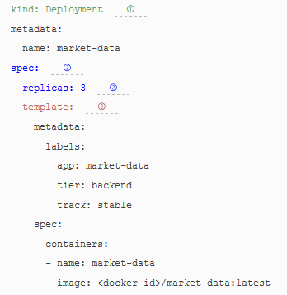
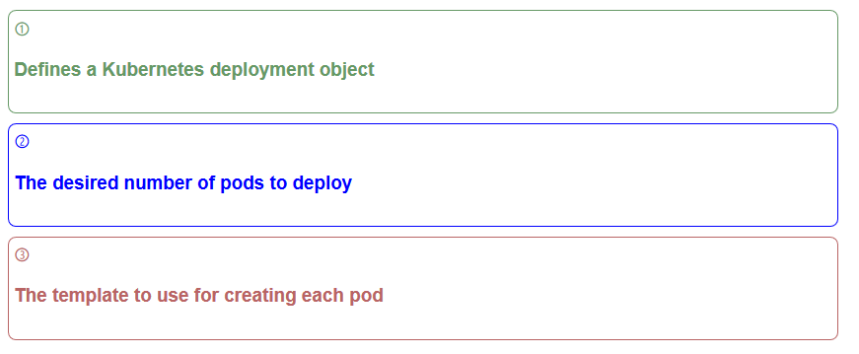
Application configuration and deployment
Rolling upgrades
Use deployment yaml file instead of replicaset yaml file

Slide 48
Application configuration and deployment
Rolling upgrades
Rolling back in case of pending or failed deployment
Inspect status of rollout
Inspect history of deployment
Roll back to a previous version of the deployment
https://kubernetes.io/docs/concepts/workloads/controllers/deployment/#rolling-back-a-deployment

Slide 49
Application configuration and deployment
Sub-aspects
Stateless service-oriented workloads
ReplicaSets
Exposing services of Pods
Rolling upgrades
Configuration and customization of rolling upgrade process
Blue-green deployments
Persistent volumes and stateful applications
External, Local, Shared volumes
Plugin architecture for volume drivers
Services networking model for stateful applications
StatefulSet
Reusable container configuration

Slide 50
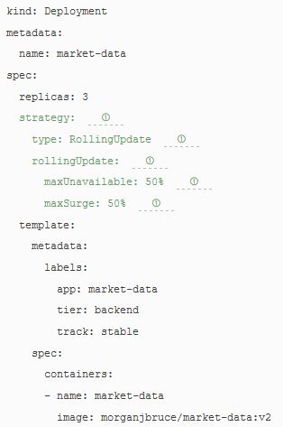
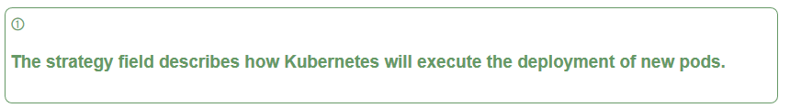
Application configuration and deployment
Rolling upgrades
Edit deployment yaml file
kubectl get deployment market-data -o yaml > tmp.yaml
<edit tmp.yaml>
kubectl replace –f tmp.yaml
OR
kubectl edit deployment.v1.apps/market-data

Slide 51
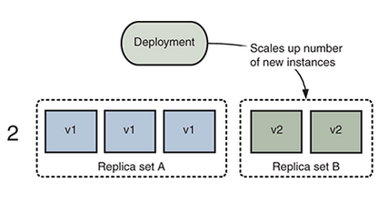
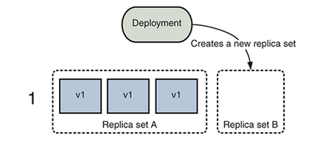
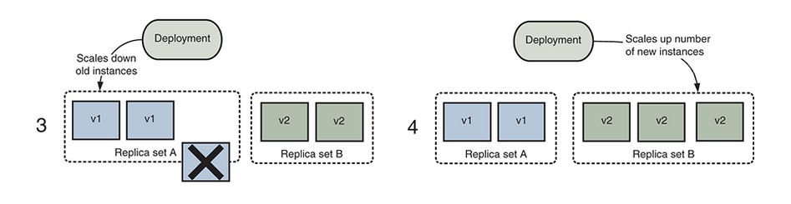
Application configuration and deployment
Rolling upgrades

Slide 52
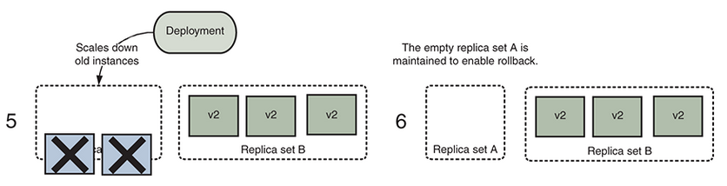
Application configuration and deployment
Rolling upgrades

Slide 53
Application configuration and deployment
Sub-aspects
Stateless service-oriented workloads
ReplicaSets
Exposing services of Pods
Rolling upgrades
Configuration and customization of rolling upgrade process
Blue-green deployments
Persistent volumes and stateful applications
External, Local, Shared volumes
Plugin architecture for volume drivers
Services networking model for stateful applications
StatefulSet
Reusable container configuration

Slide 54
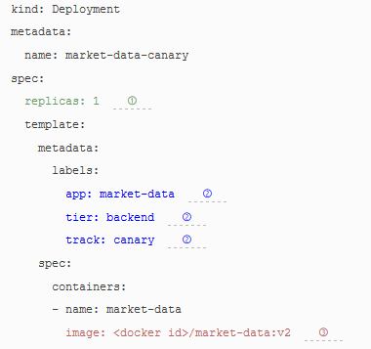
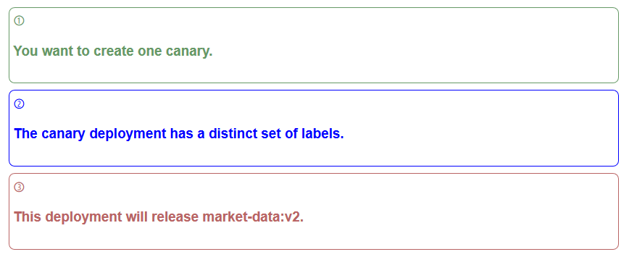
Application configuration and deployment
Canary deployment
Specify new deployment yaml file for canary deployment with new label

Slide 55
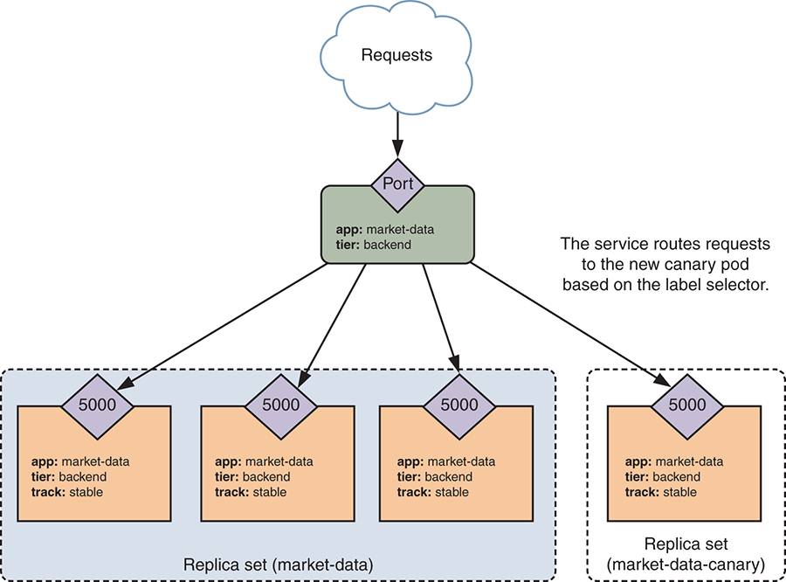
Application configuration and deployment
Canary deployment
canary
The service forwards requests to your new canary pod based on the service’s label selector, which doesn’t restrict on the track label.

Slide 56
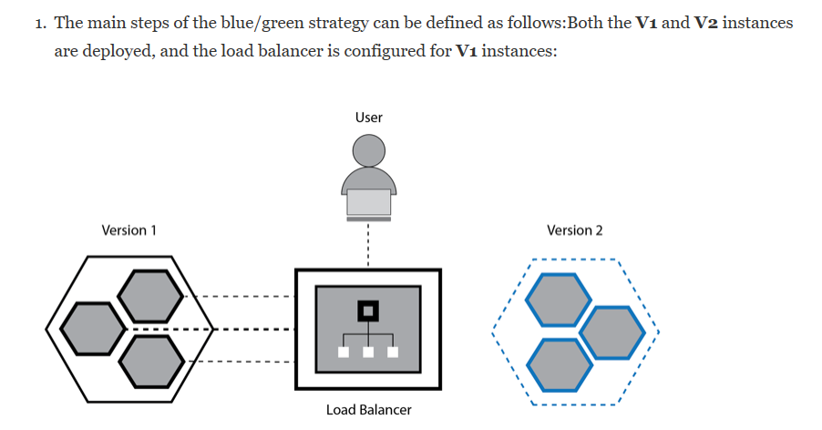
Application configuration and deployment
Blue-Green deployments

Slide 57
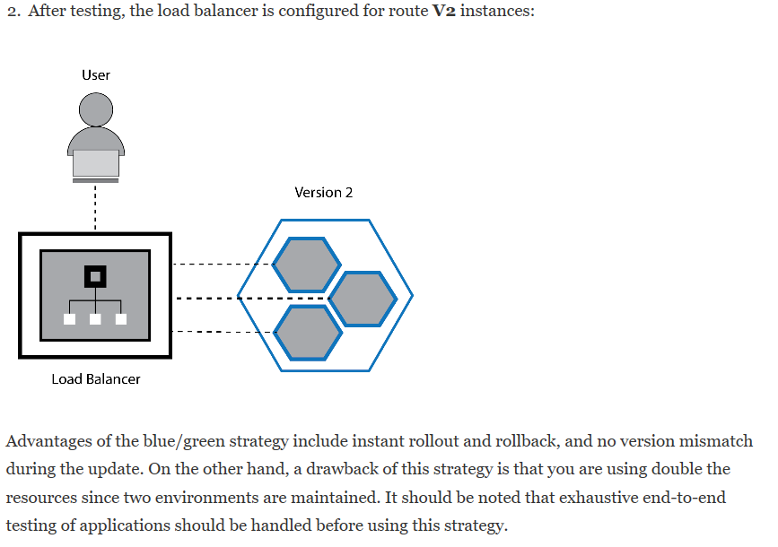
Application configuration and deployment
Blue-Green deployments

Slide 58
Application configuration and deployment
Sub-aspects
Stateless service-oriented workloads
ReplicaSets
Exposing services of Pods
Rolling upgrades
Configuration and customization of rolling upgrade process
Blue-green deployments
Persistent volumes and stateful applications
External, Local, Shared volumes
Plugin architecture for volume drivers
Services networking model for stateful applications
StatefulSet
Reusable container configuration

Slide 59
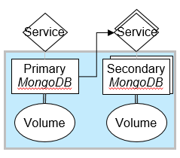
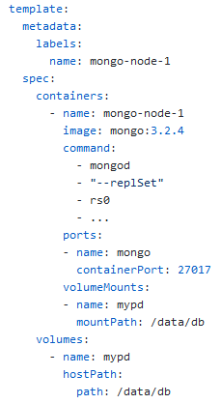
Persistent volumes and stateful appplications
Persistent volumes
Map:
Pod
volume mount:
service dependency:

Slide 60
Application configuration and deployment
Sub-aspects
Stateless service-oriented workloads
ReplicaSets
Exposing services of Pods
Rolling upgrades
Configuration and customization of rolling upgrade process
Blue-green deployments
Persistent volumes and stateful applications
External, Local, Shared volumes
Plugin architecture for volume drivers
Services networking model for stateful applications
StatefulSet
Reusable container configuration

Slide 61
Persistent volumes and stateful appplications
Plugin architecture: Dynamic provisioning of persistent volumes
Pods declare the required persistent volume type as a persistent volume claim that requests
a specific StorageClass
specific data size quota
access modes.
When none of the statically created, unmounted persistent volumes match that claim, Kubernetes dynamically provisions a volume based on the requested StorageClass.

Slide 62
Persistent volumes and stateful appplications
Plugin architecture: Dynamic provisioning of persistent volumes
Pods declare the required persistent volume type as a persistent volume claim that requests
a specific StorageClass
specific data size quota
access modes.
When none of the statically created, unmounted persistent volumes match that claim, Kubernetes dynamically provisions a volume based on the requested StorageClass.

Slide 63
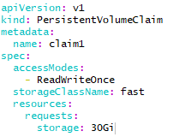
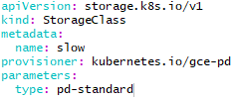
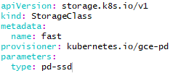
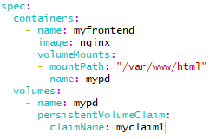
Persistent volumes and stateful appplications
Plugin architecture: Dynamic provisioning of persistent volumes

Slide 64
Persistent volumes and stateful appplications
Plugin architectures: run-time installation of new volume plugin types
Kubernetes originally supports a unified interface for different volume implementations, but these are packaged in the source code of the Kubernetes open-source distribution.
As such, third parties cannot easily add new volume drivers in a running cluster.
However, Kubernetes v1.9+ support the CSI specification [282] that allows run-time installation of external volume plugins
https://kubernetes.io/blog/2019/01/15/container-storage-interface-ga/

Slide 65
Application configuration and deployment
Sub-aspects
Stateless service-oriented workloads
ReplicaSets
Exposing services of Pods
Rolling upgrades
Configuration and customization of rolling upgrade process
Blue-green deployments
Persistent volumes and stateful applications
External, Local, Shared volumes
Plugin architecture for volume drivers
Services networking model for stateful applications
StatefulSet
Reusable container configuration

Slide 66
Persistent volumes and stateful appplications
Services networking model for stateful applications
Centralized internal DNS
Persistent service endpoints for Pods
Headless services:
No Cluster IP
stable DNS endpoint

Slide 67
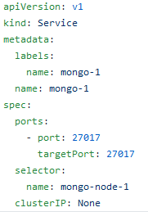
Persistent volumes and stateful appplications
Headless Services
Map:
Pod
volume mount:
service dependency:

Slide 68
Application configuration and deployment
Sub-aspects
Stateless service-oriented workloads
ReplicaSets
Exposing services of Pods
Rolling upgrades
Configuration and customization of rolling upgrade process
Blue-green deployments
Persistent volumes and stateful applications
External, Local, Shared volumes
Plugin architecture for volume drivers
Services networking model for stateful applications
StatefulSet
Reusable container configuration

Slide 69
Persistent volumes and stateful appplications
StatefulSets
StatefulSets are similar to ReplicaSets but the replicated Pods are created and destroyed in an ordered fashion.
For example in master-slave architectures such as MongoDB, primary database instances are always created first, and thereafter secondary instances
An update of a StatefulSet happens in an ordered fashion as well
https://medium.com/velotio-perspectives/exploring-upgrade-strategies-for-stateful-sets-in-kubernetes-c02b8286f251

Slide 70
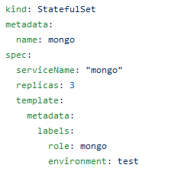
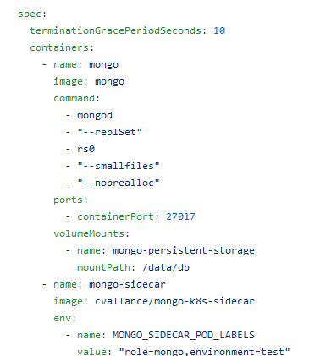
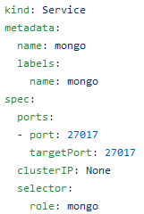
Persistent volumes and stateful appplications
StatefulSets
The sidecar container reconfigures the mongo container when the number of mongo instances scales up or down
Notes:
The sidecar pattern is about co-locating another container in a pod in addition to the main application container. The application container is unaware of the sidecar container and just goes about its business. A great example is a central logging agent. Your main container can just log to stdout, but the sidecar container will send all logs to a central logging service where they will be aggregated with the logs from the entire system. The benefits of using a sidecar container versus adding central logging to the main application container are enormous. First, applications are no longer burdened with central logging, which could be a nuisance. If you want to upgrade or change your central logging policy or switch to a totally new provider, you just need to update the sidecar container and deploy it. None of your application containers change, so you can't break them by accident.

Slide 71
Persistent volumes and stateful applications
Fast auto-recovery
mongoDB replicaset
/data/db:data/db
Volume 1
mongoDB primary
Stable
DNS
/data/db:data/db
Volume 2
X
mongoDB secundary
Stable
DNS
Map:
/data/db:data/db
Pod
mongoDB secondary
TCP/IP connection:
volume mount:

Slide 72
Functional aspects of Kubernetes
Def. Functional aspect: a set of related use cases that have the same stakeholder(s) and the same type of functionality in common
Cluster administrator: A person who installs, configures, controls and monitors container clusters.
cluster architecture and setup
customization of container orchestration framework components
container networking
resource quota management
securing clusters
Application Manager: A person who develops, deploys, configures, controls or monitors an application that runs in a container cluster.
application configuration and deployment
container QoS management
securing containers
Both stakeholders:
cluster and application management

Slide 73
Resource quota management
Resource quota management for multi-tenancy
Partitioning API objects into user groups: Namespaces != linux namespace
Resource quota per Namespace
Container CPU and mem allocation with support for oversubscription
Minimum guarantees for CPU and mem
Maximum limits for CPU and mem
Abstraction of complex cpu-shares parameter of Linux kernel’s CPU scheduler
Controlling scheduling behaviour by means of expressive placement constraints
Pod priority and preemption
Container QoS management

Slide 74

Resource quota management for multi-tenancy
shared container for tenants
shared tenant-aware application
gold tenant
silver tenant
bronze tenant
tenant-aware libraries
High tenant isolation but higher cost/tenant
Lower cost/tenant but less tenant isolation
Notes:
There are different strategies for deploying tenants
Eihjter existis multi)-tenant SaaS app in separate container
Or one tennat per container

Slide 75


Resource quota management for multi-tenancy
Single namespace for all tenants
One instance of SaaS app deployed in 1 Pod on each Node of the cluster
A Pod runs existing multi-tenant App components without modifications
1 Service needed

Slide 76


Resource quota management for multi-tenancy
Separate namespace per tenant
Separate Namespace and Service per tenant
Namespaces are associated resource quota in accordance with SLA requirements of tenant
Each SaaS container reads in the appropriate tenant configuration at start-up time
Namespace 1
Namespace n
...

Slide 77

Resource quota management for multi-tenancy
Separate namespace per SLA class
Gold, silver and bronze namespaces
Within each Namespace we deploy a multi-tenant SaaS application that is customized to serve that SLA class only
1 Service per Namespace
Namespace gold
Namespace silver
Namespace bronze

Slide 78
Resource quota management
Resource quota management for multi-tenancy
Partitioning API objects into user groups: Namespaces != linux namespaces
Resource quota per Namespace
Container CPU and mem allocation with support for oversubscription
Minimum guarantees for CPU and mem
Maximum limits for CPU and mem
Abstraction of complex cpu-shares parameter of Linux kernel’s CPU scheduler
Controlling scheduling behaviour by means of expressive placement constraints
Pod priority and preemption
Container QoS management

Slide 79
Resource Quota Management
Managing resource quota per namespace
Types of quota
Compute Resource quota
Defined in terms of maximum of sum of requested CPU and memory by all Pods in namespace)
Storage Resource Quota
Defined in terms of maximum of number of storage requests and persistent volume claims
Defined in terms of maximum of sum of requested ephemeral storage
Object Count Quota
Defined in maximum number of Pods, services, nodeports, secrets etc

Slide 80
Resource Quota Management
Managing resource quota per namespace
Quota Scopes
Restricts the number of resources that will be tracked by the quota
Pods cannot request resources that are outside their scope
https://kubernetes.io/docs/concepts/policy/resource-quotas/#quota-scopes
Resource Quota per PriorityClass (see container QoS management)
https://kubernetes.io/docs/concepts/policy/resource-quotas/#resource-quota-per-priorityclass

Slide 81
Resource quota management
Resource quota management for multi-tenancy
Partitioning API objects into user groups: Namespaces != linux namespaces
Resource quota per Namespace
Container CPU and mem allocation with support for oversubscription
Minimum guarantees for CPU and mem
Maximum limits for CPU and mem
Abstraction of complex cpu-shares parameter of Linux kernel’s CPU scheduler
Controlling scheduling behaviour by means of expressive placement constraints
Pod priority and preemption
Container QoS management

Slide 82
Container QoS Management
Container CPU and mem allocation with support for oversubscription
Requests and limits:
Request: resources a container is guaranteed to get
Σcontainer requests ≤ node resources
Limit: maximum amount of resources used by container
Σcontainer limits may be higher than total node resources
→ Oversubscription
QoS classes:
Guaranteed: request==limit
Bursty: request < limit
best-effort: no request is specified
https://github.com/kubernetes/community/blob/master/contributors/design-proposals/node/resource-qos.md

Slide 83
Container QoS Management
Oversubscription may lead to a node running out of resources
Compressible resources (CPU)
Overprovisioned CPU resources divided according to relative weight of the requests
Incompressible resources (Memory)
Pro-active: Kubelet ranks Pods according to
first by whether or not their usage of the starved resource exceeds requests,
then by PriorityClass (see Pod priority and preemption),
and then by the consumption of the starved compute resource relative to the Pods’ scheduling requests
Reactive: Killing the process with the largest OOM score
Containers with the lowest quality of service that are consuming the largest amount of memory relative to the scheduling request should be killed first in order to reclaim memory
https://kubernetes.io/docs/tasks/administer-cluster/out-of-resource/#evicting-end-user-pods

Slide 84
Container QoS Management
Example: oversubscription of CPU resources
Example: oversubscription of CPU resources
Multi-tenant SaaS benchmark at k8-scalar
https://github.com/k8-scalar/k8-scalar/tree/master/studies/WOC2019/

Slide 85

Container QoS Management
Example: Mapping an SLO to requests and limits
SLO: 95% of the requests sent to the Cassandra application must be handled within 150ms, as measured by the experiment controller.
Notes:
Validated the request and limit mechanism and recorded the baseline performance of the Cassandra application
LINEARLY INCREASING WORKLOAD
Request = 1.5 CPU
No limit set

Slide 86


Container QoS Management
Example: Mapping an SLO to requests and limits
Notes:
Request set to 1.5 CPU
Cassandra can use all available resources as there is no other pod in the node

Slide 87

Container QoS Management
Example: Improving server consolidation with and without impacting the SLO
Low priority pod added
Two tests
Equal requests
High and low requests
Notes:
Low priority pod is a simple application performing a multiplication in a loop
Single threaded -> uses 1 CPU constantly, if it is allowed to
AGAIN LINEARLY INCREASING WORKLOAD

Slide 88


Container QoS Management
Example: Improving server consolidation with and without impacting the SLO
Oversubscription with equal requests
Notes:
Linearly increasing workload
Resources are divided equally among the pods
Performance of the Cassandra application suffers

Slide 89

Container QoS Management
Example: Improving server consolidation with and without impacting the SLO
Oversubscription with high and low requests
Notes:
Linearly increasing workload
Cassandra request = 1.5 CPU
Low priority pod request = 10m (minimal allowed value)

Slide 90

Container QoS Management
Example: Improving server consolidation with and without impacting the SLO
Summary

Slide 91
Resource quota management
Resource quota management for multi-tenancy
Partitioning API objects into user groups: Namespaces != linux namespaces
Resource quota per Namespace
Container CPU and mem allocation with support for oversubscription
Minimum guarantees for CPU and mem
Maximum limits for CPU and mem
Abstraction of complex cpu-shares parameter of Linux kernel’s CPU scheduler
Controlling scheduling behaviour by means of expressive placement constraints
Pod priority and preemption
Container QoS management

Slide 92
Container QoS Management
Controlling scheduling behaviour by means of expressive placement constraints
Kubernetes offers a generic scheduler component that performs the following three steps for computing a placement for a Pod:
(1) filter the nodes using a set of predicates,
(2) prioritize the filtered list of nodes using priority functions and
(3) select the best fit node.
The default scheduling algorithm guarantees that replicated Pods of the same ReplicaSet or StatefulSet are always spread on different nodes, and that nodes with conflicting hardware states (such as ports already in use by other containers) are filtered out.
https://docs.okd.io/3.11/admin_guide/scheduling/scheduler.html#generic-scheduler
https://docs.okd.io/latest/admin_guide/scheduling/scheduler.html#default-scheduler-policy

Slide 93

Container QoS Management
Controlling scheduling behaviour by means of expressive placement constraints
nodeSelector
Step1: add label to node or use a built-in node label
kubectl label nodes <node-name> <label-key>=<label-value>
Step2: Add a nodeSelector field to your pod configuration

Slide 94

Container QoS Management
Expressive placement constraints
hard constraint
Node affinity and anti-affinity
https://kubernetes.io/docs/concepts/configuration/assign-pod-node/#node-affinity
weight: [1,100] added to priority function of selected node
soft constraint

Slide 95

Container QoS Management
Expressive placement constraints
Pod affinity and anti-affinity
https://kubernetes.io/docs/concepts/configuration/assign-pod-node/#inter-pod-affinity-and-anti-affinity
hard constraint
weight: [1,100] added to priority function of selected node
soft constraint
Key of node label
topologyKey classifies nodes in subset of nodes with the same label V

Slide 96
Container QoS Management
Controlling scheduling behaviour by means of expressive placement constraints
Taints and tolerations
work together to ensure that pods are not scheduled onto inappropriate nodes such as nodes with specific hardware such as GPUs or nodes with temporary problems such as resource pressure or network partition
One or more taints are applied to a node; this marks that the node should not accept any pods that do not tolerate the taints.
NoSchedule, PreferNoSchedule,NoExecute
e.g. kubectl taint nodes node1 key1=value1:NoSchedule
Tolerations are applied to pods, and allow (but do not require) the pods to schedule onto nodes with matching taints.
https://kubernetes.io/docs/concepts/configuration/taint-and-toleration/

Slide 97
Resource quota management
Resource quota management for multi-tenancy
Partitioning API objects into user groups: Namespaces != linux namespaces
Resource quota per Namespace
Container CPU and mem allocation with support for oversubscription
Minimum guarantees for CPU and mem
Maximum limits for CPU and mem
Abstraction of complex cpu-shares parameter of Linux kernel’s CPU scheduler
Controlling scheduling behaviour by means of expressive placement constraints
Pod priority and preemption
Container QoS management

Slide 98

Container QoS Management
Pod priority and preemption
A PriorityClass is a non-namespaced object that defines a mapping from a priority class name to the integer value of the priority.
The higher the value the higher the priority
At most one PriorityClass resource can the globalDefault property set to true. That PriorityClass will be used for all Pods without a priorityClassName property

Slide 99
Container QoS Management
Pod priority and preemption
Kubernetes uses the PriorityClasses for evicting lower-priority Pods with priority P in case the scheduler cannot find a node with enough available resources for scheduling a new Pod with priority N > P.
https://kubernetes.io/docs/concepts/configuration/pod-priority-preemption/#preemption
PodDisruptionBudget enables an application manager to limit the number of concurrent voluntary disruptions that a Deployment or StatefulSet experiences due to cluster maintenance operations or preemption
For preemption, PDB is supported, but not guaranteed
Pod priority is also used for defining resource quota scopes
Pod priority is not the main criteria for dealing with out-of-resource node conditions (see Oversubscription may lead to a node running out of resources)
Pod priority respects node affinity constraints

Slide 100
Container QoS Management
Limit ranges
Minimum/Maximum for Limits and Requests of Pods in a particular Namespace
Default Limits and Requests for those Pods that don’t have limits and requests set

Slide 101
Bringing all ports together
Multi-tenant SaaS application at k8-scalar
Namespaces and LimitRanges
https://github.com/k8-scalar/k8-scalar/tree/master/studies/WOC2019/Experiments/Operations/saas-app/kube_deployment/slas
ResourceQuota
https://github.com/k8-scalar/k8-scalar/tree/master/studies/WOC2019/Experiments/Operations/saas-app/kube_deployment/resourcequota

Slide 102
Container QoS Management
More options for controlling the performance of containers
CPU Management policies
https://kubernetes.io/docs/tasks/administer-cluster/cpu-management-policies/
DevicePlugin
https://kubernetes.io/docs/concepts/extend-kubernetes/compute-storage-net/device-plugins/
GPU support
https://github.com/NVIDIA/k8s-device-plugin
Topology manager
https://kubernetes.io/docs/tasks/administer-cluster/topology-manager/
Raw volumes
https://kubernetes.io/blog/2019/03/07/raw-block-volume-support-to-beta/

Slide 103
Functional aspects of Kubernetes
Def. Functional aspect: a set of related use cases that have the same stakeholder(s) and the same type of functionality in common
Cluster administrator: A person who installs, configures, controls and monitors container clusters.
cluster architecture and setup
customization of container orchestration framework components
container networking
resource quota management
securing clusters
Application Manager: A person who develops, deploys, configures, controls or monitors an application that runs in a container cluster.
application configuration and deployment
container QoS management
securing containers
Both stakeholders:
cluster and application management

Slide 104
Securing clusters
Identity and Access Management
Cluster network security
Network Policies
Private Docker images
Application-level secrets
Improved security isolation of containers
Securing containers

Slide 105

IAM
Open-source Kubernetes support
K8s supports a wide range of strategies for authentication and authorization of users and worker nodes to control access to the Kubernetes API at master nodes
Also authentication and authorization to control access to the kubelet API
Non-repudiation

Slide 106

IAM
Role-based access control
Role

Slide 107
IAM
Role-based access control

Slide 108
Revisiting the highlights from the previous lecture
DevOps consequences of Cloud platforms
Dev/Staging/Production environments can be easily created and kept consistent
Environment = Kubernetes cluster or a namespace within a Kubernetes cluster?
Virtual machine Container images are the output of the Dev environment
VM sprawl becomes Container sprawl?
Continuous deployment: Canary deployment, Blue/green deployments, Rolling upgrades

Slide 109
Revisiting the highlights from the previous lecture
DevOps consequences of Cloud platforms
Customers of services only see stable network address
continuous deployment transparency
recovery of failed VMs Pods
Impact of rich policy-based scheduler
Infrastructure-as-Code:
Proprietary declarative management API with MAPE-K loop
hides complexity of imperative configuration of IaaS services
Universal Kubernetes API,
less vendor lock-in
Which IaaS services becomes more complex to manage in Kubernetes?

