Slide 1
DevOps and Microservices
Based on:
Len Bass, Ingo Weber, Liming Zhu,”DevOps – A Software architecture’s perspective”, Addison-Wesley, 2015, https://learning.oreilly.com/library/view/devops-a-software/9780134049885/

Slide 2
What is DevOps? ¹
DevOps defined
DevOps is a set of practices intended to reduce the time between committing a change to a system and the change being placed into normal production, while ensuring high quality.
¹ Len Bass, Ingo Weber, Liming Zhu,”DevOps – A Software architecture’s perspective”, Addison-Wesley, 2015

Slide 3
Why DevOps?
Problems solved by DevOps
Slow releases
Downtime or errors because of upgrade failure
Poor coordination between developers and operations

Slide 4
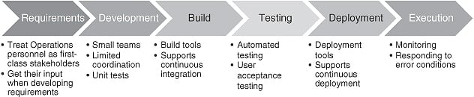
What is DevOps?
Automation of the various life cycle processes
Notes:
Continuous integration.
The developers commit early and often.
A commit triggers an execution of a test suite distributed across 30–40 machines, and the test suite takes about nine minutes to run.
Continuous deployment
Once a commit has passed all of its tests, it is automatically sent to deployment. This takes about six minutes.
The code is moved to the hundreds of machines in the cluster, but at first the code is only made live on a small number of machines (canaries).
A sampling program examines the results of the canaries and if there has been a statistically significant regression, then the revision is automatically rolled back. Otherwise the remainder of the cluster is made active. IMVU deploys new code 50 times a day, on average.

Slide 5
What is DevOps?
The ideal release process
“Testing, packaging, testing in test environment, packages deployed in test environment, further tests, system administrators upgrade systems while looking for failures. When failure there is a rollback. This release process is completely automated in an ideal world. People spend more time making improvements in how work is done rather than doing work itself.” ²
² Thomas A. Limoncelli et al., The Practice of Cloud System Administration, Volume 2, Addison-Wesley, 2015

Slide 6
What is DevOps?
The ideal operations
“ Monitoring system, storing data, analyzing data, alerts, two lines of personnel support. Failures have countermeasures. Countermeasures that are activated frequently are always automated. Exercising infrequently used automated countermeasures with intentionally caused failures. Automatic scaling up and down. In case of system overload, service switches to lower-level load alternatives. Features of services can be automatically turned on and off on a per user basis. ” ²
² Thomas A. Limoncelli et al., The Practice of Cloud System Administration, Volume 2, Addison-Wesley, 2015

Slide 7
What is DevOps?
Ideal team structure
People both develop and do operations.
Team size:
two pizza rule of Amazon
The smaller the team, the more teams are needed, the more complex the inter-team coordination
Team roles
Service owner
Reliability engineer
Gatekeeper (Release architect)
DevOps engineer

Slide 8
The Cloud as a Platform
DevOps consequences
the ability to create and switch environments in a simple manner
Dev, integration, user testing, and production environments
An environment is typically isolated from other environments.
the ability to create VMs easily
VM sprawl is used to describe the complexity in managing too many VMs. Similarly, the challenges of having too many VM images is called image sprawl.
the management of databases
The economic viability of the cloud coincided with the advent of NoSQL database systems.

Slide 9
DevOps overall architecture
Does DevOps requires architectural change?
This depends on the kind of DevOps that is adopted.
Take ops as first class citizens from the requirements
Make devs responsible for incident handling
Enforce or automate the same deployment process for all.
Continuous deployment
Maybe architectural change required, but also be architecture-agnostic
Infrastructure-as-Code: Develop infrastructure code with the same set of practices as application code
architectural change of infrastructure code required

Slide 10
DevOps overall architecture
Key requirement: little inter-team coordination required
Dramatically reducing the time required to place a component into production, however, requires architectural support:
Deploying without explicit coordination with other teams
Reasons to coordinate
Pieces developed by the various teams must work together
Avoid duplication of effort

Slide 11
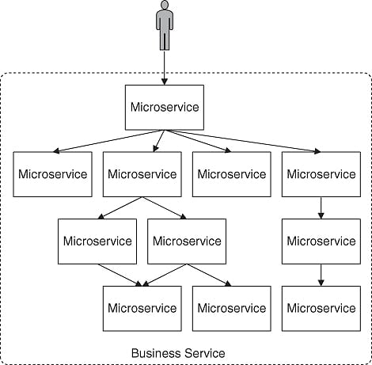
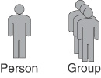

DevOps overall architecture
Micro-service architecture

Slide 12
DevOps overall architecture
Micro-service architecture: The architecture specifies a number of things globally to minimize inter-team coordination
Coordination model:
Service discovery by means of a registry/loadbalancer. E.g. Netflix’s Eureka
Service interaction by means of a protocol and an interface.
Resource management
Provisioning or deprovisioning of vms. This can be controlled by
The service itself
The client of the service
An external controller

Slide 13
DevOps overall architecture
Micro-service architecture: The architecture specifies a number of things globally to minimize inter-team coordination
Resource management
Managing varying demand in resources
Monitoring performance of service
SLAs specify the maximum request rate to guarantee a certain latency. The limitation of SLA’s is that an SLA violation can cause cascading effects through the demand chain
Mapping of architectural elements
Work assignment to teams: a team is assigned to a component.
Allocation: each component is allocated to a single VM, or multiple components are allocated to the same virtual machine

Slide 14
DevOps overall architecture
Amazon’s rules for teams
All teams will henceforth expose their data and functionality through service interfaces.
Teams must communicate with each other through these interfaces.
There will be no other form of inter-service/team communication allowed: no direct linking, no direct reads of another team’s datastore, no shared-memory model, no backdoors whatsoever. The only communication allowed is via service interface calls over the network.
It doesn’t matter what technology they [other services] use.
All service interfaces, without exception, must be designed from the ground up to be externalizable. That is to say, the team must plan and design to be able to expose the interface to developers in the outside world.”

Slide 15
DevOps overall architecture
Amazon’s rules for teams
All teams will henceforth expose their data and functionality through service interfaces.
Teams must communicate with each other through these interfaces.
There will be no other form of inter-service/team communication allowed: no direct linking, no direct reads of another team’s datastore, no shared-memory model, no backdoors whatsoever. The only communication allowed is via service interface calls over the network.
It doesn’t matter what technology they [other services] use.
All service interfaces, without exception, must be designed from the ground up to be externalizable. That is to say, the team must plan and design to be able to expose the interface to developers in the outside world.”

Slide 16
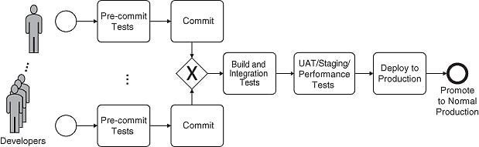
The Deployment Pipeline

Slide 17
The Deployment Pipeline
Development and Pre-commit testing
Version control and branching
Feature toggles
Configuration parameters
Unit testing

Slide 18
The Deployment Pipeline
Build and Integration testing
Packaging of modules and components
Run-time specific packages (Java Archives)
Operating system packages
VM images
Heavily baked
Light baked
Container images
Continuous integration and Build status

Slide 19
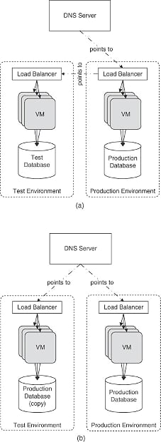
The Deployment Pipeline
UAT/Staging/Performance testing

Slide 20
The Deployment Pipeline
Deploy to production
Canary testing
Blue-green deployments
A/B Testing
Rolling upgrades

Slide 21
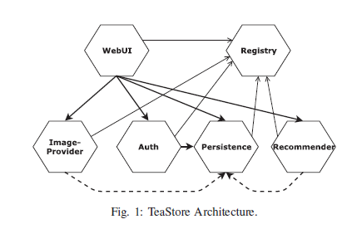
Teastore
A Microservices-based application
[1] J. von Kistowski, S. Eismann, N. Schmitt, A. Bauer, J. Grohmann and S. Kounev, "TeaStore: A Micro-Service Reference Application for Benchmarking, Modeling and Resource Management Research," 2018 IEEE 26th International Symposium on Modeling, Analysis, and Simulation of Computer and Telecommunication Systems (MASCOTS), 2018, pp. 223-236, doi: 10.1109/MASCOTS.2018.00030.

