Slide 1
VpK Visual parsed Kubernetes

Slide 2
VpK - Visual parsed Kubernetes What is it?
VpK was created as the result of needing to understand and visualize what is defined in all those Kubernetes configuration files.

Slide 3


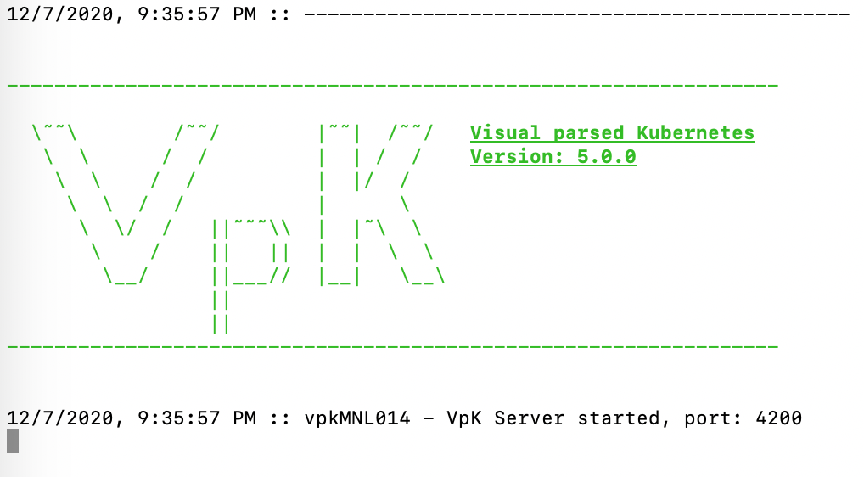
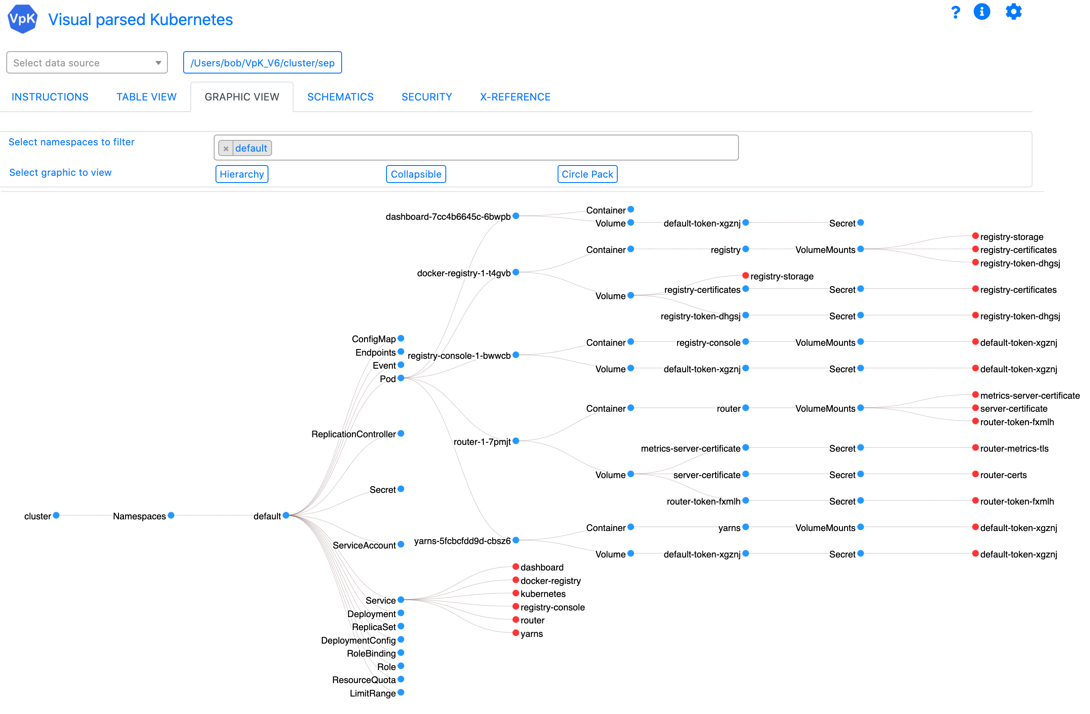

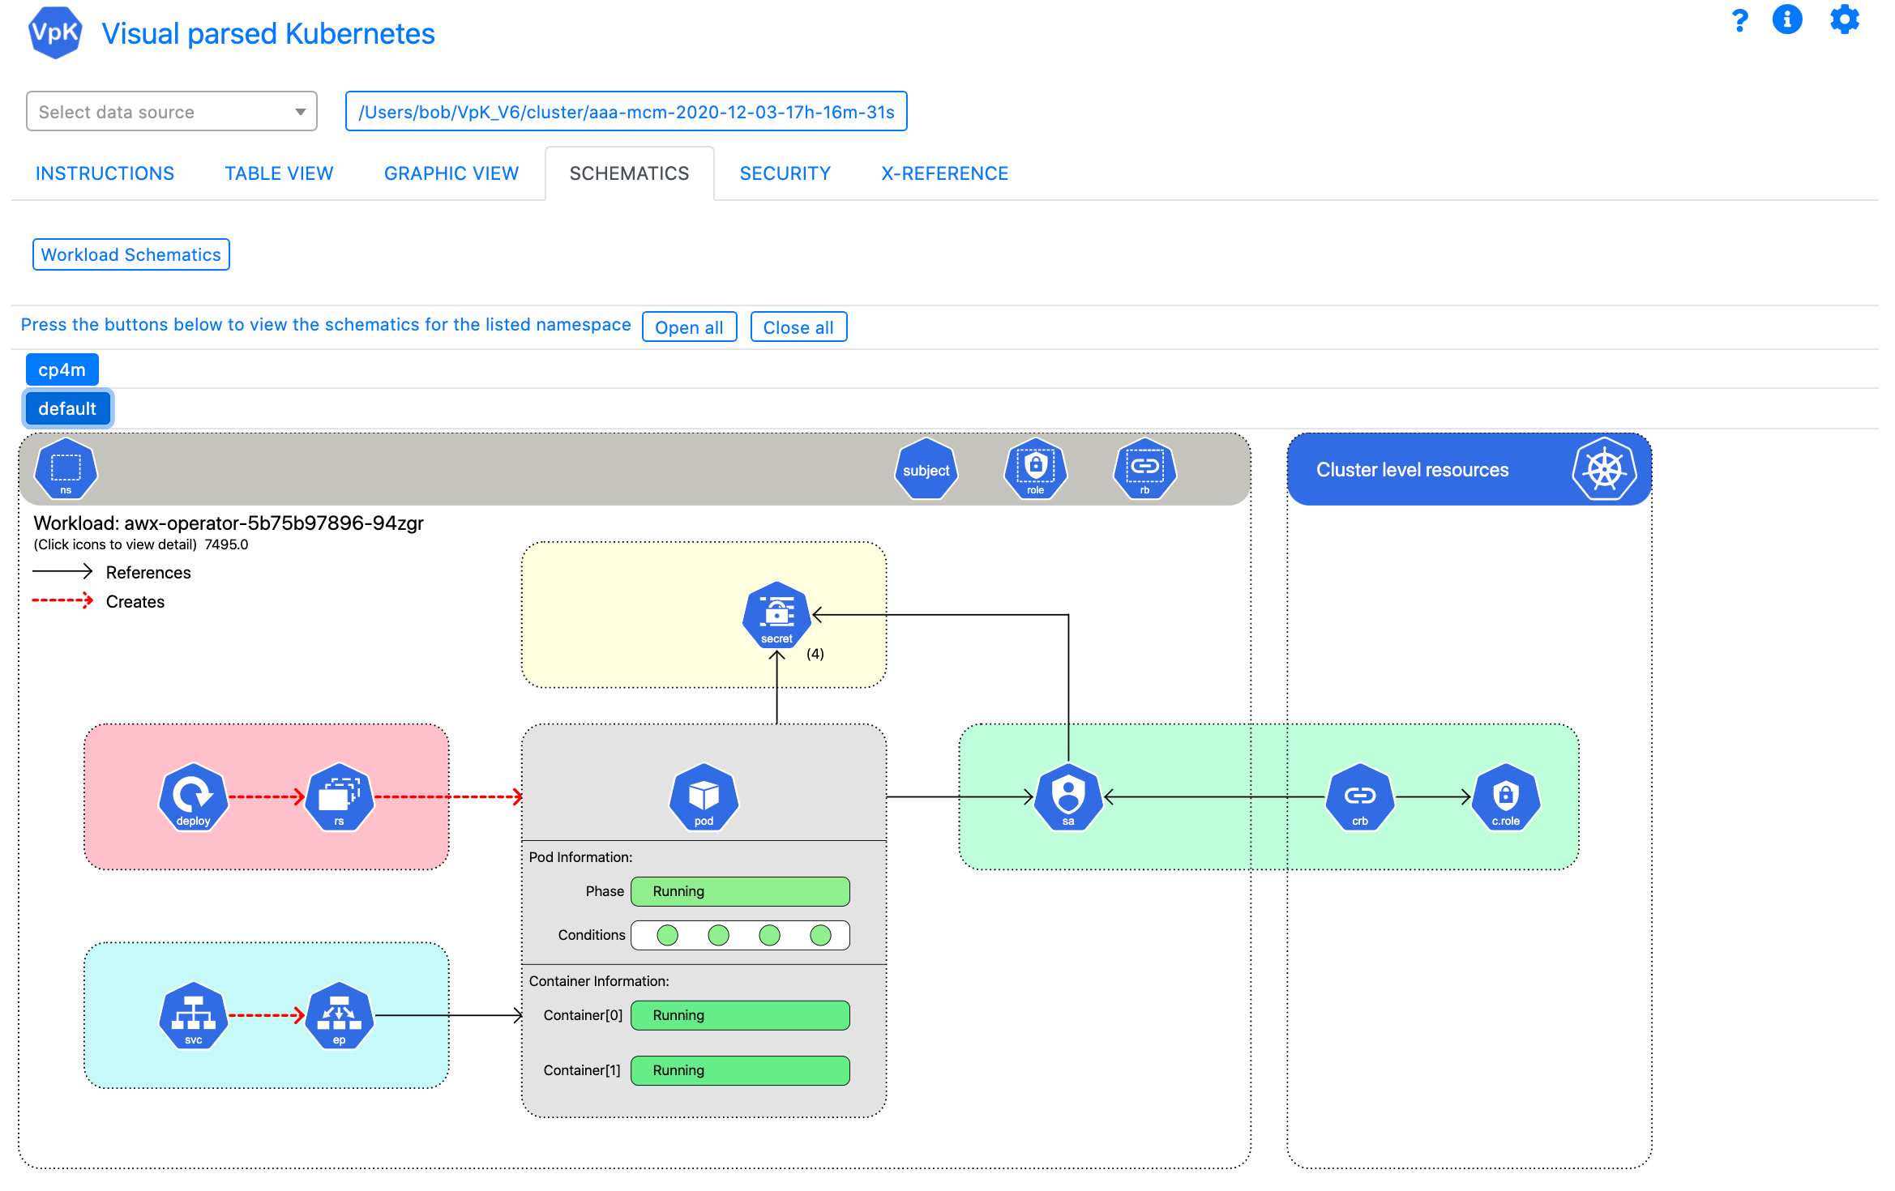
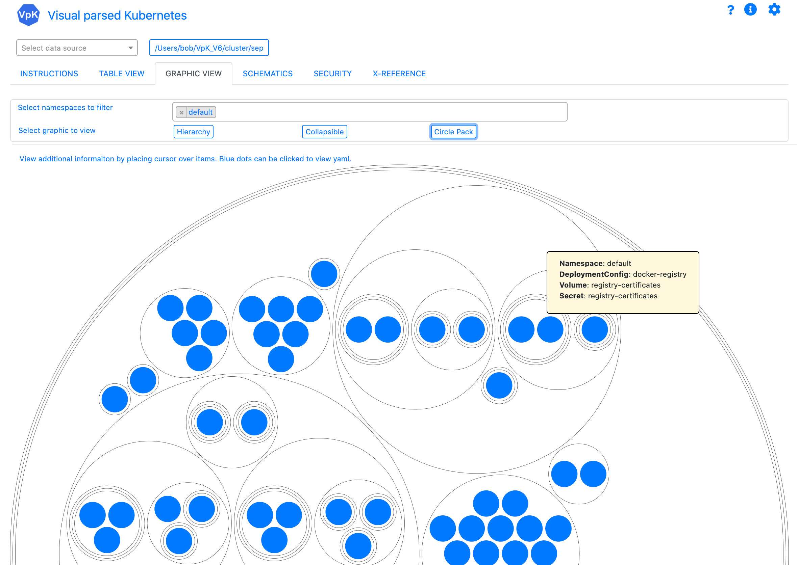

Visual parsed Kubernetes
Kubernetes
Application UI
(Browser based)
Supports most flavors of Kubernetes eg OpenShift, Minikube, MicroK8s, RKE, etc.
Server
(Node.js application)
Typically installed on desktop / laptop

Slide 4
VpK - Visual parsed Kubernetes Prerequisites
Web browser that supports html version 5
node js is required to run the server component
npm is required to install required node js packages
kubectl command line tool, this is invoked by the server

Slide 5
VpK - Visual parsed Kubernetes Getting started
Clone or download source code from GitHub link:
https://github.com/IBM-ICP-CoC/VpK

Slide 6
VpK - Visual parsed Kubernetes User Guide
The user guide and installation documentation is available at the same GitHub link:
https://github.com/IBM-ICP-CoC/VpK

Slide 7
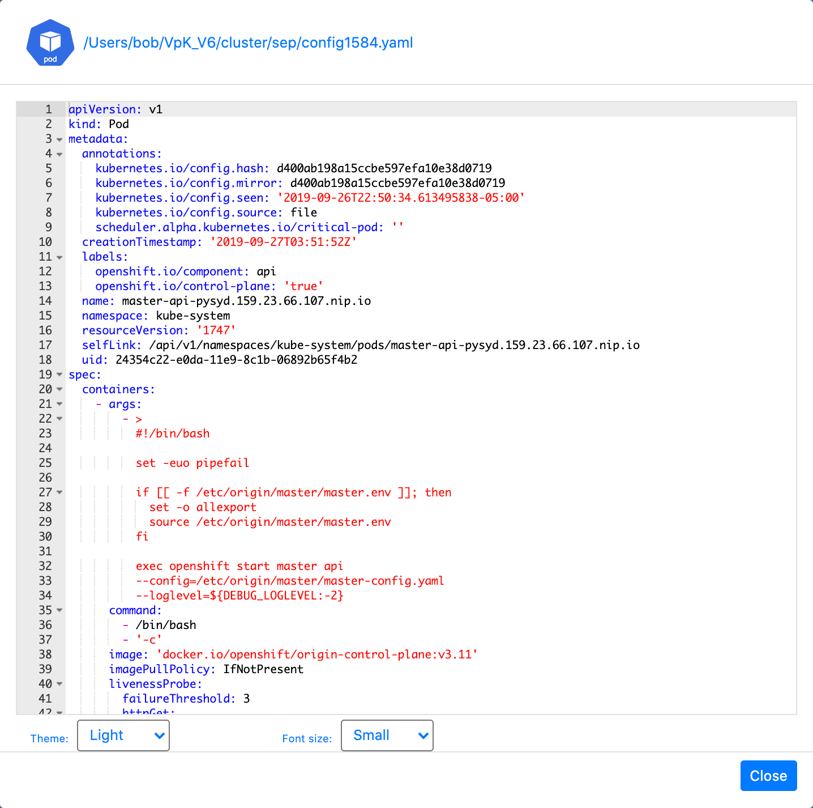
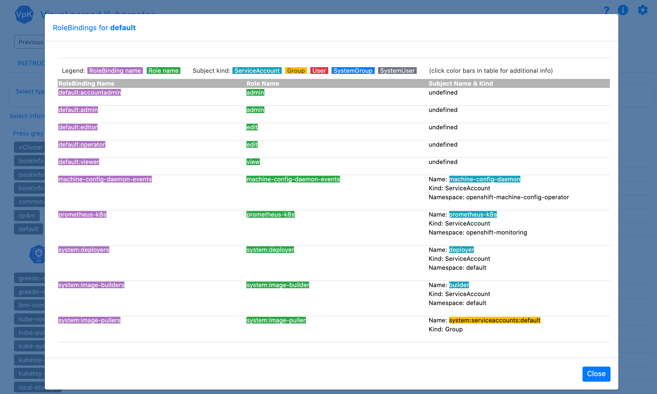
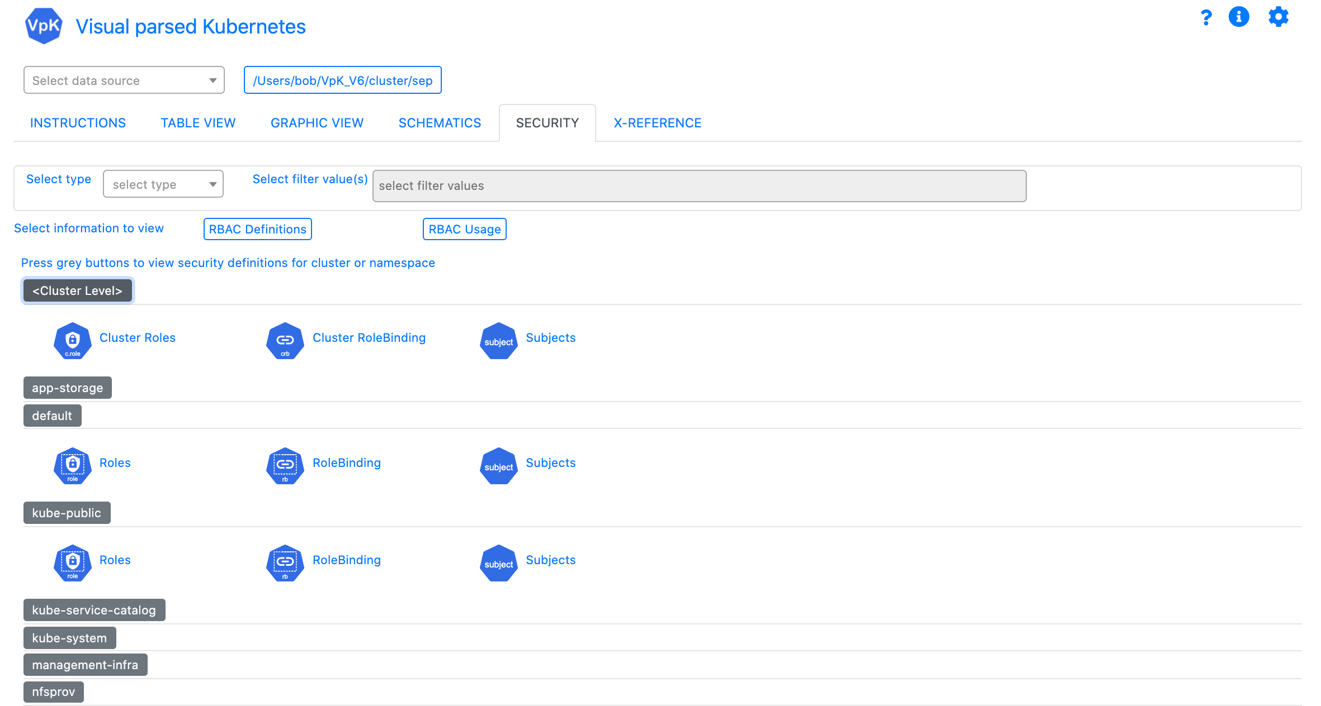
Visual parsed Kubernetes
Video coming soon

Slide 8
Visual parsed Kubernetes
Getting started
Installation and initial use

