Slide 1
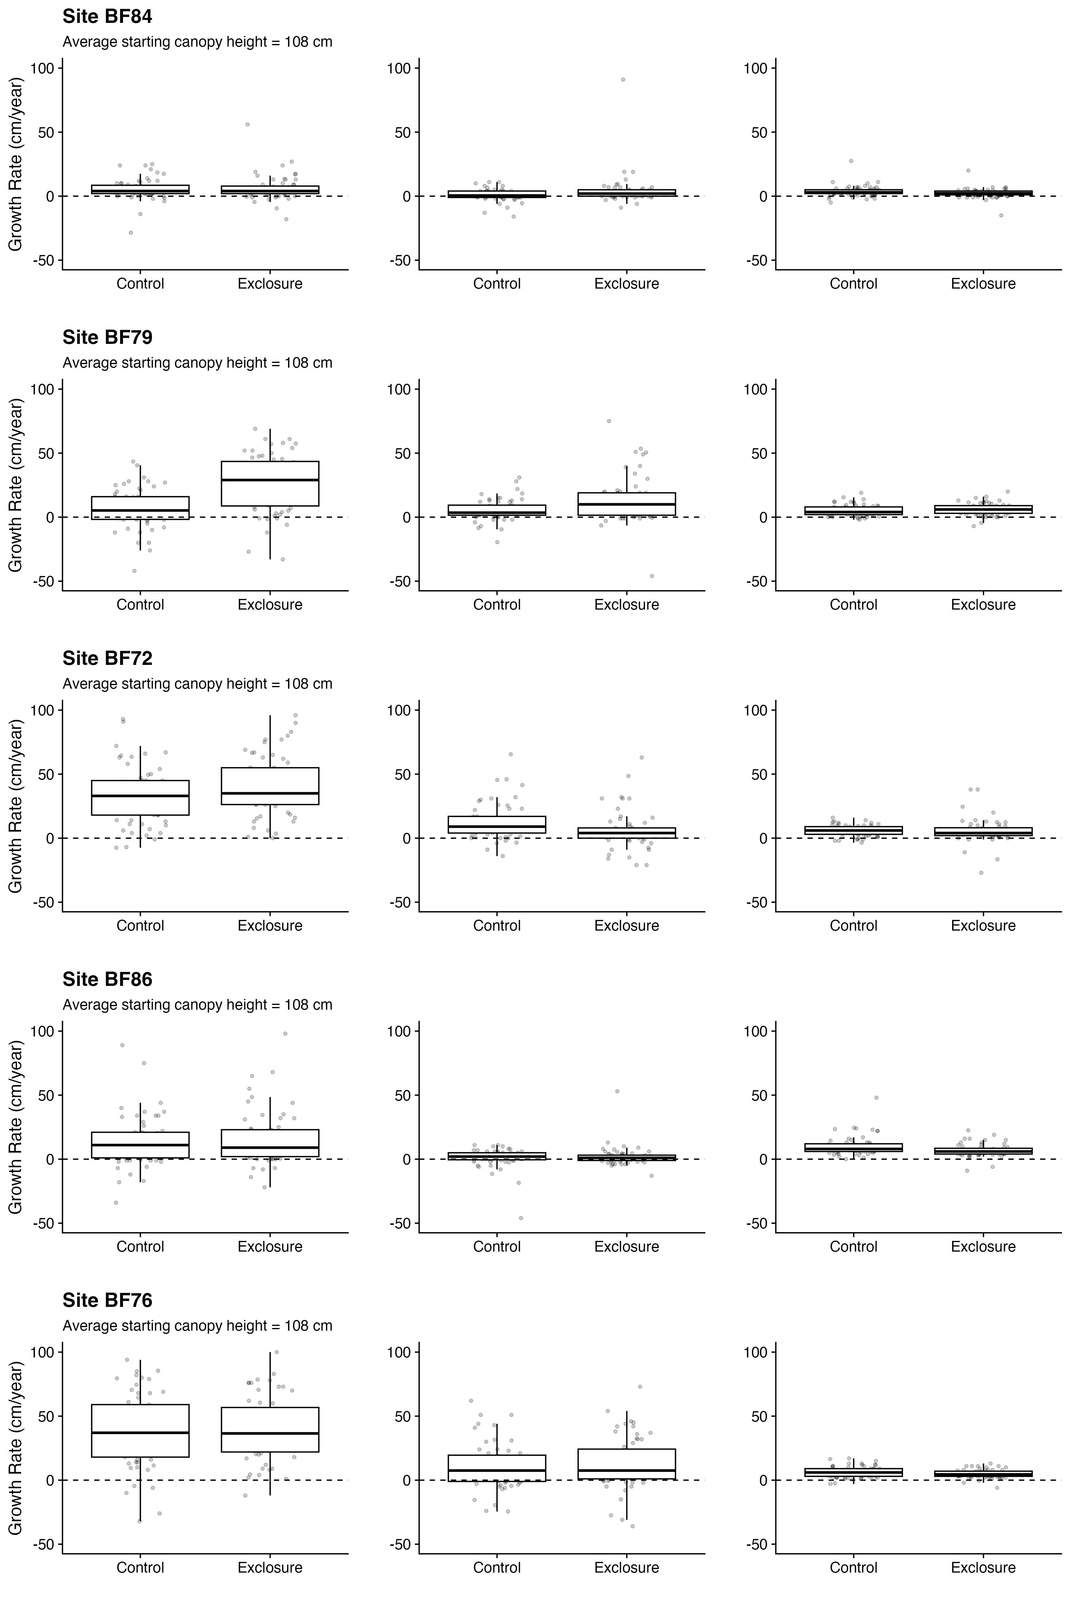
Birch
Aspen
Black Spruce

