Slide 1
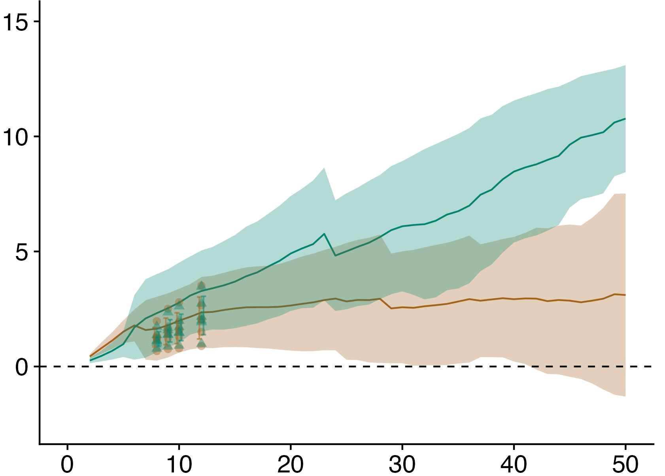
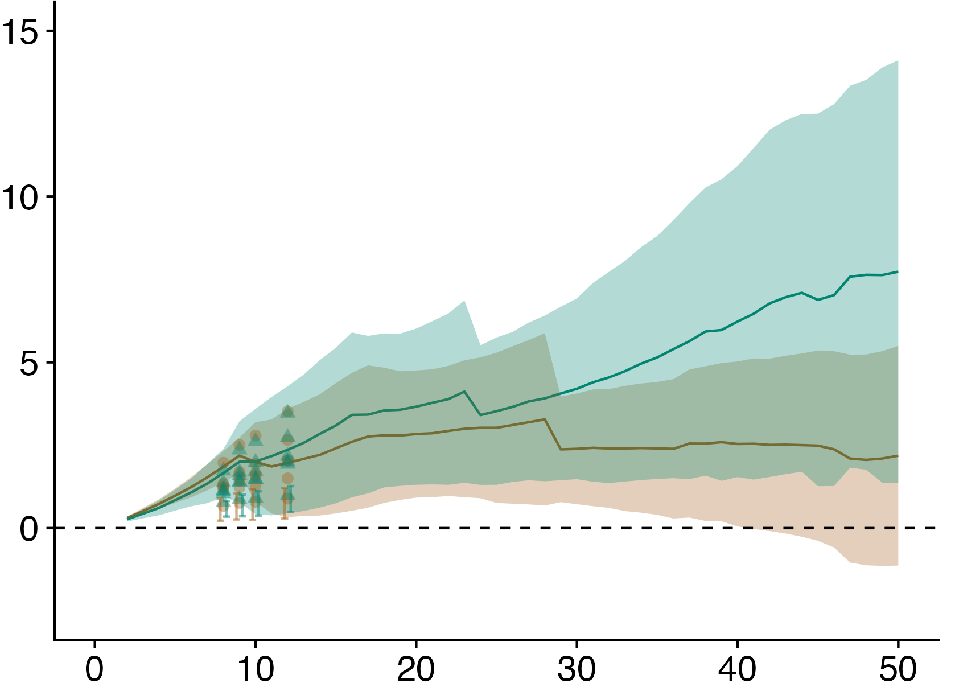
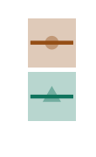
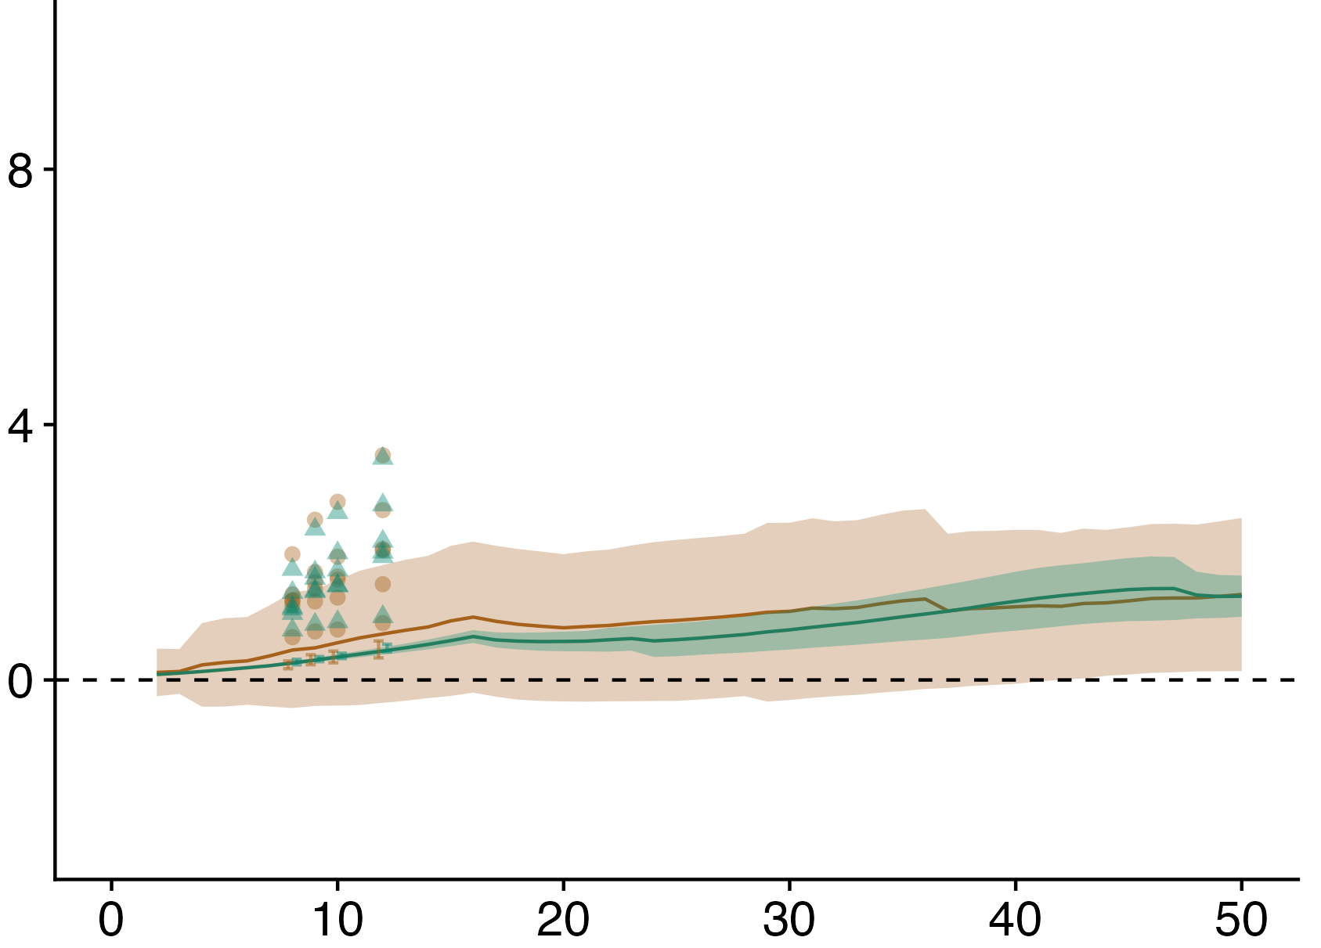
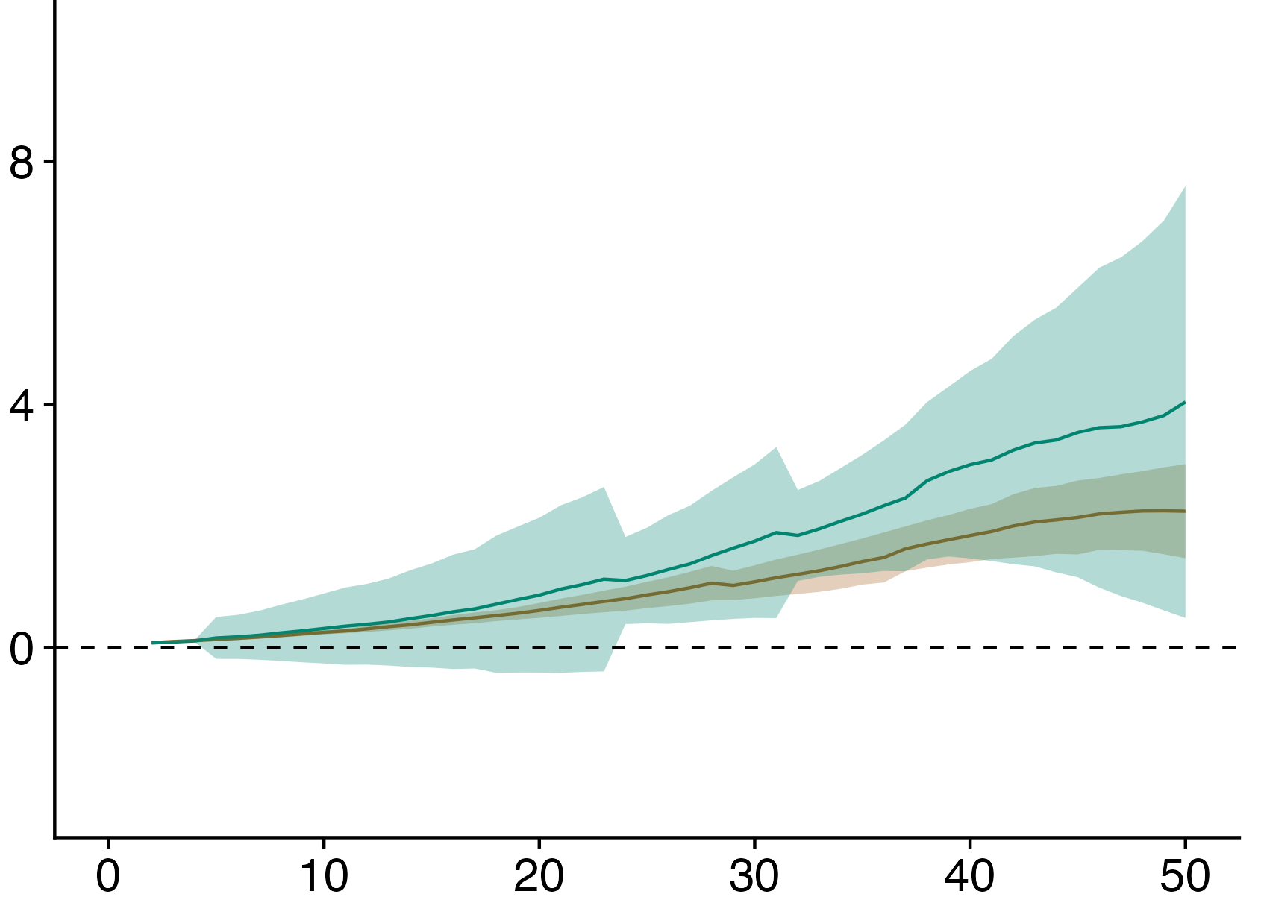
Birch
Aspen
Scenario
Scenario
Browsing
Browsing
No Browsing
No Browsing
Height (m)
Conway et al.
Conway et al.
Black spruce
White Spruce
Scenario
Scenario
Browsing
Browsing
No Browsing
No Browsing
Height (m)
Conway et al.
Time since fire (years)
Time since fire (years)

Slide 2
Birch
Aspen
Scenario
Scenario
Browsing
Browsing
No Browsing
No Browsing
Height (m)
Conway et al.
Conway et al.
Time since fire (years)
Time since fire (years)

