Slide 2
IBM App Connect's Journey to Istio
Greg Hanson
Special thanks: Martin Ross and App Connect Team
Notes:
First off, hello everyone. My name is Greg Hanson and I am a software developer from IBM. Today I am going to tell the story of one team’s journey to adopting Istio in their service.
Now, before I go any further, I want to give a shout out to the app connect team. I am presenting in their place today since they could not be here themselves - they put in the elbow grease and I, as a developer and maintainer of Istio, became their lead contact for troubleshooting.

Slide 3
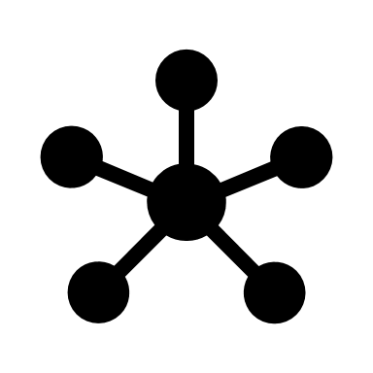


IBM App Connect
An Integration Platform as a Service
Over 150 micro-services
20M+ requests per day
100s of different endpoints and applications
Notes:
So, what is App Connect? App Connect is an Integration Platform as a Service that provides support for events, API’s and batch processing.
the app connect service itself is composed of over 150 microservices - each on a replica set with a minimum of 3 replicas for every service
The result is, the app connect service handles over 20million requests per day ranging from users interacting with the UI, calls from scheduled flows, service to service calls within the mesh, and calls to target applications hosted externally.
App connect integrates with 100’s endpoints and applications - The service itself relies on cloudant, elasticasearch, redis, kafka, sysdig to name a few. But it also supports additional endpoints through the use of connectors which are configured by the user. Examples of some of these connectors are - salesforces, db2 system, and or a standard HTTP endpoint

Slide 4
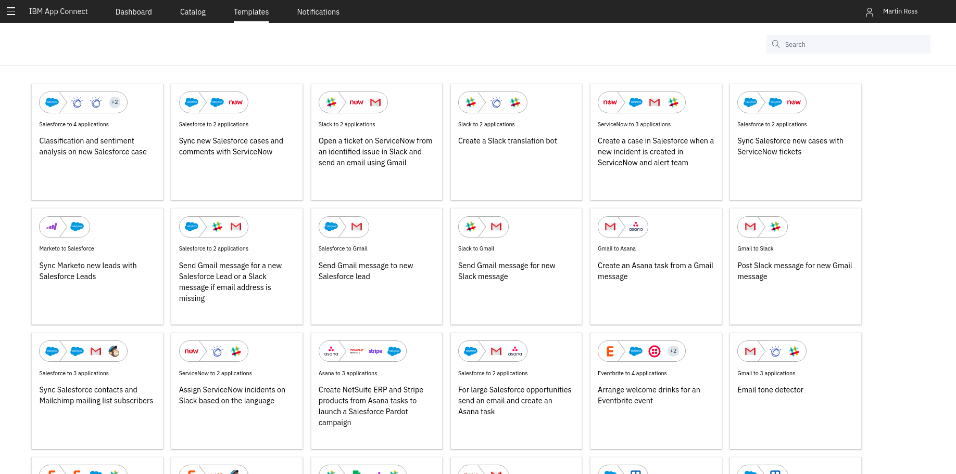
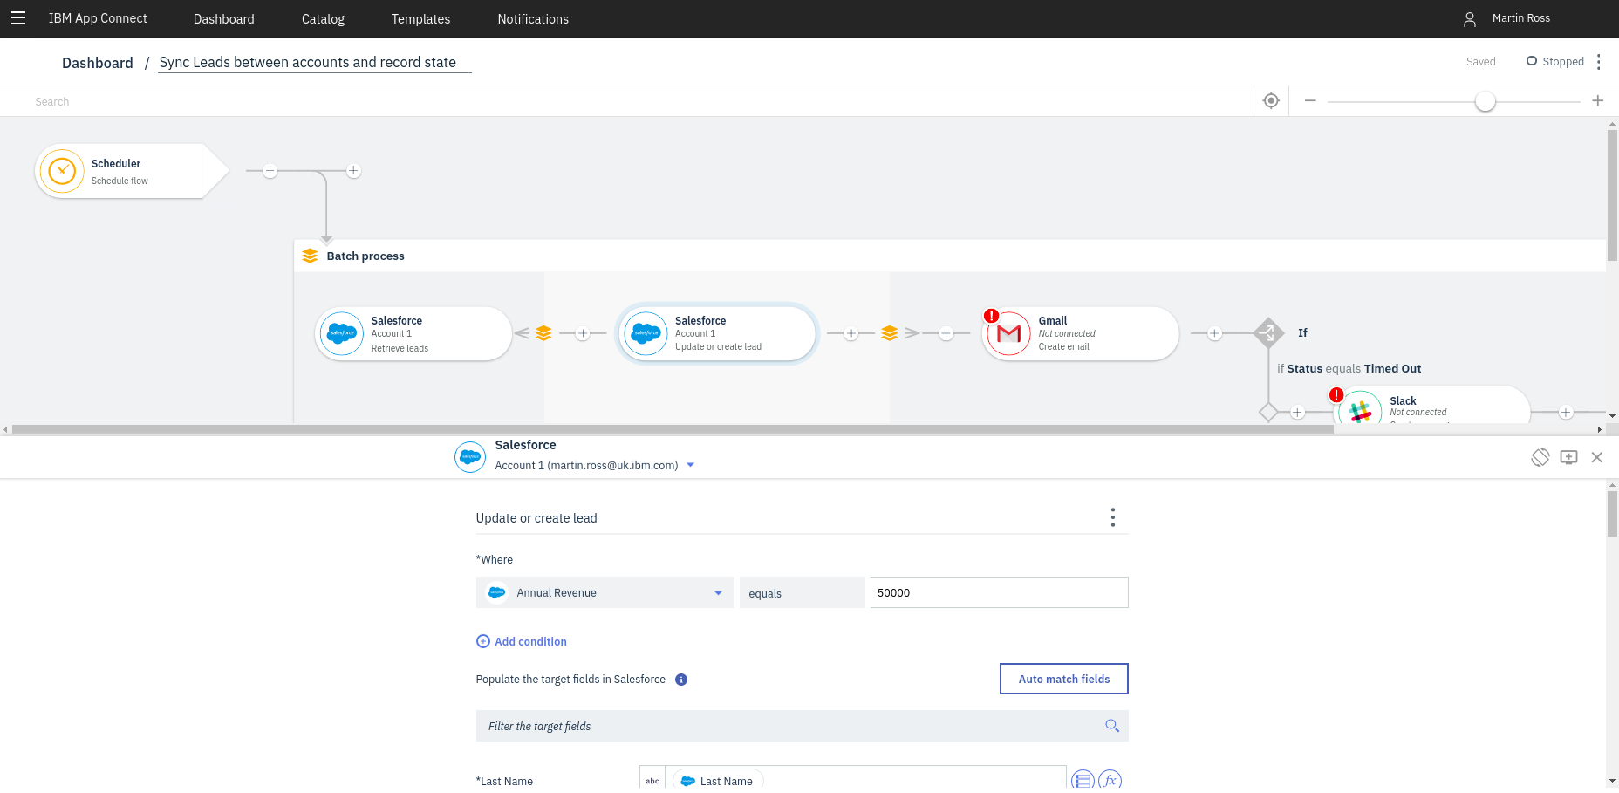
IBM App Connect
Notes:
for example, here a user creates a sample flow from a template. This flow, which runs periodically, gets the leads for a particular account, sends out some notifications in slack or email for each lead, and then saves a record state to a database backed.

Slide 5







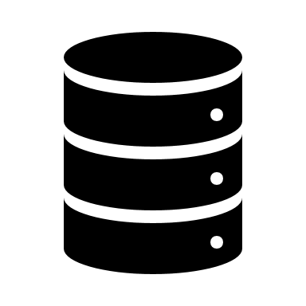



IBM App Connect
Cloud Foundry
Monitoring
Alerting
Applications
Logging
Users
Databases
Security
Target Applications / Endpoints
Messaging
Notes:
So, putting that into a helpful little diagram, Incoming traffic comes users scheduling and creating flows or other applications calling a user created API. Requests are handled by the app connect services - which make calls to external applicaitons for monitoring/alerts/logging/oauth/etc, and eventually the corresponding connectors interact with the configured SaaS target application

Slide 6

Existing Platform
"Home Grown"
Deployment
Monitoring
Logging
Rate limiting
Deployment
Every 2 weeks
Takes hours
Feature toggles
Notes:
Lets talk about App Connect prior to istio. App connect and all of its services were originally written all in Nodejs. They wrote and published their own npm modules for wrappers which perform consistent logging, metrics, retry logic and then used these wrappers in all of their separate microservices. Since everything was in NodeJS, the department could skillup and code share pretty easily and programmers within the team could move between different components smoothly
However as more connectors were added, they discovered different connectors needed to be written in different languages - JAVA for instance, so their common wrappers could no longer be dropped in. Thus they Needed to support polyglot runtimes. Polyglot meaning the services could be written in a mix of any programming language.
IBM originally didn’t have a Kubernetes based cloud offering when App Connect GA’d, so the team adopted a homegrown and non-declarative model for deployment. Services were all deployed via a bash script with a bunch of cloud foundry commands which had to be run sequentially and took hours to complete. So at the time, they were not strictly following 12-Factor application and cloud-native practices

Slide 7
Sample Flow
Cloud Foundry
User
UI
Authoring
Notes:
So here is just a quick sample use case of a user creating a flow in their original cloud foundry environment
The user interacts with the UI microservice, and a separate authoring service stores the user created flow in a database backend
And behind the scenes, the wrapper libraries are calling external logging, alerting and monitoring services

Slide 8
Sample Flow
Cloud Foundry
Logging
Application
API
Connector
Connector
Connector
Billing
Notes:
And one more quick example. A User has created an API that can be called by other applications.
The API is logged and sent to elasticsearch to be viewed later by the user, and then sent to one or more connectors which make calls to the corresponding SaaS endpoints to complete the request.
The API service calls a separated billing servicec, which records the number # of times the API is called and eventually billed to the user
And once again, those wrappers for each component are also using external logging / alerting / monitoring services

Slide 9

Areas of Improvement
Deployments
Traffic shaping
Circuit breakers
Request retires
Canary testing
Visibility
Error rates
External systems
Ingress
Notes:
So the App Connect team had some areas for improvement
they were using A very homegrown deployment model and wanted to move to a cloud-native and declarative model
Additionally, all of the Circuit breaking and retry logic was currently hardcoded using those shared wrapper libraries - which will not work as the team moves towards polyglot runtimes
Also The UI developers in particular were very interested in canary testing - opening the ability to share workloads between different service versions for testing and staging.
the team also Wanted better visibility on error rates, interactions with external systems and ingress. With Cloud Foundry, the GoRouter in front of the App Connect service was performing a lot of things behind the scenes - the team wanted better observability and metrics on this

Slide 10

Why Istio?
Service expanding
Moving to polyglot runtimes
Reduce code maintenance
Observability
Workload control
Community support
Available features
Notes:
So Why Istio?
For those who don’t know what Istio is, Istio is an open platform to connect, manage, observe, and secure microservices.
App Connect started on Cloud Foundry with 10 services originally, all of them written in NodeJS
But they are expanding and now Moving to polyglot runtimes
They didnt want to maintain common wrapper libraries that perform the consistent logging, metrics, and retries across the entire service
They wanted jaegar and kiali specifcally observability for end-to-end transactions and requests
They wanted better workload control with focus on Canary testing and traffic splitting
they also wanted to utilize Error injection for making more robust and stable microservices
Istio also has community support - within IBM and its open source community as a whole
lots of features the team is interested in implementing in the future

Slide 11

IBM App Connect with Istio
Monitoring
Alerting
Applications
Logging
Users
Databases
Security
Target Applications / Endpoints
Messaging
Notes:
So here is the same diagram as earlier except deployed with Istio on Kubernetes.
Requests come in through the Ingress gateway, which use a combination of Gateway and VirutalService rules to expose different microservices to the outside world.
The services themselves use ServiceEntry rules to communicate with external applications for monitoring / alerting / logging/ security / etc
And at the bottom, these are the SasS target applications the connectors talk to. App Connect supports a variety of SaaS targets and as a result cannot define all the Service Entries that might be needed at deployment for the connectors a user may configure down the line. As a workaround, the team is currently using the includeoutboudIPRanges notation. And I’ll show a example later

Slide 12
Sample Flow with Istio
User
UI
Authoring
Notes:
So, looking a that same scenario where a user creates a workflow.
The request comes in through the ingress gateway, there’s a Gateway and VirtualService rule to direct traffic to the UI microservice
And the microservices communicate with the external logging / alerting / and storage services using ServiceEntries

Slide 13
Sample Flow with Istio
Logging
Application
API
Connector
Connector
Connector
Billing
Notes:
And similar setup for the user exposed API example.
Application call their API service by going through the ingress gateway, and ServiceEntries for all external applications except the SaaS target applications called by the connectors
Notice there are not any rules needed for communication from API service to any of the other - this is because with Istio default routing works by default for services within the mesh

Slide 14
Ingress
apiVersion: networking.istio.io/v1alpha3
kind: Gateway
metadata:
name: gateway
spec:
selector:
istio: ingressgateway
servers:
- port:
number: 443
name: https
protocol: HTTPS
tls:
mode: SIMPLE
serverCertificate: /etc/istio/ingressgateway-certs/tls.crt
privateKey: /etc/istio/ingressgateway-certs/tls.key
hosts:
- "*.eu-gb.appconnect.cloud.ibm.com"
Notes:
Here is an example of a Gateway rule for controlling ingress into the appconnect service,
Gateway rules describe which ports are exposed to traffic coming from outside the mesh, as well as what the protocol type, SNI configuration, etc
In this rule port 443 is open for requests for hostnames matching the domain specified above and it has TLS enabled
No HTTP section because there is a cloudflare instance in front of production system that enforces https

Slide 15
Virtual Service
apiVersion: networking.istio.io/v1alpha3
kind: VirtualService
spec:
gateways:
- gateway
hosts:
- "ui.eu-gb.appconnect.cloud.ibm.com"
http:
- route:
- destination:
host: ui
port:
number: 80
Notes:
Here is a Virutal Service rule. VirtualService rules defines how traffic is routed to a service within the mesh.
For this one here, it defines the routing behavior for the port/host combination defined in the Gateway
Matches on a particular hostname from the request, and routes to the destination host and port
Even though this VirtualService is defined with http, this also works with Isito auth enabled (which will automaticlaly upgrades to https)

Slide 16
Service Entry
apiVersion: networking.istio.io/v1alpha3
kind: ServiceEntry
metadata:
name: elasticsearch
spec:
hosts:
- "elasticsearch.database.com"
location: MESH_EXTERNAL
ports:
- number: 12345
name: https
protocol: HTTPS
resolution: NONE
Notes:
And here is an exmaple service entry
Service Entry rules define services that are not automatically discoverable within the mesh - so that internal service can route traffic to them
This one is for elasticsearch.

Slide 17
Deployment
apiVersion: extensions/v1beta1
kind: Deployment
metadata:
labels:
app: http-connector
chart: http-connector-1.0.0
heritage: Tiller
release: app-connect
name: http-connector
spec:
template:
metadata:
annotations:
traffic.sidecar.istio.io/includeOutboundIPRanges: 172.30.0.0/16,172.21.0.0/16,10.10.10.0/24
labels:
app: http-connector
release: app-connect
spec:
containers:
...
Notes:
And here is an example deployment for one of the connectors
I mentioned the includeoutboundip ranges notation before, for those not aware, this annotation is used to decide which traffic is sent to the envoy proxy sidecar running along the local service. The way it is configured now, all local traffic in mesh gets routed through the service’s local envoy proxy and everything else bypasses it.
Since App connect service doesn’t know all the endpoints a user may specify when configuring a connector- this is the current workaround. The team is still working on investigating alternative implementations because they want obeservability and metrics on those external calls

Slide 18
Where are we today?
Using Istio ~1 year
Istio ingress gateway
MTLS
Auto injection
rewriteAppHTTPProbe
150+ micro-services
Moving to production for majority of workload
Notes:
So, where is the App Connect team today?
They have Been using Istio for over a year now. Istio 1.0.4 was the first version installed on one of their primary clusters but they have been playing with versions as early of 0.9 and 0.7
they Have a pre-prod system up and running, everything deployed using pipelines and testing is currently underway
they also have A Production environment is deployed and ready for testing to complete
Their current environments have the Istio ingressgateway installed, with autoinjection enabled (which deploys the sidecar proxy alongside each of their services automatically), mtls enabeld gloablly, and rewriteAppHttpProbe for liveness/readyness probes
The rewriteAppHTTPProbe is something needed once mTLS is enabled . This flag tells the injector to rewrite the liveness health check in the PodSpec to redirect to the sidecar instead. This is because there currently isn’t a way to configure kubernetes health checks to use the certs generated by Istio citadel.
150+ microservices with multiple instances - so closer to 500 containers.
First Istio based deployment is actually only going to be one custerom. On boarding one customer - represents majority traffic. So once the team verifies the sucessful transition of that customer then they will start staging everyone else in early next year.

Slide 19
Using Istio
System functionality and stability
Found stability in 1.1 release
Outbound integrations
Annotations
Improves understanding of interactions with external systems
Pod start-up time and connectivity
Identified bugs in our code
Ingress solution
Not straightforward – many options
Deployment and maintenance
Need to stay up to date
Not using all features yet
Turn off what you are not using
Notes:
So lets talk a little bit about their adoption process
The team experienced some stability issues prior Istio version 1.1
503’s specifically, which made their initial attempts more difficult to diagnose along the way
it was a learning experience understanding in finer detail how their services talked to external endpoints.
One such pain point was Pod start up time.
When injecting the sidecar proxy to services during deployment - the Proxy wasnt ready in time - and a lot of their microservices were failing the inital calls to setup connections to these external applications. Some were never retrying to connect to external endpoints on startup. and in a few instances, didn’t crash on failure. So they would come up, fail to connect to a database, staying up, but then not being able to actually do anything
as a result The team Ended up identifying bugs in their applicaitons - the result of some Bad coding proactices creeping. istio and kubernetes were a way to discover these bad practices and move towards more Cloud native and 12 Factor applications
the outbound annotations were useful for saying a particular microservice can talk to anything - while tying down the rest of the services for better control
Another items was Implementing an ingress solution - which was not as straightforward.
partly bc its environment specific - slide to follow for that
Automating how deployments are handled since Istio while it does have log term support for so many versions, version updates do need to happen
currently perform some manual testing, then run compent and integrations tests, and eveutally promote to production
The team want to use more features, but a number of them are currently disabled dduring deployment
Found out that failures were introduced by components even though the team wasn’t specifically using them. The result was, since they weren’t directly using the component - the team wasn’t watching for failures there
for example, even though the team wasn’t using prometheus for observability - prometheus running away with resources on the cluster which resulted in scheduling errors with other services
But they are currently Going to prod with istio 1.2.7 and have begun testing with 1.3.4

Slide 20
Ingress
DNS Response
my-istio-cluster.com IN A 169.15.23.81
my-istio-cluster.com IN A 169.15.24.43
my-istio-cluster.com IN A 169.15.25.12
Health Checks
Multi-zone cluster
Network Load Balancer
Health checks
Clone Istio Service
DNS
Worker 1
NLB
Service A
169.15.23.81
Service A
Service A
my-istio-cluster.com
NLB
Worker 2
169.15.24.43
Service A
Client
Service A
Service A
NLB
Worker 3
169.15.25.12
Service A
Service A
Service A
Notes:
This is a diagram for ingress in a multizone cluster. Since it’s a little envionment specific, so I wont go into too much detail
The App Connect service has 3 public IP’s, They have cloned a Network load balancer service for each availabilty zone, and modified to point to different IP’s for each AZ.
Behind each NLB is an istio ingress gateway and the services running for that az
So a client calls the DNS service, which performs healthchecking,for each AZ and will only return a healthy endpoint to the client

Slide 21


MTLS and probes
Disabled
Passive
Strict
Service A
Service B
TLS
Ingress Proxy
Proxy
Proxy
Egress Proxy
mTLS
mTLS
mTLS
Istio Control Plane
Pilot
Citadel
Notes:
App connect is also running with isito auth enabled
Added mTLS after everything else was working - so ingress, auto-injection, and routing
started with disabed, moved to passive, and then eventually strict
As you can see, the team is currently only using Pilot and Citadel, and has the other components of the controlplane disabled

Slide 22
Roadmap
Enable more of the Istio control plane
Upgrade to most recent release
Adopt the operator model for installing
Locale aware routing
Fault injection
Notes:
So looking forward, the App Connect team still has more features to adopt
observabilty with kiali / jaegar
move to 1.3 to 1.4
operator model
prefer local routing / local aware routing
fault injection - learned a lot of things about how their services were written and how resilient they were to failures on startup - they want to keep exploring these dependencies and failures so they can be prevented in the future

Slide 23
Summary
Disable components not being used
Plan ingress solution
Enforces good practice
Control egress where possible
Plan update process
Just works
Notes:
So some words of wisdom from the team for those thinking of trying something similar with their own service
Disable components not in use
Think about how ingress will be handled in your environment. For instance do you want to chain your existing ingress to Istio ingress gateway or just dive straight in with Istio’s
Enforce good development practices - think cloud-native and 12 factor
Learn about all of your external endpoints and how your services interact with them
Think about how you want to handle updates
And, with auto injection, things just work. The team hit a few bumps with their initial configuration, but once you figure it out, you deploy your service, it’s injected, and it just works

