Slide 1
HealthcareOS
The AI Care Coordination Layer for Bharat
An AI voice nurse that calls every discharged patient in their own language — reminds, listens, escalates, and closes the loop with the doctor.

Slide 2
The problem: care ends at the hospital gate
Post-discharge is a black hole
Once a patient leaves, doctors have no visibility into whether medicines are taken or symptoms worsen.
Follow-up doesn't scale
Manual phone follow-ups are expensive; nurses can't call hundreds of patients twice a day.
Apps don't work for Bharat
Most patients won't install an app or read English SMS — but everyone answers a phone call in their language.
Missed signals become emergencies
Skipped doses and early symptoms (chest pain, dizziness) surface only at readmission.

Slide 3
The solution: a closed-loop AI voice nurse
1 · Plan
Doctor saves a care plan — medicines, dose times, follow-up questions, call window.
2 · Call
The scheduler auto-places real phone calls at each dose time, speaking in the patient's language (Hindi, Tamil, ...).
3 · Listen
The patient just talks. Speech is transcribed and turned into structured data: took medicine, symptoms, urgency.
4 · Escalate
High-urgency replies (e.g. chest pain) raise an escalation on the doctor's dashboard within seconds.
5 · Close the loop
The doctor types advice once — it's translated and delivered back as a voice callback. No app, no SMS.

Slide 4
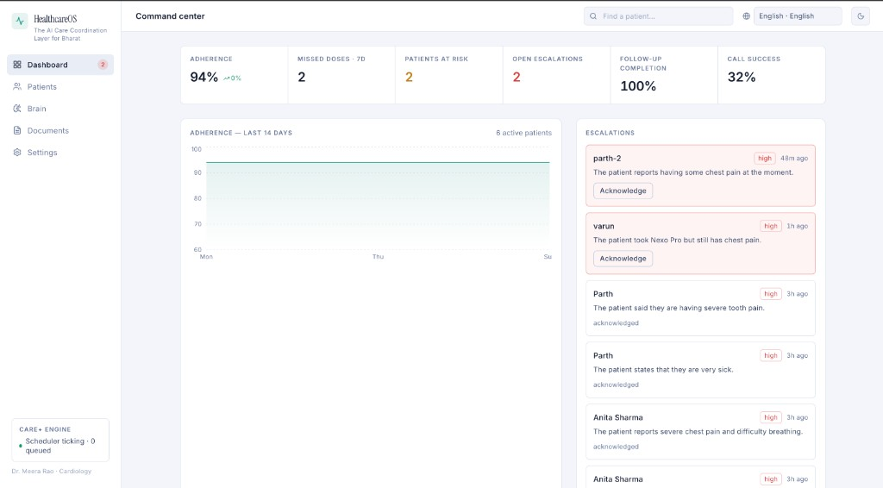
Command center
One glance tells the care team who needs attention right now.
• Live KPIs: adherence %, missed doses, patients at risk, call success.
• Escalation feed sorted by urgency — chest pain surfaces at the top.
• One-click acknowledge keeps the queue clean.
• 14-day adherence trend across all active patients.

Slide 5
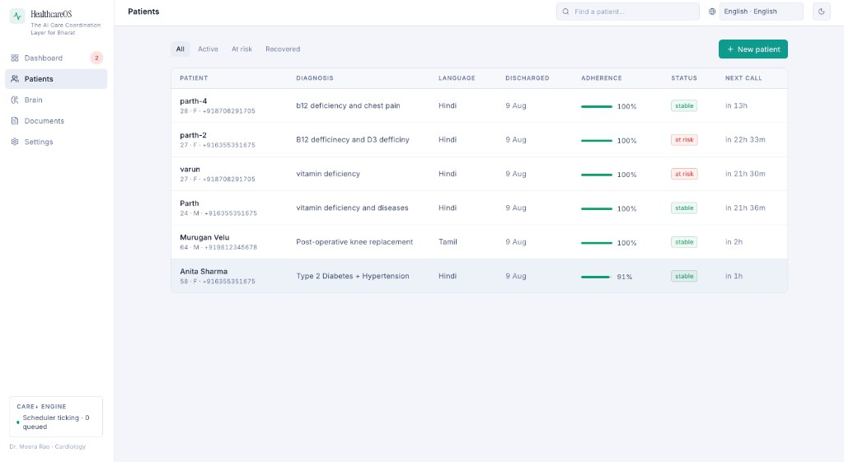
Patient roster
Every discharged patient, their language, adherence and next scheduled call.
• Filter by Active / At-risk / Recovered.
• Per-patient adherence bar and risk status computed automatically.
• “Next call” shows exactly when the AI nurse dials next.
• Multilingual by design — Hindi, Tamil and more per patient.

Slide 6
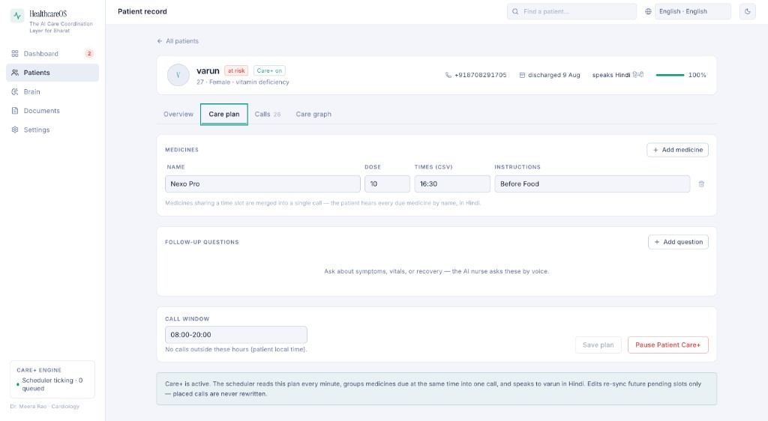
Care plan → Care+ engine
The doctor writes the plan once; the scheduler does the rest, every day.
• Medicines with dose, times and instructions (“Before Food”).
• Follow-up questions the AI nurse asks by voice.
• Call window guarantees no calls at odd hours (patient-local time).
• Edits re-sync future slots only — placed calls are never rewritten.

Slide 7
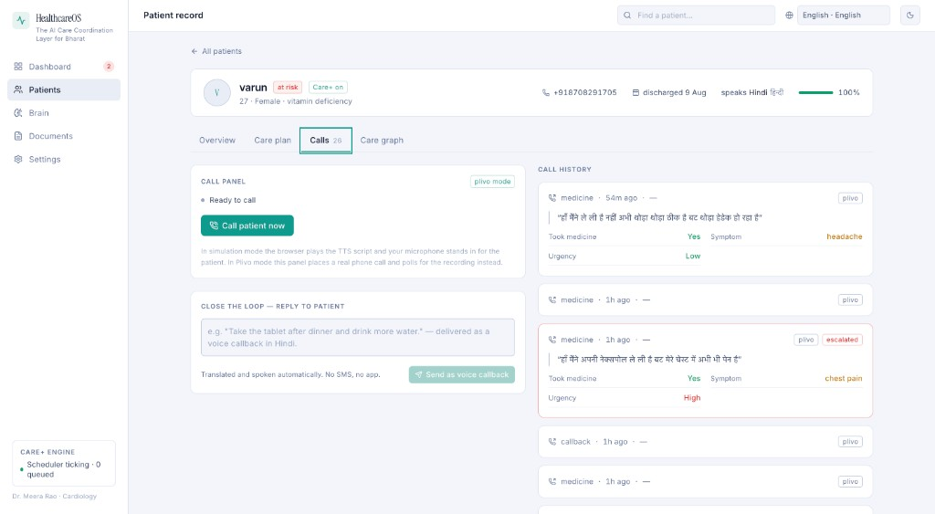
Calls & the closed loop
Real Plivo phone calls in, structured clinical data out.
• Each call is transcribed and parsed: took medicine, symptom, urgency.
• “Chest pain, urgency High” auto-raises an escalation mid-call.
• Doctor replies in the reply box — delivered as a voice callback in Hindi.
• Simulation mode lets you demo the whole flow without telephony.

Slide 8
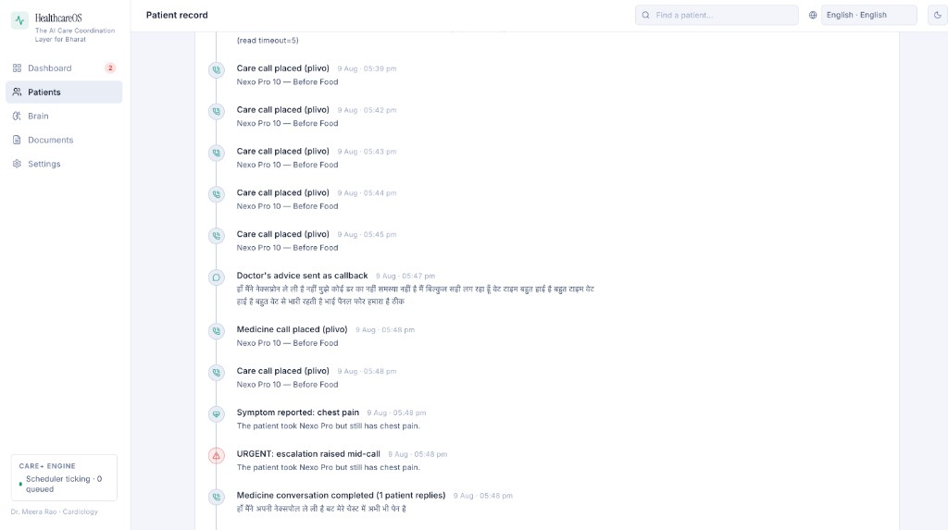
Care graph — the patient's full journey
A single timeline from discharge to recovery: calls, symptoms, alerts, advice.
• Every event is logged: care calls, symptom reports, escalations, callbacks.
• Doctors see cause and effect — advice sent, next call outcome.
• Perfect audit trail for handovers and clinical review.

Slide 9
Under the hood
Voice & language — Sarvam AI
• LLM for call scripts & reply understanding
• TTS / STT in Indian languages
• Translate + language ID for the closed loop
• Deterministic fallbacks if the API is down
Telephony — Plivo
• Real outbound calls with recorded replies
• Answer / recording / hangup webhooks
• Live voice websocket streaming
• Simulation mode for demos & tests
Engine — FastAPI + SQLite
• Cron scheduler: materialize slots, group by time, dial
• Retries with backoff, call windows, missed-dose events
• Brain: document Q&A with citations (cite-or-refuse)
• React frontend, 5-language UI (en/hi/kn/mr/ta)

Slide 10
Verified end-to-end
Plan → scheduled call → patient reply → structured data → escalation → doctor advice → voice callback.
HealthcareOS — no app, no SMS. Just a phone call, in the patient's language.

