Slide 1

Retrieval Augmented Generation (RAG) for Scientific Question Answering
erhtjhtyhy
Presenter
Presented at:
Ozan Gokdemir
Computer Science PhD Student
The University of Chicago
MICDE
Scientific Foundation Models Conference
University of Michigan
April 2, 2024

Slide 2
Why do we need RAG?
Shortcomings of LLMs
LLMs are probabilistic models and therefore suffer from “hallucinations”.
“Unlearning” bias and outdated data is challenging for LLMs.
Updating the knowledge base with new information is not straightforward.
LLM training data can sacrifice domain expertise for generalizability.
LLMs are black-box models that offer little interpretability of responses.

Slide 3

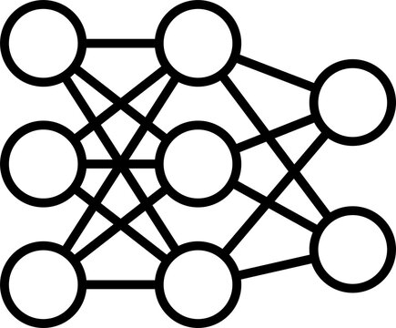
A Hallucination Scenario
regarding antimicrobial peptides
How does the antimicrobial peptide defensin contribute to the immune response in plants? Please provide a citation that supports your answer.
Defensin in plants contributes to the immune response by enhancing the production of antibodies that target and neutralize pathogens.
Source: Smith, A. J., & Johnson, B. K. (2018). "Enhancement of Antibody Production in Plants by Defensin Peptides." Scientific Reports, 8(1), 12345.

Slide 4

Mitigating Hallucination
Equipping LLMs with external sources
How does the antimicrobial peptide defensin contribute to the immune response in plants? Please provide a citation that supports your answer.
“…They are thought to bind as monomers onto anionic lipid headgroups of the membrane, thereby covering the membrane in a ‘carpetlike’ manner. The subsequent neutralization of the anionic lipid headgroups disrupts the integrity of the lipid bilayer, causing transient gaps and allowing ions and larger molecules to cross the membrane…”
The antimicrobial peptide defensin contributes to the immune response in plants by disrupting the integrity of fungal cell membranes and inhibiting fungal growth. This action is part of the plant's innate immune system to protect against pathogen invasion.
Source: Thomma, B.P., Cammue, B.P., Thevissen, K. (2002). "Plant defensins." Plant Cell, 14(Suppl), S333-S343.

Slide 5



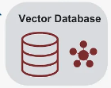


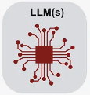



How does RAG work?
Anatomy of a RAG system
Domain expertise, context window
Semantic search (cosine similarity, L2 distance)
indexing
question encoding
Fixed-size,
Semantic,
Structural
Agentic
retrieval
FAISS, Chroma, Pinecone
Nougat, Marker, Grobid
PubMed, Arxiv, Wikiopedia
icons from: gradientflow.com

Slide 6
Limitations of RAG
Potential pitfalls
Knowledge extraction might fail to sufficiently extract data from PDFs.
Fixed-size chunking might lead to incomplete and incoherent sentences.
Embeddings might lack sufficient semantic signal.
Information in the knowledge base might be irrelevant to the queries.
Retrieval strategy might suffer from low precision and confuse the generator.
Semantic search tends to be sub-optimal in precise, keyword queries.
Context window of the generator could be underutilized by the retrieved content.
Generator may lack the capacity to perform well on niche domains.

Slide 7
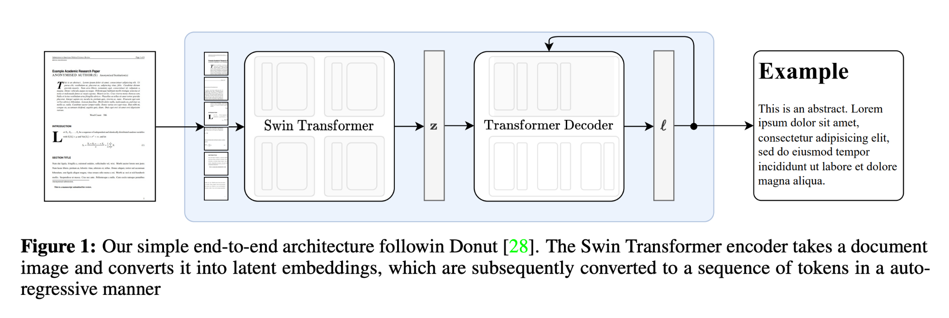
Addressing RAG Limitations
PDF Parsing with Nougat
Source: Nougat: Neural Optical Understanding for Academic Documents, Blecher et al.

Slide 8
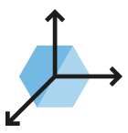
Addressing RAG Limitations
Semantic Chunking
sentence5
sentence6
sentence1
sentence1
sentence2
sentence3
sentence4
grouping
s1
s2
s1
s2
s3
s2
s3
s4
s3
s4
s5
s4
s5
s6
s5
s6
encoding
cosim(s1s2, s1s2s3)
cosim(s1s2s3, s2s3s4)
cosim(s3s4s5, s4s5s6)
cosim(s4s5s6, s5s6)
1
cosim(s2s3s4, s3s4s5)
4
sentence1
sentence2
sentence3
sentence4
sentence5
sentence6

Slide 9
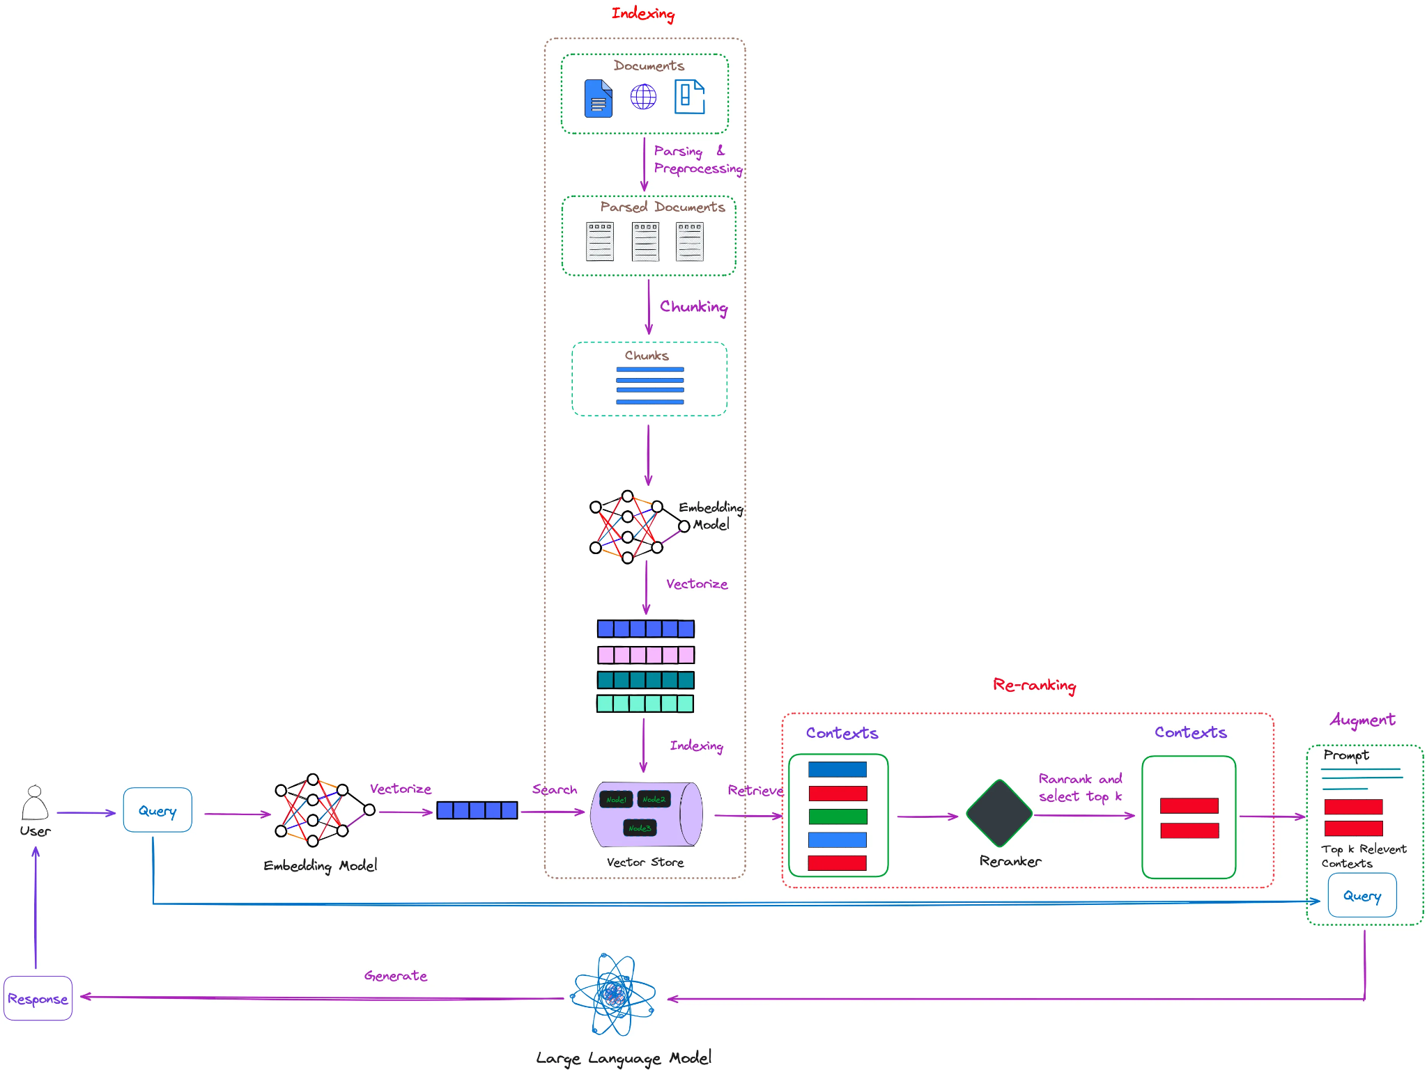
Addressing RAG Limitations
Re-Ranking
figure by the courtesy of Florian June

Slide 10
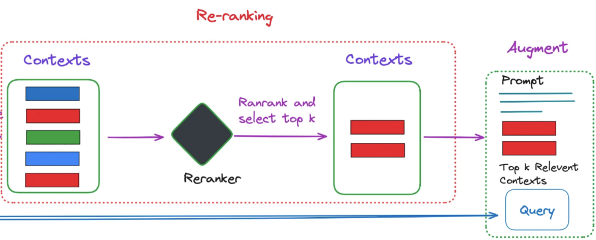
Addressing RAG Limitations
Re-Ranking

Slide 11
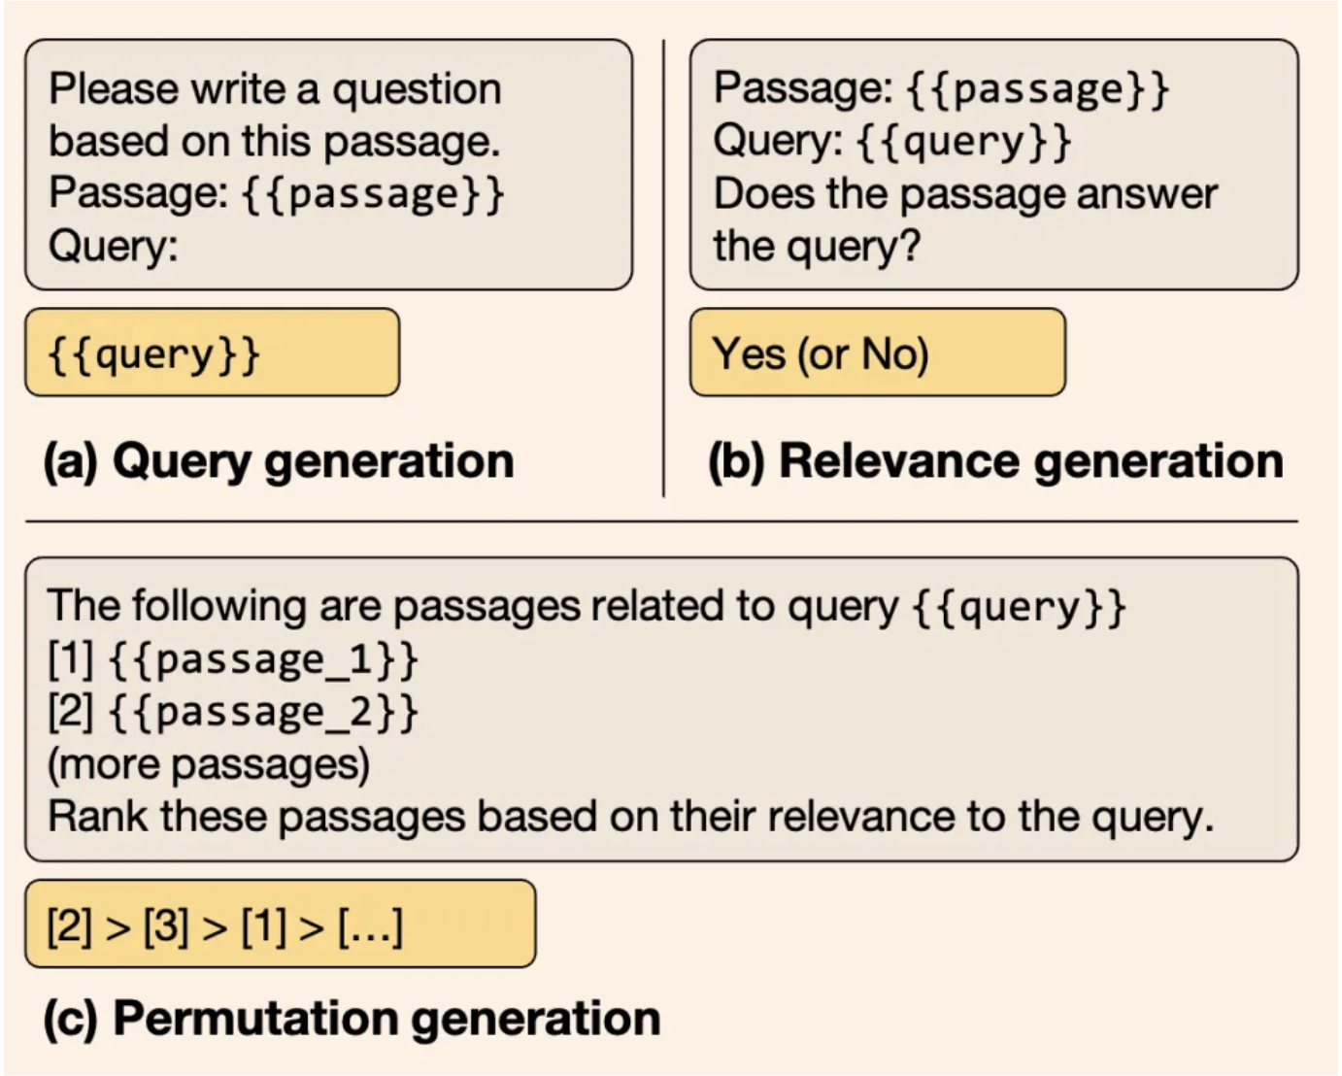
Addressing RAG Limitations
Re-Ranking with RankGPT
Sun, Weiwei et al., “Is ChatGPT Good at Search? Investigating Large Language Models as Re-Ranking Agents”

Slide 12
Advantages of RAG
Enhancing LLMs
RAG allows LLMs to reference external sources on-the-fly in its responses.
Factuality of responses can be grounded in citations.
New knowledge can be integrated independently from the underlying LLM.
Outdated or biased knowledge can be removed without modifying the LLM.
The same LLM can go from an expert biologist to material scientist without further training.
LLM-generated responses can be rendered more diverse by addition of additional resources into RAG reference database.

Slide 13
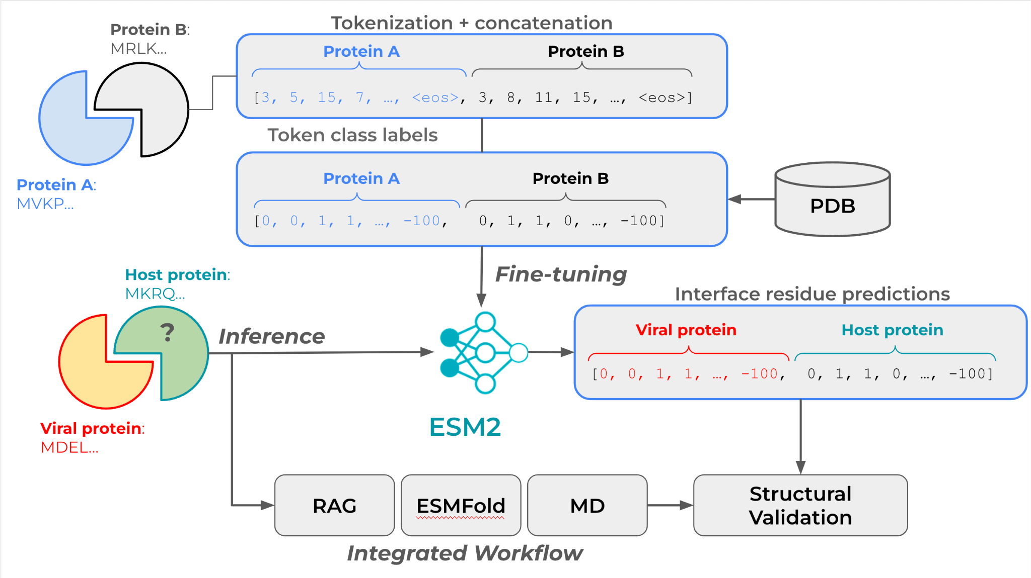
Case Studies
Viral-Host Protein-Protein Interaction Prediction (Ongoing)

Slide 14
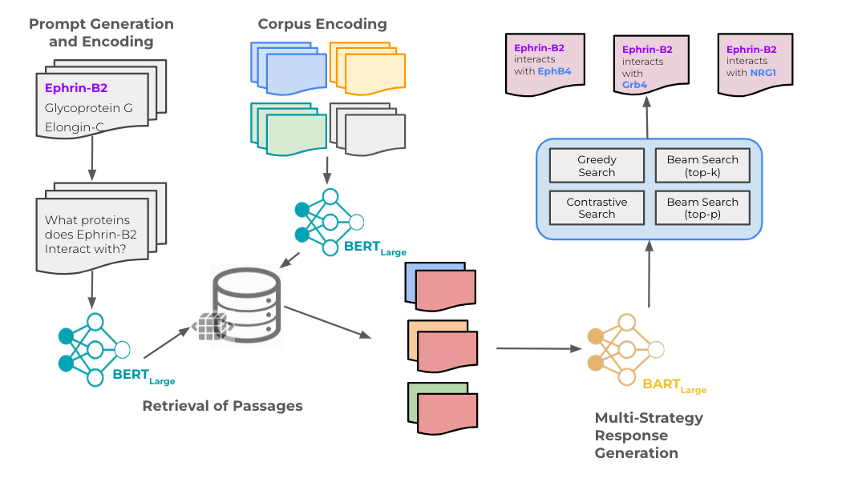
Case Studies
Viral-Host Protein-Protein Interaction Prediction (Ongoing)

Slide 15
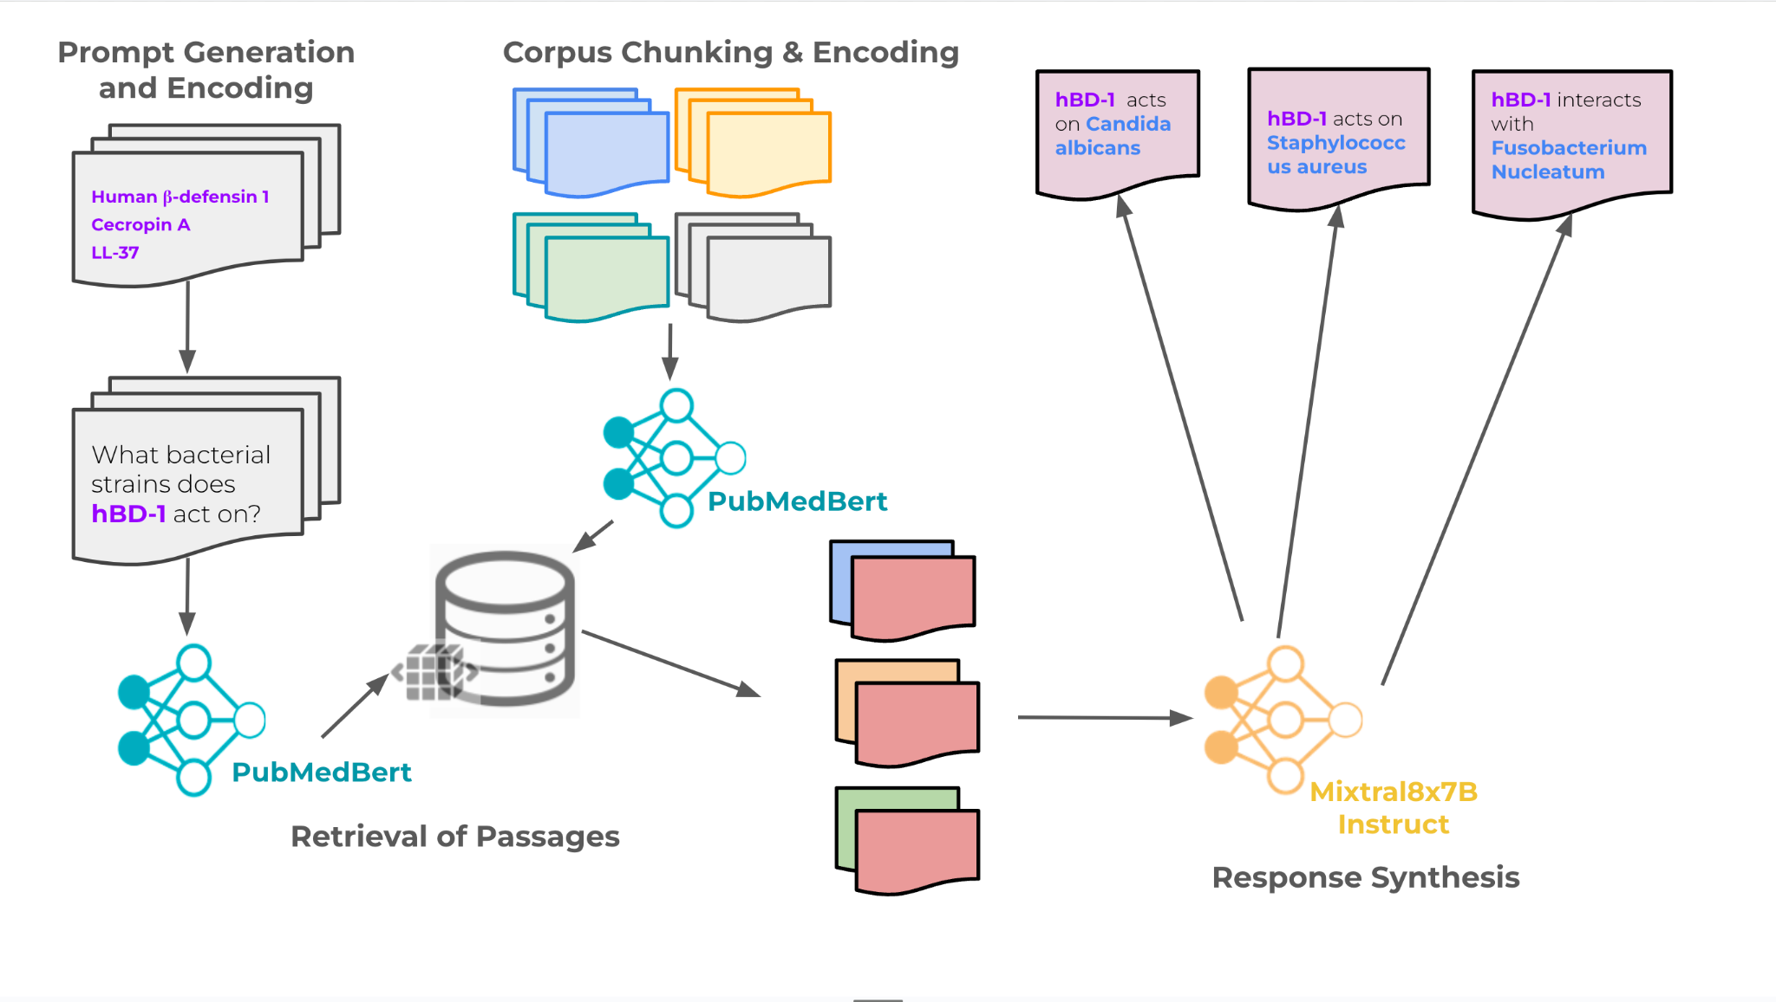
Case Studies
Antimicrobial Peptide Repurposing (Ongoing)

Slide 16
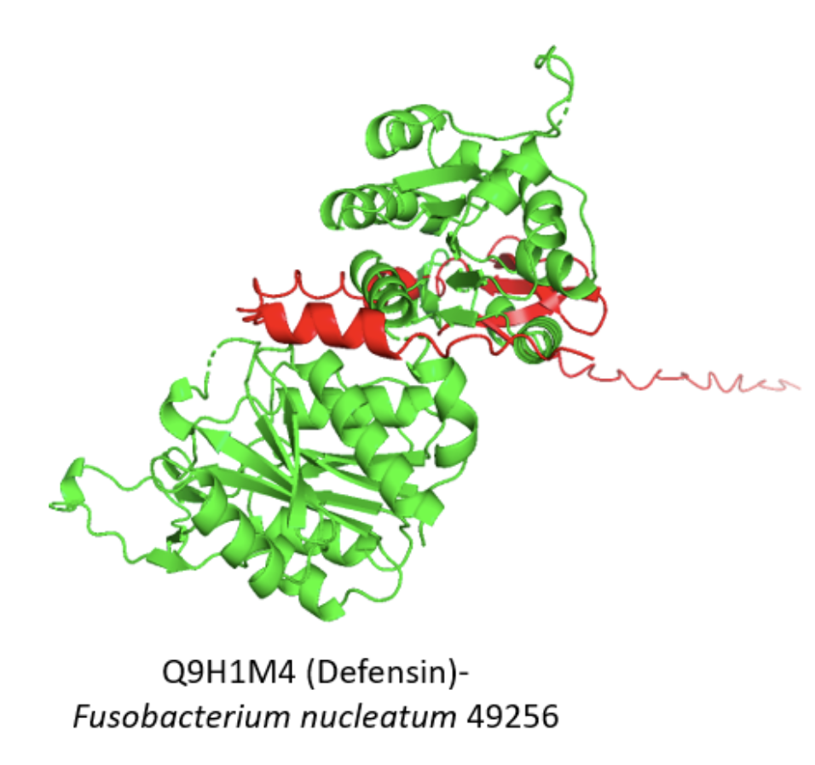
A potential discovery

