Slide 1
jQuery Introduction

Slide 2
What is jQuery
jQuery is a lightweight, "write less, do more", JavaScript library.
jQuery takes a lot of common tasks and wraps them into methods that you can call with a single line of code.
The purpose of jQuery is to make it much easier to use JavaScript on your website.

Slide 3
What is jQuery
The jQuery library contains the following features:
HTML/DOM manipulation
CSS manipulation
HTML event methods
Effects and animations
AJAX
Utilities

Slide 4
Why jQuery
Lots of other JavaScript frameworks out there, but jQuery seems to be the most popular, and also the most extendable.
Many of the biggest companies on the Web use jQuery, such as:
Google
Microsoft
IBM
Netflix

Slide 5
Adding jQuery to Your Web Pages
There are several ways to start using jQuery on your web site.
Download the jQuery library from jQuery.com
<script src="jquery-2.2.4.min.js" type="text/javascript"></script>
Include jQuery from a CDN, like Google
<script src="https://ajax.googleapis.com/ajax/libs/jquery/2.2.2/jquery.min.js" type="text/javascript"></script>

Slide 6
Download from jQuery.com
There are two versions of jQuery available for downloading:
Production version - this is for your live website because it has been minified and compressed
jquery-2.2.4.min.js
Development version - this is for testing and development (uncompressed and readable code)
jquery-2.2.4.js

Slide 7
Example
<!DOCTYPE html>
<html>
<head>
<meta charset="utf-8">
<title>範例</title>
<script src="jquery-2.2.4.min.js"></script>
<script>
$(document).ready(function(){
document.write("Hello World!");
});
</script>
</head>
<body>
</body>
</html>

Slide 8
Include jQuery from a CDN1
If you don't want to download and host jQuery yourself, you can include it from a CDN (Content Delivery Network).
Both Google and Microsoft host jQuery
<head>
<script src="https://ajax.googleapis.com/ajax/libs/jquery/2.2.2/jquery.min.js"></script>
</head>
<head>
<script src="http://ajax.aspnetcdn.com/ajax/jQuery/jquery-2.2.2.min.js"></script>
</head>

Slide 9
Include jQuery from a CDN2
Advantage of using the hosted jQuery from Google or Microsoft
Many users already have downloaded jQuery from Google or Microsoft when visiting another site.
As a result, it will be loaded from cache when they visit your site, which leads to faster loading time.
Also, most CDN's will make sure that once a user requests a file from it, it will be served from the server closest to them, which also leads to faster loading time.

Slide 10
jQuery Syntax1
The jQuery syntax is tailor made for selecting HTML elements and performing some action on the element(s).
先選網頁元素、再對網頁元素做一些效果
jQuery uses CSS syntax to select elements.
如果CSS規則很熟，寫jQuery就成功一半
Basic syntax is: $(selector).action()
A $ sign to define/access jQuery
A (selector) to "query (or find)" HTML elements
A jQuery action() to be performed on the element(s)

Slide 11
jQuery Syntax2
Example of $(selector).action()
$(this).hide() - hides the current element.
$("p").hide() - hides all <p> elements.
$(".test").hide() - hides all elements with class="test".
$("#test").hide() - hides the element with id="test".
hide.html

Slide 12
Exercise 1
Write a HTML document
Include jQuery library
After loading document, popup a “Hello World!” alert dialog

Slide 13
jQuery Selector
jQuery selectors allow you to select and manipulate HTML element(s).
jQuery selectors are used to "find" (or select) HTML elements based on their id, classes, types, attributes, values of attributes and much more.
All selectors in jQuery start with the dollar sign and parentheses: $().

Slide 14
The Element (Tag) Selector
Selects elements based on the element name.
You can select all <p> elements on a page like this:
$(document).ready(function(){
$("button").click(function(){
$("p").hide();
});
});
selectP.html

Slide 15
The #id Selector
Uses the id attribute of an HTML tag to find the specific element.
An id should be unique within a page, so you should use the #id selector when you want to find a single, unique element.
To find an element with a specific id, write a hash (#) character, followed by the id of the HTML element:

Slide 16
The .class Selector
Finds elements with a specific class.
To find elements with a specific class, write a period (.) character, followed by the name of the class:

Slide 17
Basic Selectors
By Tag:
$(“div”)
// <div>Hello jQuery</div>
By ID:
$(“#usr”)
// <span id=“usr”>John</span>
By Class:
$(“.menu”)
// <ul class=“menu”>Home</ul>

Slide 18
More Precise Selectors
$(“div.main”) // tag and class
$(“table#data”) // tag and id

Slide 19
Combination of Selectors
// find by id + by class
$(“#content, .menu”)
// multiple combination
$(“h1, h2, h3, div.content”)

Slide 20
Hierarchy Selectors
$(“table td”) // descendants (後代)
$(“tr > td”) // children (下一代)
$(“label + input”) // next (隔壁的)
$(“#content ~ div”)// siblings (同一層的）

Slide 21
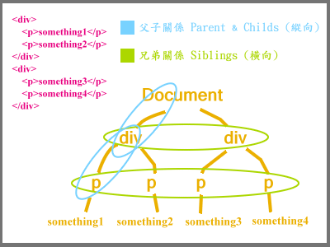
Hierarchy Selectors2
http://webdesign.kerthis.com/jquery/jquery_traversing

Slide 22
Visibility Filters
$(“div:visible”) // if visible
$(“div:hidden”) // if not

Slide 23
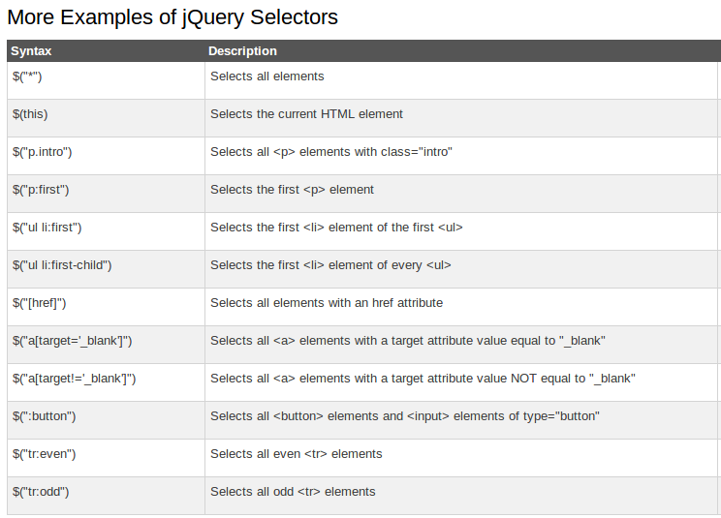
More jQuery Selectors
http://www.w3schools.com/jquery/jquery_selectors.asp
http://www.w3schools.com/jquery/jquery_ref_selectors.asp

Slide 24
Exercise 2
use p:first to hide first paragraph
use id selector to hide second paragraph
<body>
<p>This is a paragraph.</p>
<p>This is another paragraph.</p>
<button id="btn1">Hide Paragraph 1</button>
<button id="btn2">Toggle Paragraph 2</button>
</body>
ex-partial.html

Slide 25
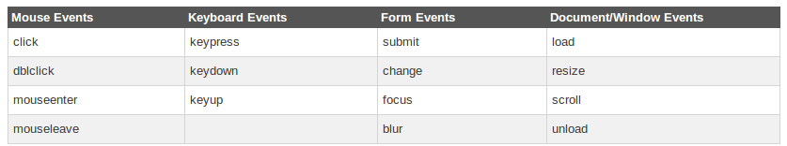
jQuery Events
Here are some common DOM events:

Slide 26
jQuery Syntax for Event Method
In jQuery, most DOM events have an equivalent jQuery method.
To assign a click event to all paragraphs on a page, you can do this:
The next step is to define what should happen when the event fires. You must pass a function to the event:
$("p").click(…);
$("p").click(function(){
// action goes here!!
});

Slide 27
Commonly Used jQuery Event Methods
$(document).ready()
click()
dblclick()
mouseenter()
mouseleave()
mousedown()
mouseup()
hover()
focus()
blur()
http://www.w3schools.com/jquery/jquery_events.asp
http://www.w3schools.com/jquery/jquery_ref_events.asp

Slide 28
When the DOM is ready…
$(document).ready(function(){ //… });
Fires when the document is ready for programming.
Uses advanced listeners for detecting.
window.onload() is a fallback.
比onload的作法快一些→無需等待文字外的resource之loading時間

Slide 29
Attach Event
// execute always $(“div”).bind(“click”, fn);
// execute only once $(“div”).one(“click”, fn);
Possible event values: blur, focus, load, resize, scroll, unload, beforeunload, click, dblclick, mousedown, mouseup, mousemove, mouseover, mouseout, mouseenter, mouseleave, change, select, submit, keydown, keypress, keyup, error
(or any custom event)

Slide 30
Detaching Events
$(“div”).unbind(“click”, fn);

Slide 31
Events Triggering
$(“div”).trigger(“click”);
Triggers browser’s event action as well.
Can trigger custom events.
Triggered events bubble up.

Slide 32
Live Events
// attach live event (“div”).live(“click”, fn); // detach live event (“div”).die(“click”, fn);
Attach a handler to the event for all elements which match the current selector, now and in the future.
http://api.jquery.com/live#typefn

Slide 33
jQuery Effect: Hide and Show
jQuery hide() and show()
With jQuery, you can hide and show HTML elements with the hide() and show() methods:
$("#hide").click(function(){
$("p").hide();
});
$("#show").click(function(){
$("p").show();
});
$("#hide").click(function(){
$("p").hide(100);
});
http://www.w3schools.com/jquery/jquery_hide_show.asp

Slide 34
jQuery Effect: Toggle
jQuery toggle()
With jQuery, you can toggle between the hide() and show() methods with the toggle() method.
$("#hide").click(function(){
$("p").toggle();
});
http://www.w3schools.com/jquery/jquery_hide_show.asp

Slide 35
jQuery Effect: Fade
jQuery fadeIn() Method (淡入)
The jQuery fadeIn() method is used to fade in a hidden element.
jQuery fadeOut() Method (淡出)
The jQuery fadeOut() method is used to fade out a visible element.
jQuery fadeToggle() Method
The jQuery fadeToggle() method toggles between the fadeIn() and fadeOut() methods.
jQuery fadeTo() Method
The jQuery fadeTo() method allows fading to a given opacity (value between 0 and 1). (特別的淡出功能)
http://www.w3schools.com/jquery/jquery_fade.asp

Slide 36
jQuery Effect: Sliding
jQuery slideDown() Method
The jQuery slideDown() method is used to slide down an element.
jQuery slideUp() Method
The jQuery slideUp() method is used to slide up an element.
jQuery slideToggle() Method
The jQuery slideToggle() method toggles between the slideDown() and slideUp() methods.
http://www.w3schools.com/jquery/jquery_slide.asp

Slide 37
jQuery Effect: Animation
The animate() Method
The jQuery animate() method is used to create custom animations.
Syntax
Example
$(selector).animate({params},speed,callback);
$("button").click(function(){
$("div").animate({left:'250px'});
});
http://www.w3schools.com/jquery/jquery_animate.asp

Slide 38

Object in JavaScript
The syntax for an object using an object initializer is:
Example:
var myHonda =
{color: "red", wheels: 4,
engine: {cylinders: 4, size: 2.2}};
Notes:
https://developer.mozilla.org/zh-TW/docs/Web/JavaScript/Guide/Working_with_Objects

Slide 39
jQuery Effect: Stop
jQuery stop() Method
The jQuery stop() method is used to stop an animation or effect before it is finished.
The stop() method works for all jQuery effect functions, including sliding, fading and custom animations.
Syntax
The optional stopAll parameter specifies whether also the animation queue should be cleared or not. Default is false.
The optional goToEnd parameter specifies whether or not to complete the current animation immediately. Default is false.
$(selector).stop(stopAll,goToEnd);
http://www.w3schools.com/jquery/jquery_stop.asp

Slide 40
jQuery Callback Function
A callback function is executed after the current effect is 100% finished.
Typical syntax:
Example
$(selector).hide(speed,callback);
$("button").click(function(){
$("p").hide("slow",function(){
alert("The paragraph is now hidden");
});
});
http://www.w3schools.com/jquery/jquery_callback.asp

Slide 41
jQuery Method Chaining
With jQuery, you can chain together actions/methods.
Chaining allows us to run multiple jQuery methods (on the same element) within a single statement.
Example
$("#p1").css("color","red").slideUp(2000).slideDown(2000);
http://www.w3schools.com/jquery/jquery_chaining.asp

Slide 42
Exercise 3
Revise exercise 8-2 to add some animations to the picture of the selected Doraemon accessory.

Slide 43
jQuery: Get Content and Attribute
Get Content - text(), html(), and val()
Three simple, but useful, jQuery methods for DOM manipulation are:
text() - Sets or returns the text content of selected elements
html() - Sets or returns the content of selected elements (including HTML markup)
val() - Sets or returns the value of form fields
Get Attributes - attr()
The jQuery attr() method is used to get attribute values.
http://www.w3schools.com/jquery/jquery_dom_get.asp

Slide 44
jQuery: Set Content
Set Content - text(), html(), and val()
text() - Sets or returns the text content of selected elements
html() - Sets or returns the content of selected elements (including HTML markup)
val() - Sets or returns the value of form fields
A Callback Function for text(), html(), and val()
The callback function has two parameters:
the index of the current element in the list of elements selected and
the original (old) value.
http://www.w3schools.com/jquery/jquery_dom_set.asp

Slide 45
jQuery: Set Attribute
Set Attribute - attr()
The jQuery attr() method is also used to set/change attribute values.
Example
A Callback Function for attr()
The callback function has two parameters:
the index of the current element in the list of elements selected
the original (old) attribute value
$("button").click(function(){
$("#w3s").attr("href","http://www.w3schools.com/jquery");
});
http://www.w3schools.com/jquery/jquery_dom_set.asp

Slide 46
jQuery: Add Element
Add New HTML Content
Four jQuery methods that are used to add new content:
append() - Inserts content at the end of the selected elements
prepend() - Inserts content at the beginning of the selected elements
after() - Inserts content after the selected elements
before() - Inserts content before the selected elements
http://www.w3schools.com/jquery/jquery_dom_add.asp

Slide 47
jQuery: Remove Element
Remove Elements/Content
To remove elements and content, there are mainly two jQuery methods:
remove() - Removes the selected element (and its child elements)
empty() - Removes the child elements from the selected element
http://www.w3schools.com/jquery/jquery_dom_remove.asp

Slide 48
jQuery: Get and Set CSS
jQuery Manipulating CSS
jQuery has several methods for CSS manipulation.
addClass() - Adds one or more classes to the selected elements
removeClass() - Removes one or more classes from the selected elements
toggleClass() - Toggles between adding/removing classes from the selected elements
css() - Sets or returns the style attribute

Slide 49
Example
jQuery addClass() Method
.important
{
font-weight:bold;
font-size:xx-large;
}
.blue
{
color:blue;
}
$("button").click(function(){
$("h1,h2,p").addClass("blue");
$("div").addClass("important");
});
jQuery removeClass() Method
$("button").click(function(){
$("h1,h2,p").removeClass("blue");
});
jQuery toggleClass() Method
$("button").click(function(){
$("h1,h2,p").toggleClass("blue");
});
http://www.w3schools.com/jquery/jquery_css_classes.asp

Slide 50
jQuery: CSS Method
jQuery css() Method
The css() method sets or returns one or more style properties for the selected elements.
To return the value of a specified CSS property, use the following syntax:
Example
To set a specified CSS property, use the following syntax:
Example
css("propertyname");
$("p").css("background-color");
css("propertyname","value");
$("p").css("background-color","yellow");
http://www.w3schools.com/jquery/jquery_css.asp

Slide 51
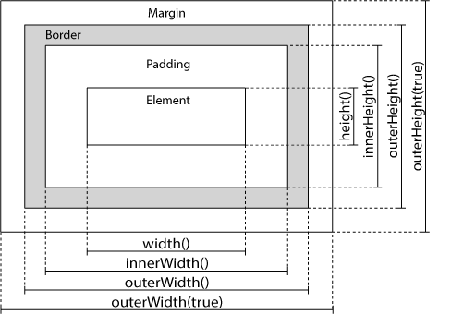
jQuery: Dimensions
jQuery has several important methods for working with dimensions:
width()
height()
innerWidth()
innerHeight()
outerWidth()
outerHeight()
http://www.w3schools.com/jquery/jquery_dimensions.asp

Slide 52
AJAX
AJAX
exchanging data with a server
updating parts of a web page - without reloading the whole page
json-demo.html

Slide 53
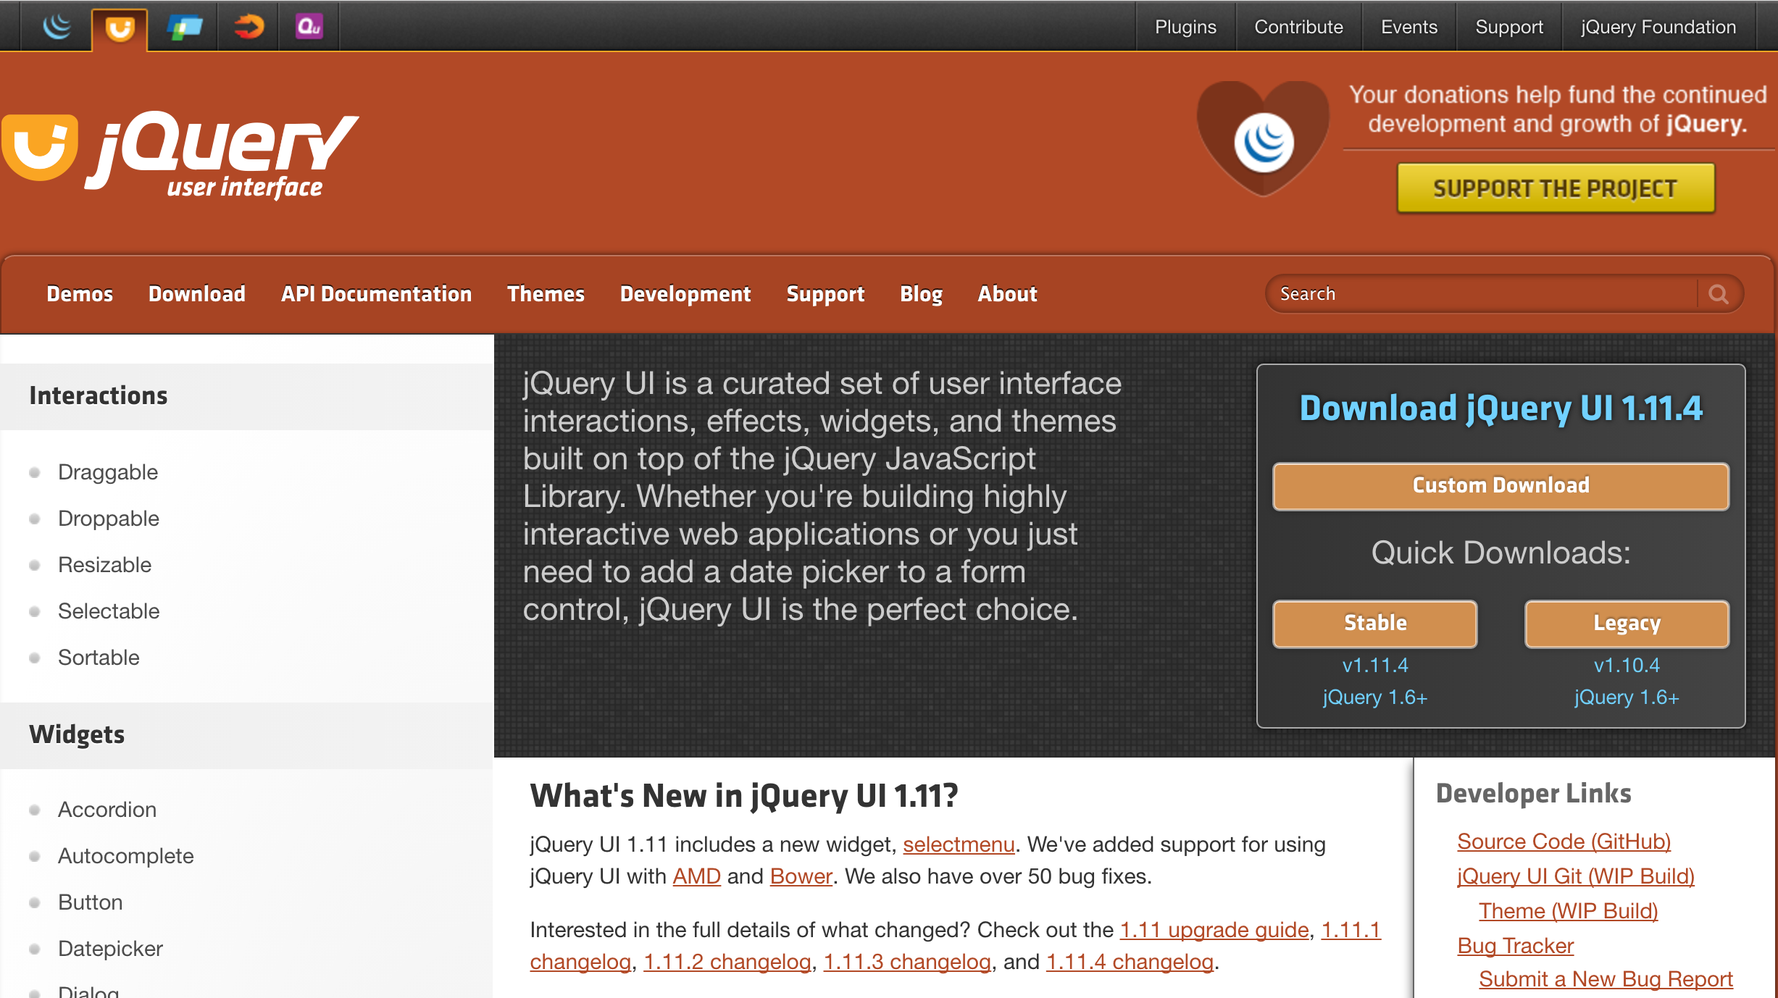
JQuery UI
http://jqueryui.com

Slide 54
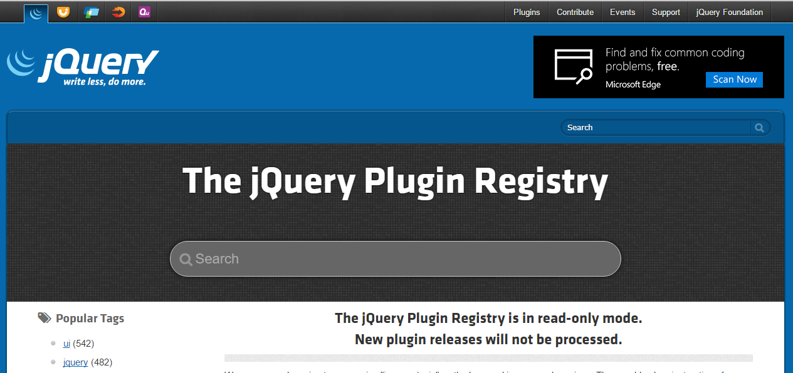
jQuery Plugins
https://plugins.jquery.com/
slideshow.html

Slide 55
Resources
http://api.jquery.com/
https://learn.jquery.com/
http://try.jquery.com/
http://www.w3schools.com/jquery/

Slide 56

Any Question?

