Slide 1

Title : Design and Evaluation of Lightweight Architectures for Single Sentence Video Captioning
Under the Guidance of
Assistant Prof. Dr. Parijat Bhowmick
Kuldeep (234156024)
M.Tech CICPS

Slide 2
Outline
Introduction
Motivation
Datasets Used
Proposed Pipeline
Decoder Models
Key Frame Selection
Feature Extractors Compared
Results
Conclusion
Future Work

Slide 3

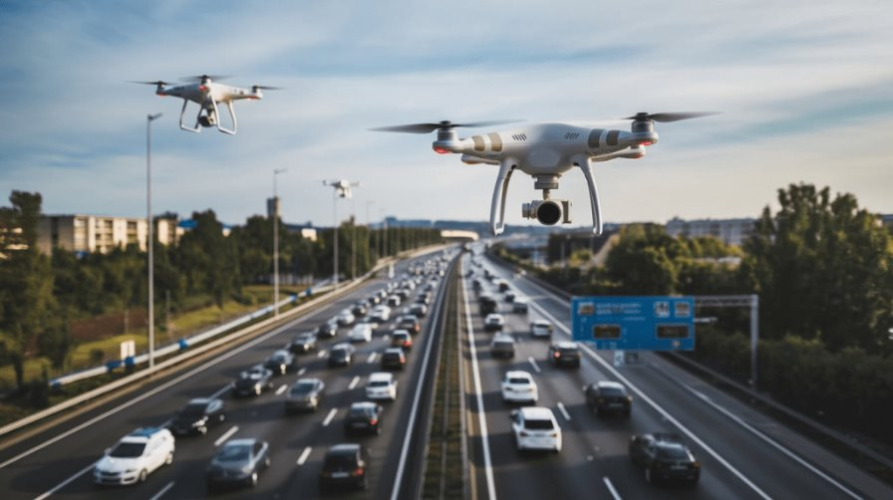
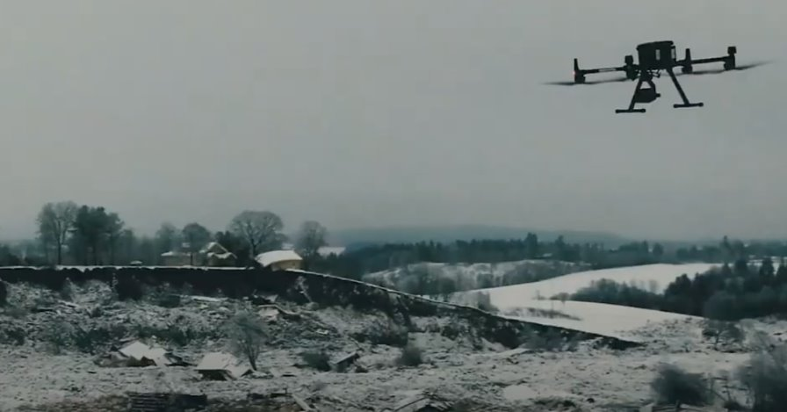
Introduction

Slide 4
Motivation for Lightweight Models
Heavy models → slow + high compute
Need real-time captioning
Edge devices (mobile, CCTV, drones)
Focus on CNNs like MobileNet, ShuffleNet

Slide 5
Challenges
High visual complexity
Temporal reasoning
Semantic ambiguity
Information bottleneck (1 sentence only)
Noisy captions in datasets

Slide 6
Datasets Used
MSVD dataset(1970 Videos clip)
MSR-VTT dataset(7010 Videos clip)
Short videos + multiple captions

Slide 7
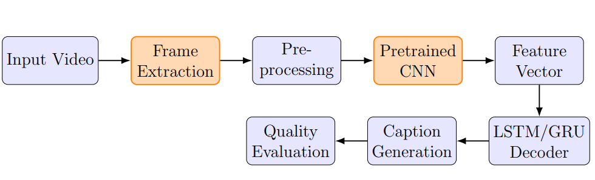
Proposed Pipeline

Slide 8
LSTM
GRU
Decoder Base Transformer
Compare performance
Decoder Models

Slide 9
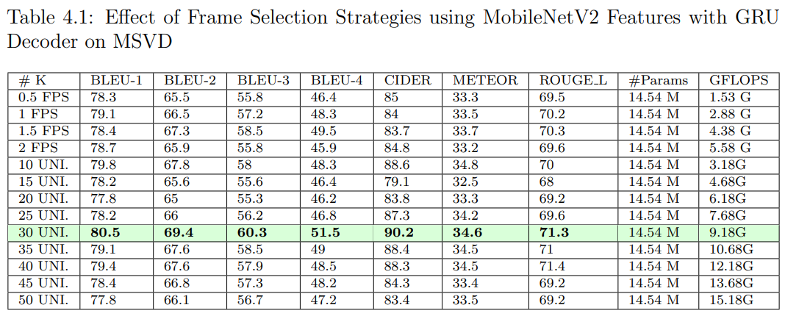
Experiment Frame Selection Strategy

Slide 10
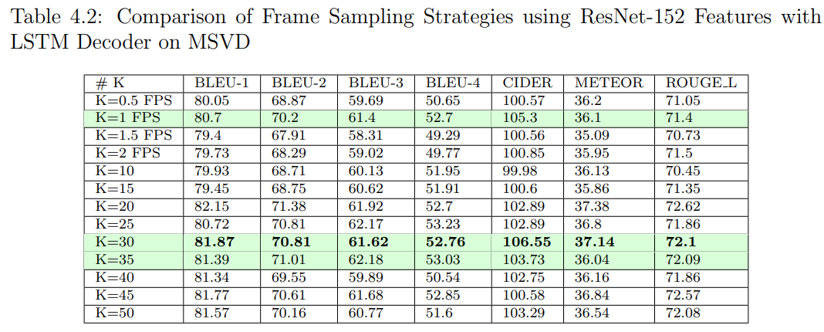
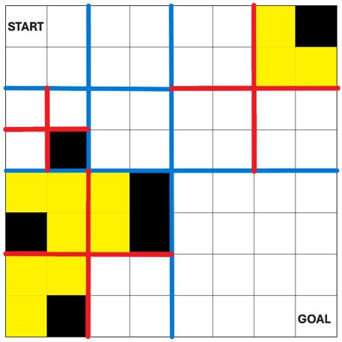

Experiment of Frame Selection

Slide 11
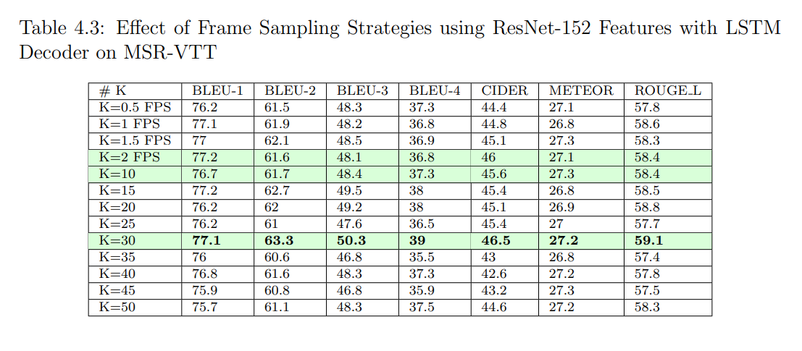
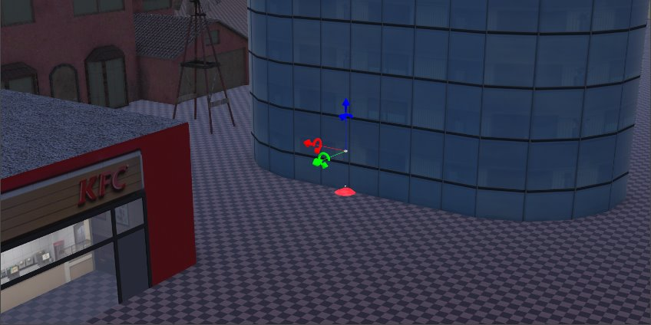
Experiment of Frame Selection

Slide 12
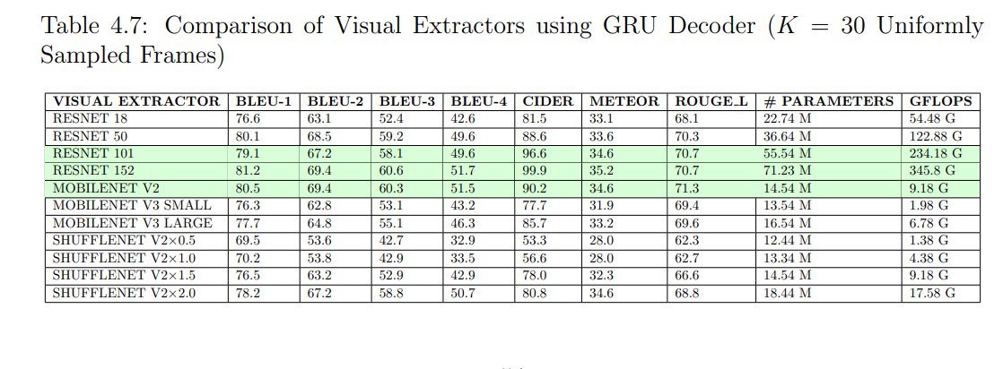
Feature Extractors Compared

Slide 13
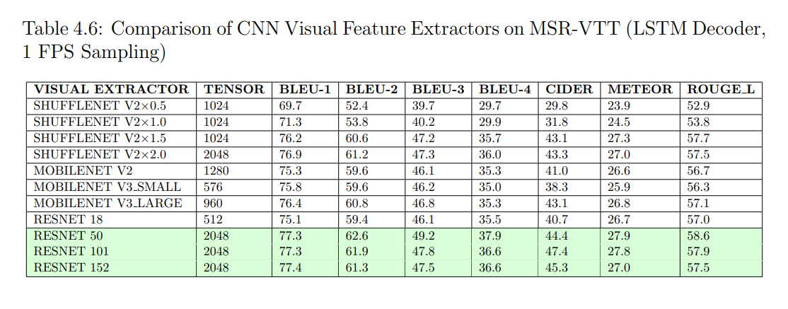
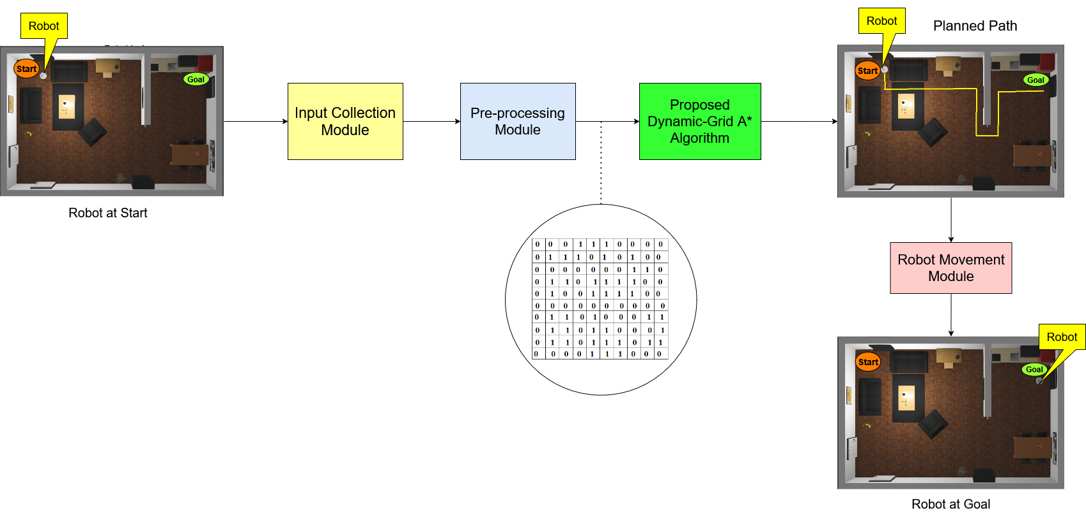
Feature Extractors Compared

Slide 14
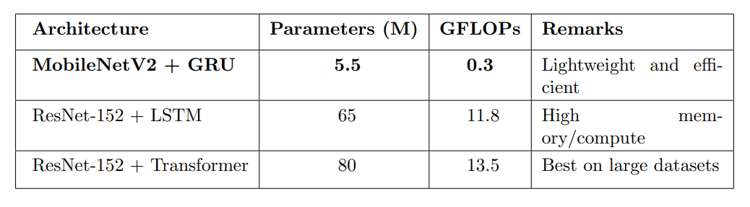
Comparison of Model Architectures Based on Parameters and GFLOPs

Slide 15
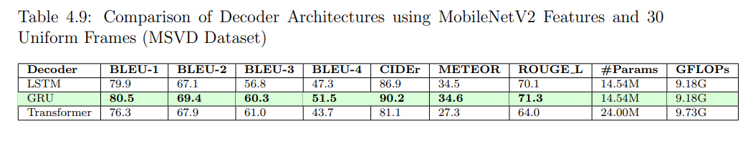
Results

Slide 16
Conclusion
Lightweight models = efficient + accurate
Suitable for real-time systems
Good trade-off achieved
Deployed on low compute devices

Slide 17
Future Works
Learning-Based Frame Selection
Multimodal Fusion
Multilingual & Domain-Specific Expansion

Slide 18
Thank You

