Slide 1
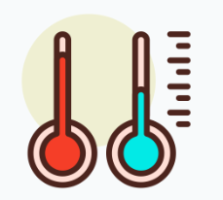


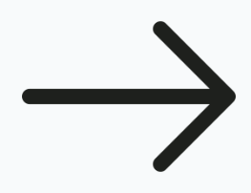


If(value is low)
heating
Else if(value is high)
cooling
Else sleep
Value
=readtemperature()
value
TemperatureTask
temperTask
If(value is low)
window open
Else if(value is high)
window close
Value
=readadc()
value
LightTask
adcTask

